Slide 1

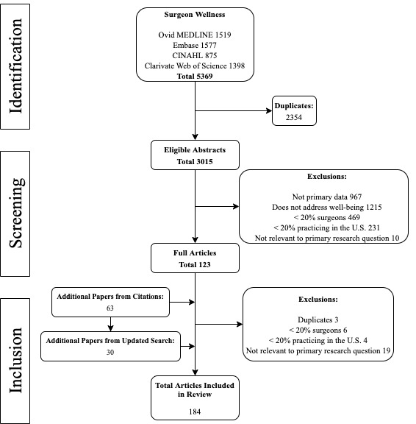
Characterizing Surgeon Well-Being: A Systematic Review and Mixed-Methods Meta-Synthesis
Duyhoang Q. Dinh, BS¹; C. Ann Vitous, MA, MPH²; Sara M. Jafri, BS³; Olivia Bennett, BS¹; Elayna Sabelhaus, BS³; Lindsay Ma, BS³; Christopher Varlamos, BS³; Pasithorn A. Suwanabol, MD, MS²
¹University of Michigan Medical School, ²Department of Surgery, University of Michigan, ³Center for Healthcare Outcomes and Policy, University of Michigan
Abstract
Methods and Materials
Results
Discussion
Attention to surgeon wellness has increased significantly given persistently high rates of burnout. However, the mere absence of burnout does not fully consider the complex nature of being a surgeon. Therefore, the objectives were to define surgeon wellbeing in the literature, to examine causative factors associated with lack of wellbeing, and to make recommendations for potential opportunities to promote wellbeing. A systematic review of the literature was performed within multiple research databases from inception to May 7, 2020 in accordance with Preferred Referring Items for Systematic Reviews and Meta-Analyses guidelines. A total of 5369 abstracts were identified and screened. 184 articles fulfilled criteria for data abstraction and thematic analysis. Analysis revealed 4 emergent themes: professional, personal, work-life balance, and impacts to well-being. Overall, current literature frequently characterizes surgeon wellbeing as the absence of burnout, failing to acknowledge its multidimensional nature. To effectively improve surgeon wellbeing, efforts from multiple avenues need to be made for a truly comprehensive approach.
We performed a systematic review of the literature focused on surgeons and well-being within Ovid Medline, Elsevier Embase, EBSCOhost CINAHL, and Clarivate Web of Science databases from inception to May 7, 2020 according to the Preferred Reporting Items for Systematic Reviews and Meta-Analyses (PRISMA) guidelines.⁶ Quantitative and qualitative studies with primary data evaluating surgeon well-being were selected for full review by at least two study team members based on predefined inclusion criteria. Data were extracted based on a predetermined instrument and compared across studies using thematic analysis in a meta-synthesis of findings.
A total of 5369 abstracts were identified and screened, and 184 articles fulfilled criteria for full review (Figure 1). Among these, 172 were quantitative studies, 3 were pure qualitative studies, and 9 were mixed-methods studies.
Four major themes across studies emerged: 1) professional; 2) personal; 3) work-life balance; and 4) impacts to well-being. Some themes were then divided into subthemes. The components of the professional theme were career satisfaction, burnout, and work-related stressors. The components of the personal theme were relationships & family, emotional health, and physical health. The components of the impacts to well-being were work environment, home life, and personal factors. Work-life balance did not present with any notable subthemes.
This extensive systematic review provides comprehensive insight into the numerous critical components that comprise surgeon wellbeing. The review also allowed for an aggregation of policies and implemented programs targeted towards addressing this systemic issue. As such, recommendations can be made regarding ”best practices” in order to optimize surgeon wellbeing.
These “best practices” fit well within the pre-existing framework of a wellness model that was developed by the American College of Emergency Physicians. This wellness model is divided into 7 “spokes” of a wheel: intellectual, emotional, physical, social, spiritual, occupational, and financial.⁷
As it pertains to surgeon wellbeing, the intellectual component signifies surgeons’ desire to develop their own practice and the need for protected time for professional growth and learning.⁴ With the long hours inherent with the specialty, surgeons often fall victim to emotional exhaustion and physical fatigue.^{8,9} However, studies have shown that social support within and outside of the workplace can help improve wellbeing.¹⁰ The spiritual component entails dedicated time for reflection and introspection. Occupationally, surgeons have benefited from policies that mitigate the high demands of their work.¹¹ Lastly, the continued burden of financial debt has been shown to be a significant source of stress for surgeons.¹² Figure 2 highlights some of the many “best practices” found in the literature that have been implemented to address suboptimal surgeon wellbeing.
Occupational
Intellectual
Social
Spiritual
Emotional
Physical
Financial
Mortality & Morbidity conferences
On-site child care
Mid-Level Support (i.e. physician assistants)
Structured mentorship programs
Protected time for research
Programming activities to promote stronger collegial support
Peer-to-Peer Debriefs
Access to fitness equipment
Practical duty hour regulations
Greater access to loan forgiveness and repayment options
Support to navigate financial matters
Stress-management training
Mindfulness programs
Access to healthy food
Inpatient psychiatrist available for the team
Introduction
In general, suboptimal wellbeing among physicians has been shown to have lasting impacts on many involved parties. With regard to the individual physicians, they are at increased risk for developing physical and emotional health issues.¹ In terms of the patients, they are at risk of poorer health outcomes as well as lower satisfaction with the quality of their care.² And from a societal perspective, the notion of suboptimal physician wellbeing as an accepted sacrifice of the medical field is self-perpetuating, leading to a culture that threatens the future of the physician workforce altogether.³
Recent attention to surgeon wellness has increased significantly given persistently high rates of burnout.⁴ Though historically the sole defining metric for physician wellbeing, the mere absence of burnout does not fully consider the complex nature of being a surgeon in a comprehensive fashion.⁵ As such, we sought to utilize a systematic review of the literature to identify the various elements that contribute to the overarching definition of surgeon wellbeing in the current literature. In addition, the process inherently revealed associated factors with lack of wellbeing that we were subsequently able to categorize into themes and subthemes. Lastly, our extensive review gave us the opportunity to make recommendations regarding potential opportunities and mechanisms to promote surgeon wellbeing.
Conclusions
Reports of surgeon well-being are inconsistent and frequently characterized as the absence of burnout, which fails to acknowledge the multidimensional nature of individuals’ physical and emotional needs.
The pervasive themes in our extensive literature review provide opportunities and some efficacious recommendations on interventions that can improve surgeon well-being.
Overall, to effectively support surgeon well-being, efforts should encompass all aspects of well-being, including work-life balance, quality of life, resilience, and coping.
Figure 1. PRISMA (Preferred Reporting Items for Systematic Reviews and Meta-Analyses) diagram.
Figure 2. Examples of best practices to improve surgeon well-being based on the reviewed literature and framed by the 7 spokes of wellness model proposed by the American College of Emergency Physicians.
Contact
References
Duyhoang Dinh
University of Michigan Medical School
Email: dqdinh@med.umich.edu
Sargent MC, Sotile W, Sotile MO, et al. Quality of life during orthopaedic training and academic practice. Part 1: orthopaedic surgery residents and faculty. J Bone Joint Surg Am. 2009; 91:2395–2405
Shanafelt TD, Bradley KA, Wipf JE, et al. Burnout and self-reported patient care in an internal medicine residency program. Ann Intern Med. 2002; 136:358–367
Gifford E, Galante J, Kaji AH, et al. Factors associated with general surgery residents’ desire to leave residency programs: a multi-institutional study. JAMA Surg. 2014; 149:948–953
Shanafelt TD, Balch CM, Bechamps GJ, et al. Burnout and career satisfaction among American surgeons. Ann Surg. 2009; 250:463–471
Siedsma M, Emlet L. Physician burnout: can we make a difference together? Crit Care. 2015; 19:273
Liberati A, Altman DG, Tetzlaff J, et al. The PRISMA statement for reporting systematic reviews and meta-analyses of studies that evaluate health care interventions: explanation and elaboration. J Clin Epidemiol. 2009; 62:e1–34
Manfredi RA, Huber JM. Being Well in Emergency Medicine: ACEP’s Guide to Investing in Yourself. 2017. American College of Emergency Physicians
Lee RT, Seo B, Hladkyj S, et al. Correlates of physician burnout across regions and specialties: a meta-analysis. Hum Resour Health. 2013; 11:48
Kant IJ, de Jong LC, van Rijssen-Moll M, et al. A survey of static and dynamic work postures of operating room staff. Int Arch Occup Environ Health. 1992; 63:423–428
Wai PY, Dandar V, Radosevich DM, et al. Engagement, workplace satisfaction, and retention of surgical specialists in academic medicine in the United States. J Am Coll Surg. 2014; 219:31–42
Campbell DA, Sonnad SS, Eckhauser FE, et al. Burnout among American surgeons. Surgery. 2001; 130:695–696
Jolly P. Medical school tuition and young physicians’ indebtedness. If tuition continues its rapid increase, young physicians may find it difficult to repay their medical school debts, and some students may be deterred from attempting a career in medicine. Health Aff. 2005; 24:527–535

