Slide 1


Denoising stimulated Raman histology using weak supervision to improve label-free optical microscopy of human brain tumors
Esteban Urias, MHS¹, Christopher Freudiger, PhD², Daniel Orringer, MD³ Honglak Lee, PhD⁴, Todd Hollon MD¹
¹ Department of Neurosurgery, University of Michigan ²Invenio Imaging, Inc., ³Department of Neurosurgery, New York University, ⁴Computer Science and Engineering, University of Michigan
Notes:
Hello my name is Esteban Urias and I ama student researcher at the University of Michigan Medical School. Today, I will be talking about using weak supervision machine learning to remove noise from stimulated raman histology images of human brain tumors.

Slide 2
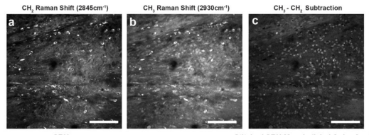
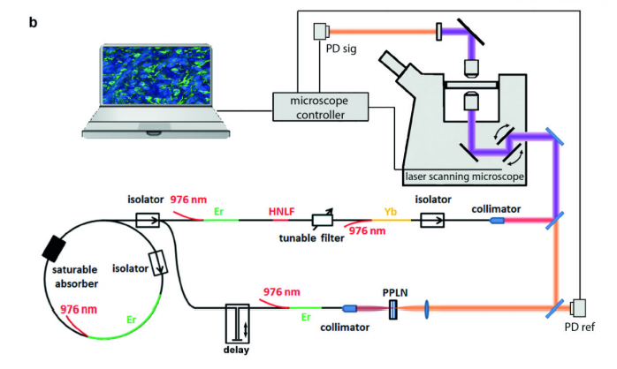
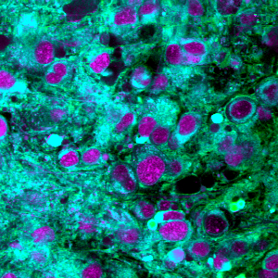
Stimulated Raman Histology
B
G
R
Notes:
Stimulated Raman Histology is a label-free, optical imaging method that produces high-resolution histologic images of tissue samples. By measuring different wavelengths of the Raman shifts, this modality is able to capture a CH2 signal corresponding to lipids, CH3 signal corresponding to protein, and the CH3 minus CH2 signal corresponding to nuclei. We combine these three signals into a three channel RGB image to produce an image like the one shown below.

Slide 3
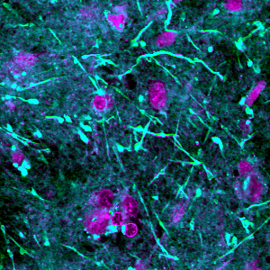
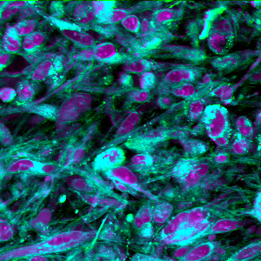
SRH Image Quality and Noise
Notes:
Unfortunately, Raman scattering is subject to image degradation both from microscope laser aberrations and the biochemical properties of imaged specimens.
The images on top are high quality images, while the images in the bottom are low-quality images that have lost features essential for histopathologic diagnosis.

Slide 4
Proposed Solution
We propose a solution to the problem of denoising SRH images using a training algorithm that leverages weak supervision based on perceptual image quality ratings.
Our goal is to restore low-quality and nondiagnostic SRH images without the need for paired training data.
Notes:
We propose a solution to the problem of denoising SRH images by using a training algorithm that leverages weak supervision based on perceptual image quality ratings.
In other words, we want to restore low-quality and nondiagnostic SRH images by training a deep learning network with our own paired dataset from high-quality images.

Slide 5
SRH Dataset
572 specimens -Brain tumor or epilepsy surgery
High-quality
Average-quality
Low-quality
Pre-training Noise Generator
Post-training Testing
Notes:
Our SRH dataset was split into three groups based on their perceptual quality: high, average, and low quality. For now we will focus on the high quality images that were used to generate a paired training dataset.

Slide 6
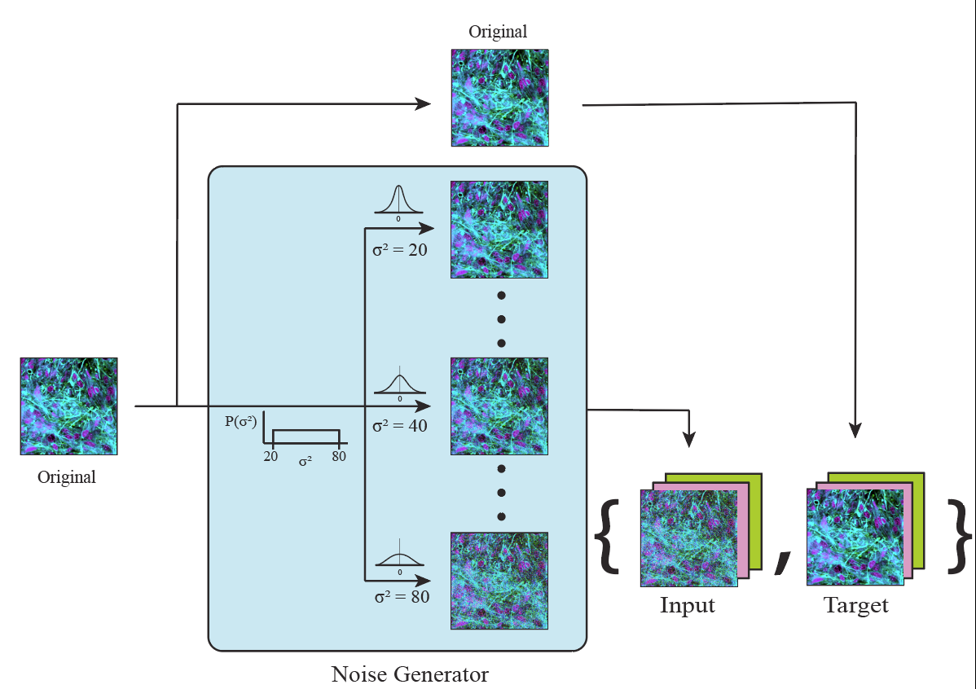
Noise generator
Notes:
To create the dataset, the original high quality image is copied and noise from a Gaussian distribution with variance randomly ranging between 20 and 80 is added. This noisy image serves as the input to the network and its corresponding high quality image serves as the target, thus creating a weak-supervision training dataset.

Slide 7
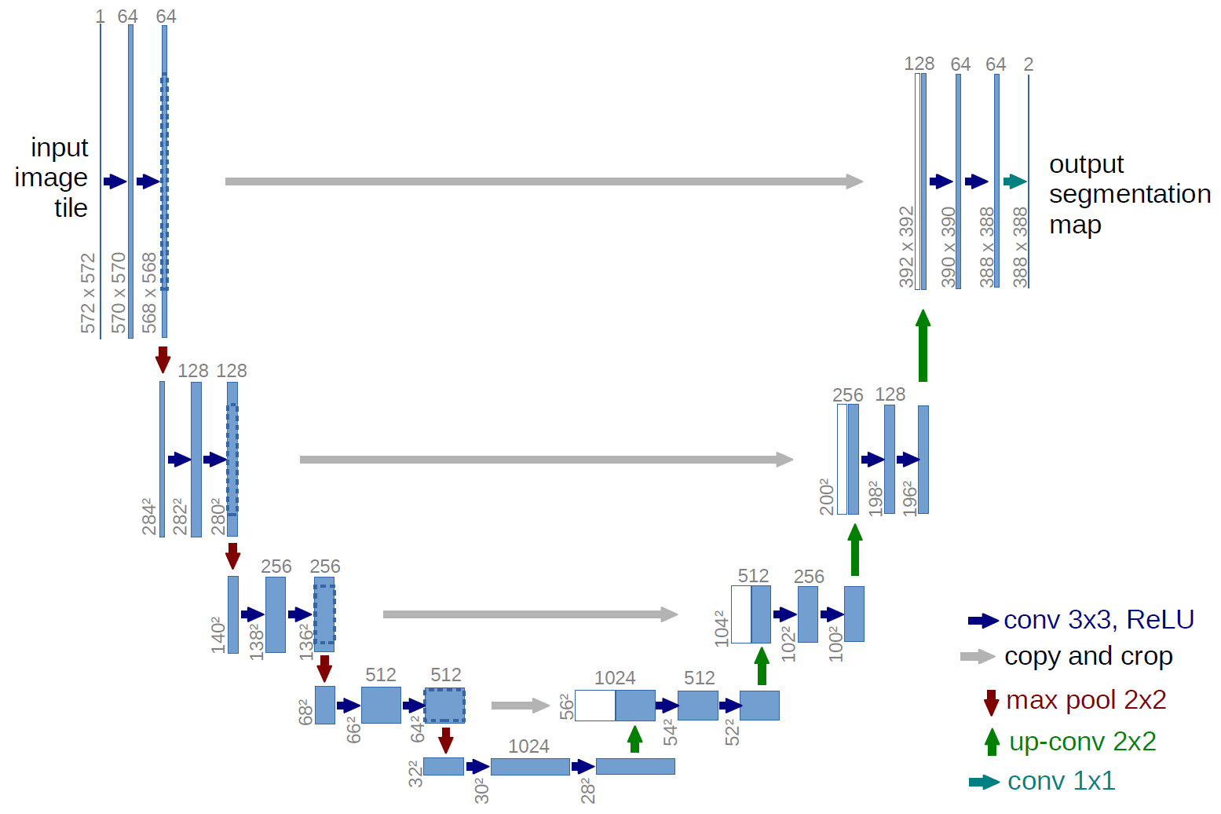
U-Net
Figure from: Ronneberger, Olaf, Philipp Fischer, and Thomas Brox. "U-net: Convolutional networks for biomedical image segmentation." Springer, Cham, 2015.
Notes:
Our network consisted of a U-net convolutional network with downsampling encoder and upsampling decoder regions joined by skip connections at each level. We additionally compared our network to a traditional denoising autoencoder and a non-learning denoising algorithm, called non-local means.

Slide 8
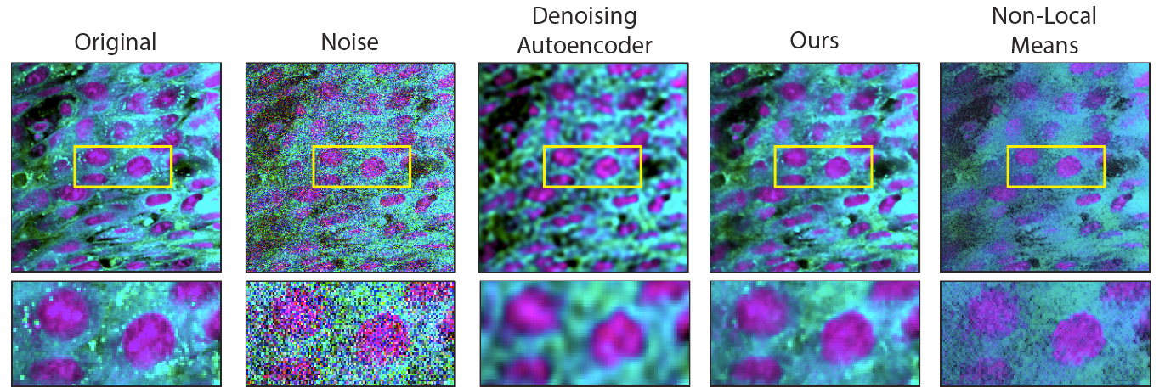
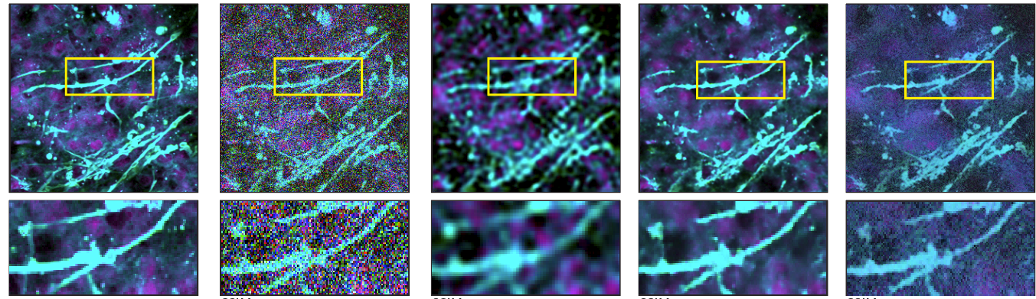
Preservation of diagnostic histopathologic features
Notes:
Some of the most important features with high diagnostic power are the nuclei of cells and axon-like structures. As you can see above, our network has restored many of the lost features of the noisy image and its almost undistinguishable from the original image. Its perceptual quality is also remarkably superior compared to the images generated by the other methods.

Slide 9
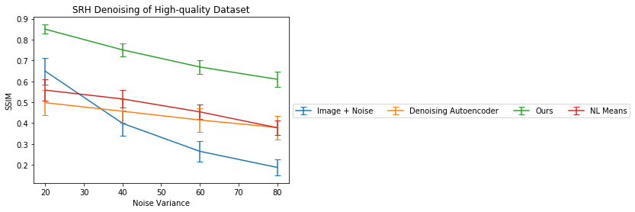
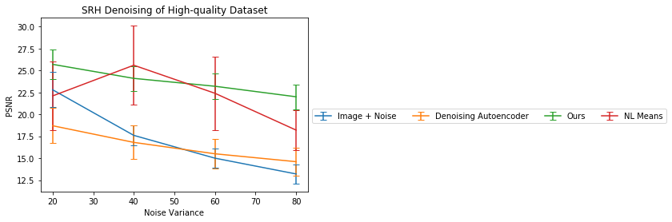
Results of Training
Notes:
When tested by denoising 1000 patches, our network outperformed the other methods with higher SSIM and mostly higher PSNR scores, which represent higher image quality.

Slide 10
SRH Dataset
572 specimens - Brain tumor or epilepsy surgery
High-quality
Average-quality
Low-quality
Pre-training Noise Generator
Post-training Testing
Notes:
Lastly, we used the trained networks to denoise the low quality images from our dataset.

Slide 11
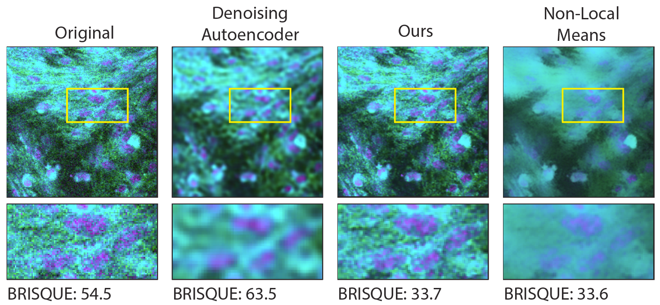
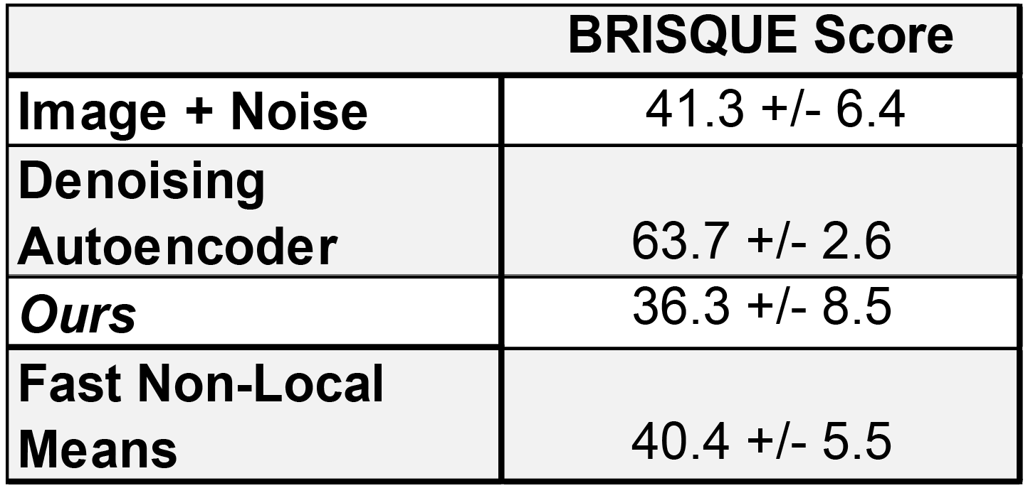
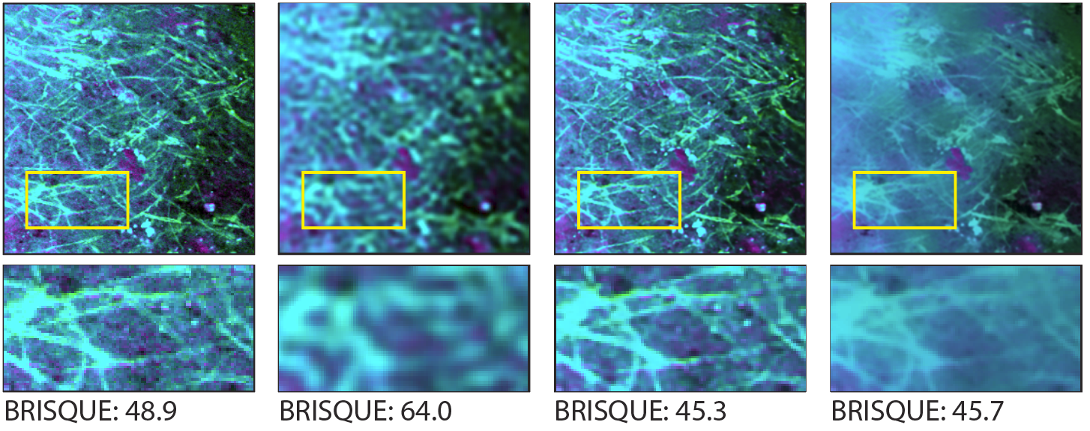
Test Results Denoising Low-quality Images
Notes:
As you can see, our U-net outperformed all the other methods. The zoomins, once again, show improved perceptual quality of diagnostic features. The average BRISQUE scores denoising 1000 patches were also lower using our network, which is consistent with higher quality of images.

Slide 12
Conclusion
Our network outperformed other learning and non-learning denoising methods in restoring SRH images.
We generated our own paired dataset by leveraging weak supervision based on perceptual image quality ratings.
Notes:
Overall, our network outperformed the other learning and non-learning denoising methods, and we successfully created a pipeline that generates a paired dataset used for semi-supervised training. This has been validated for neuroncology but could be expanded to include other malignancies that share similar diagnostic features.

Slide 13
Thank you!

