Slide 1

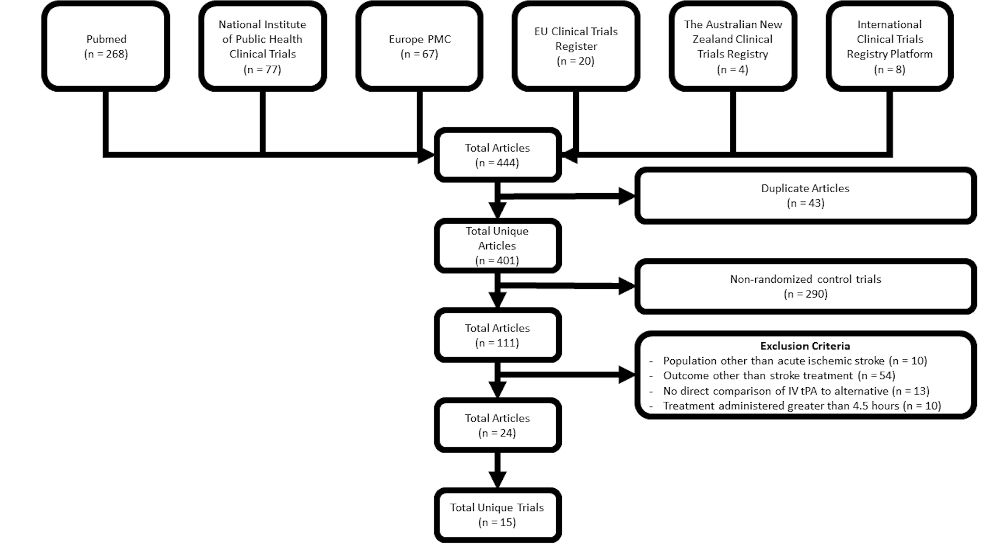
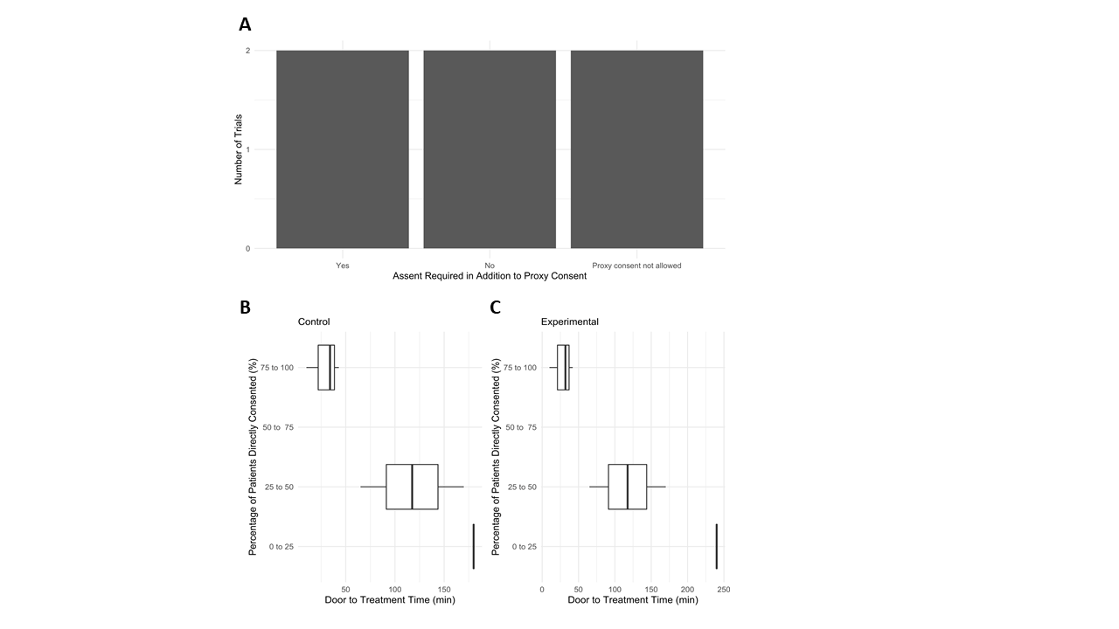
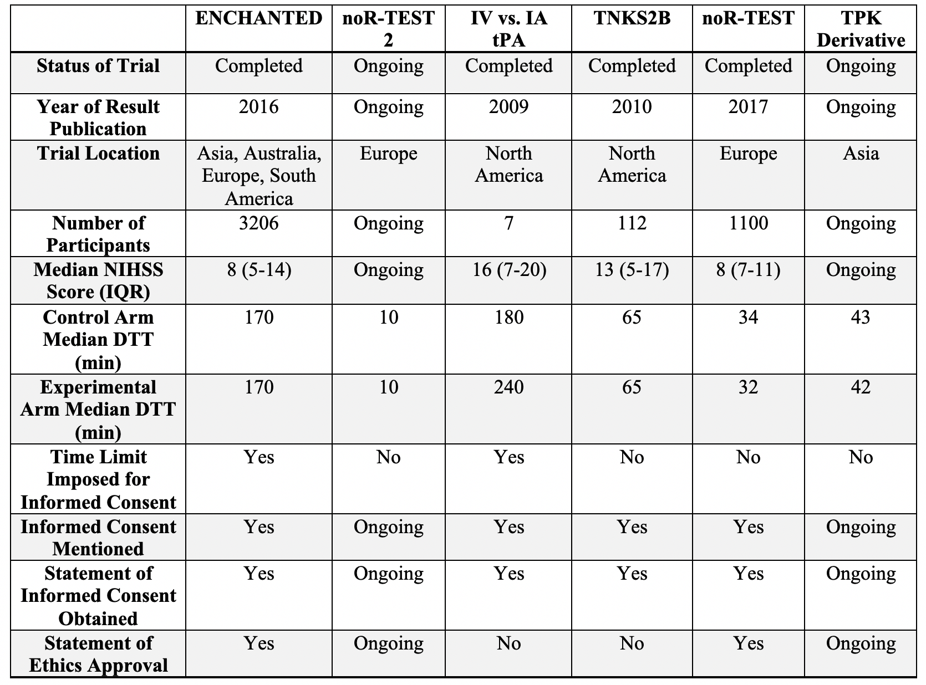
Ethical Considerations during the Informed Consent Process for Acute Ischemic Stroke in International Clinical Trials
Jennifer Fokas, BA ¹; Tiffany Bellomo, BA ¹; Clare Anderson, BA¹; Noah Tsao, BA ^{2,} ; Christopher Becker, MD, ³; Rachel Gioscia-Ryan,MD PhD ¹; William Meurer, MD ^{3,4}
¹University of Michigan Medical School, ² University of Pennsylvania, ³ University of Michigan Department of Neurology, ⁴ University of Michigan Department of Emergency Medicine
Abstract
Methods and Materials
Results
Discussion
Introduction Obtaining informed consent from acute ischemic stroke patients poses many challenges, especially in the context of a research setting. Specifically, consenting for alternative acute ischemic stroke treatments to the standard of care, Tissue Plasminogen Activator (tPA), can cause delays leading to increased time to reperfusion and worse outcomes.
Objectives We sought to investigate the experiences of researchers in existing active-control trials in acute ischemic stroke comparing investigational therapy to tPA in order to identify the approaches and challenges in obtaining informed consent in this unique patient population.
Methods Out of 401 articles evaluated from international trial databases, 14 trials met inclusion criteria of patients receiving IV tPA vs alternative treatment within 4.5 hours of onset of symptoms for acute ischemic stroke. Trial representatives were emailed by the study team with a request for a copy of their patient consent form and to complete a survey concerning aspects of the consent process. Informed consent documents from each trial were analyzed.
Of the 6 trials conducted across 6 continents that completed the survey in its entirety, 2 were ongoing, 4 were published between 2009 and 2016, and the median NIHSS for each published trial was at least an 8. All published trials in the sample stated that informed consent was obtained, but only ½ reported involvement of a research ethics committee. 3 trials performed in Europe or Asia reported directly consenting 75-100% of enrolled patients, the median NIHSS for these trials represented a moderate stroke. Trials with 75-100% of patients directly consented had shorter door to treatment (DTT) times. 5 trials allowed consent by proxy, but only 2 of those trials also required patient assent. 4 trials had translators and translated consent documents, and these trials had longer DTT times. All trials relied on experienced providers or dedicated research coordinators to obtain informed consent; however, only 2 of 6 trials mentioned specific training with regards to informed consent skills.
The survey provides evidence of the diverse landscape of informed consent. 3 of 6 trials reported consenting patients directly for 75 to 100 % of participants, suggesting alternate definitions of direct consent may be used outside of the USA. Only one trial allowed consent to be obtained over the phone and no trials obtained consent upon patient transfer or in an ambulance. Consent in the pre-hospital setting should be considered for future trials. A third of the trials reviewed implemented a time limit in which consent had to be obtained. This approach may be appropriate in the acute setting due to time sensitive nature of treatment and to promote efficiency in the consent process. A more time sensitive consent model may be preferable. Efficiency and efficacy of consent may be impacted in cases where language barriers exist as seen by longer DTT in these cases. Rapid bedside interpretation services may help correct ethnicity-based disparities in thrombolysis. The findings from this study are limited by the small sample of trials that met inclusion criteria and that some trials were ongoing and could not answer all survey fields.
Figure 1. Flowchart from Lit search
Introduction
The prevalence of stroke in the United States of America (USA) in 2016 was 2.5%, which is projected to increase to 3.9% by 2030.(1,2) Given this increasing burden, a large effort has been made to improve upon current stroke treatments. Administration of IV Tissue Plasminogen Activator (tPA) within 4.5 hours and mechanical thrombectomy for large vessel occlusions within 6 hours of symptoms onset are the standard of care for eligible patients according to the American Heart Association (AHA) guidelines for acute ischemic stroke with significant functional deficits.(3,4) Reperfusion therapies in acute stroke show a clear time-dependent effect.(5–7). Therefore, time constraints on informed consent make the consent process difficult and may pose a barrier to examining new and potentially more beneficial therapies.(8–11) In addition, patients with severe stroke symptoms may not have the capacity to consent for research, and thus require consent by proxy (12). Although there has been investigation of alternate methods such as targeted consent models to reduce delays in treatment (13), ethical considerations involved in conducting clinical research in the urgent setting with respect to the process of obtaining informed consent have been an area of ongoing deliberation.(11)
Table 1. Demographics of included trials
Conclusions
The current informed consent process is not transparent and poses challenges to investigators in the USA directly comparing tPA to an alternative treatment. International differences in the standards of informed consent, such as deferred consent, may have allowed more patients with moderate strokes to provide direct consent after treatment administration without delaying DTT time. While targeted and innovative approaches for informed consent are needed to improve patient outcomes, we must balance protecting the autonomy of individuals whose willing involvement enables such pivotal discoveries. The stroke community must aim for efficiency, transparency, and inclusion of patients of diverse backgrounds in the informed consent process so that therapeutic advances are possible.
Figure 2. A) Number of trials requiring assent in addition to consent by proxy. DTT of the B) control arm and C) experimental arm was plotted in relation to percentage of patients directly consented divided into quartiles: 0% to 25% (n=1), 25% to 50% (n=2), 50% to 75% (n=0), 75% to 100% (n=3).
Contact
References
1. Virani SS, et al. Circulation. 2020.
2. Heidenreich PA, et al. Circ Hear Fail. 2013.
3. Powers WJ, et al. Stroke. 2019.
4. Palaniswami M, et al. Interv Neurol. 2015
5. Saver JL. Stroke. 2006.
6. Saver JL, et al. JAMA - J Am Med Assoc. 2013.
7. Hacke W, et al. Lancet. 2004.
8. Tissue plasminogen activator for acute ischemic stroke. N Engl J Med. 1995.
9. Shibata K, et al. Curr Pharm Des. 2019.
10. Feuerstein GZ, Chavez J. Stroke. 2009. [cited 2020 Oct 8].
11. Skolarus LE, et al. Stroke. 2019.
12. Thomalla G, et al. Neurology. 2017.
13. Wendler D, et al. Critical Care Medicine. 2017
Jennifer Fokas
University of Michigan Medical School
Email: jafokas@med.umich.edu
Twitter: J_Fokas

