Slide 1


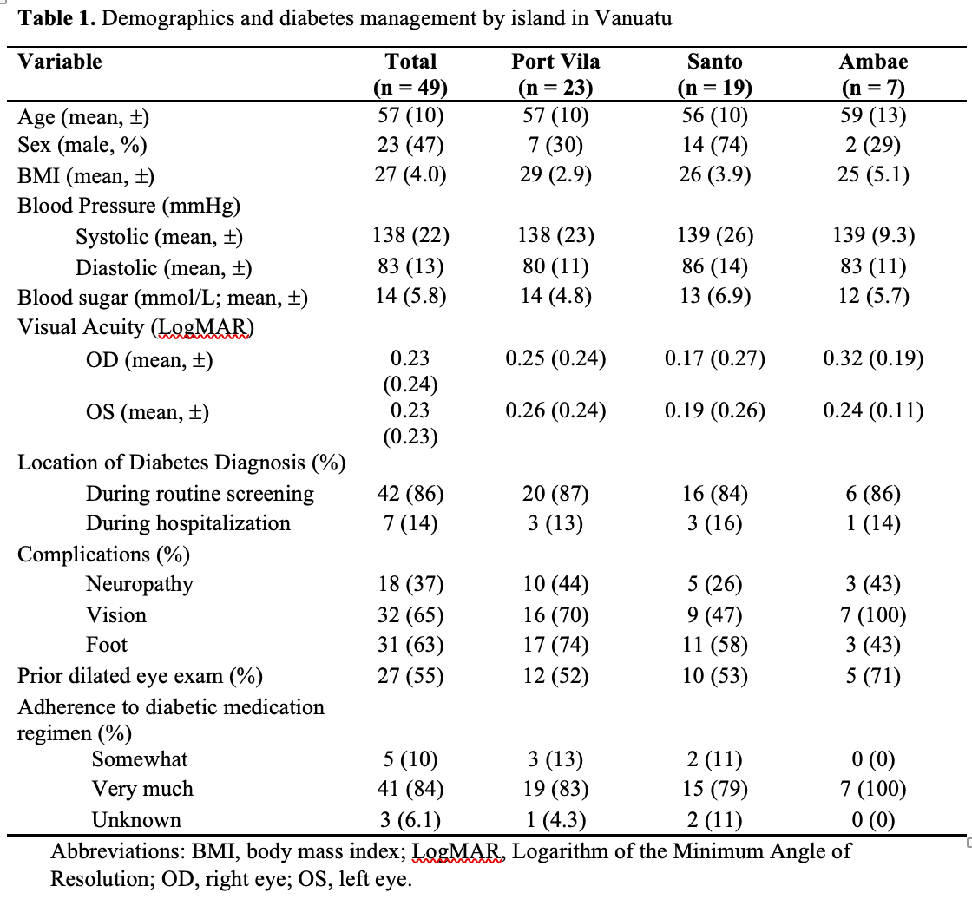
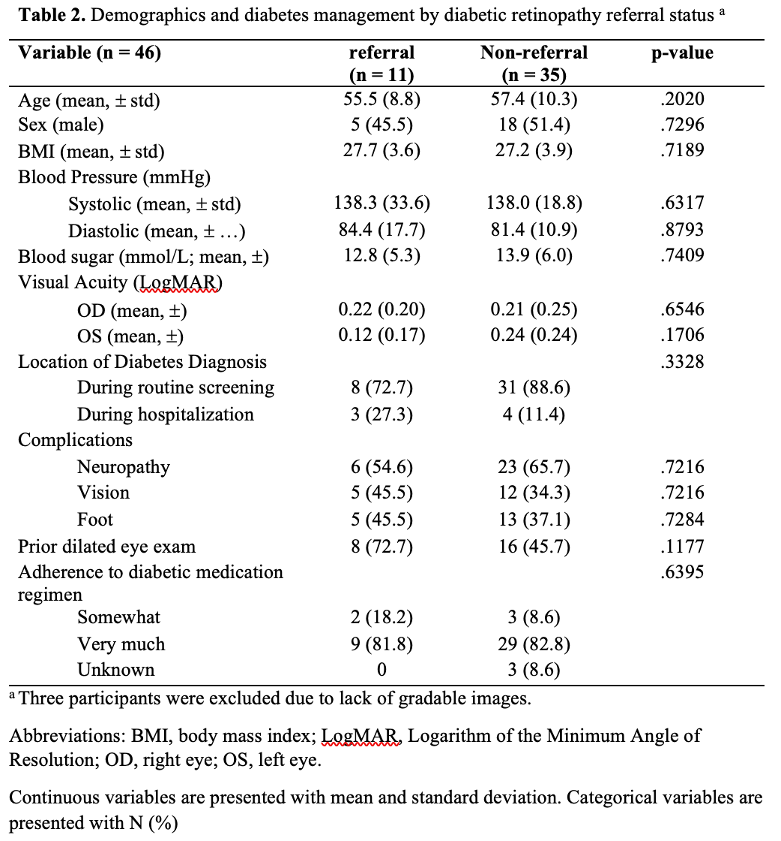
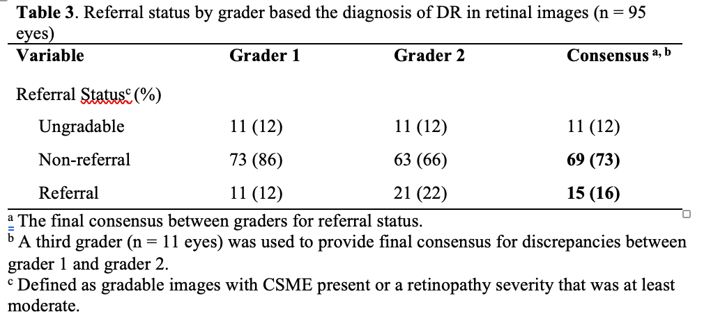
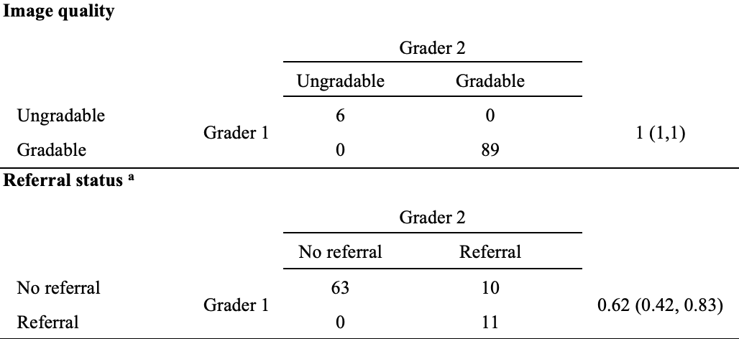
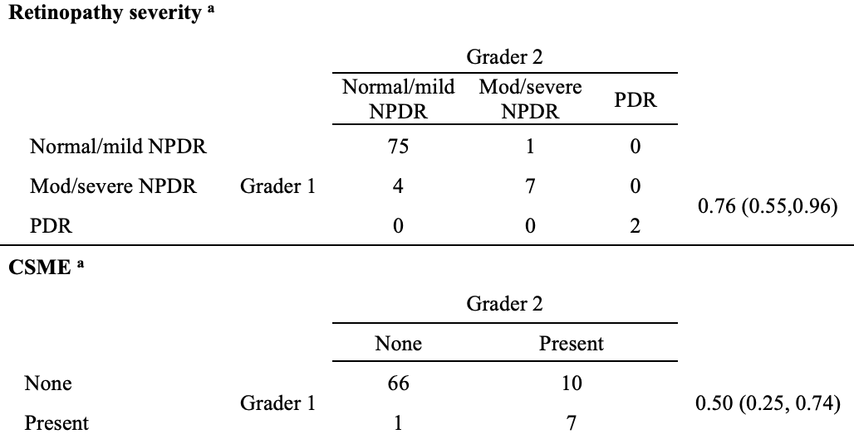
Diabetic retinopathy screening using a portable, non-mydriatic retinal camera in patients with diabetes mellitus in Vanuatu
Juan Caceres¹, BS, Yibing Zhang BS¹, Lawrence Boe² MD, Yunshu Zhou³ PhD, Yannis Paulus³, MD, Julie Rosenthal³, MD
¹University of Michigan Medical School, Ann Arbor, Michigan, USA; ²Lolowai Hospital, Ambae, Vanuatu ³Kellogg Eye Center, Michigan Medicine, Ann Arbor, MI, USA
Background
Results
Conclusions
Diabetes has become endemic in the islands of Vanuatu, affecting about 10.9% of adults¹.
Diabetic retinopathy is one of the major causes of visual impairment in the South Pacific Islands and the second most common diabetes-related complication in Vanuatu^{2,3}
There is a need for a “baseline screening program” for diabetic retinopathy in order to enable adequate intervention and treatment ⁴.
This can be done through teleophthalmology, which is among the most efficient screening strategies for diabetic retinopathy due to the cost-effectiveness and the ability to be used in both rural and urban settings^{5,6}.
Our study confirmed the high prevalence of referral-warranted DR in Vanuatu.
Our results suggest that handheld cameras can be used to obtain retinal images of sufficient quality for effective diabetic retinopathy screening due to their portability, non-mydriatic capabilities, relatively low skill required for use, and cost-effectiveness.
Moving forward, a validation study consisting of image acquisition by trained local nurses and image analysis by the Port Vila ophthalmology team should be performed to further evaluate the infrastructure capabilities for a telemedicine program in Vanuatu.
A teleophthalmology screening program is essential for the prevention of blindness due to diabetic retinopathy in Vanuatu.
Objective
Characterize the prevalence of diabetic retinopathy in a sample of diabetic patients in three islands of Vanuatu and test the feasibility of using an all-in-one portable retinal camera for the screening of referral-warranted diabetic retinopathy.
To evaluate the effect of lifestyle factors on the presence or absence of referral-warranted diabetic retinopathy in these diabetic patients.
Acknowledgement
The authors would like to thank the statistics team at Kellogg Eye center, the ophthalmology team in Port Vila, Vanuatu, and the nurses in Lolowai Hospital in Ambae and Luganville, Santo.
Methods
References
Patient Selection
Between February 10, 2020, through February 28, 2020, we recruited patients (aged 18 years or older) with Type 1 or Type 2 diabetes who had an appointment at the non-communicable disease clinic of the three principal hospitals (Port Vila Central, Lolowai, and North Provincial Hospital) on the Vanuatu islands of Port Vila, Ambae, and Santo, respectively.
Data Collection
Participants (n = 49) were asked to complete a survey of demographics (including age and sex), diabetic self-management, and lifestyle factors. Visual acuity, fasting blood sugar levels (mmol/L), blood pressure, and BMI were also obtained from the participant if available.
A total of 209 images were taken and Images were graded based on image quality, the presence or absence of diabetic retinopathy, and the severity level of the retinopathy.
Three patient excluded because of no gradable images.
1. International Diabetes Federation. Vanuatu Country Report. IDF Diabetes Atlas, 8th Edition. Published 2017. Accessed January 1, 2020. https://diabetesatlas.org/resources/2017-atlas.html
2. Keeffe JE, Konyama K, Taylor HR. Vision impairment in the Pacific region. Br J Ophthalmol. 2002;86(6):605-610. doi:10.1136/bjo.86.6.605
3. Win Tin ST, Kenilorea G, Gadabu E, Tasserei J, Colagiuri R. The prevalence of diabetes complications and associated risk factors in Pacific Islands countries. Diabetes Research and Clinical Practice. 2014;103(1):114-118. doi:10.1016/j.diabres.2013.09.017
4. Smith TST, Szetu J, Bourne RRA. The prevalence and severity of diabetic retinopathy, associated risk factors and vision loss in patients registered with type 2 diabetes in Luganville, Vanuatu. Br J Ophthalmol. 2007;91(4):415-419. doi:10.1136/bjo.2006.104174
5. Pasquel FJ, Hendrick AM, Ryan M, Cason E, Ali MK, Narayan KMV. Cost-effectiveness of Different Diabetic Retinopathy Screening Modalities. J Diabetes Sci Technol. 2015;10(2):301-307. doi:10.1177/1932296815624109
6. Kalogeropoulos D, Kalogeropoulos C, Stefaniotou M, Neofytou M. The role of tele-ophthalmology in diabetic retinopathy screening. J Optom. 2020;13(4):262-268. doi:10.1016/j.optom.2019.12.004

