Slide 1

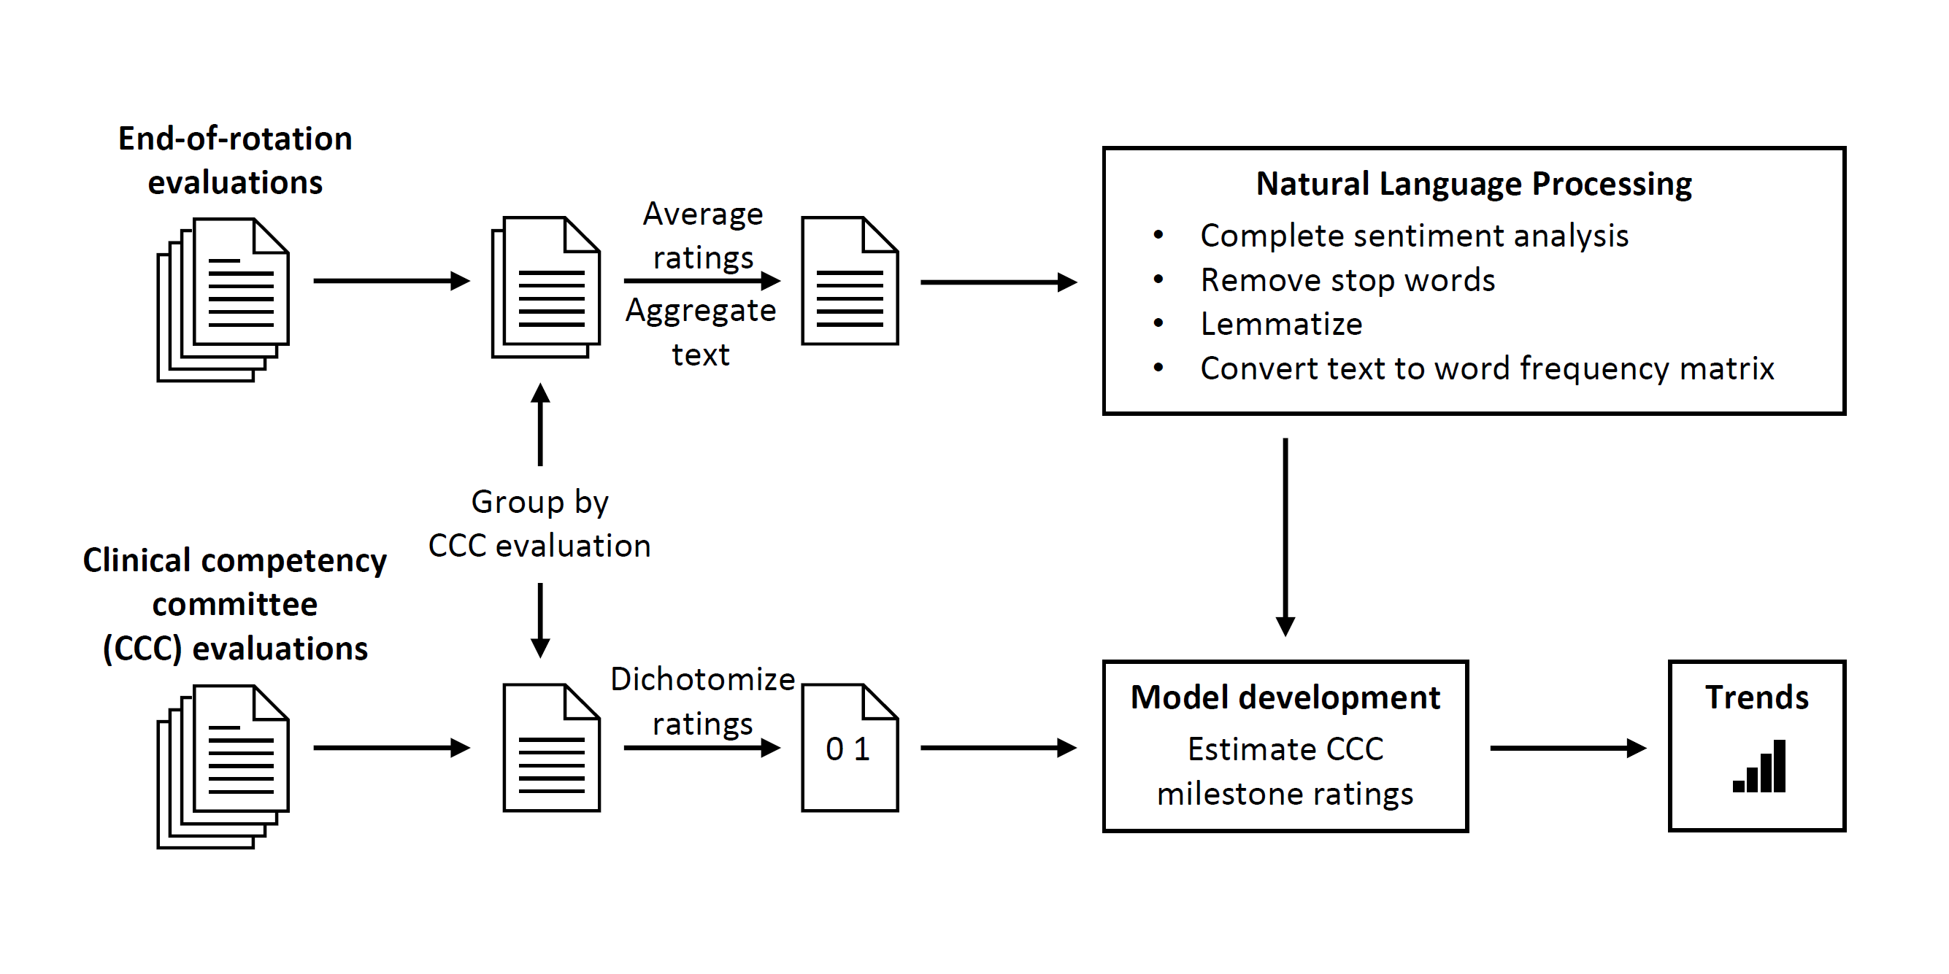
Natural Language Processing to Estimate Clinical Competency Committee Ratings
Kenneth L. Abbott, MS¹, Brian C. George, MD, MAEd², Gurjit Sandhu, PhD², Calista M. Harbaugh, MD, MS², Paul G. Gauger, MD², Erkin Ötleş, MEng¹, Niki Matusko, BS², Joceline V. Vu, MD²
¹University of Michigan Medical School, Ann Arbor, Michigan; ²Department of Surgery, University of Michigan, Ann Arbor, Michigan
Introduction
Methods
Results
Residency programs use a system of assessments to track trainee progress and development. For example, a subset of faculty members participates in clinical competency committee (CCC) meetings, which occur every six months and are designed to evaluate performance and aid in the development of individualized learning plans and interventions.¹ In preparation for the CCC meetings, committee members synthesize performance information from a variety of sources—some formal (e.g., monthly end-of-rotation assessments) and some informal (e.g., conversations).
Artificial intelligence could support the CCC faculty performing these holistic reviews by guiding their attention to residents who may benefit from additional support. Natural language processing (NLP) is a form of artificial intelligence that interprets complex human language.² In general surgery, Milestones are used to structure CCC meeting discussion and resident assessment.^{3,4} It is unknown whether NLP can identify language correlated with specific Accreditation Council for Graduate Medical Education (ACGME) Milestone ratings, but this could help faculty identify residents who may need additional support in a specific performance domain. For example, faculty could review predictions of Milestone ratings, gather additional information about residents who are predicted to have low Milestone ratings, and spend additional CCC meeting time discussing these residents.
With this study, we examine whether NLP can be used to estimate CCC Milestone ratings, using text from end-of-rotation assessments.
We collected deidentified monthly end-of-rotation assessments and biannual CCC assessments for surgical residents who trained at one institution between 2014 and 2018. We aggregated text from all the end-of-rotation assessments (not CCC assessments) delivered during each CCC assessment period and dichotomized CCC ratings into high (≥7) and low (<7) ratings. We used googleLanguageR ⁵ to connect to Google Cloud Natural Language⁶ and complete sentiment analysis of text comments, tidytext and textstem^{7,8} to create a frequency matrix of words extracted from text comments, Driverless AI⁹ to estimate the probability of a low CCC assessment rating. We created 48 ensemble models: 16 models with non-NLP predictors, 16 models with NLP predictors, and 16 models with all predictors. Outcome variables included each of the 16 numeric ratings on CCC assessments. NLP predictors included Google sentiment score for text comments from aggregated end-of-rotation assessments and the above-described word frequency matrix. We evaluated the performance of each of these models with 3-fold cross validation, using the resulting predictions to calculate area under the receiver operating characteristic curve (AUC). We used R version 4.0.0¹⁰ for analyses.
We analyzed 594 end-of-rotation assessments and 97 clinical competency assessments for 24 general surgery residents. CCC assessment ratings varied by Milestone, with the prevalence of low ratings <7 ranging from 0.23 to 0.57; prevalence of low ratings was greatest for performance of operations and procedures under patient care and performance of assignments and administrative tasks under professionalism. Across all models, sensitivity for detection of low ratings ranged from 0.28 to 0.89; accordingly, AUCs ranged from 0.71 to 0.96. AUCs were comparable for models with NLP predictors, non-NLP predictors, and all predictors.
Competency |  | Prevalence | AUC
 |  | Low ratings, mean (SD) = 0.36 (0.11) | Non-NLP predictors, mean (SD) = 0.84 (0.05) | NLP predictors, mean (SD) = 0.83 (0.06) | All predictors, mean (SD) = 0.87 (0.05)
Patient care
 | 1. Care for diseases and conditions | 0.23 | 0.86 | 0.95 | 0.96
 | 2. Care for diseases and conditions | 0.27 | 0.93 | 0.88 | 0.92
 | 3. Performance of operations and procedures | 0.57 | 0.89 | 0.78 | 0.95
Medical knowledge
 | 1. Care for diseases and conditions | 0.45 | 0.81 | 0.82 | 0.85
 | 2. Performance of operations and procedures | 0.45 | 0.83 | 0.82 | 0.81
Systems-based practice
 | 1. Coordination of care | 0.26 | 0.79 | 0.81 | 0.83
 | 2. Improvement of care | 0.40 | 0.75 | 0.82 | 0.81
Practice-based learning and improvement
 | 1. Teaching | 0.28 | 0.76 | 0.80 | 0.81
 | 2. Self-directed learning | 0.42 | 0.78 | 0.83 | 0.85
 | 3. Improvement of care | 0.33 | 0.83 | 0.92 | 0.92
Professionalism
 | 1. Care for diseases and conditions | 0.23 | 0.88 | 0.87 | 0.94
 | 2. Maintenance of physical and emotional health | 0.29 | 0.86 | 0.82 | 0.83
 | 3. Performance of assignments and administrative tasks | 0.52 | 0.83 | 0.79 | 0.84
Interpersonal and communication skills
 | 1. Care for diseases and conditions | 0.30 | 0.83 | 0.74 | 0.86
 | 2. Coordination of care | 0.29 | 0.89 | 0.89 | 0.90
 | 3. Performance of operations and procedures | 0.49 | 0.88 | 0.71 | 0.92
Discussion
No previous research applies NLP to the ACGME Milestone rating process. In this study, we used NLP of end-of-rotation assessments to examine whether NLP could identify language correlated with specific Milestone ratings. We found that NLP could be used to estimate Milestone ratings on biannual CCC assessments. Information automatically extracted from text could help faculty focus attention on residents who might benefit from additional support.
This study has limitations. First, the development of predictive models can entail tradeoffs between performance and interpretability, and this increases the risk of an NLP model obscuring bias related to gender, ethnicity, or other variables that should have no bearing on performance ratings. Therefore, implementation of these methods should be preceded by attempts at detection and mitigation of biases that NLP might propagate from written assessments. Second, our study incorporated assessments from only 24 residents at a single institution and these findings might not generalize to other groups of residents. However, the pattern of high AUCs across models, despite such a small sample, is reassuring.
Conclusions
NLP can identify language correlated with specific ACGME Milestone ratings. Faculty could use information automatically extracted from text to focus attention on residents who might benefit from additional support.
Figure 1. Summary of analytic process.
Table 1. Performance of models estimating clinical competency committee assessment ratings, with and without natural-language processing predictors.
Contact
References
Kenneth Abbott
University of Michigan Medical School
keabbott@med.umich.edu
Accreditation Council for Graduate Medical Education. Clinical competency committees. https://www.acgme.org/Portals/0/ACGMEClinicalCompetencyCommitteeGuidebook.pdf. Published 2020. Accessed May 6, 2020.
Manning CD, Schütze H. Foundations of statistical natural language processing. 2nd printing, with corrections. ed. Cambridge, Mass.: MIT Press; 2000.
Kuo LE, Hoffman RL, Morris JB, et al. A milestone-based evaluation system-the cure for grade inflation? J Surg Educ. 2015;72(6):e218-225.
Accreditation Council for Graduate Medical Education, American Board of Surgery. The general surgery milestone project. http://www.acgme.org/Portals/0/PDFs/Milestones/SurgeryMilestones.pdf?ver=2015-11-06-120519-653. Published 2015. Accessed July 22, 2018.
Edmondson M. googleLanguageR: Call Google's 'Natural Language' API, 'Cloud Translation' API and 'Cloud Speech' API. https://cran.r-project.org/web/packages/googleLanguageR/index.html. Published 2020. Accessed February 7, 2020.
Google LLC. Cloud Natural Language. https://cloud.google.com/natural-language/. Published 2020. Accessed February 7, 2020.
Silge J, Robinson D. tidytext: Text mining and analysis using tidy data principles in R. http://dx.doi.org/10.21105/joss.00037. Published 2016. Accessed.
Rinker TW. textstem: Tools for stemming and lemmatizing text. http://github.com/trinker/textstem. Published 2018. Accessed February 7, 2020.
h2o.ai Inc. Driverless AI. https://www.h2o.ai/products/h2o-driverless-ai/. Published 2020. Accessed February 7, 2020.
R Core Team. R: A language and environment for statistical computing. R Foundation for Statistical Computing. https://www.R-project.org/. Published 2020. Accessed May 11, 2020.

