Slide 1

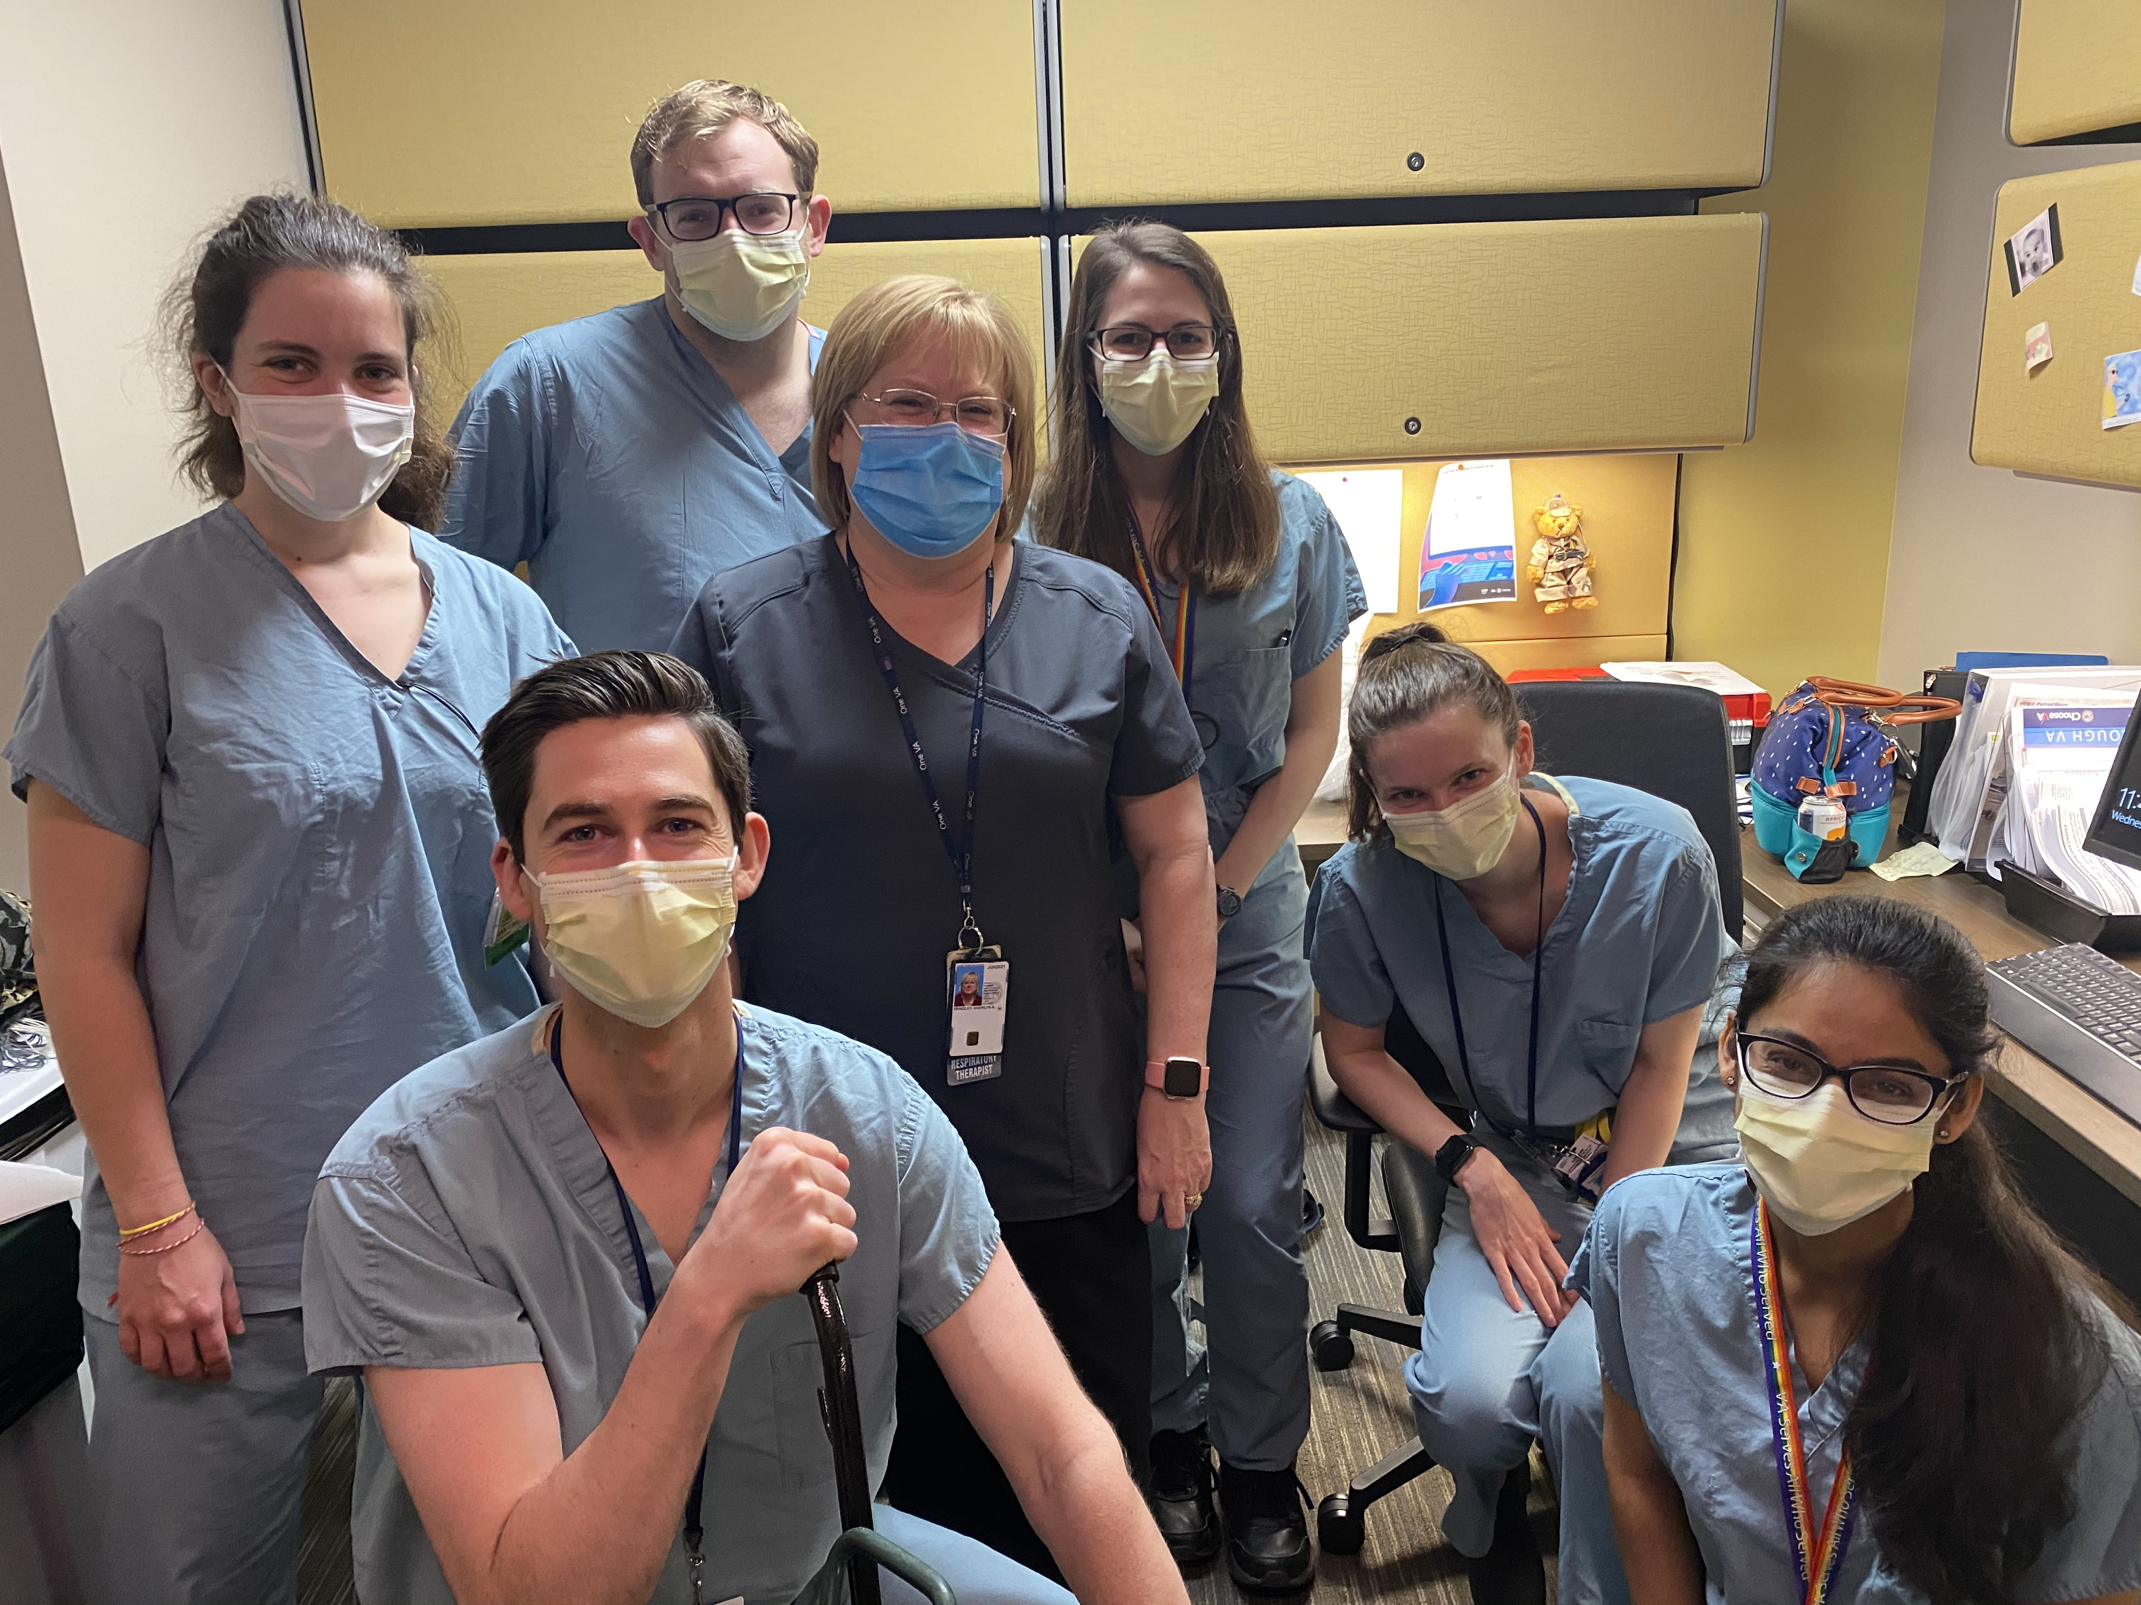
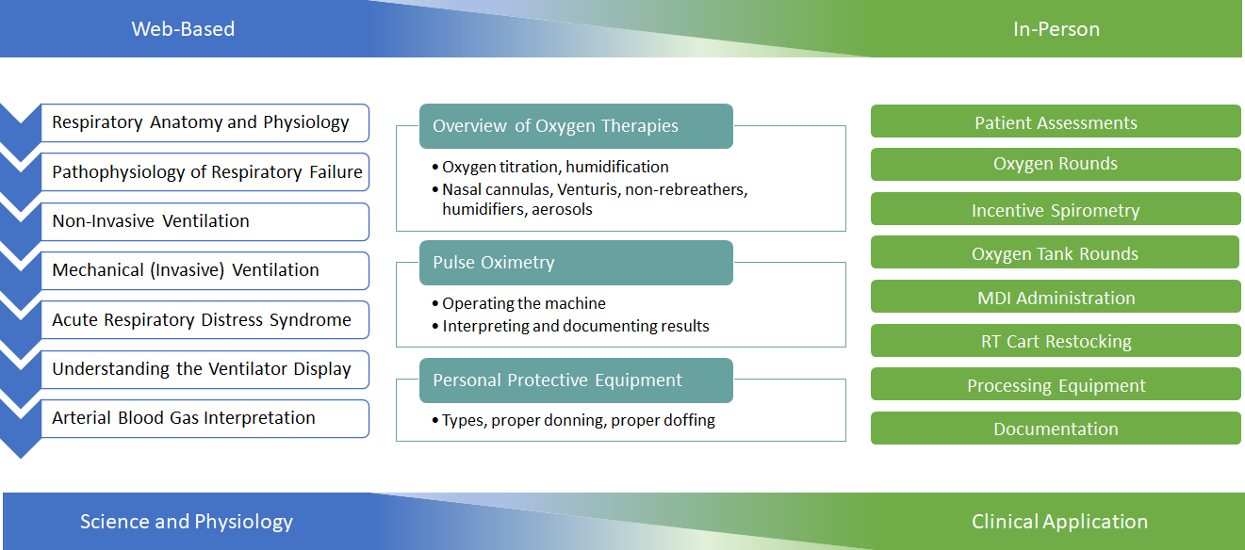
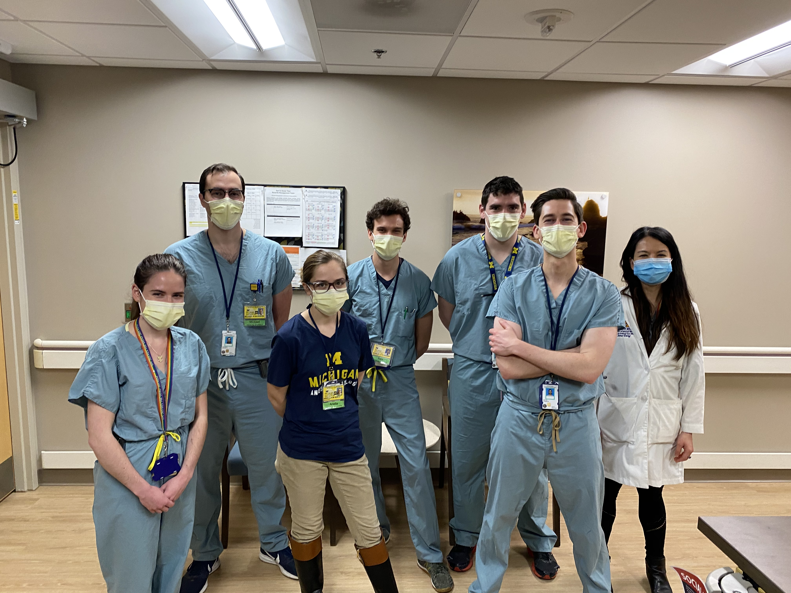
Training and Deployment of Medical Students as Respiratory Therapist Extenders During COVID-19
Thomas B. Hester¹, Kevin J. Karlic¹ , Julia D. Cartwright¹, Domenic G. DiGiovine¹, Jacquelyn B. Kercheval¹, Bruno DiGiovine², Steven E. Gay^{1,3,4}, Carl Haas², Daphne Hawkins⁵, Andrew Weirauch², and Theodore J. Iwashyna^{1,4,5}
¹School of Medicine ³Department of Respiratory Care, and ⁴Department of Internal Medicine, at the University of Michigan, Ann Arbor, Michigan ²Medical Specialties, IHA, Ann Arbor, Michigan; and ⁵VA Ann Arbor Healthcare System, Ann Arbor, Michigan
Background
Methods
Results
Respiratory failure requiring oxygen support and/or mechanical ventilation is the signature injury of SARS-CoV-2 infection. Care requires not only adequate equipment but also the expertise of trained respiratory therapists. Early experience during the COVID-19 pandemic and predictive modeling indicate that the need for respiratory therapists (RTs) will exceed the current supply. We present an implemented model to train and deploy medical students in the novel role of “respiratory therapist extender” (RTE) to address respiratory therapist shortage during the COVID-19 pandemic. RTEs are trained to assist RTs with low acuity tasks, thereby allowing RTs to focus on critically ill patients.
Needs Assessment
Internal and External
Curriculum Development
Peer reviewed by two ICU physicians
Recruitment
Via M Response Corps
Within five days of volunteer recruitment, we trained our first cohort of RTEs, including completion of the online training and the in-person PPE and RTE skills sessions.
Within three weeks of conceptualizing the role, the first group of RTEs began working in a hospital.
Eleven medical students volunteered 432 work hours as RTEs in the Ann Arbor VA
Training
  Online
  In person
  PPE
Conclusions
Deployment
Healthcare professionals, including medical students, can be quickly trained and deployed in the novel RTE role as a surge strategy during the COVID-19 pandemic. Further investigation is required to quantify the impact associated with RTE volunteers.

