Slide 1

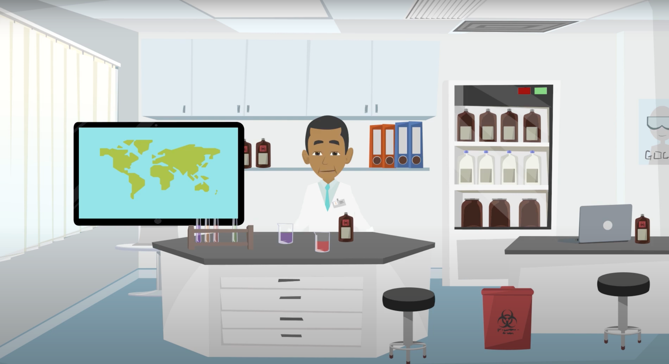
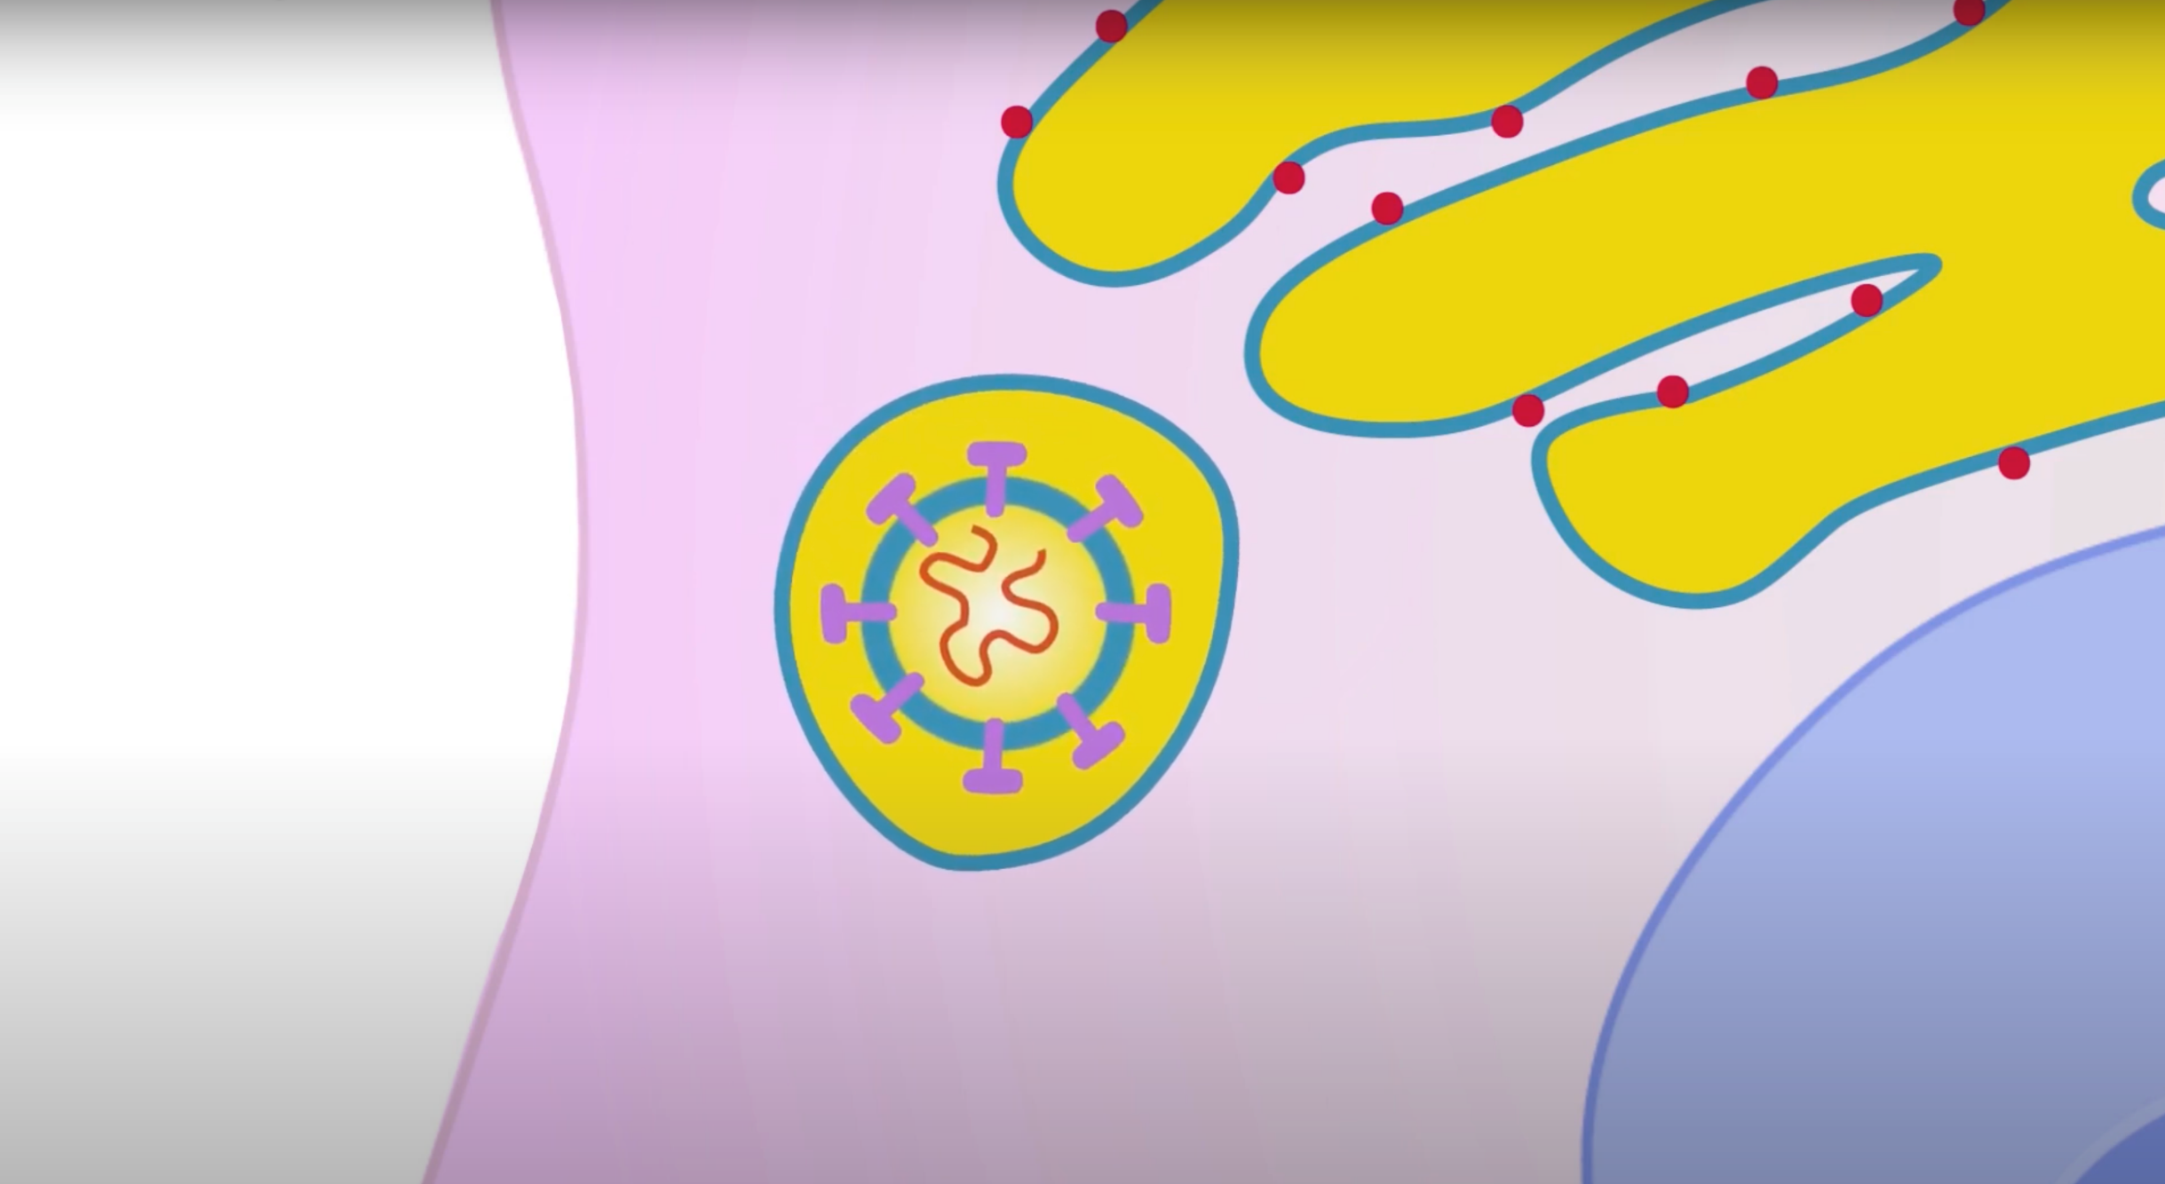
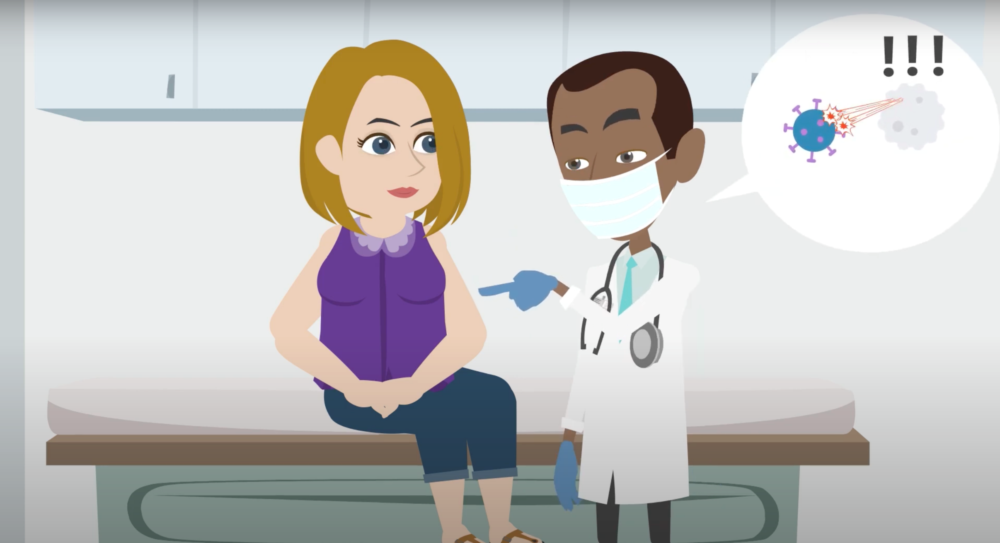
Understanding COVID-19: An animated explainer video
Marc G. Gutierrez¹; Kevin S. Gregg, MD^{1,2};
¹University of Michigan Medical School, ²Department of Internal Medicine, Infectious Disease
Abstract
Results
We created a 13-minute animated video about COVID-19 with the goal of improving health literacy and slowing the spread of SARS-CoV2 in KwaZulu-Natal, South Africa. We translated the video into isiZulu, the predominant language of KwaZulu-Natal. There is evidence that animation can be an effective means of educating people about health concepts and we are hopeful that this video will improve mask compliance, vaccination rates and hand hygiene which will improve health outcomes. As animation software becomes more affordable and easier to use and the internet more widely available, animated explainer videos in multiple languages provide exciting opportunities for globally communicating vital health information.
When combining the various websites and languages that the video is available in, at the time of poster printing, the video has been viewed on YouTube 6483 times. Our video received the required COVID approval from YouTube to be run as an ad and was promoted in South Africa. This does not include in-person viewing. Average view time was 3 minutes and 13 seconds.
Discussion
Providing resources in an individual’s native language are essential to improving health literacy. By improving health literacy, we hope to improve mask compliance, social distancing, vaccination rates and hand hygiene which will ultimately result in improved health outcomes (Figure 1).
Animated videos have been shown to be effective in providing information, especially in minority populations with low health literacy.² Animation has advantages over traditional live-action video because it gives the animator greater control over presentation, characterization, staging and timing and lends itself to conveying symbolic theories and concepts (Figures 2,3). Animations allow content to be presented in a humorous and non-threatening manner that is accessible across age groups and cultures which improves the attention-span of viewers and enhances recall. In fact, animation may be superior to traditional methods of improving health literacy: a randomized control trial showed that animated video was effective for educating people about antibiotic use and resulted in long-term knowledge retention that was superior to pamphlet education³.
There is evidence that animation can be an effective tool for teaching basic science concepts as well: at a medical school in West Virginia, a group of new medical students who learned about DNA replication via an animation performed better on a test than those who read a book chapter on DNA replication.⁴ In our video, we show a simplified scheme for cell invasion and describe the spike protein and we are hopeful that this will assist compliance with the vaccine (Figure 4). Our video has been viewed 6483 times on the internet and more times in person. Animation enables the animator to reach a wider audience than would be possible in person.
With improved access to devices and internet access, animated explainer videos are a powerful format for sharing health information and improving health literacy.⁶
Improving health literacy
Improved mask compliance, handwashing,
Social distancing
vaccination rates
Improved health outcomes
Figure 2. Animation allows the narrator to share the accent and culture of
the target audience.
Figure 4. A simplified scheme of viral entry and replication. Spike proteins (purple) are discussed to help people understand how the vaccine works.
Future Directions
We have since made a Spanish version of the video.
We are working on translation into Hungarian and French to increase the reach of this video. We are open to translate into other languages and are seeking translators and voice artists.
We also hope to create a video about the coronavirus vaccine which would teach people about its efficacy, dispel rumors and encourage people to get vaccinated.
Figure 1. Project Goals
Introduction
The goal of this project was to develop an animated explainer video in English and IsiZulu to explain COVID-19 to people in South Africa. South Africa has eleven official languages and many people do not have access to medical information in their native language, which contributes to poor health literacy. We selected IsiZulu as it is the largest language spoken in the provinces of KwaZulu-Natal and Gauteng. Poor health literacy is associated with increased mortality and thus, resources in people’s native languages are essential to improving outcomes.¹ We produced a 13-minute animated video which covered a basic science explanation of how SARS-CoV-2 invades cells, viral transmission, immune response to COVID-19, an explanation of vaccines, symptoms of COVID-19 and what to do if you have them and how to prevent the spread of the virus. The English version of the video can be viewed at the following link: https://youtu.be/TiayYWG_qP0
Figure 3. With animation, basic science concepts such as vaccine mechanism can be explained with humor, making them more accessible to those with low scientific literacy.
References
Bostock S., Steptoe A.: Association between low functional health literacy and mortality in older adults: longitudinal cohort study. BMJ 2012 2012; 344: pp. e1602.
George S, Moran E, Duran N, Jenders RA. Using animation as an information tool to advance health research literacy among minority participants. AMIA Annu Symp Proc. 2013 Nov 16;2013:475-84. PMID: 24551351; PMCID: PMC3900192.
Schnellinger M, Finkelstein M, Thygeson MV, Vander Velden H, Karpas A, Madhok M. Animated video vs pamphlet: comparing the success of educating parents about proper antibiotic use. Pediatrics. 2010;125(5):990–996.
Thatcher JD. Computer animation and improved student comprehension of basic science concepts. J Am Osteopath Assoc. 2006 Jan;106(1):9-14. PMID: 16428683.
Independent Communications Authority of South Africa. The state of the ICT sector report in South Africa 2019. Available at: https://www.icasa.org.za/uploads/files/state-of-ict-sector-report-2019.pdf/. Accessed January 12, 2021.
Methods
Storyboard and script was developed based on CDC recommendations and journal articles. Dr. Gregg assisted with script revision. Animation was performed using Adobe After Effects, Character Animator, Illustrator, Photoshop, Premier Pro and Vyond. Audio was edited with Logic Pro X and Adobe Audition. IsiZulu translation and narration was done by Thukuthuku Xulu. English narration was done by Silas Lekoathi. The video was published on YouTube and shared with Bethel Health Builders and Izulu Orphan Projects. These organizations are distributing the video in South Africa, where it is being viewed on cellphones, tablets and laptops.

