Slide 1






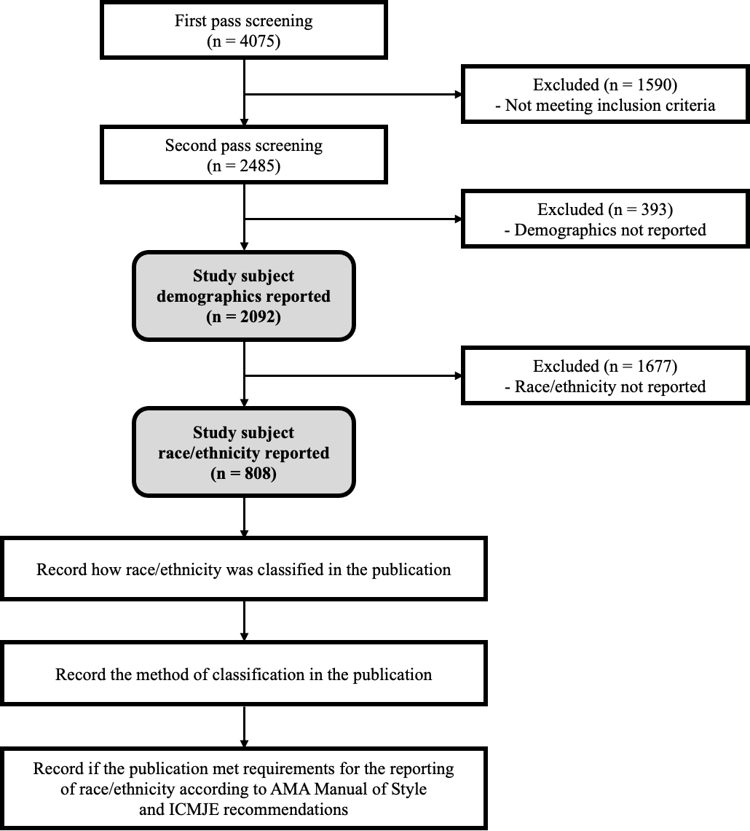
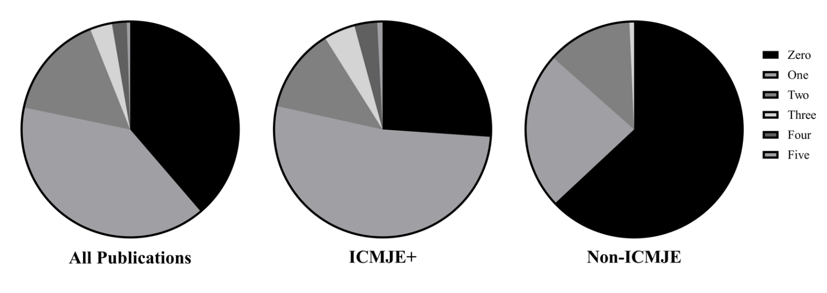
The Reporting of Race and Ethnicity in Surgery Literature
Richard C. Maduka, MD¹, Michael Broderick, BS², Erin M White, MD¹, Dena Balouz, BS², Harminder Sandhu, BS³, Gifty Kwakye, MD⁴, Herbert Chen, MD⁵, Gurjit Sandhu, PhD⁴
1 Department of Surgery, Yale University School of Medicine, New Haven CT
2 University of Michigan School of Medicine, Ann Arbor, MI
3 Michigan State University College of Human Medicine, East Lansing, MI
4 Department of Surgery, University of Michigan School of Medicine, Ann Arbor, MI
5 Department of surgery, University of Alabama at Birmingham School of Medicine, Birmingham, AB
Introduction
Results
Discussion
Health inequities and worse outcomes have been associated with certain racial and ethnic groups within the U.S. population^{1,2}
Despite guidelines such as those of the International Committee of Medical Journal Editors (ICMJE), race is infrequently reported in the medical literature, with variable quality when present^{3,4,5}
For instance, In the ophthalmology literature, 88% of studies report demographics, but only 43% report race⁶
No current data exists on the frequency or quality of the reporting of race within the general surgical literature
Race vs Adjuncts (income, zip code, ancestry, etc.)
- Subject identifier, relevance, low representation
Transparency in Race Data
- Critical appraisal of results across diverse population
ICMJE Recommendations for the Reporting of Race/Ethnicity in Medical Journals
1. The authors reported who classified the individuals in terms of race/ethnicity
2. The authors explained why the classification reported in the study was used
3. The authors indicated whether the classification options were defined by the investigator or the subject
4. The authors explained why race was assessed in the study
5. The authors defined the variable "race"
Standardization of Guidelines = Stronger Databases
- ICMJE as a foundation, but need for clear expectations
Figure 2. Bar Graph depicting percentage of reviewed literature articles that reported general demographics and specifically racial demographics between ICMJE and Non-ICMJE journals.
Monitor and Adapt Over time
- Reporting improvements, guideline changes with population
Methods
Out of 2485 publications, the reporting of race is low at 32.5%
When reported, most common classification was “race” (57.7%) followed by “race/ethnicity” (30.8%)
Classification was most often decided using a database or EMR with uncertain methodology on how race was determined (84.3%)
No significant difference in race reporting frequency between publications that state they follow ICMJE recommendations (ICMJE) versus those that do not (non-ICMJE) (p =0.722)
Demographics are reported 84.2% of the time, with a significant difference between ICMJE and non-ICMJE publications (p < 0.001)
ICMJE journals are more likely to follow ICMJE recommendations for quality reporting, both in terms of total number of recommendations followed per article (Figure 3) and statistically significant increased adherence to individual recommendations 3, 4, and 5 (p-value = <0.001, <0.001, 0.002, respectively)
Conclusion
Data demonstrates overall low frequency and highly varied quality of race reporting among primary research publications from high impact surgery journals in 2019, which is comparable to studies performed looking at reporting in other medical disciplines
Efforts must be made to promote race reporting in surgical research, with standardization of the way in which this data is obtained and reported
The ICMJE recommendation can act as a foundation for quality standards, but clear guidance and expectations for authors are paramount
Despite the challenge, improved transparency regarding race within the literature will improve our ability to identify and address ongoing healthcare disparities within our country
Screening of High Impact Surgical Journal Publications from 2019
Included Journals:
JAMA Surgery
JACS
Annals of Surgery
Surgery
American Journal of Surgery
Journal of Surgical Research
Journal of Surgical Education
References
Burchard EG, Ziv E, Coyle N, Gomez SL, Tang H, Karter AJ, Mountain JL, Pérez-Stable EJ, Sheppard D, Risch N. The importance of race and ethnic background in biomedical research and clinical practice. N Engl J Med. 2003 Mar 20;348(12):1170-5.
Cooper RS, Nadkarni GN, Ogedegbe G. Race, Ancestry, and Reporting in Medical Journals. JAMA. 2018 Oct 16;320(15):1531-1532.
Bokor-Billmann T, Langan EA, Billmann F. The reporting of race and/or ethnicity in the medical literature: a retrospective bibliometric analysis confirmed room for improvement. J Clin Epidemiol. 2020 Mar;119:1-6.
Iverson C, Chritiansen S, Flanagin A, et al; International Committee of Medical Journal Editors. Recommendations for the conduct, reporting, editing, and publication of scholarly work in medical journals. Accessed October 25, 2020. https://www.icmje.org/icmje-recommendations.pdf
International Committee of Medical Journal Editors. Journals stating they follow the ICMJE recommendations. Accessed October 25, 2020. http://www.icmje.org/journals-following-the-icmjerecommendations.
Moore DB. Reporting of Race and Ethnicity in the Ophthalmology Literature in 2019. JAMA Ophthalmol. 2020 Aug 1;138(8):903-906.
Figure 3. Graphic displaying the percentage of publications that followed a specific number of ICMJE recommendations. ICMJE+ includes five journals which state they are following the ICMJE recommendations. Non-ICMJE represents two journals that do not state whether they follow the ICMJE recommendations.
Figure 1. Descriptive Flow Diagram of the publication screening methodology

