Slide 1

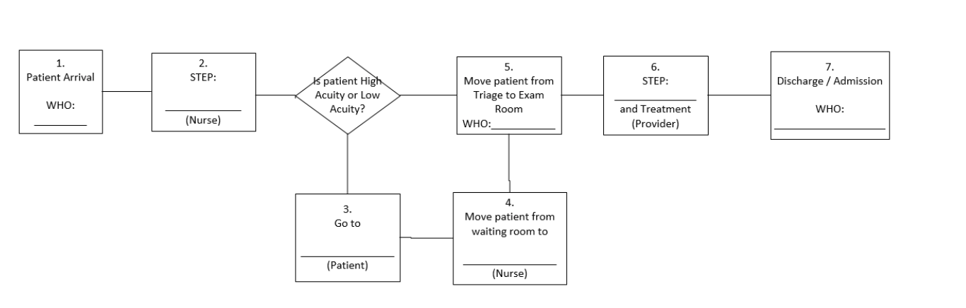
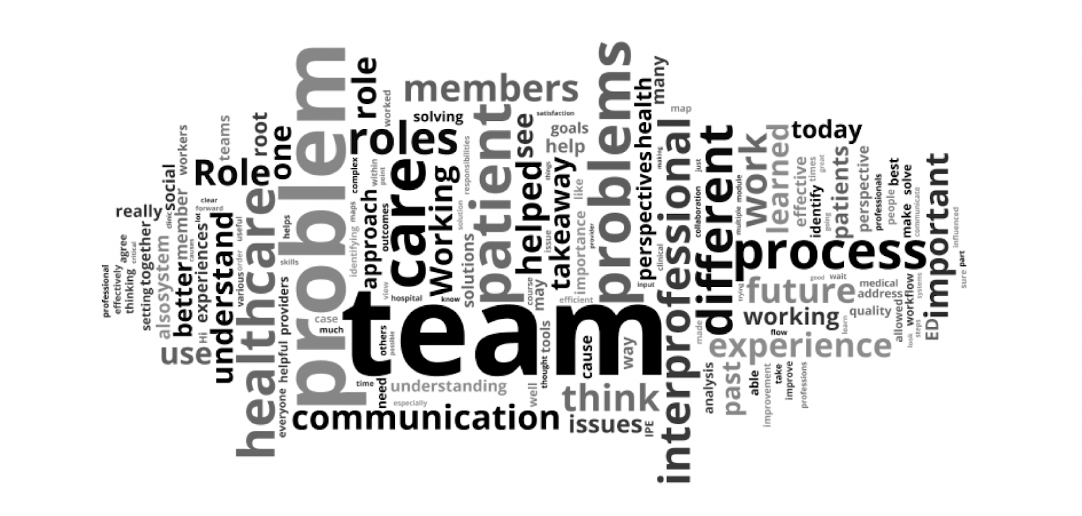
Using an interprofessional educational approach to improve pre-clinical student knowledge and skills in quality improvement methodologies
Nadine Makki, BA, Jamie Lindsay, BS, Rosalyn Maben-Feaster, MD, MPH, Debra Burke, Priscilla Hohmann, LLMSW, MDIV,5 Suzy McTaggart, Jennifer Vredeveld, MD ^{The University of Michigan}
Abstract
Results
Discussion
An interprofessional approach to quality improvement and patient safety (QIPS) has been identified as an opportunity to improve health care and is a core competency in health care professional training. Since the 2016-17 school year at the University of Michigan Medical School, first year medical students (pre-clinical) have attended a required two hour IPE Quality Improvement workshop, with students from other health professional schools including the schools of Dentistry (pre-clinical) and Nursing (clinical). Prior to the COVID-19 pandemic, it was planned to have the first year (M1) medical students work with students from the School of Nursing and School of Social Work to identify problems within a previously developed emergency room case and then develop process maps as a team as an in-person small group session. However, in light of the need for social distancing, the course was adapted into an asynchronous online module on the Canvas platform.
Prior to the pandemic, close to 400 students were expected to participate from across the School of Nursing, School of Social Work, and the medical school. However, as a result of the pandemic, the School of Nursing and the School of Social Work made the session optional, while the medical school kept the session mandatory for its students. There were a total of 195 students enrolled in the Canvas-Instructure Inc. online module, with 185 page views of the online module (94.9%).
Regarding the quizzes, Quiz 1, titled “Build a Process Map”, yielded an average score of 92%, with the range of scores of 29%-100%, SD=0.99. Quiz 3, titles “S.M.A.R.T Goals”, resulted in an average score of 52%, with the range of scores from 0%-100%, SD=0.39. The second quiz, titled “Develop a Problem Statement,” had a total of 184 free responses, 123 students (66.8%) properly identified a gap to close, whereas 61 (33.2%) developed a problem statement that did not have a gap to close.
Of those students participating, 145 (74.4%) completed the module evaluation. The majority of the students were from the medical school (n=139, 95.2%) and the majority (124, 86.11%) reported they strongly agreed that they recognized the value of multiple roles participating in the improvement process.
There were 6 discussion posts in total, but only the last one, titled “Reflection” was evaluate for themes and phrases as it provided insight into what the students took out of the session and what concepts they would take with them moving forward. The key words were then generated into a word cloud (see Figure 1).
In effort to introduce important concepts surrounding interprofessional education, problem solving, and QIPS early on in medical student education, an IPE Quality Improvement workshop was created with the goal that students are better prepared to apply these skills on the wards and in turn contribute to their clinical teams. Based on the overall results, feedback, discussion responses, and reflection as a group after the implementation of this online module, there were aspects of this session that went well and others that could be improved.
The COVID-19 pandemic presented unique challenges for the planned implementation of this course and thus steps were necessary to allow for the education to still occur but in a fashion that allowed for social distancing. However, the acuity of changes required for learners in our institution to manage the pandemic resulted in participation in this module becoming optional for both social work and nursing students. Thus, their participation was significantly limited which in turn limited our ability to provide a robust IPE experience.
Although we tried to amend this through discussions on the online module and requiring students to respond to one another, aspects of collaborative-based thinking and interprofessional education were lost as a result of this as well, particularly concerning the exercises surrounding process mapping and root cause analysis. Given that this session was no longer held in classroom settings with facilitator leads, there was also the limitation of not having a QI coach or faculty member with more experience in these subject matters leading discussions and guiding students. It was difficult to make up for this foreseen limitation through the online module.
Figure 1: Example of Process Map quiz exercise
Methods and Materials
Based on some of the feedback from previous sessions, we worked on developing more creative and relevant ways to teach some of the concepts in this IPE session. Informational videos were made that played throughout this session (4 in total) to serve as the baseline information and also to standardize the delivery of this content across groups.
Prior to the COVID-19 pandemic, it was planned to have the first year (M1) medical students work with students from the School of Nursing and School of Social Work to identify problems within a previously developed emergency room case and then develop process maps as a team as an in-person small group session.
However, in light of the need for social distancing, the course was adapted into an asynchronous online module on the Canvas platform. This module still required the students to work through the case and planned educational content, but the interprofessional component was achieved via responses to discussion questions throughout the course. This version was also reviewed by a small group of students for feedback as well. The online module opened on Wednesday April 15, 2020 and closed on May 1st, 2020. We plan for future iterations to be done in-person as initially proposed.
In order to evaluate if key themes and concepts translated well to students, discussion questions were added within the module for students to not only reply to, but to reply to other students in the course on the same discussion questions. There were 6 discussion posts in total.
In addition to the discussion questions, there were also three quizzes students had to complete. The first quiz (Figure 1) was “Build a Process Map,” which consisted of two questions, seven points total. The second quiz, “Develop a Problem Statement,” required that the students develop their own problem statements. To grade this, four different assessors took about 50 students each and determined if the students properly developed a problem statement that included a gap to close. The assessors then wrote “yes” or “no” in grading these problem statements. Finally, the last quiz, “S.M.A.R.T Goals,” also consisted of one question for one point.
To assess learner reaction to the session regarding achieving the stated educational objectives, a student evaluation was developed. The link to the evaluation was attached to the end of the module for students to access once the module was completed. The questions addressed student perceptions of the effectiveness of the videos, understanding, and the overall quality of the case study and module itself.
Introduction
An interprofessional approach to quality improvement and patient safety (QIPS) has been identified as an opportunity to improve health care and is a core competency in health care professional training. Interprofessional education (IPE) refers to “educators and learners from 2 or more health professions and their foundational disciplines who jointly create and foster a collaborative learning environment.”¹ It has become increasingly critical to introduce IPE early on in medical student education and throughout medical education in order to ensure learners have the necessary team-based training to carry forward into their respective practices.^{1,2}
The Liaison Committee on Medical Education (LCME) includes “Interprofessional Collaborative Skills” as one of their core competencies for undergraduate medical education. This ensures that medical students are taught “to function collaboratively on health care teams” and have exposure to experiences that also “include practitioners and/or students from the other health professions”.³ This core competency is addressed in a variety of ways throughout medical student training at the University of Michigan Medical School via partnerships with other health professional schools throughout the University of Michigan.
Since the 2016-17 school year, first year medical students (pre-clinical) have attended a required two hour IPE Quality Improvement workshop, with students from other health professional schools including the schools of Dentistry (pre-clinical) and Nursing (clinical). This session has focused on utilizing the A3 framework to teach scientific problem solving methods, tools, and concepts to approach problems they may encounter within the clinical environment and is a foundational component of the Quality Improvement training provided as part of the University of Michigan Medical School’s longitudinal Health Systems Science Curriculum.
Conclusions
The need to adapt this session into a virtual exercise on such short notice lends itself to improvement going forward, in addition to the improvements that can be made from the feedback given from the initial pilot sessions and from the session overall. For example, while the videos were received relatively well, we can potentially add transcriptions of the videos for learners who prefer to read the content versus receiving it virtually. If there is a need for the online version of this session next year due to the pandemic, there are changes we can make to the module, such as lessening the amount of discussion questions or, perhaps more importantly, finding a way to moderate the discussion better given the loss of facilitator guides. Finally, while a survey was distributed at the end of the module, going forward, we can ask open-ended questions to better evaluate the effectiveness of this session and get more variety of feedback.
Figure 2: Word Cloud with key words from the Reflection Discussion
Contact
References
Nadine Makki
The University of Michigan Medical School
nimakk@med.umich.edu
Buring, S. M., Bhushan, A., Broeseker, A., Conway, S., Duncan-Hewitt, W., Hansen, L., & Westberg, S. (2009). Interprofessional education: definitions, student competencies, and guidelines for implementation. American journal of pharmaceutical education, 73(4), 59. https://doi.org/10.5688/aj730459
Valenziano KB, Glod SA, Jia S, Belser A, Brazell B, Dellasega C, Duncan L, Farnan M, Haidet P, Phillips J, Wolpaw D, Dillon PW. An Interprofessional Curriculum to Advance Relational Coordination and Professionalism in Early-Career Practitioners. MedEdPORTAL. 2018 Mar 22;14:10697. doi: 10.15766/mep_2374-8265.10697. PMID: 30800897; PMCID: PMC6342369.
LCME. (2017). FUNCTIONS AND STRUCTURE OF A MEDICAL SCHOOL. https://medicine.vtc.vt.edu/content/dam/medicine_vtc_vt_edu/about/accreditation/2018-19_Functions-and-Structure.pdf
Bjerke MB, Renger R. Being smart about writing SMART objectives. Eval Program Plann. 2017 Apr;61:125-127. doi: 10.1016/j.evalprogplan.2016.12.009. Epub 2016 Dec 23. PMID: 28056403.
Bates. (2004). A critical analysis of evaluation practice: the Kirkpatrick model and the principle of beneficence. Evaluation and Program Planning., 27(3), 341–347. https://doi.org/info:doi/

