Slide 1

Providing Clarity:
Value of Information Centers in the Sustainability of Business Schools.
56th Virtual International Congress
CLADEA2021
October 22, 2021
Corey Seeman, University of Michigan
cseeman@umich.edu

Slide 2
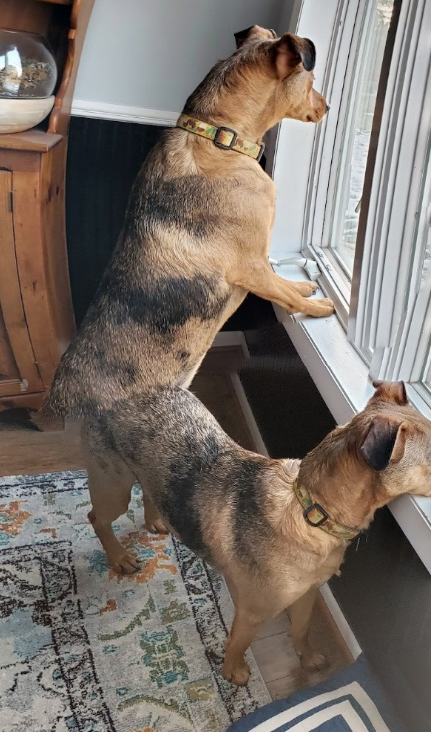
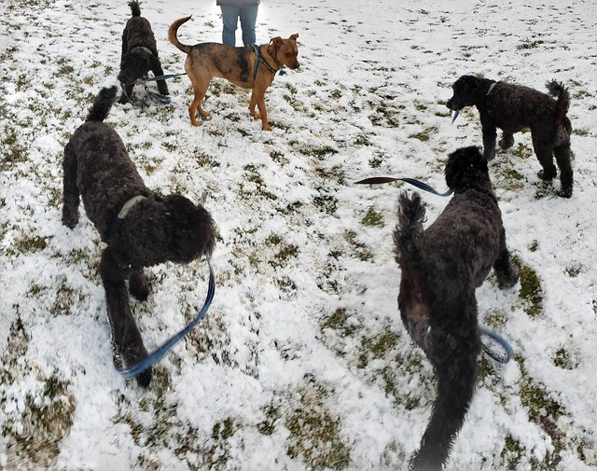
Change and the Business Library
Libraries are being asked to respond and react to conditions that might be less than ideal.
We may never return to “normal.”
Are we ready to give up services and resources our space will no longer accommodate?
Are we ready to embrace the change being asked – or demanded of us?
Change may be a dual edged sword – vibrant schools will demand more changes than stagnant ones.
New technologies might have potential, but may be years away from being options

Slide 3
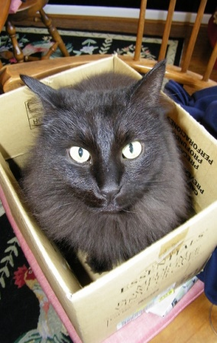
Change and the Business Library
Kresge Library By the Numbers:
  Total Staff: 19 (9 librarians* & 10 staff)
  Total volumes: 15 (used to have 150,000)
  Annual materials budget ($1.1m)
  Annual total budget ($2.4m)
  Reference transactions – around 3-4K/year
  Also support course materials (cases) and LMS for Ross.
  Became a digital only library in 2014 during a contruction project.
  Enabled us to move easily when the school shifted in March 2020.

Slide 4
Change and the Business Library – Collections
This is my vision of collection building in libraries – we need to find the balance between these needs.
Future Use
This is where Libraries have traditionally bought for (and many still do)
Community Needs
Community Aspirations & Desires
This is where our campuses really want us to be working. This might be where the turnaways come from.
Current Use

Slide 5
Change and the Business Library – Collections
Library challenge is that we have multiple stakeholders and they have different needs – especially for business.
Faculty needs – scholarly journals, articles, books , datasets
Student needs – articles, company & industry information, market reports
Community – Mostly similar to student needs
Our Library needs to be aligned to our community?
Student
Community
Faculty

Slide 6
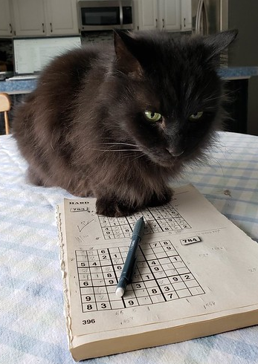
Change and the Business Library - Services
As librarians try to figure out reference, we often think there is one solution.
But the scope of the requests & the needs may vary tremendously.
Some have definitive answers (like Sudoku), some do not.
We are merely guides or Sherpas to help them learn about the terrain so they can understand what are their next steps.
Reference and research are a voyage.

Slide 7
Change and the Business Library - Services
Green line – the availability of information
Blue line – the need for assistance

Slide 8

Change and the Business Library - Services
Our primary job is to provide clarity to our users.
Our reference work really is driven by the appetite of our users & the scope of their research.
For many of our users, there is not a great deal of information on their topic.
Reference support is still an important part of the process for our community.

Slide 9
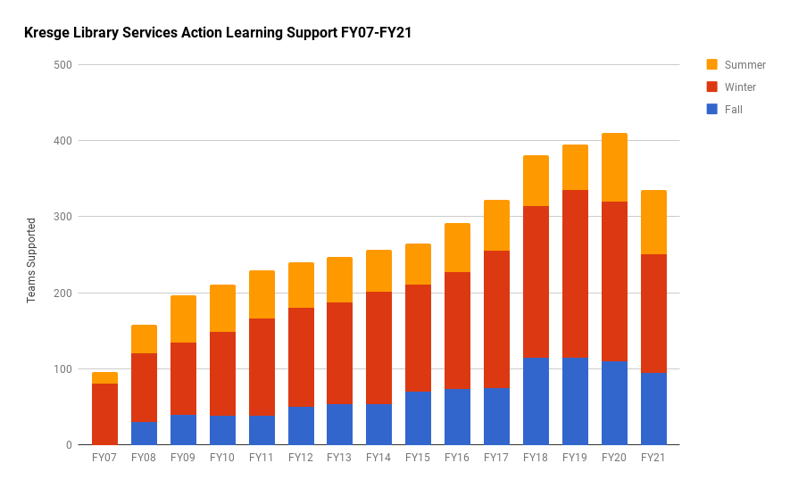
Change and the Business Library - Services
Action learning support at Kresge Library is widely accepted as our biggest contribution.
We need to teach students how to manage through Ambiguity and Complexity.
We do this through experiential learning programs.
This is a great opportunity for the Kresge Library.
Our job is to Provide Clarity.
Our future is tied to meeting the needs of the school and connecting our services with goals.

Slide 10
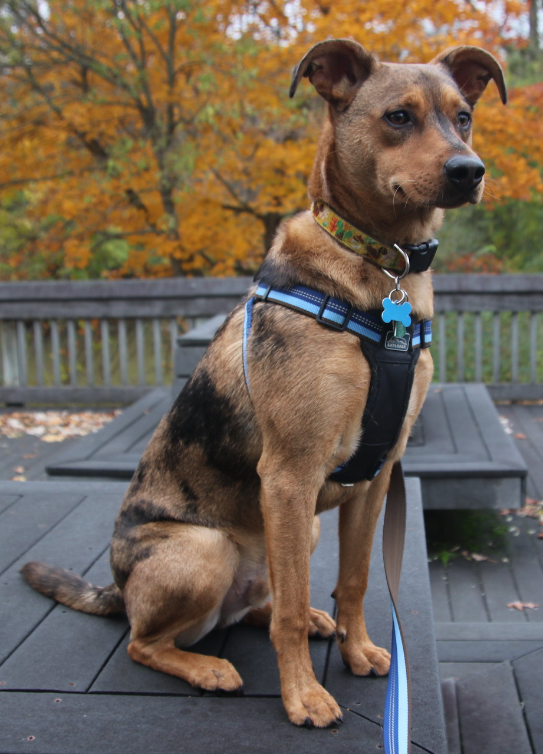
Change and the Business Library - Services
Kresge Value Proposition
“A completely re-thought Kresge Library Services, transitions from a collection of physical reference materials to a full suite of information resources and research services, guided by expert staff.” – Ross Dividend, Fall 2016 (Ross Alumni Magazine)
The library did not close, but become virtually unrecognizable.
You do not always choose your path, but how you respond to the challenges.

Slide 11
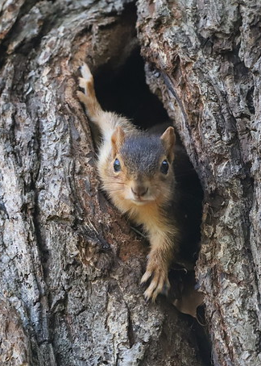
Change and the Business Library - Services
We view Kresge as , the “Ethereal Library’s” value proposition is:
  Live within the restrictions of virtually no collection space.
  Figure out new collaboration mechanisms to serve our community.
  Focus on what we can do vs. what we have done.
  Forget the dead, take care of the living!
Squirrel at the University of Michigan, Ann Arbor
October 19th, 2021

Slide 12
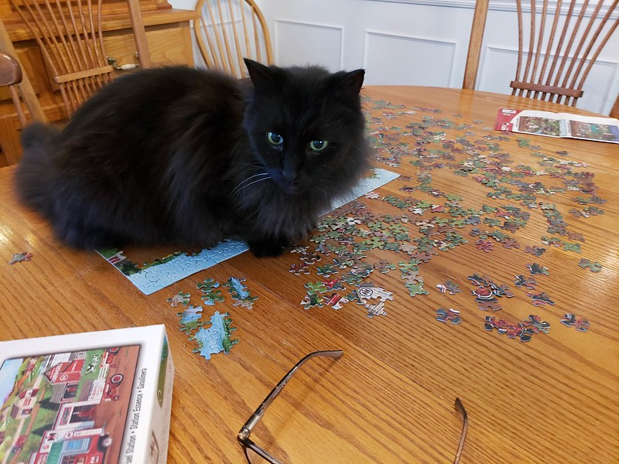
Thank you!
Enjoy the Puzzles of Life
Corey Seeman
cseeman@umich.edu
Corey - https://sites.google.com/view/squirrelman/home
Kresge - https://www.bus.umich.edu/Kresgelibrary/

