Slide 1

Tax Diversification Strategies and Tax Research
2021 MichALL Fall Education Meeting, 11/12/21
Joel Scheuher, MILS
Business Librarian
University of Michigan
Kresge Business Library
Ann Arbor, MI
jscheuhe@umich.edu
734-647-0469
Joel Scheuher, EA, MBA
Tax Preparation Specialist
Knepp & Associates Tax Service
Livonia, MI
joel@knepptax.com
734-953-9478

Slide 2
Your Tax Journey
Tax Law Authority
Information Resources for Tax Research
Employer Plans (401(k) and 403(b) plans)
Individual Retirement Plans (IRAs)
Tax Diversification Strategies
Tax Preparation Assistance
IRS Tools and Tax Tips
Note: All numbers and examples are based on 2020 Tax Year Information

Slide 3
US Federal Tax Law Authority Hierarchy
US Constitution
Internal Revenue Code
US Treasury Regulations
Legislative History
Judicial Authority
IRS Positions and Publications
Secondary Sources
WWDD?
More Info: https://njsea.org/files/u-s-federal-tax-law-hierarchy-quick-reference-chart.pdf and https://libguides.law.lsu.edu/c.php?g=191374&p=1264047

Slide 4
Information Sources for Tax Research
What Tax Attorneys and Academic Researchers use:
  IRS Code - Cornell
  Tax Products - Checkpoint (RIA), VitalLaw (CCH), Bloomberg Tax (BNA)
  Court Decisions - Lexis, West, Hein, Bloomberg Law, etc. (ex. Cohan v. Commissioner, 39 F.2d 540)
What Tax Preparers use
  IRS Pubs – IRS Website (ex. Pub 17)
  Professional Associations
  Secondary Sources
    Kiplinger Tax Letter and Personal Finance
    Quickfinder Handbook (Thomson Checkpoint)

Slide 5
Diversified Tax Portfolio
Tax diversification vs Financial diversification
Why diversify?
  Minimizing risk through hedging
Set up multiple “tax buckets”
More buckets = more flexibility = more opportunity

Slide 6
Employer Plans (401(k) and 403(b))
Applicable to all 401(k) and 403(b) plans
  Established by the employer
  Often have an employer matching contribution
  Contribute up to $19,500 ($26,000 if age 50 or older)
  Borrowing usually permitted against the balance
  Must start withdrawing a minimal amount at age 72
  10% Penalty for withdrawals before age 59 ½*
*See exceptions to penalty later

Slide 7
Employer Plans (401(k) and 403(b))
Two types of “buckets” within the employer plan
  1. Pre-tax buckets
    Deduction on amount contributed now; tax is paid upon withdrawal
    More $ in paycheck
  2. After-tax buckets (aka Roth 401(k) and 403(b))
    No deduction when contribution made; no tax due at retirement (tax-free growth)
    Less $ in paycheck

Slide 8
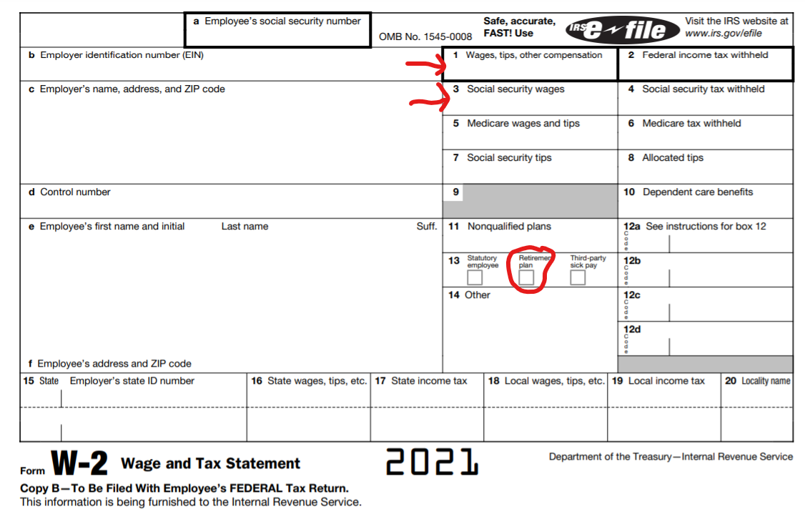

Slide 9
Individual Retirement Accounts (IRAs)
Applicable to all IRA plans
  Must have “earned income” to contribute (i.e. wages, commissions, self-employment income)
  Contribute lesser of $6000 or “earned income” ($7000 if age 50 or older)
  10% Penalty for withdrawals before age 59 ½*
*See exceptions to penalty later
More Info: https://www.irs.gov/pub/irs-pdf/p590a.pdf and https://www.irs.gov/publications/p590b

Slide 10
Traditional IRAs
Many are rollover IRAs from former jobs
If NEITHER the taxpayer nor spouse are eligible to participate in an employer plan the allowable deduction is allowed, regardless of income
If EITHER the taxpayer or spouse is eligible to participate in an employer plan there are limits on how much is DEDUCTABLE, BUT taxpayers can still CONTRIBUTE to a Traditional IRA regardless of income (aka a non-deductible traditional IRA).
Must start withdrawing a minimum amount at age 72 (aka Required Minimum Distributions or RMDs)
Withdrawals are taxable at taxpayer’s marginal rate

Slide 11
Roth IRAs
Roth contributions aren’t deductible, BUT there ARE income limits to who can CONTRIBUTE to a Roth IRA
5-year holding period needed for qualified distributions
No mandate to withdrawal at age 72
Qualified withdrawals are tax-free
More Info: Roth IRA vs. Traditional IRA: What's the Difference? Investopedia. https://www.investopedia.com/retirement/roth-vs-traditional-ira-which-is-right-for-you

Slide 12
IRA Withdrawal Ordering Rules
Traditional IRAs and Roth IRAs have different withdrawal ordering treatment
Traditional IRA’s
  Taxed at your marginal rate at retirement.
  Withdrawals before age 59 ½ are subject to penalty.
Roth IRA’s
  Withdrawals before age 59 ½ may NOT be subject to penalty because of ordering rules.
  1st - Contributions (subject to 5-year rule) – No tax, no penalty
  2nd - Conversions (subject to 5-year rule) – No tax, no penalty
  3rd – Earnings
    Qualified – No tax, no penalty
    Nonqualified – Taxed & penalized

Slide 13
Penalties on early distributions (IRAs)
Traditional IRAs and Roth IRAs have different withdrawal ordering rules that could impact penalties
The tax code allows taxpayers to waive the 10% penalty for withdrawal before age 59 ½ under certain circumstances
Employer Plans and IRAs have different exceptions to waive the 10% penalty

Slide 14
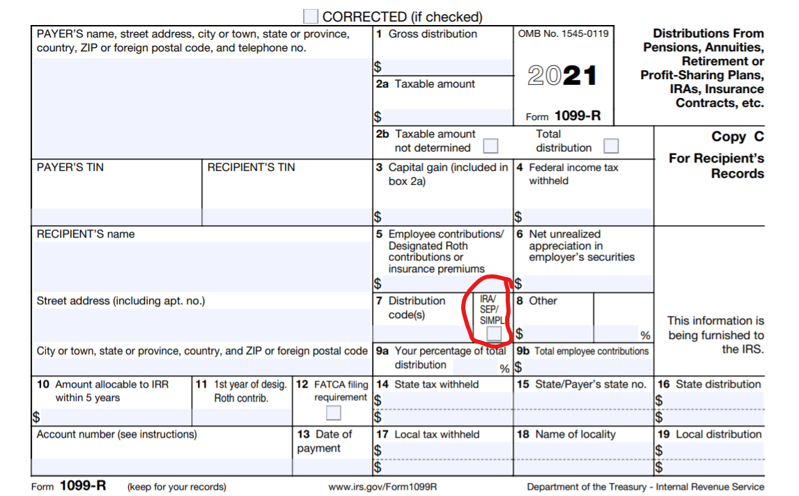

Slide 15
Terminology
Contributions: adding money to an account by sending cash, check, or direct payroll deferral
Transfers: change custodians but same type of account (i.e. traditional IRA in one company to traditional IRA in another) – no tax consequence
Rollovers: (change to different kind of account, but not tax character: i.e. pretax 401(k) → pretax traditional IRA) – no tax consequence
Conversions: (change tax character: i.e. pretax traditional IRA to after tax Roth IRA) – taxes due at conversion

Slide 16
Tax Diversification Options
Why consider Roth Options?
  Conventional wisdom: tax rates in retirement will be lower than while working.
  New reality: tax rates are at historic lows. There is a good chance they will increase in the future.
  It’s a way to hedge our bets.
More buckets = more flexibility = more opportunity

Slide 17
Tax Diversification Example
Assume Single person with $500k balance in each a Traditional IRA and Roth IRA. At retirement withdrawal $30K from each*
Item | Amount
Gross Income | $60,000
Less Roth Distribution(non-taxable) | ($30,000)
Adjusted Gross Income | $30,000
Standard Deduction | ($12,400)
Taxable Income | $18,600
Tax | $2,038
That’s an effective tax rate of 3.4%!
Tax would have been $6,488 if all had been taken from traditional IRA
More Info: 2020 Standard Deduction and 2020 Tax Brackets
*Social Security further complicates this scenario

Slide 18
Tax Diversification Strategies
Divert your next raise to Roth 401(k) or 403(b) plan
  Won’t notice the difference in take-home pay
Divert future contributions to Roth 401(k) or 403(b) plan
Contribute to a Roth IRA (Assuming you are eligible)
  Use tax refund to fund the account
  Contributions allowed up to April 15 for previous year
Convert some (not all) Traditional IRAs to Roths
  This can be done over several years – pay tax in small increments

Slide 19
Other Tax Strategies
Put higher risk / higher growth investments in Roths v. Traditional IRAs
  Diversify across all your tax buckets (i.e. 70% stocks and 30% bonds)
  Since Roths aren’t taxable when withdrawn, put growth investments (stocks and mutual funds) in there because that portfolio will grow more – tax free!
Back door Roth IRA (may go away soon)
Roth IRA for children
  Child needs earned income
  Get children in the savings mindset
  Can use for education without penalty

Slide 20
Other Tax Buckets
Social Security
Pension Plans
457 Plans
  State and Local governments
  No penalty if withdrawn before age 59 1/2
  Big catch-up provision in last 3 years of retirement

Slide 21
Other Tax Buckets
Self-Employment Plans (SEPs)
Stocks, Mutual Funds, ETFs (Capital Gains Tax Rates)
Bonds
Health Savings Accounts (HSAs)
529 College Savings Plans
Many others

Slide 22
Buckets = Flexibility = Opportunity

Slide 23
Tax Preparation Help – Types of Preparers
Representation Rights
  Attorneys
  CPAs
  Enrolled Agents
Limited or No Representation Rights
  Annual Filing Season Program Participants
  Other PTIN Holders Tax Professionals

Slide 24
Tools and Tips
IRS Tools
  Where’s my refund?
  IRS Account
  Find a tax professional
Tips for upcoming tax season
  Advanced Child tax credit
  Cryptocurrency
  Charitable contributions

Slide 25
Homework
Learn the tax code!
Check your employer to see if they offer a Roth option
Take inventory of your savings and retirement accounts
Identify areas where diversification makes sense
Speak to your IRA, 401(k), or 403(b) custodian about different tax vehicle options

Slide 26
Questions

Slide 27
Tax Diversification Strategies and Tax Research
2021 MichALL Fall Education Meeting, 11/12/21
Joel Scheuher, MILS
Business Librarian
University of Michigan
Kresge Business Library
Ann Arbor, MI
jscheuhe@umich.edu
734-647-0469
Joel Scheuher, EA, MBA
Tax Preparation Specialist
Knepp & Associates Tax Service
Livonia, MI
joel@knepptax.com
734-953-9478

