Slide 1
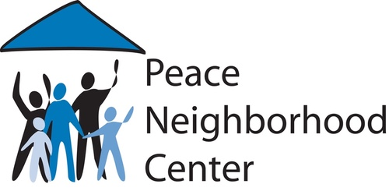

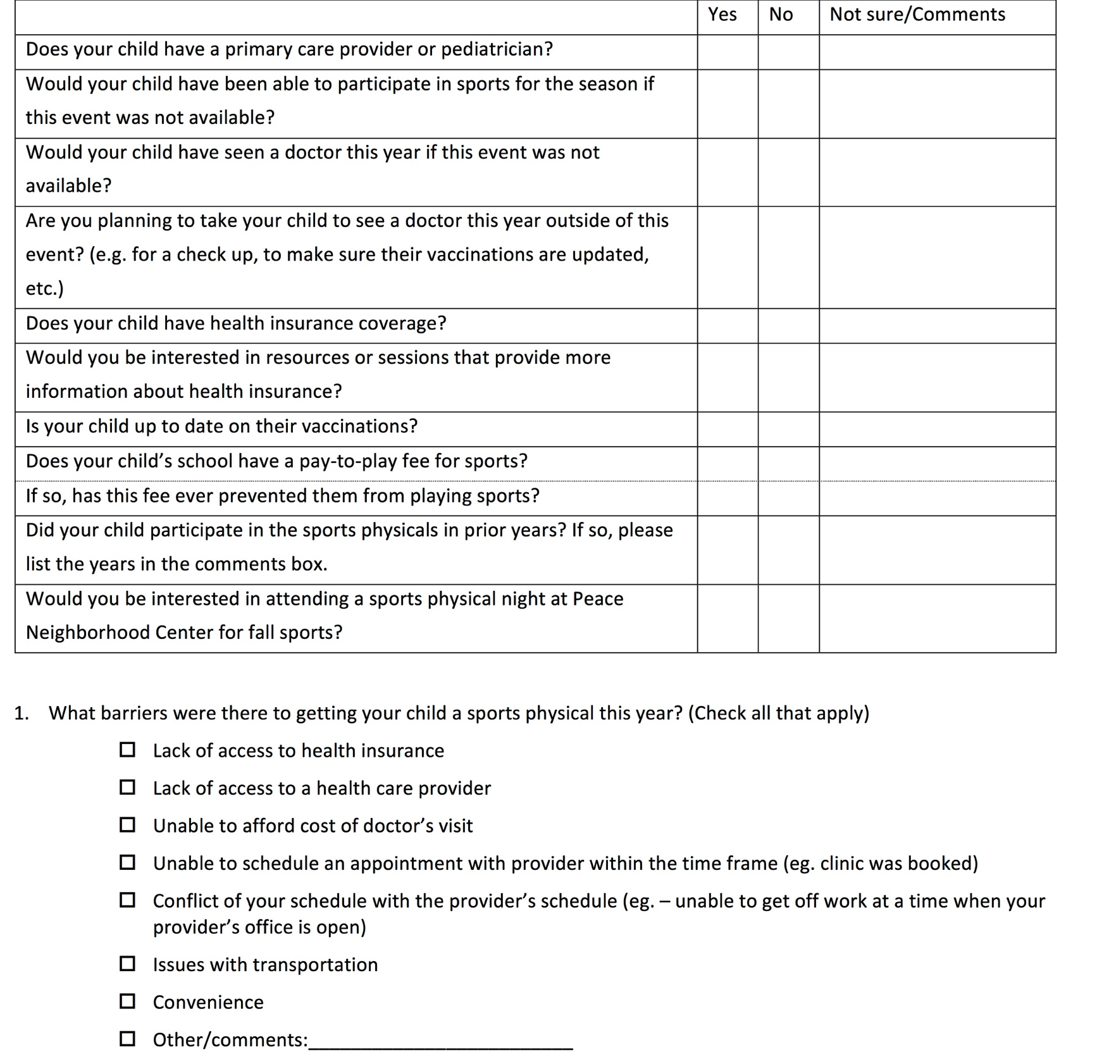
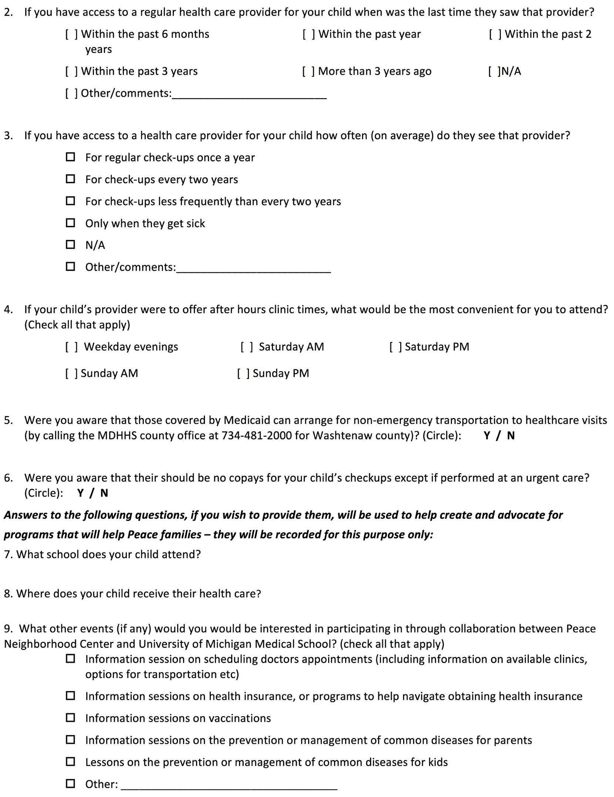
On-site preparticipation sports physicals project and impact on community health
Katherine Selwa
Introduction
Results
Limitations
This capstone project began during a meeting with Peace Neighborhood Center, an after-school program for underprivileged children in Ann Arbor. Leaders at PNC inquired about the possibility of a sports physical clinic as they noted that they had noticed many students unable to participate in school sports due to guardians not being able to bring them to a clinic for a pre-participation physical. I led the implementation of a free sports physical clinic at PNC with help from medical student and physician volunteers, and carried this over into an annual recurring event with plan-do-study-act cycles for improving the event each year.
Survey Questions:
All participants: | 15/16 participants:
- Would have seen a doctor this year if this event were not available | - Have a PCP
- Planned to see a doctor this year for a checkup outside of this event | - Would have been able to participate in sports if not for this event
- Have health insurance coverage
- Are up to date on vaccinations
While this study shows some useful information about the barriers to care in this population and the usefulness of on-site pre-participation sports physicals, the generalizability of this study to other populations is unknown. Barriers to health care are community-dependent, but the data presented here provide a helpful case study of a population.
Conclusions and future directions
None of the children involved in the 2019 sports physical clinic were relying on this event as their main source of care – this event appears to merely allow children and guardians more convenience and flexibility. There is room for education in this population with respect to matters of scheduling appointments, frequency of check-ups, availability, and cost – as well as discussion with some of the reported sources of care to see if offering weekday night clinic during busy times may help address this access issue.
Future directions include taking further steps to address the barriers to care described here. Specifically, an educational session for guardians will be added to this year’s clinic to discuss the logistics of scheduling clinic visits for children, including discussion of how far in advance appointments should be scheduled, a list of available clinics in the area and their extended “sports physical” hours if applicable, discussion of options for transportation, and addressing misconceptions about cost of visits and some matters of general health care literacy. I will also discuss the data on preferred times for extended clinic hours in this population with the pediatrics department. Finally, before graduation it will be ensured that appropriate protocol is in place to continue the hand-off of leadership for continuation of this event.
Disclosures
None
Background
During a study cycle while looking into the impact of such programs, our team discovered that concerns have been published that free onsite pre-participation sports physical clinics may lead to overreliance on such events for medical care in vulnerable communities [1]. Based on what we had already learned about the community making use of this event at PNC, we hypothesized that this may not the case for this particular group of students. We strove to make sure that our event addressed these concerns and was beneficial for the community, and we wanted to better characterize the barriers and social determinants of health faced to better meet the needs of the community.
Objectives
- To determine what barriers prevent the population of students attending Peace Neighborhood Center from getting sports physicals.
- To determine whether offering free on-site preparticipation sports physicals is beneficial to this community.
- To discuss methods for addressing the health care barriers faced by this community.
Reflection
I have volunteered with Peace Neighborhood Center in the past and it was a real pleasure to work with them again in the context of this project as a medical student. It was a rewarding challenge to work on implementing this project as an answer to a need they had observed. Working with my collaborators to solve the issues we encountered helped me grow as a leader and a team member. I appreciated the opportunity to dive deeper into the context of such events and think critically about the ways in which they can impact communities. I am looking forward to using data presented here to further optimize the way we can serve the community.
Methods
An IRB was submitted and approved for collecting anonymized survey data from parents and guardians of the children attending this event as part of a formal needs assessment.
For the sports physical clinic, physician volunteers were recruited to perform the physicals and medical student volunteers were recruited to take vitals and assist in the filling out of forms. Supplies were acquired to turn three private rooms at Peace Neighborhood Center into clinic rooms.
Acknowledgements
Dr. Brent Williams was an invaluable mentor throughout the process. I would like to thank our physician volunteers without whom this clinic would not be possible - including the kind cohort of Dr. Andrew Barnosky, Dr. Keith Aaronson and Dr. Linda Balogh who volunteered their time in the first year for an unproven event. I would like to thank Dr. Kelly Orringer from the department of pediatrics for meeting with me to discuss her perspectives on free sports physical clinics and her advice on future directions and useful survey questions. Jessica Williams, a fellow medical student, worked closely with me on this project and was a great source of help and advice. Grace Carey, Clare Jacobson and Sarah Jabour assisted with the preparation of the IRB and survey questions and led the event in its third year. Nicole Mott and Daniel Brooks led the event in its second year. Luc Overholt, Jonathan Melendez, Nikki Khandwala and Anicia Mirchandani also assisted with the project in the year of its inception. Finally, thank you to Kenya Jackson and MaryAnn Meyers Johnson at Peace Neighborhood Center for their collaboration.
References: [1] Orringer, Kelly. “It’s (sports) physical time” U-M Northville Health Center. Patch. Aug 13 2014 https://patch.com/michigan/novi/its-sports-physical-time

