Slide 1

Reducing contact precautions for patients with a history of MRSA/VRE
Claire Shea, MPH
Period 8 Hospitalist Sub-I

Slide 2
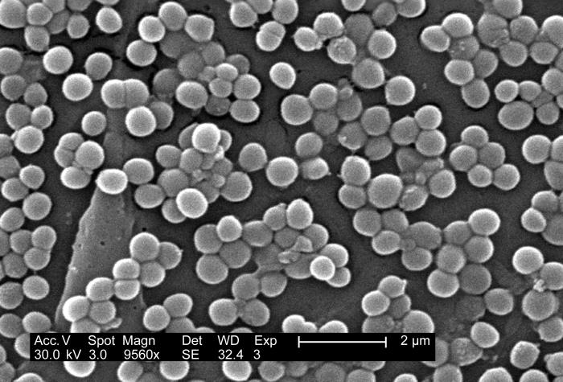
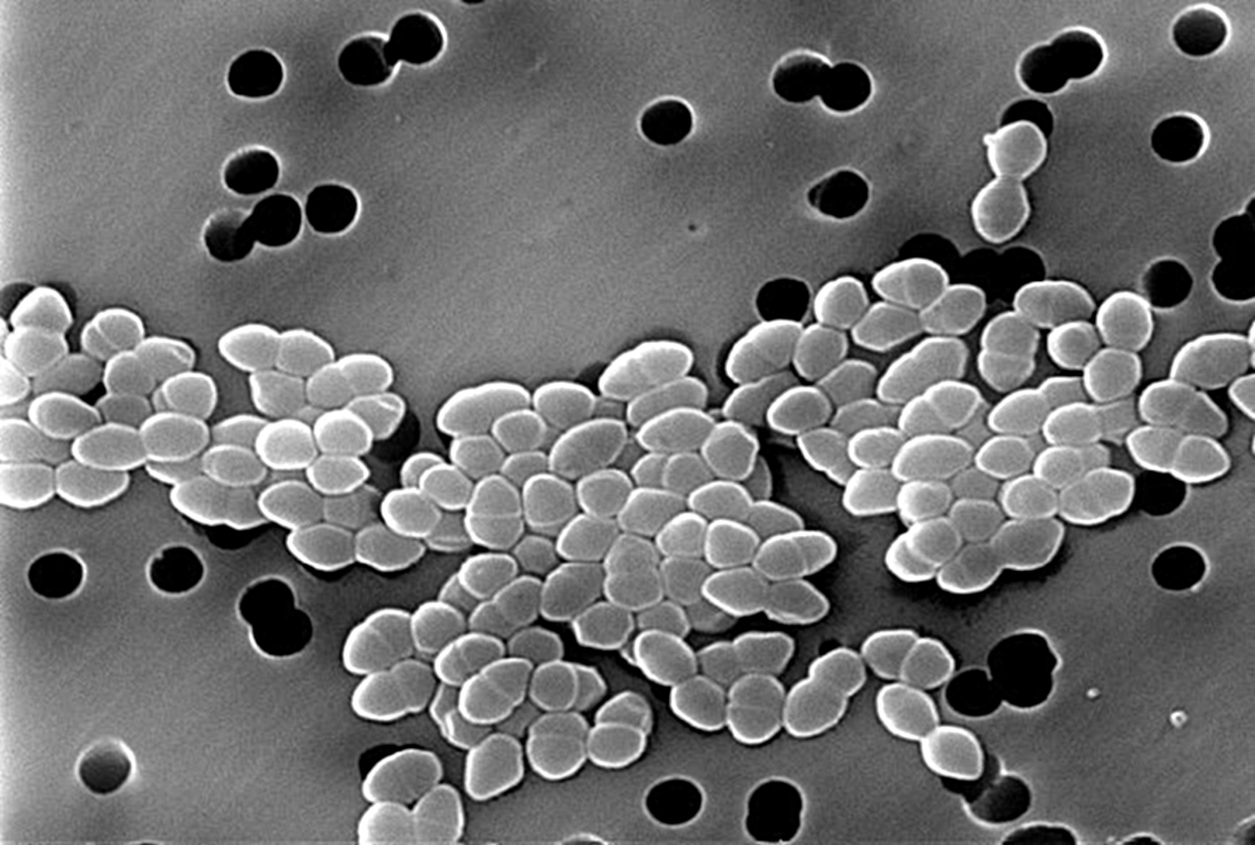
Methicillin-resistant Staph aureus
  Colonizes skin and nares
  Transmitted via contact with colonized individual or fomite
Vancomycin-resistant enterococci
  Colonizes GI tract
  Transmitted via contact with colonized individual
Notes:
Oldest MDROs and most studied; things like ESBL or CRE are too novel, and thus most institutions default to CP out of an abundance of caution.

Slide 3
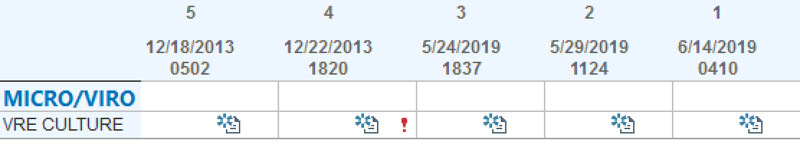
Case Study
79 year old male admitted for a CHF exacerbation. Placed on contact precautions for VRE due to a positive rectal swab from 2013, now with 3 negative rectal swabs.
Does this patient require contact precautions?

Slide 4
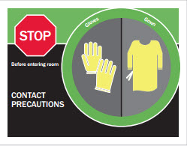
Why do we care?
Contact precautions:
  Decrease time spent in room with patients by healthcare workers
  Create delays at admission with bed placement
  Increase patient anxiety and depression
  Decrease patient satisfaction with care
  Make adverse events six times more likely (including falls, pressure ulcers, post-op hematoma)
Notes:
Why not just put patients on CP? Isn’t it better to be safe than sorry? Can you guys think of some of the negative aspects of being on CP?
It’s not benign to have people on contact precautions unnecessarily- other aspects of patient care may be compromised.
So, it’s really important to identify who exactly needs to be on contact and who doesn’t.
Changes everyone’s behavior- nurses, meal deliverer’s gowns.
How many gowns used?

Slide 5


Background
CDC recommended CP after prior studies demonstrated their effectiveness during acute outbreaks of transmissible infections.
They were included in bundles alongside interventions such as:
Hand hygiene
Chlorhexidine gluconate bathing
Isolation/cohorting
Environmental decontamination
Notes:
What is the data supporting contact precautions? Are they actually useful in reducing transmission of infections?
CDC started recommending CP after data demonstrated their effectiveness during outbreaks of infections- where rates are higher than normal. They were also introduced as a bundle along with several other infection control interventions like hand hygiene, chlorhexidine bathing, isolation (giving patient own room) or cohorting (putting patients with same infection in same room), and environmental decontamination (cleaning rooms between patients).

Slide 6
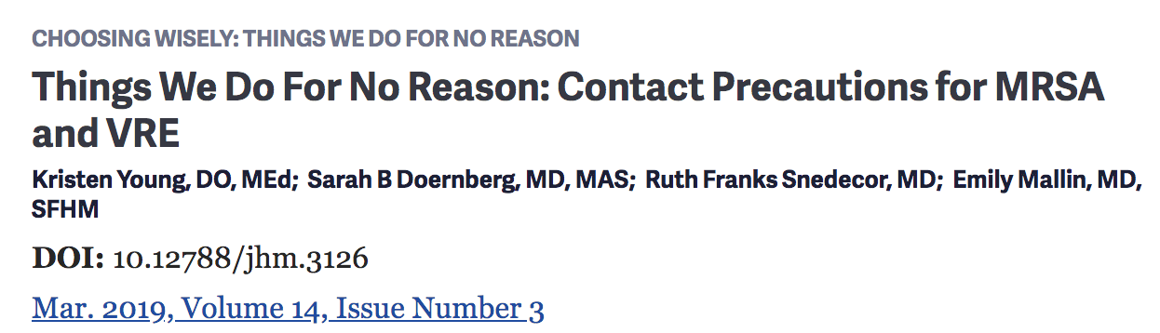
Background
However, data demonstrating that gowning/gloving alone decrease transmission of endemic MRSA and VRE are limited.
Notes:
It’s still unclear how much gowning/gloving as an intervention by itself can decrease transmission of things like MRSA and VRE, and it hasn’t really been studied in endemic situation or non-outbreak scenarios (meaning there’s just a stable, baseline rate of MRSA or VRE)
If you guys are familiar with the “Choosing Wisely” campaign, this was featured in the March Issue

Slide 7
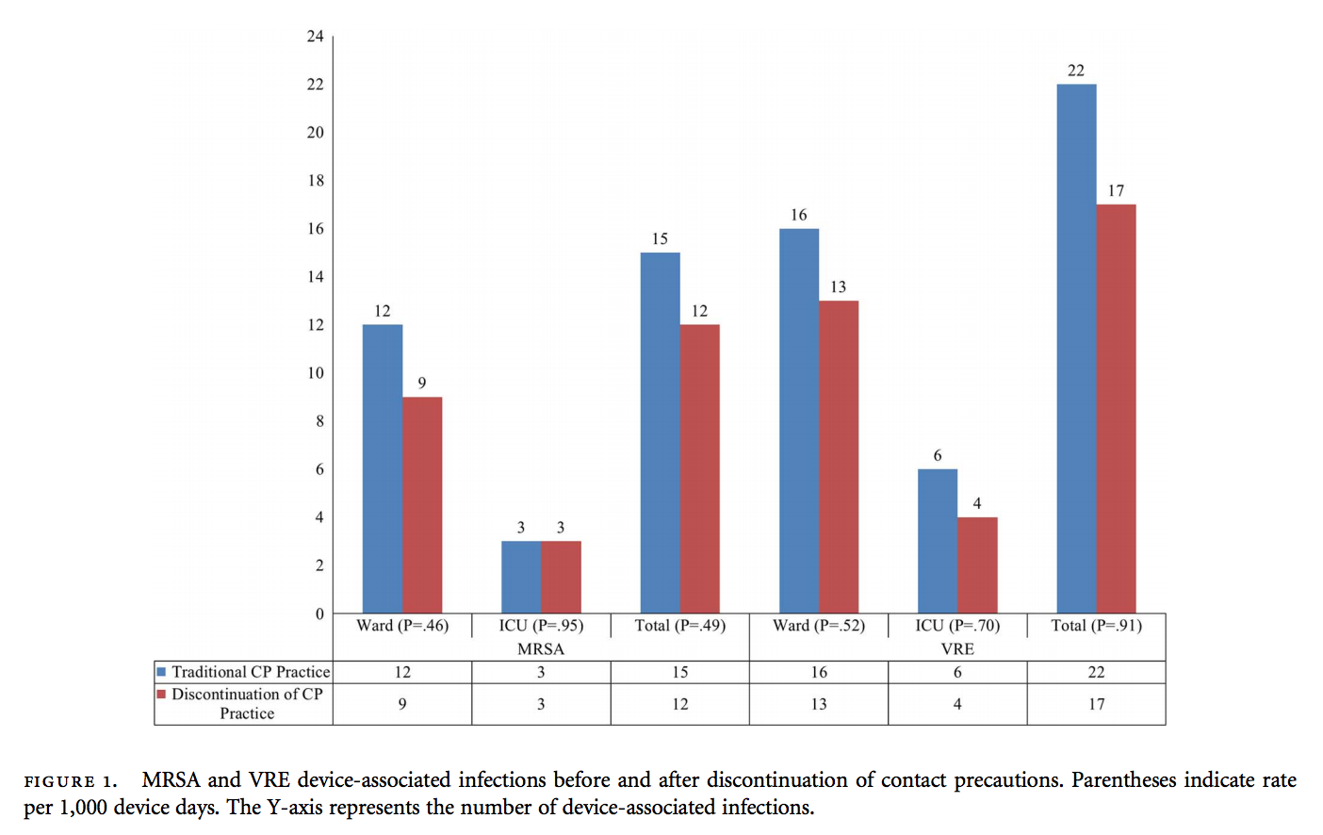
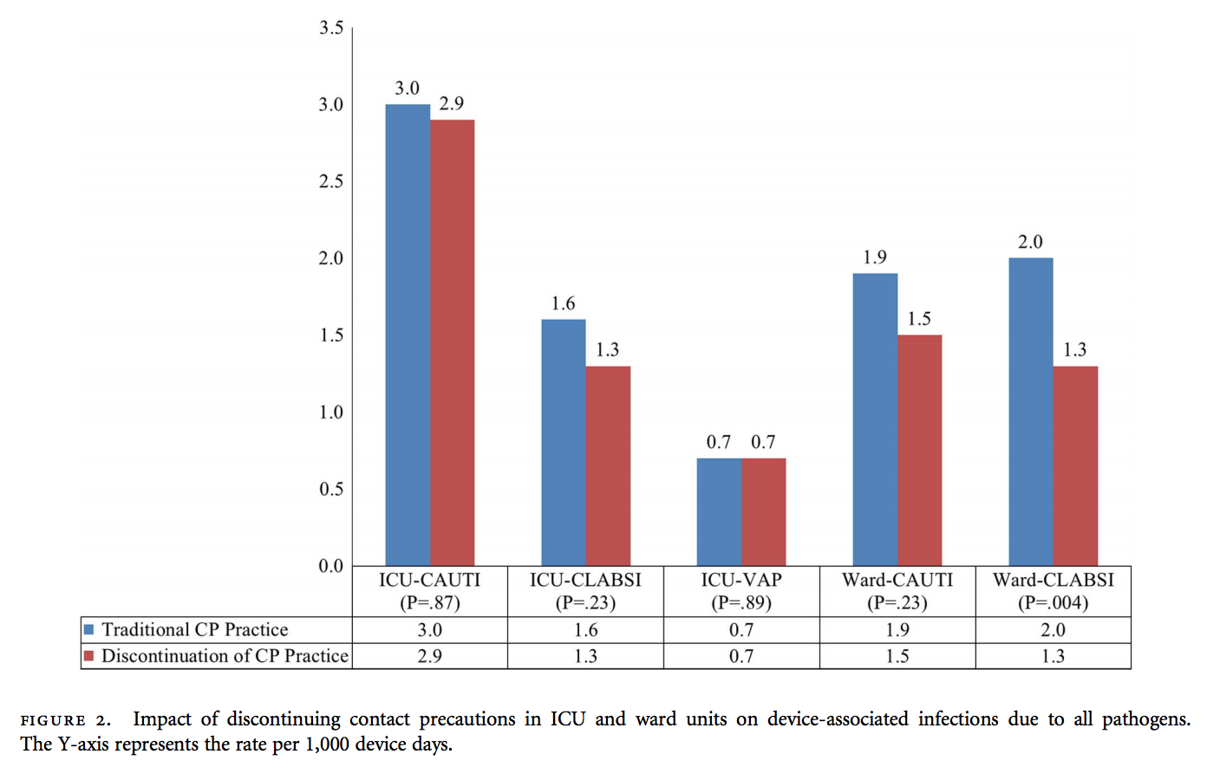
Background
Impact of discontinuing CPs for patients with MRSA and VRE infection/colonization on device-associated healthcare-acquired infections at VCU:
No increase in the rates of MRSA or VRE
No increase in the rates of CAUTI, CLABSI, or VAP
Notes:
A couple studies sought to tease out the contribution of gowning/gloving to infection transmission by discontinuing them, and then observing whether rates increase afterward.
In this study at VCU (800 bed academic hospital), discontinued CP for MRSA and VRE unless the patient had an open draining wound, and other infection control strategies were continued like hand hygiene and daily chlorhexidine bathing of patients.
Saw No increase in rates of MRSA or VRE, and no increase in rates of device-associated infections like CAUTI, CLABSI, and VAP in both ICU and ward settings. Actually saw a decrease in CLABSI in the ward setting after CPs were discontinued

Slide 8
Background
Impact of discontinuing routine CP for endemic MRSA and VRE on healthcare-acquired infection rates:
  Ronald Reagan UCLA and Santa Monica UCLA medical centers
  No increase in MRSA or VRE rates at either hospital after CP were discontinued
  Cost savings of $643,776 from decreased isolation gown usage
  Total nursing time spent in 1 year donning PPE for MRSA and VRE was more than 45,000 hours (mean donning time 38 seconds)
Notes:
*Endemic meaning a non-outbreak setting, with stable baseline rates of MRSA and VRE
Retrospective, non-randomized, observational, quasi-experimental study comparing clinical culture rates at both hospitals before and after the CP policy change
Prior to change, patients were placed on CP for active disease, history of, or positive surveillance screening. Afterward, CP were not required for MRSA or VRE unless draining wounds were present. CP were still required for MDRO gram-negative infections and spore precautions for Cdiff.

Slide 9
Current State at U of M
  Change in guidelines in November 2018:
  MRSA: only patients with MRSA-positive open, draining wound infections require CP
  VRE: any positive specimen; remain in CP until one negative rectal swab/specimen
Notes:
Recognizing this growing data that gowning/gloving is not all that effective and that there are harms associated with CP, U of M recently changed its policy in November.
Do you know who is required to be on CP for MRSA at the U?
How about VRE?
For MRSA, contact is only required for MRSA-positive open draining wound, no longer just for a positive nasal swab
For VRE, only require one negative rectal swab instead of three.

Slide 10
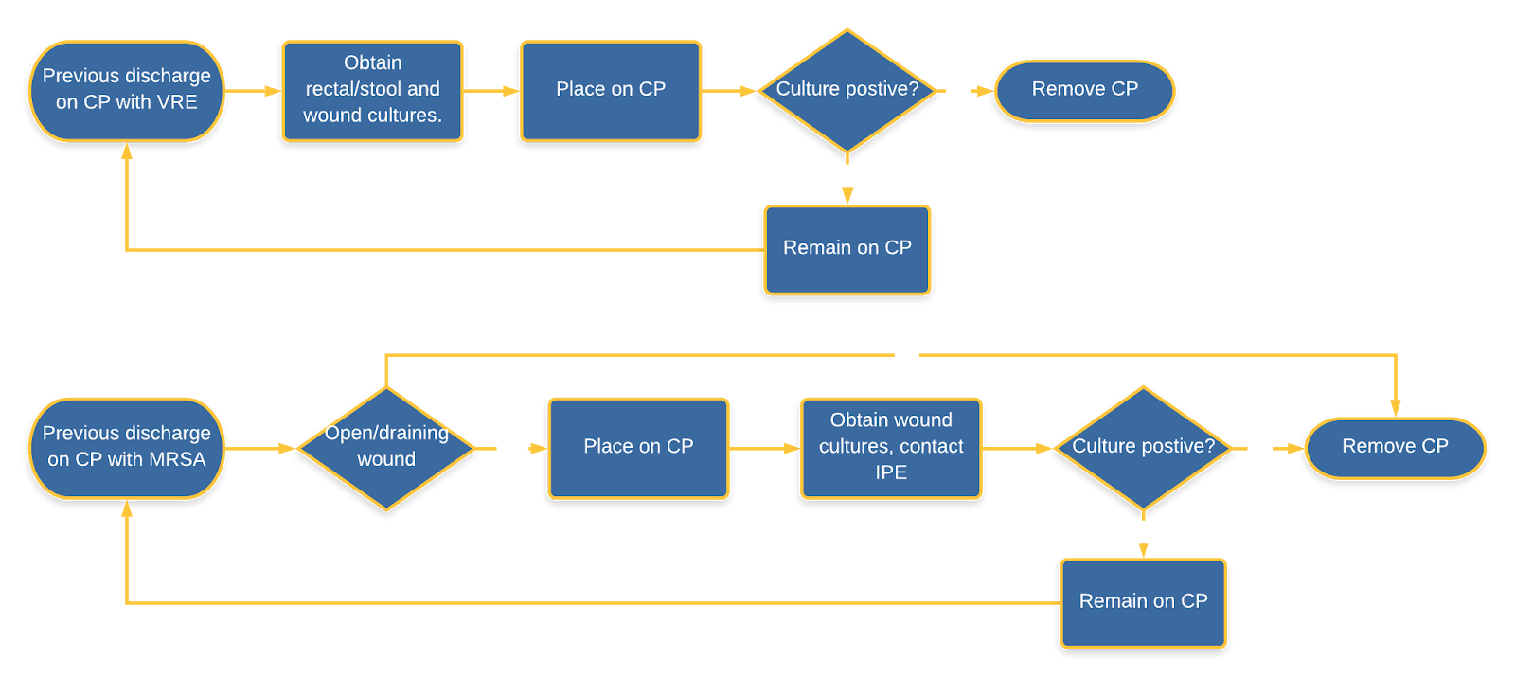
Current Guidelines at U of M
Notes:
Flowchart just to illustrate the process as it currently stands.

Slide 11
Current State at U of M
Currently, 30% (25/81) of patients at U of M on contact precautions for MRSA/VRE during the month of August were placed unnecessarily
Inconsistent CP ordering for MRSA
  4 patients with MRSA history but no open wound
  One patient with positive nasal swab but no open wound
Inappropriate CP ordering for VRE
  12 patients with VRE history but negative swab since; never removed from contact
  3 patients with VRE in UCx but clean urine since; never removed from contact
  5 patients with remote VRE (>1 year ago) but were never re-swabbed
Notes:
Seems to be some inertia surrounding this policy change, where practitioners are still applying the old guidelines.
Inconsistent ordering for MRSA
Inappropriate ordering for VRE for patients with clear evidence that they have cleared infection

Slide 12
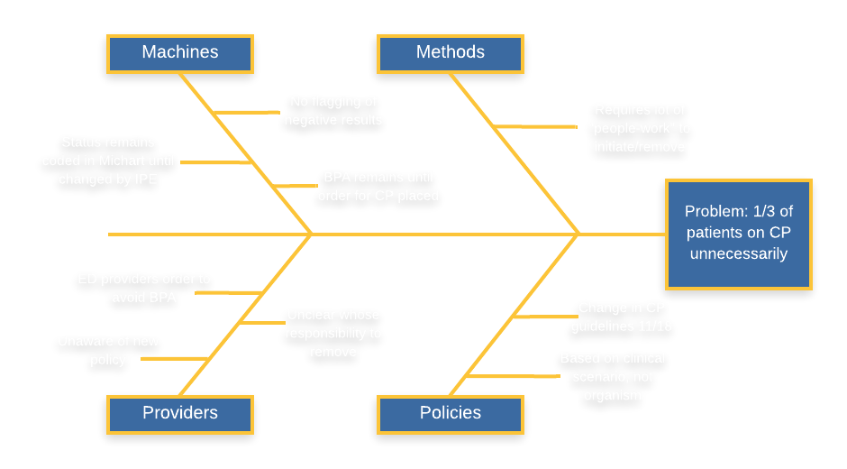
Root causes
Notes:
“pressure-points”/ root-cause analysis
Policy:
Recent policy change in November last year, seems to be some inertia in adopting largely due to unawareness on the provider’s part.
Policy is not clear-cut; requires application and thought, makes it easier to just opt into contact precautions rather than delineating whether they apply
Providers:
- ED providers place order to quiet BPA (even if they know CP may not be necessary)
- Physicians largely unaware of new policy
- Unclear whose responsibility to maintain or remove CP; placed by nursing, but then physicians would be required to order any follow-up or screening swabs (but this is not something we even really think about or are taught to do)
Machine/MiChart:
Infection status remains coded until removed by IPE
BPA cannot be bypassed until order is placed
Methods:
- Overall requires a lot of time and energy to recognize person no longer needs contact and then get them removed by IPE
Not really something physicians are taught or asked to think about, but really we are the ones responsible for placing removing.
With “no flagging of negative results” – this really belongs just on right side of A3, because then

Slide 13
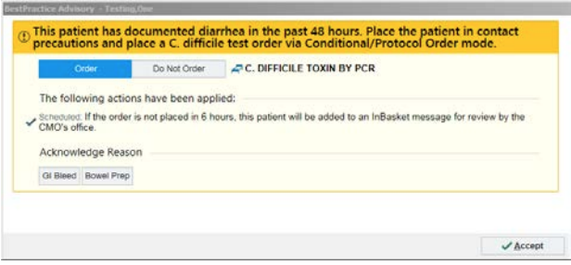

Counter-measures
Educate healthcare staff on current institutional guidelines
Screen patients re-admitted on CP for VRE with rectal swab
Flag when negative rectal VRE results
Automate process of removal (i.e. orderset requesting removal)
Allow ED staff to override BPA
Notes:
In development (that’s the project at the U)
24 isolation rooms that otherwise did not need to be occupied- cost savings associated with gowning for these patients, and systems issues that present with a full capacity hospital and bed crunch issues.
Matrix - Counter measures and which root cause do they address (A, B, C) then rate effort, impact, and feasibility for each.

Slide 14
Current State at the AA VA: Case study
70 year old male with history of PAD s/p right below knee amputation, admitted for cellulitis of the left foot. On contact precautions for MRSA identified from right fifth metatarsal bone culture from amputation in 2014, now with 4 negative MRSA nasal swabs. On antibiotics for cellulitis.
Does this patient require contact precautions?
Notes:
Yes- because nasal swabs have all been obtained while he’s on contact, even though presumably he’s no longer colonized and the MRSA-containing bone has been amputated.

Slide 15
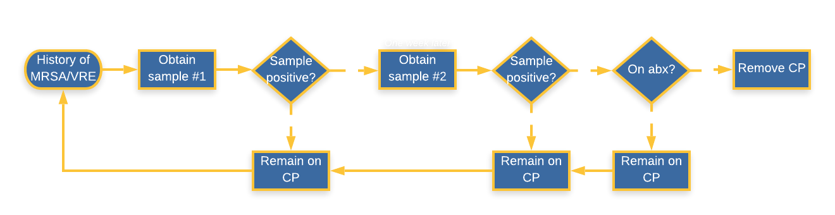
Current State at the AA VA
Notes:
After starting this project at the U, wanted to take a look at the situation at the VA.
Must be on contact precautions if colonized (i.e. with a positive nasal swab). Have to be here long enough to get two samples, and can’t be on antibiotics.

Slide 16
National VA Directive
 | Ann Arbor VA Policy | National VA Policy
MRSA | Patient re-admitted with any prior history of MRSA must be placed in CP CP may be discontinued after 2 sets of nasal swabs obtained one week apart are negative for MRSA, and are obtained at least one week after all antibiotics have been stopped. | Patient re-admitted with history of MRSA >12 months ago do not need to be placed in CP CP may be discontinued after 2 sets of nasal swabs obtained 12 hours apart are negative for MRSA. Patient does not have to be off antibiotics.
VRE | CP may be discontinued after 2 rectal swabs taken at least one week apart are negative, and are obtained at least one week after antibiotic treatment for VRE has been stopped.
Notes:
Currently national VA recommendation more lax than AA VA’s policy
Local VA can have more stringent policies in accordance with their local situation, but cannot be more liberal than national directive.
Our rate of MRSA colonization is on par with national rate of ~7%, so no reason to argue that we would need more stringent policies at this point. In a non-epidemic scenario.
There is recognition at the VA here recognizing that its too difficult to get people off of contact- presenting problems with bed crunch, etc. Ultimately up to our MDRO coordinator, Jacob John. Change is currently in the pipeline; will require voting and approval by 2 committees. Expected to be approved just fine because will ultimately free up beds for the hospital.

Slide 17
Recommendations
Liberalize AA VA policy to align with National VA policy for MRSA
Culture change to emphasize that infection control is everyone’s responsibility
Educate staff regarding policy change (e.g. nursing huddle, morning report announcements)
Automate ordering of nasal swabs q12h x1
Notes:
As we think about this transition to the more lax policy, to ensure a smooth transition when this rolls out,
Education→ culture change that it’s everyone’s responsibility, not just nursing since they typically place the order
Automated order to put in two sets of swabs

Slide 18
References
CDC (2017) Public Health Image Library. https://phil.cdc.gov/default.aspx
Edmond et al. (2015) “The Impact of Discontinuing Contact Precautions for VRE and MRSA on Device-Associated Infections” Infection Control & Hospital Epidemiology. 36 (8): 978-980
Marra et al. (2018). “Discontinuing contact precautions for multidrug-resistant organisms: A systematic literature review and meta-analysis.” A J Infec Con 46:333-40
Martin et al. (2016) “Elimination of Routine Contact Precautions for Endemic Methicillin-Resistant Staphylococcus aureus and Vancomycin-Resistant Enterococcus: A Retrospective Quasi-Experimental Study.” Infect Control Hosp Epidemiol. 37(11):1323-1330
UMHHC Infection Control Policy (2018) Contact Precautions (CP)/Contact Precautions Diarrheal (CP-D). http://www.med.umich.edu/i/ice/policies/umhhc_policies.html
VHA Directive 1131 (2017). Management of Infectious Diseases and Infection Prevention and Control Programs. https://www.va.gov/vhapublications/ViewPublication.asp?pub_ID=5616
Young et al. (2019) Things We Do For No Reason: Contact Precautions for MRSA and VRE. J Hosp Med 14:178-180.
Notes:
Plans: who will do what when? Step by step who will do what when? Diurese, with 40 mg Lasix.
Effort impact matrix – take counter-measures and array them. Impact (high low), then effort (low and high) low effort high impact do right away. What, who when. How will you allow ED providers override BPA-
Chief nursing information officer.
Infection control & epidemiology
Narrow the scope- non-ICU
Counter-measures and root causes may be different for someone re-admitted than for someone placed on during current hospitalization and then with a negative swab which then becomes removed. Narrow to just focus on those re-admitted on VRE from a prior swab. Can you narrow it to a certain geography of the hospital? Narrow it to just those who are re-admitted on VRE with a negative swab in a prior hospitalization.
Going to the gemba- where do I need to go to observe this process. Who’s cooperation do I need and how can I get this A3 in front of them? Nurse manager in the ED? Jennifer Holmes- wonderful lean practitioner.

