Slide 1
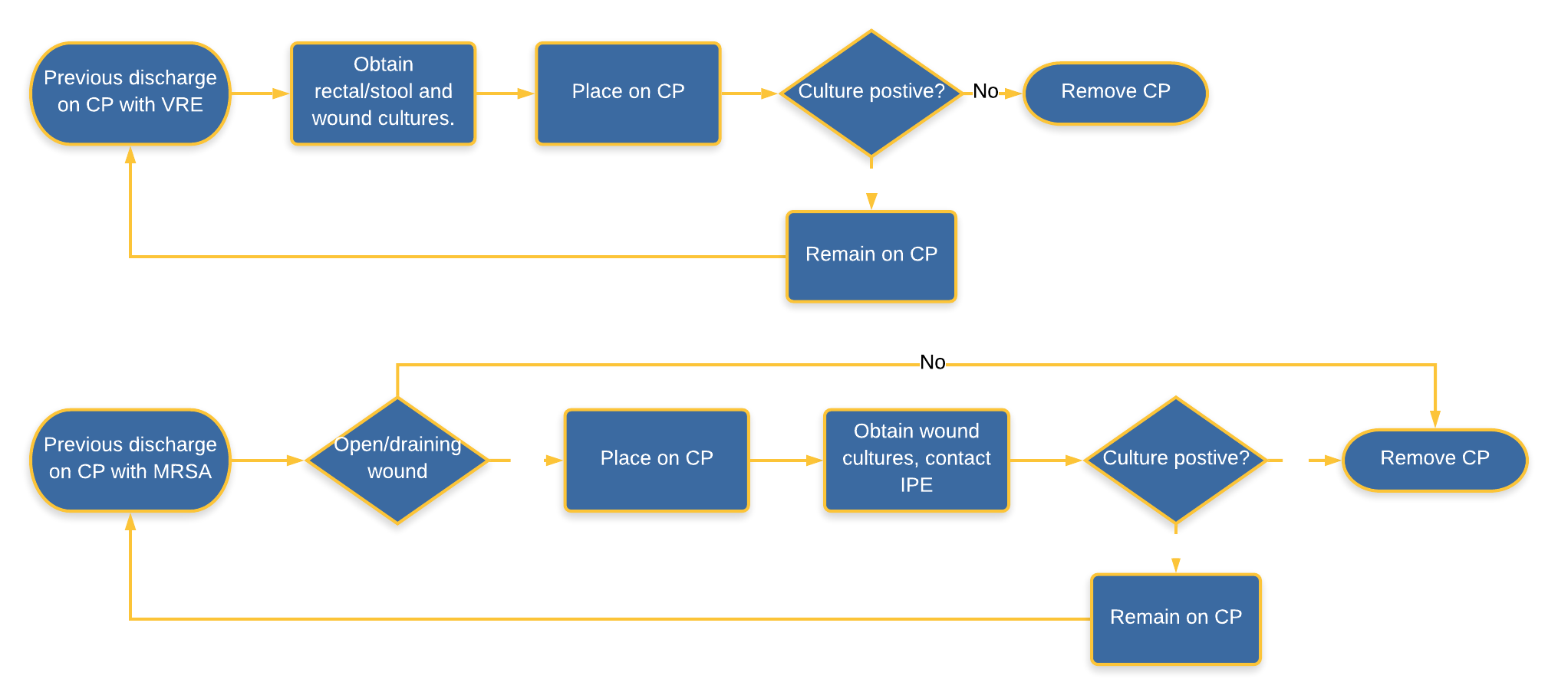
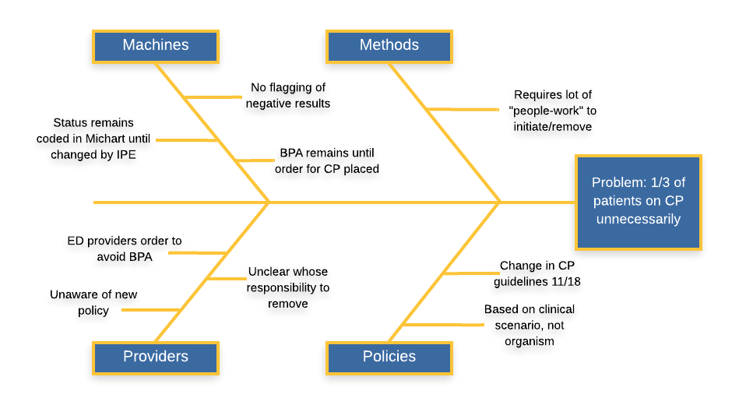
Reducing contact precautions for patients with a history of VRE/MRSA
Claire Shea, MPH
University of Michigan Medical School
Background
Methods and Materials
Results
Discussion
Contact precautions (CP) for patients with vancomycin-resistant Enterococcus (VRE) and methicillin-resistant Staphylococcus aureus (MRSA) infections are common in many health systems. The Center for Disease Control recommended CP after prior studies demonstrated their effectiveness during outbreaks of transmissible infections alongside a bundle of interventions, including hand hygiene, chlorhexidine bathing, room isolation, and environmental decontamination¹. However, data demonstrating that gowning and gloving alone decrease transmission of endemic MRSA and VRE are limited. Studies at several large academic medical centers have shown that rates of transmission of MRSA and VRE were not impacted by the discontinuation of CP when other horizontal preventions were continued^{2,3,4}.
CP can adversely affect patient outcomes and have been shown to decrease the amount of time spent in-room with patients by healthcare workers, increase patient anxiety and depression, decrease patient satisfaction with care, and create delays at admission with bed placement¹. Adverse events including falls, pressure ulcers, and post-op hematoma development are six times more likely for patients placed on CP⁵.
In November 2018 the Michigan Medicine CP guidelines for MRSA and VRE changed⁶. Currently for MRSA, only patients with a MRSA-positive open and draining wound require CP (formerly, any positive culture specimen required CP). Currently for VRE, any positive specimen requires CP and one negative specimen is required for discontinuation (formerly, three negative specimens were required to discontinue CP). Despite this change, many patients are still being placed on CP per the old guidelines, resulting in a significant number of patients on CP unnecessarily.
Chart review was conducted for patients admitted to Michigan Medicine in August 2019 and placed on CP for either VRE or MRSA alone (i.e. no other concurrent infections requiring CP). Patients were categorized as having appropriate or inappropriate CP depending on whether their status adhered to the current Michigan Medicine guidelines (Figure 1).
Root cause analysis was performed after speaking with Infection Control & Epidemiology, physicians on the Hospitalist medicine service, and Emergency Department nursing staff (Figure 2).
In August 2019, 30% (25/81) of patients at Michigan Medicine on contact precautions for MRSA or VRE were placed unnecessarily (Chart 1).
Inconsistent CP ordering for MRSA:
4 patients with MRSA history but no open wound
1 patient with positive nasal swab but no open wound
Inappropriate CP ordering for VRE:
12 patients with VRE history but negative swab since; never removed from CP
3 patients with urine culture positive for VRE but clean urine since; never removed from CP
5 patients with remote VRE (>1 year) but never re-swabbed
Root cause analysis revealed several factors contributing to the propagation of inappropriate CP (Figure 2), including:
Inertia in adopting the new institutional guidelines due to unawareness on the part of the providers
Michart’s ‘best practice advisory’ prompting emergency department providers to order CP based on infection status from prior admissions
Removal of infection status coding in Michart requiring contact and approval by Infection Control & Epidemiology
Counter-measures will aim to address gaps at the ‘provider’ and ‘machine’ levels (Figure 2). Potential interventions include:
Educating healthcare staff on current institutional guidelines
Screening patients re-admitted on CP for VRE with rectal swabbing
Flagging in Michart when negative rectal VRE results to prompt providers to change infection coding status
Automating the process of infection status removal (e.g. Michart orderset sending change request to Infection Control & Epidemiology)
Allowing emergency department staff to override BPA
Figure 1: Process for VRE/MRSA contact precautions at Michigan Medicine
Chart 1. Appropriate and Inappropriate use of contact precautions for MRSA and VRE at Michigan Medicine, August 2019 (n = 81)
Figure 2. Root causes contributing to unnecessary contact precautions
Table 1. Classification of appropriate and inappropriate use of contact precautions for MRSA and VRE at Michigan Medicine, August 2019
References
Young et al. (2019) Things We Do For No Reason: Contact Precautions for MRSA and VRE. J Hosp Med 14:178-180.
Marra et al. (2018) “Discontinuing contact precautions for multidrug-resistant organisms: A systematic literature review and meta-analysis.” A J Infec Con 46:333-40
Martin et al. (2016) “Elimination of Routine Contact Precautions for Endemic Methicillin-Resistant Staphylococcus aureus and Vancomycin-Resistant Enterococcus: A Retrospective Quasi-Experimental Study.” Infect Control Hosp Epidemiol. 37(11):1323-1330
Bearman et al. (2018) “Impact of discontinuing contact precautions for methicillin-resistant Staphylococcus aureus and vancomycin-resistant Enterococcus: an interrupted time series analysis” Infect Control Hosp Epidemiol. 39(6):676-682.
Karki et al. (2013) “Patients under contact precautions have an increased risk of injuries and medication errors a retrospective cohort study” Infect Control Hosp Epidemiol. 34(10):1118-1120.
UMHHC Infection Control Policy (2018) Contact Precautions (CP)/Contact Precautions Diarrheal (CP-D). http://www.med.umich.edu/i/ice/policies/umhhc_policies.html
Edmond et al. (2015) “The Impact of Discontinuing Contact Precautions for VRE and MRSA on Device-Associated Infections” Infection Control & Hospital Epidemiology. 36 (8): 978-980
 | Appropriate CP | Inappropriate CP
MRSA | 26 | 5
Prior history; no open wound |  | 4
Positive nasal swab; no open wound |  | 1
VRE | 35 | 20
Prior positive rectal swab; negative swab since |  | 12
Prior positive urine culture; negative culture since |  | 3
Remote history (>1 yr), never re-swabbed |  | 5
Total | 56 | 25
Notes:
References: decontamination:
Continued: (12, 13, 14 from things we do for no reason- Marra AR, Martin EM, Bearman G)

