Slide 1


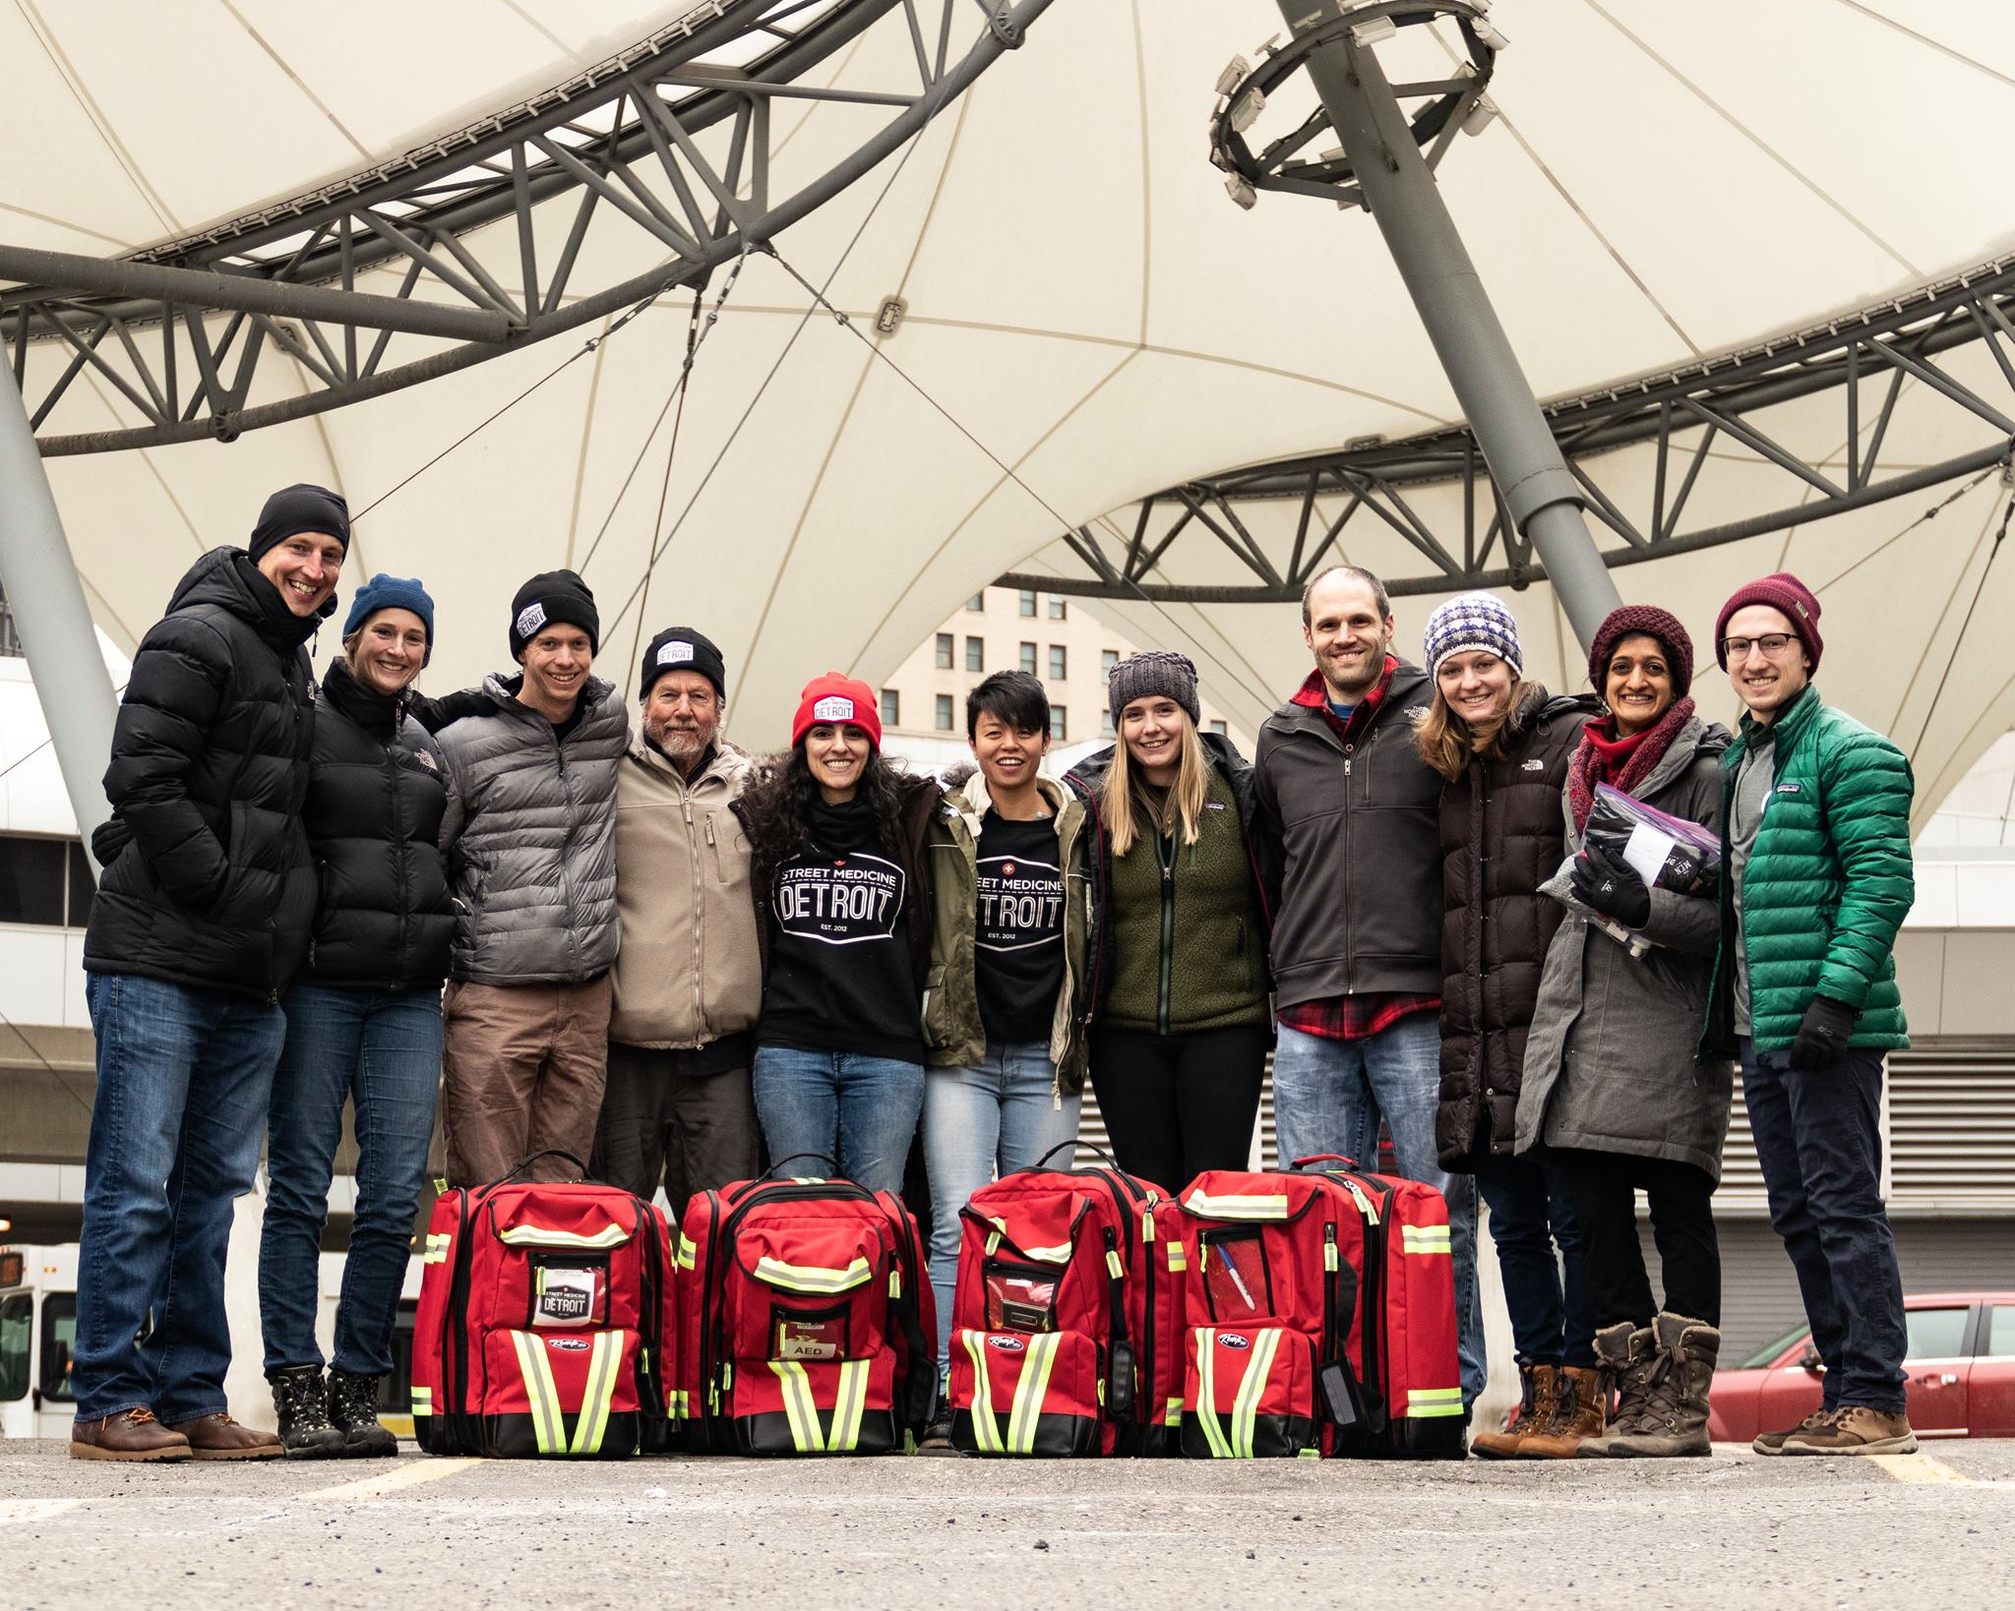
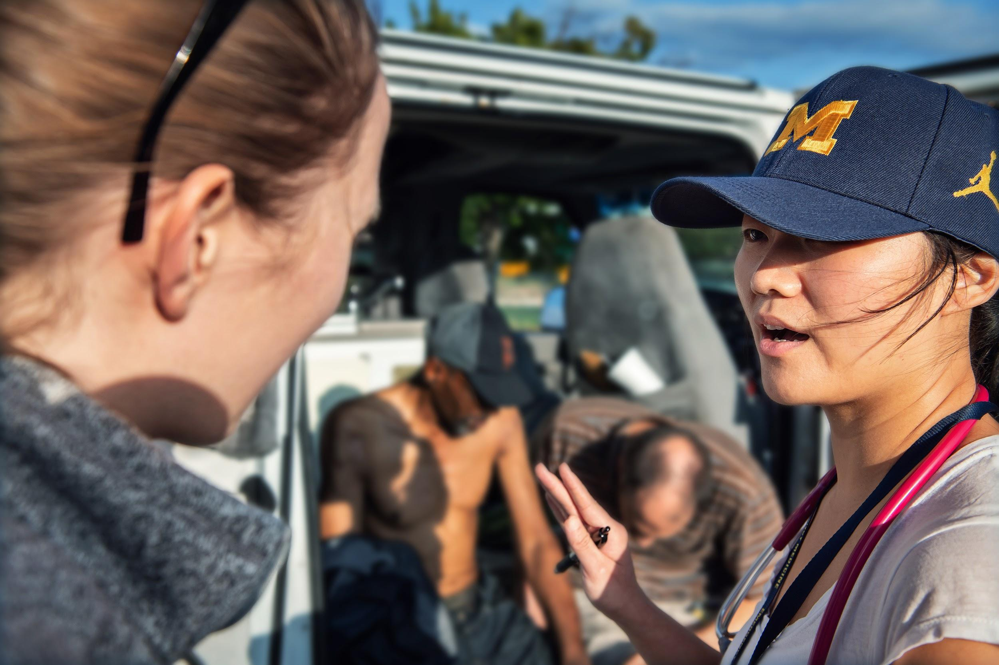
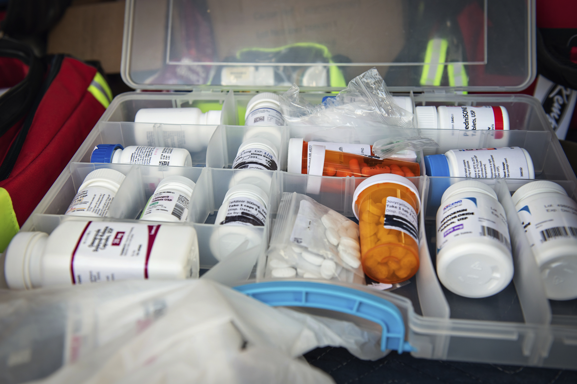
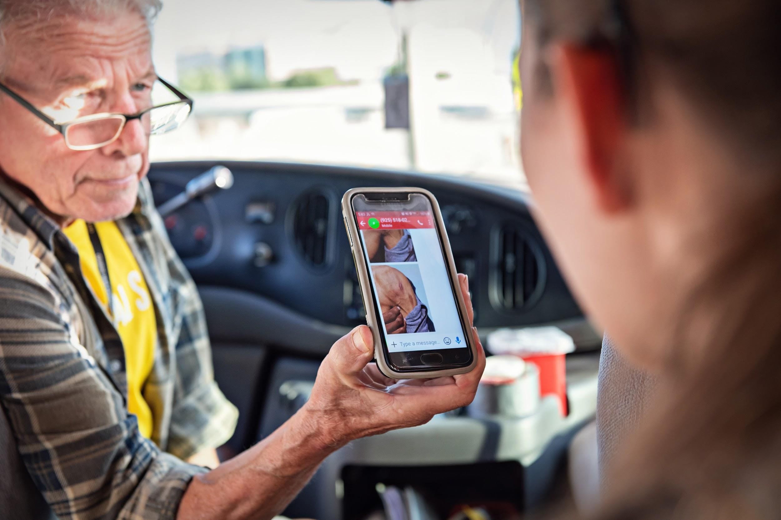
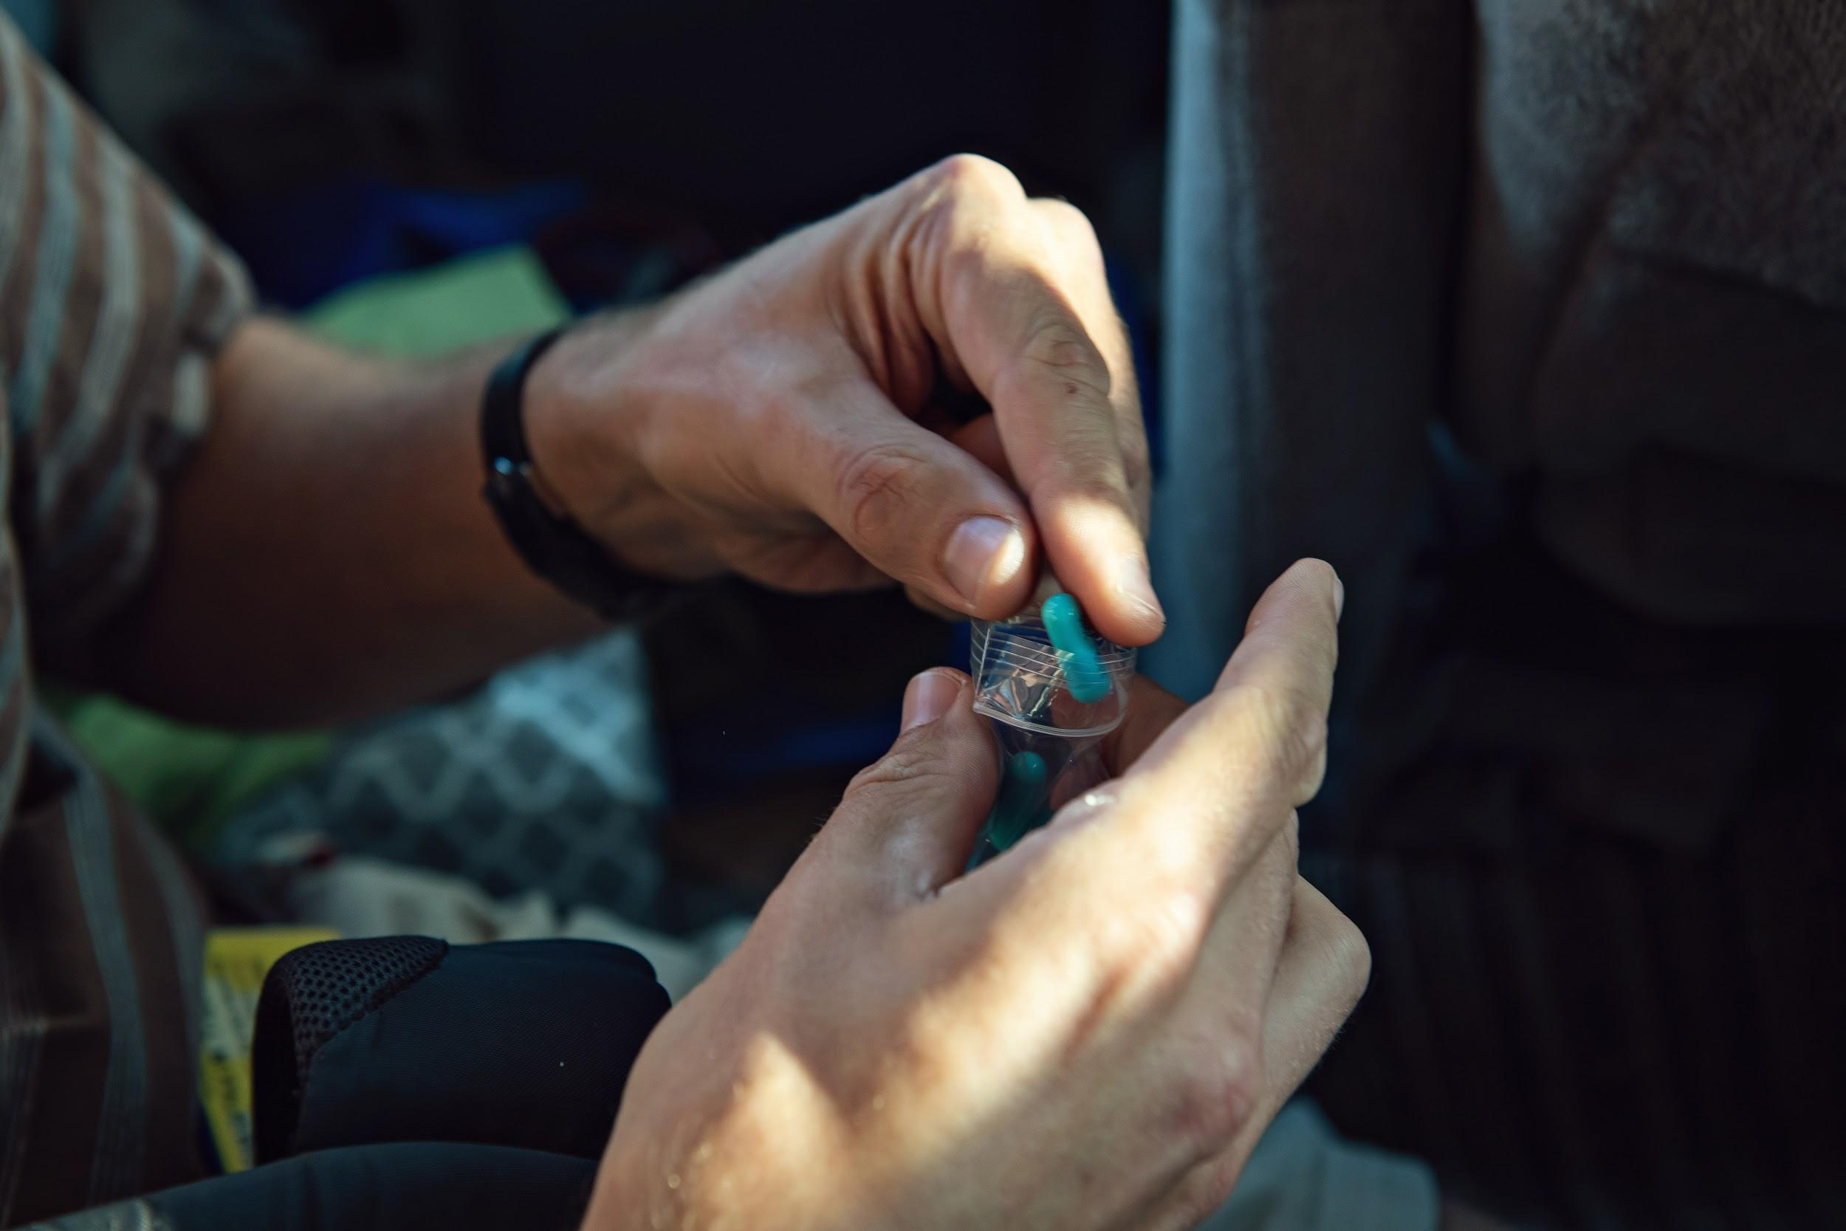
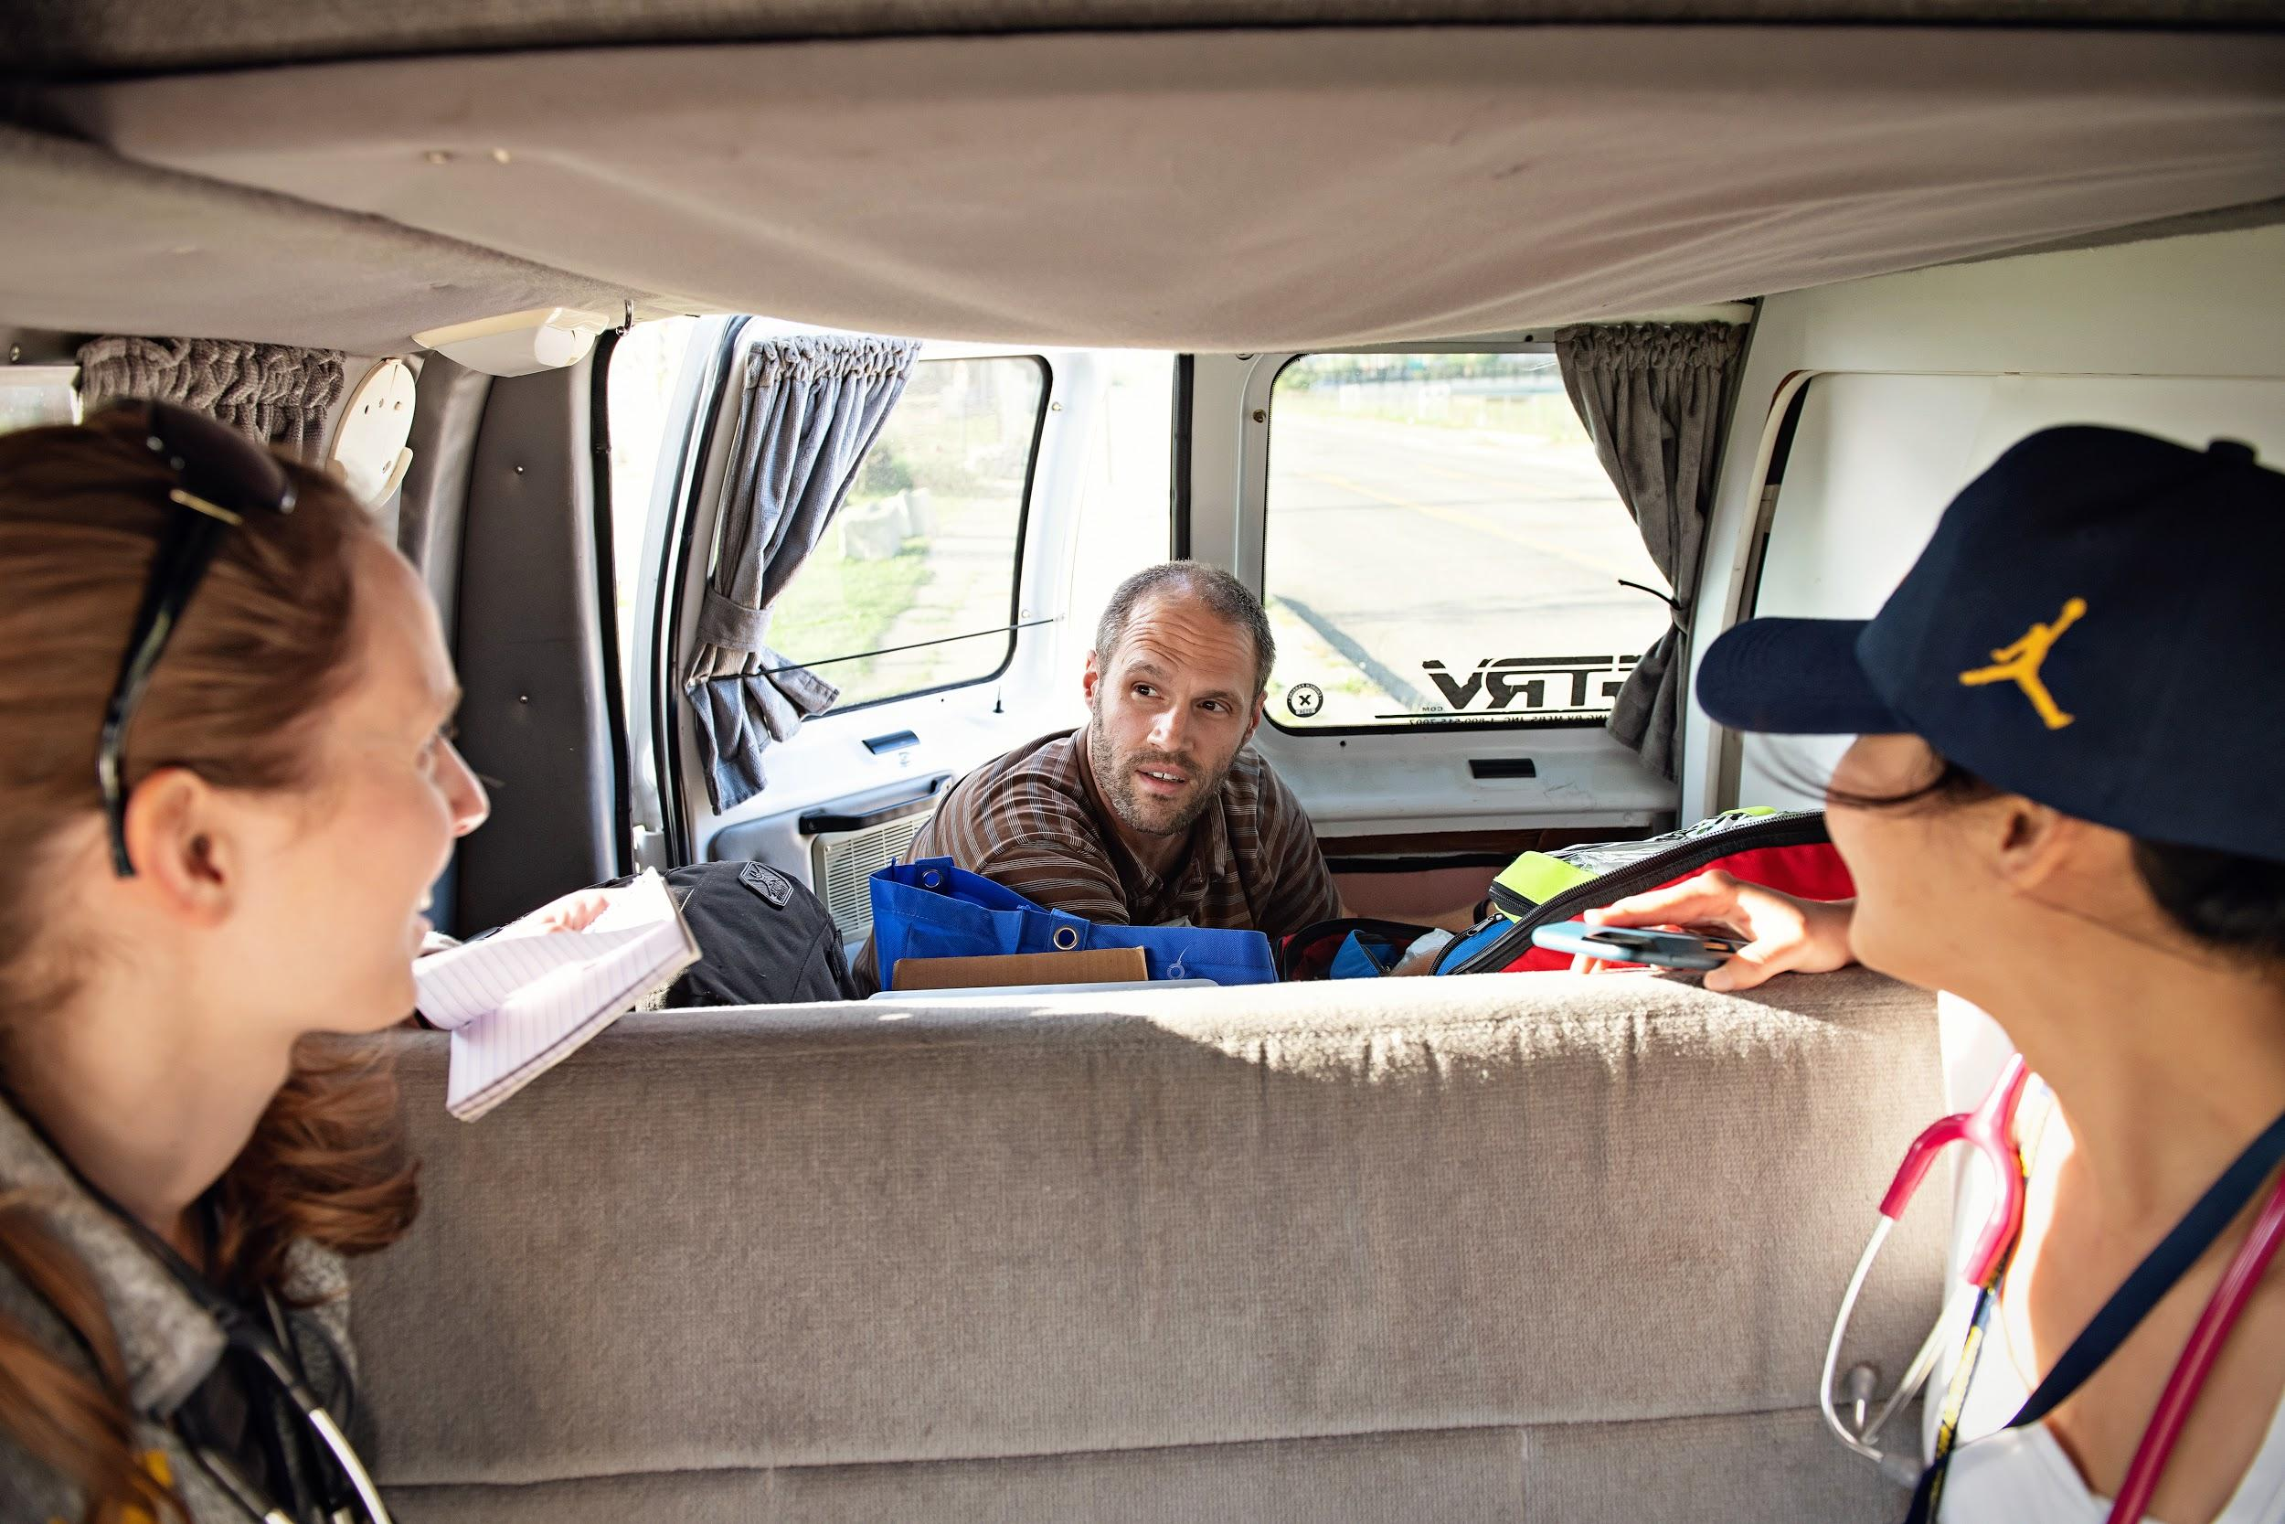

Wolverine Street Medicine:
Making Street Medicine Sustainable at UMMS
Casimir Klim, Jessica Winkels, Emily Zhao, Anita Vasudevan, Carol Noronha, Marissa Guo, Ruth Bishop, Molly Fessler, Gary Graca, Sarah Jabour, Allan Metz, Ellery Sarosi, Eric Steinbrook, Fred Ayers, Trista Benitez, Shannon Cahalan, Kenzie Corbin, Grace Frecentese, John Gerlach, Sarena Gill, Alyssa Hardin, Sonia Iyengar, Annie Li, Christian Mackey, Shay Nguyen, Chris Reynolds, Rebekah Sugarman, Jim Bastian RN, and Russ Pajewski, MD
BACKGROUND
2019 MILESTONES
FUTURE DIRECTIONS
Health and Homelessness
  Individuals experiencing homelessness have mortality rates up to 10 times that of the general population and are disproportionately affected by many common chronic diseases. They often struggle to access primary care and are more likely to seek care in the Emergency Department.
  Street Medicine Programs address the unique social and medical needs of people experiencing homelessness by providing care where patients live and gather.
  As of January 2019, conservative estimates project that there are 284 and 1965 unsheltered homeless individuals living in Washtenaw County and the metro-Detroit area, respectively.
Wolverine Street Medicine is a medical student organization founded in 2017 with a mission to improve the health of the homeless community, to incorporate education about the care of this population into the University of Michigan Medical School curriculum, and to raise awareness in the community regarding health issues associated with homelessness.
  Patient Care
    Street Runs – weekly opportunities for 3-4 preclinical and clinical students, along with a Michigan Medicine attending and nurse, to provide street-based medical care for homeless patients in Ann Arbor and Detroit
  Education
    Street Medicine - Healthcare for the Homeless – a WSM student-designed, 4-week clinical elective available to Branches students
    Lectures and seminars open to the entire medical school
ORGANIZATIONAL STRUCTURE
  Leadership Structure
    Established official student leadership roles – split among the M4 and M1 classes to ensure continuity of patient care and major projects
    Took steps to secure formal mentorship and oversight through a faculty advisor and faculty advisory board
  Organizational Identity
    Became a registered student organization in April 2019 and a sponsored student organization via the Department of Internal Medicine in September 2019
    Created a website, logo, and marketing materials to improve our ability to engage with the community
  Volunteer Recruitment and Training
    Formalized workflows around volunteer recruitment, training, scheduling, and retention; tripled our student volunteer base through these efforts
PATIENT CARE
  Partnered with Street Medicine Detroit and Detroit Street Care–nearby student-led street medicine organizations with whom we share patients–to improve continuity of care
  Successfully began transitioning to a new electronic medical record (EMR), which will allow for better tracking of patient data and access to shared patient information across partner street medicine organizations, as well as facilitate planned quality improvement projects
  Launched pop-up clinic nights at Neighborhood Service Organization (NSO) in Detroit
EDUCATION
  Elective - “Street Medicine - Healthcare for the Homeless”
    Created content for a 4-week clinical elective available to Branches students (first student registered in January 2020) – a significant amount of the student’s clinical time is spent on street runs
    Developed infrastructure for administering assignments and evaluating students, with responsibilities divided among student and faculty leadership
FUNDING AND RESOURCES
  Obtained significant medium-term funding via a grant from the Blue Cross Blue Shield of Michigan Foundation – will be used to fund a yearlong feasibility study examining how WSM treats HTN and T2DM longitudinally in our patients, as well as to purchase certain necessary supplies
  Formed an ongoing relationship with the Michigan Medicine Office of Development to facilitate identification of key sources of funding
  Implemented a process for inventory tracking and utilization of free and discounted supplies
ORGANIZATIONAL STRUCTURE
  Continue the process of formally integrating WSM into the framework of UMMS and Michigan Medicine
INTERPROFESSIONAL EDUCATION
  Further develop collaborative relationships with the School of Nursing and students of other allied health professions
PROVIDERS
  Recruit additional interdisciplinary faculty providers in order to expand our ability to provide patient care
QUALITY IMPROVEMENT AND RESEARCH
  Strive for continuous process improvement on our street runs to optimize delivery of patient care and student service-learning
  Utilize student and faculty feedback throughout the year as we make improvements to our clinical elective
  Complete research study (as described in 2019 timeline)
FUNDING AND SUPPORT
  Actively seeking medium- and long-term grant funding through various public and private sources
ACKNOWLEDGEMENTS
Ginsberg Foundation
Blue Cross Blue Shield of Michigan Foundation
Michigan Medicine Department of Internal Medicine
Michigan Medicine Office of Development
Washtenaw County Shelter Association
Washtenaw County Community Mental Health
Neighborhood Service Organization
HOPE Clinic
Drs. Mike Englesbe and Brent Williams
University of Michigan School of Nursing
Detroit Street Care (MSU)
Street Medicine Detroit (WSU)
Bhartiya Temple of Troy
Tony Mira and MiraMed Global Solutions
Ann Arbor Hockettes
2019 CHALLENGES: ACHIEVING SUSTAINABILITY
In early 2019, our organization was at a moment of transition. Outgoing student leaders had made strides towards fulfilling our mission, bringing on Dr. Russ Pajewski–who leads street runs and serves as our medical director–and obtaining a $5,000 Ginsberg Foundation grant. The incoming leadership team aimed to build on their work and make WSM a sustainable part of the UMMS community. They identified several obstacles to this goal:
Minimal overlap between outgoing M4 and incoming M3 leaders due to curriculum structure; no preclinical student leadership
Funds limited and difficult to access
Challenges in coordinating care with other street medicine groups in Detroit despite a shared patient base
Different patient needs in Washtenaw County vs. Detroit
Shortage of trained student volunteers
Relationship with Michigan Medicine and UMMS not yet formalized
CONTACT
If you are interested in learning more about street medicine or volunteering with our team, please visit www.wolverinestreetmedicine.org
or email wsm-leaders@umich.edu

