Slide 1

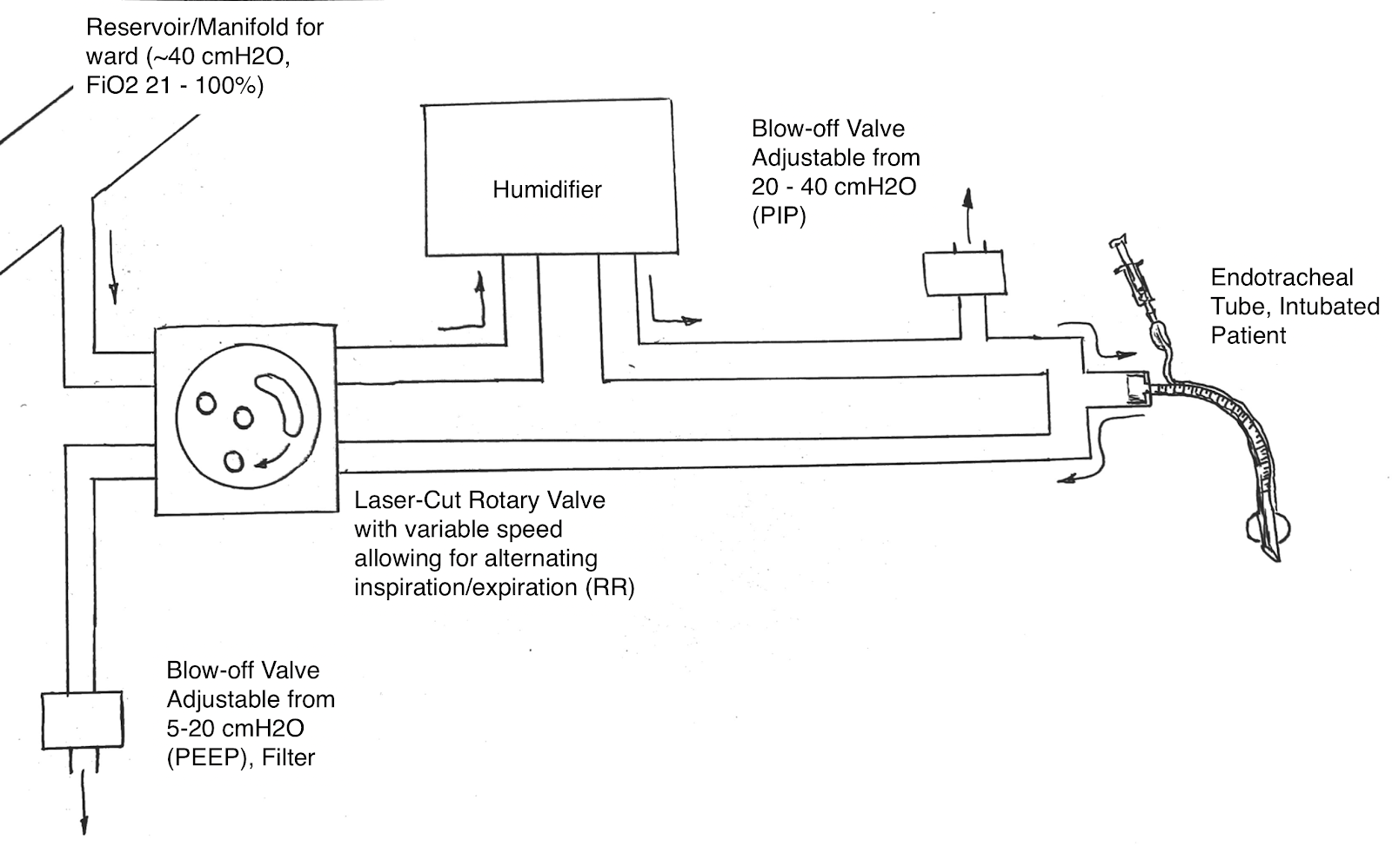
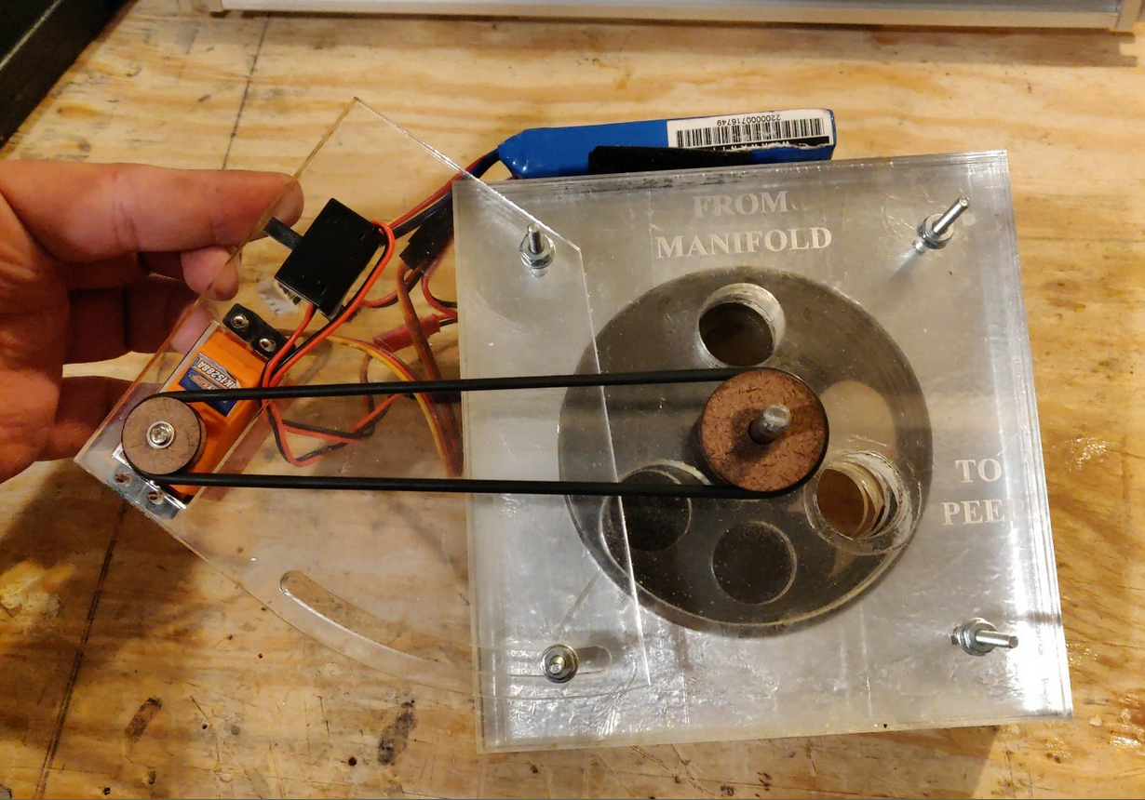
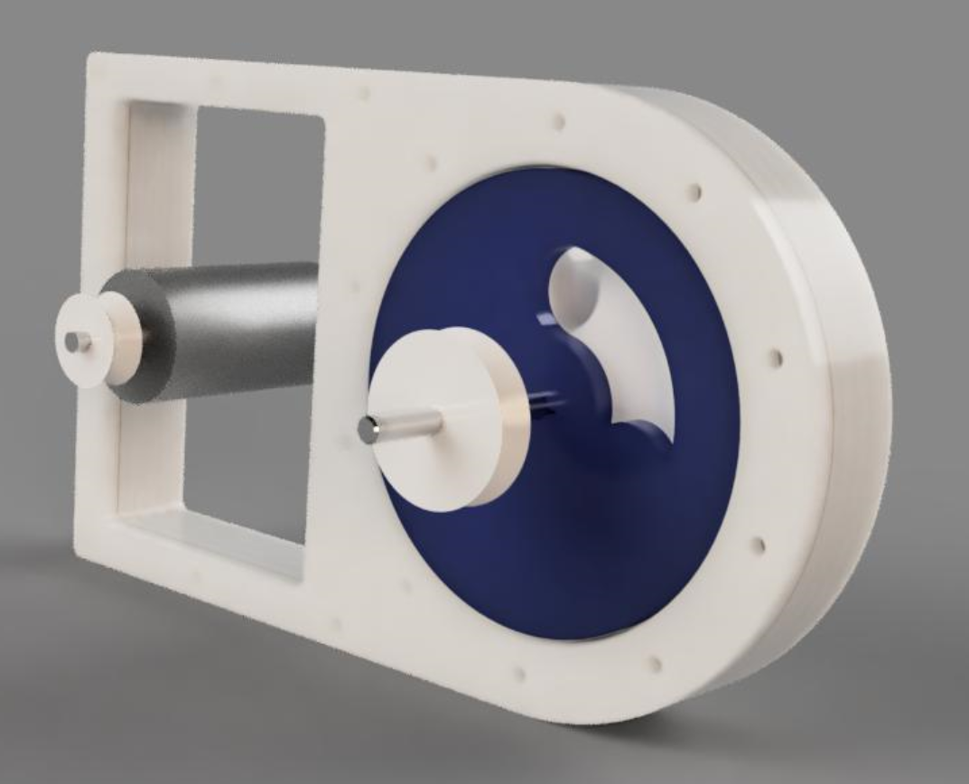
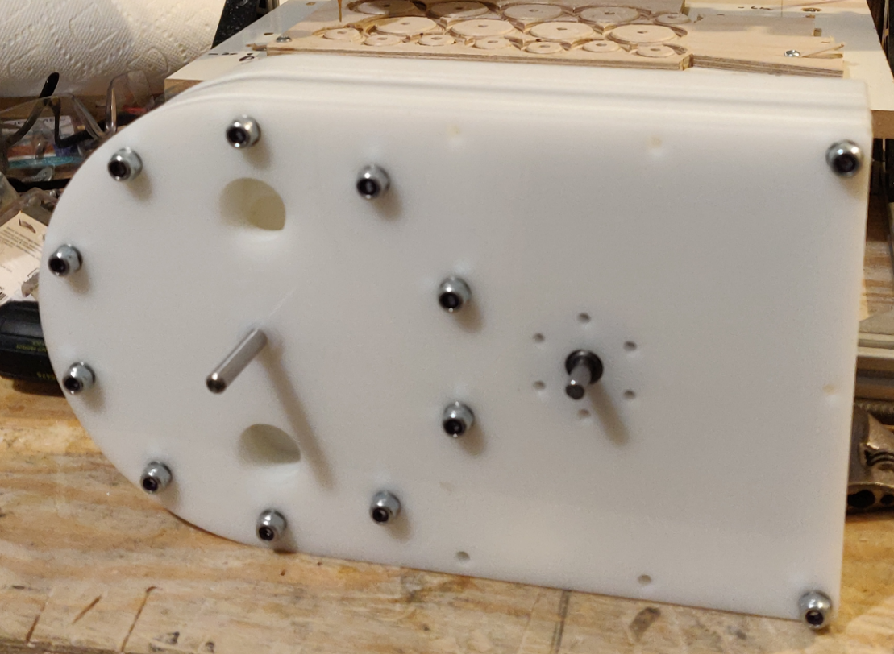
Rapidly Produced, Improvised Ventilator
REPLACE THIS BOX WITH YOUR ORGANIZATION’S
HIGH RESOLUTION LOGO
REPLACE THIS BOX WITH YOUR ORGANIZATION’S
HIGH RESOLUTION LOGO
Max Witt
University of Michigan
Abstract
Methods and Materials
Results
Discussion
With the expected surge of COVID-19 cases, we sought to rapidly develop an improvised, basic mechanical ventilator to deal with the increased need, while avoiding the common issues of supply chain and manufacturing bottlenecks.
We sought to design a ventilator system that meets the minimum requirements for a mechanical ventilator, which would support patients for several days while allowing further triage for patients who would be most likely to benefit from conventional ventilators.
Working with basic manufacturing techniques, we produced an initial proof of concept device, and tested it with an ASL-5000 lung simulator on 3/20/2020.
The initial design was created in Solidworks. The initial version was built primarily with acrylic sheet that had been laser cut with a 50w Epilog laser cutter. The updated version was changed to be made from HDPE sheet that was machined on a CNC router (Shop-Bot CNC). The updated version is in the process of assembly and planning for testing.
Our initial results with the first prototype were promising. We utilized a 35 cmH20 manifold pressure, and found peak pressures of 34 cmH20 in the test lung.
Our second prototype is in the process of being assembled and preparations are being made for testing.
Our goal was to develop a system that meets the minimal requirements for a ventilator to support COVID-19 patients who would otherwise be denied mechanical ventilation, allowing further triage to identify patients who could most likely benefit from a conventional mechanical ventilator.
Overall, our project had made significant progress towards the goal of a successful test for the mechanical ventilator. One significant roadblock we have encountered is the shelter in place order preventing us from having access to needed facilities.
Initial Prototype
Conclusions
Our design is currently pending testing, but we are hopeful that we will have further results soon.
Introduction
Given the estimated deficits between projected need for ventilators and current supply, there exists a need for a rapidly producible device capable of treating Covid-19 associated ARDS. We sought to make a device that can manage patients’ respiratory rate, end expiratory pressure, and peak inspiratory pressure. Some research groups have developed automatic manual resuscitators to provide respiratory support pending ventilator availability (MIT). This approach is limited by lack of long term studies demonstrating the safety and efficacy of long term use of manual resuscitators, which have traditionally been used in critical care environments. Additionally, designing full-featured invasive ventilators was also considered. However, these devices are often proprietary, have substantial lag times in manufacturing and shipping, and require complex components and materials that make them difficult to rapidly produce. Lastly, numerous efforts have been made
This design will most likely incorporate the ability to split non-invasive pressure support/continuous positive airway support (CPAP) to provide pressure-controlled continuous mandatory ventilation (PC-CMV) to many patients. Alternatively, it could be supplied with an improvised pressure source.
Our design aims to be simple and capable of being rapidly produced locally using readily available materials and parts. Additionally, the design will include flexibility to deal with part/material shortages, should they arise.
Second Prototype
Contact
References
<your name>
<your organization>
Email:
Website:
Phone:

