Slide 1
Office of Clinical Informatics
August 5, 2019

Slide 2
Decision: Optimizing the IP MAR for clinical decision making
Decision Point: Should we optimize IP MAR for clinical decision making?
Requestor: Emily Zhao Executive/Leadership sponsor: Robert Chang, M.D. Impact: (area, audience/discipline, high, medium, low): Inpatient Clinicians/Med Resource Allocation: MiChart Clinical Doc AC Estimated Implementation date or length: September, 2019 Communication/Training Plan: MiChart Tell-All, HOQSC
Notes:
Decision: Name of topic, functionality; High level; Same as SharePoint Item
Decision Point: Format as a question; Same as SharePoint Item
Background / Current State: Include definitions if appropriate
Considerations: Accreditation or regulatory factors that may influence; Policies and procedures that will influence; Workflow factors to consider; Previously made decisions that impact this decision; Who is impacted by the issue or the potential solution (end users or other Application Teams); Who requested the change or champions the change request

Slide 3
Decision: Optimizing the IP MAR for clinical decision making
Decision Point: Should we optimize IP MAR for clinical decision making?
Background/Current Status: The Inpatient Medication Administration Record (IP-MAR) report was created in 2014 Go live for inpatient providers to make decisions about current/future medication therapy Current IP MAR History is an IP Summary report and contains: the list of medications start/stop times Dosage formulations initials of person who administers the medication for the patient Problems: long loading times, irrelevant information, poor formatting/missing data, minimal navigation options
Consideration: Unable to measure the number of clinicians utilizing the report currently. May be able to identify which clinical roles access the report
Notes:
Decision: Name of topic, functionality; High level; Same as SharePoint Item
Decision Point: Format as a question; Same as SharePoint Item
Background / Current State: Include definitions if appropriate
Considerations: Accreditation or regulatory factors that may influence; Policies and procedures that will influence; Workflow factors to consider; Previously made decisions that impact this decision; Who is impacted by the issue or the potential solution (end users or other Application Teams); Who requested the change or champions the change request

Slide 4
Current IP MAR

Slide 5
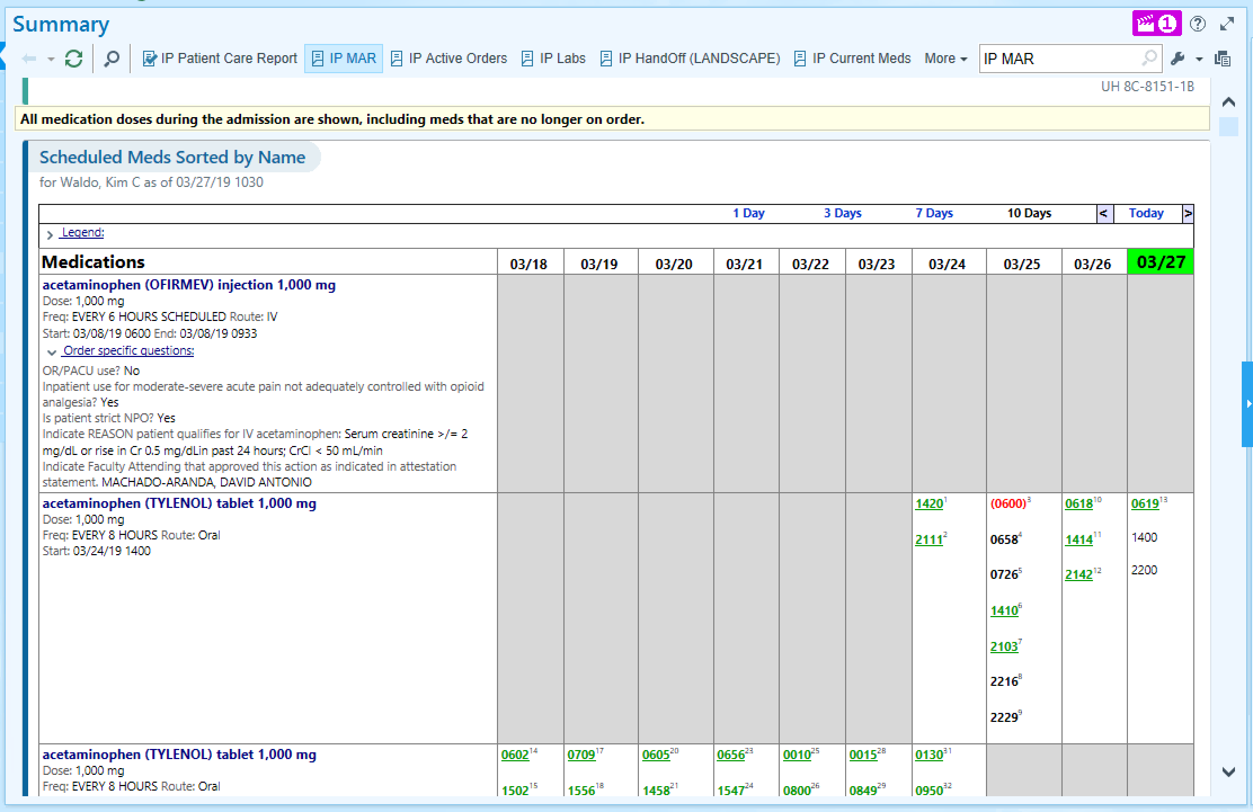
IP MAR
Only scheduled meds
Will lose the date row
A long list of medications that requires scrolling

Slide 6
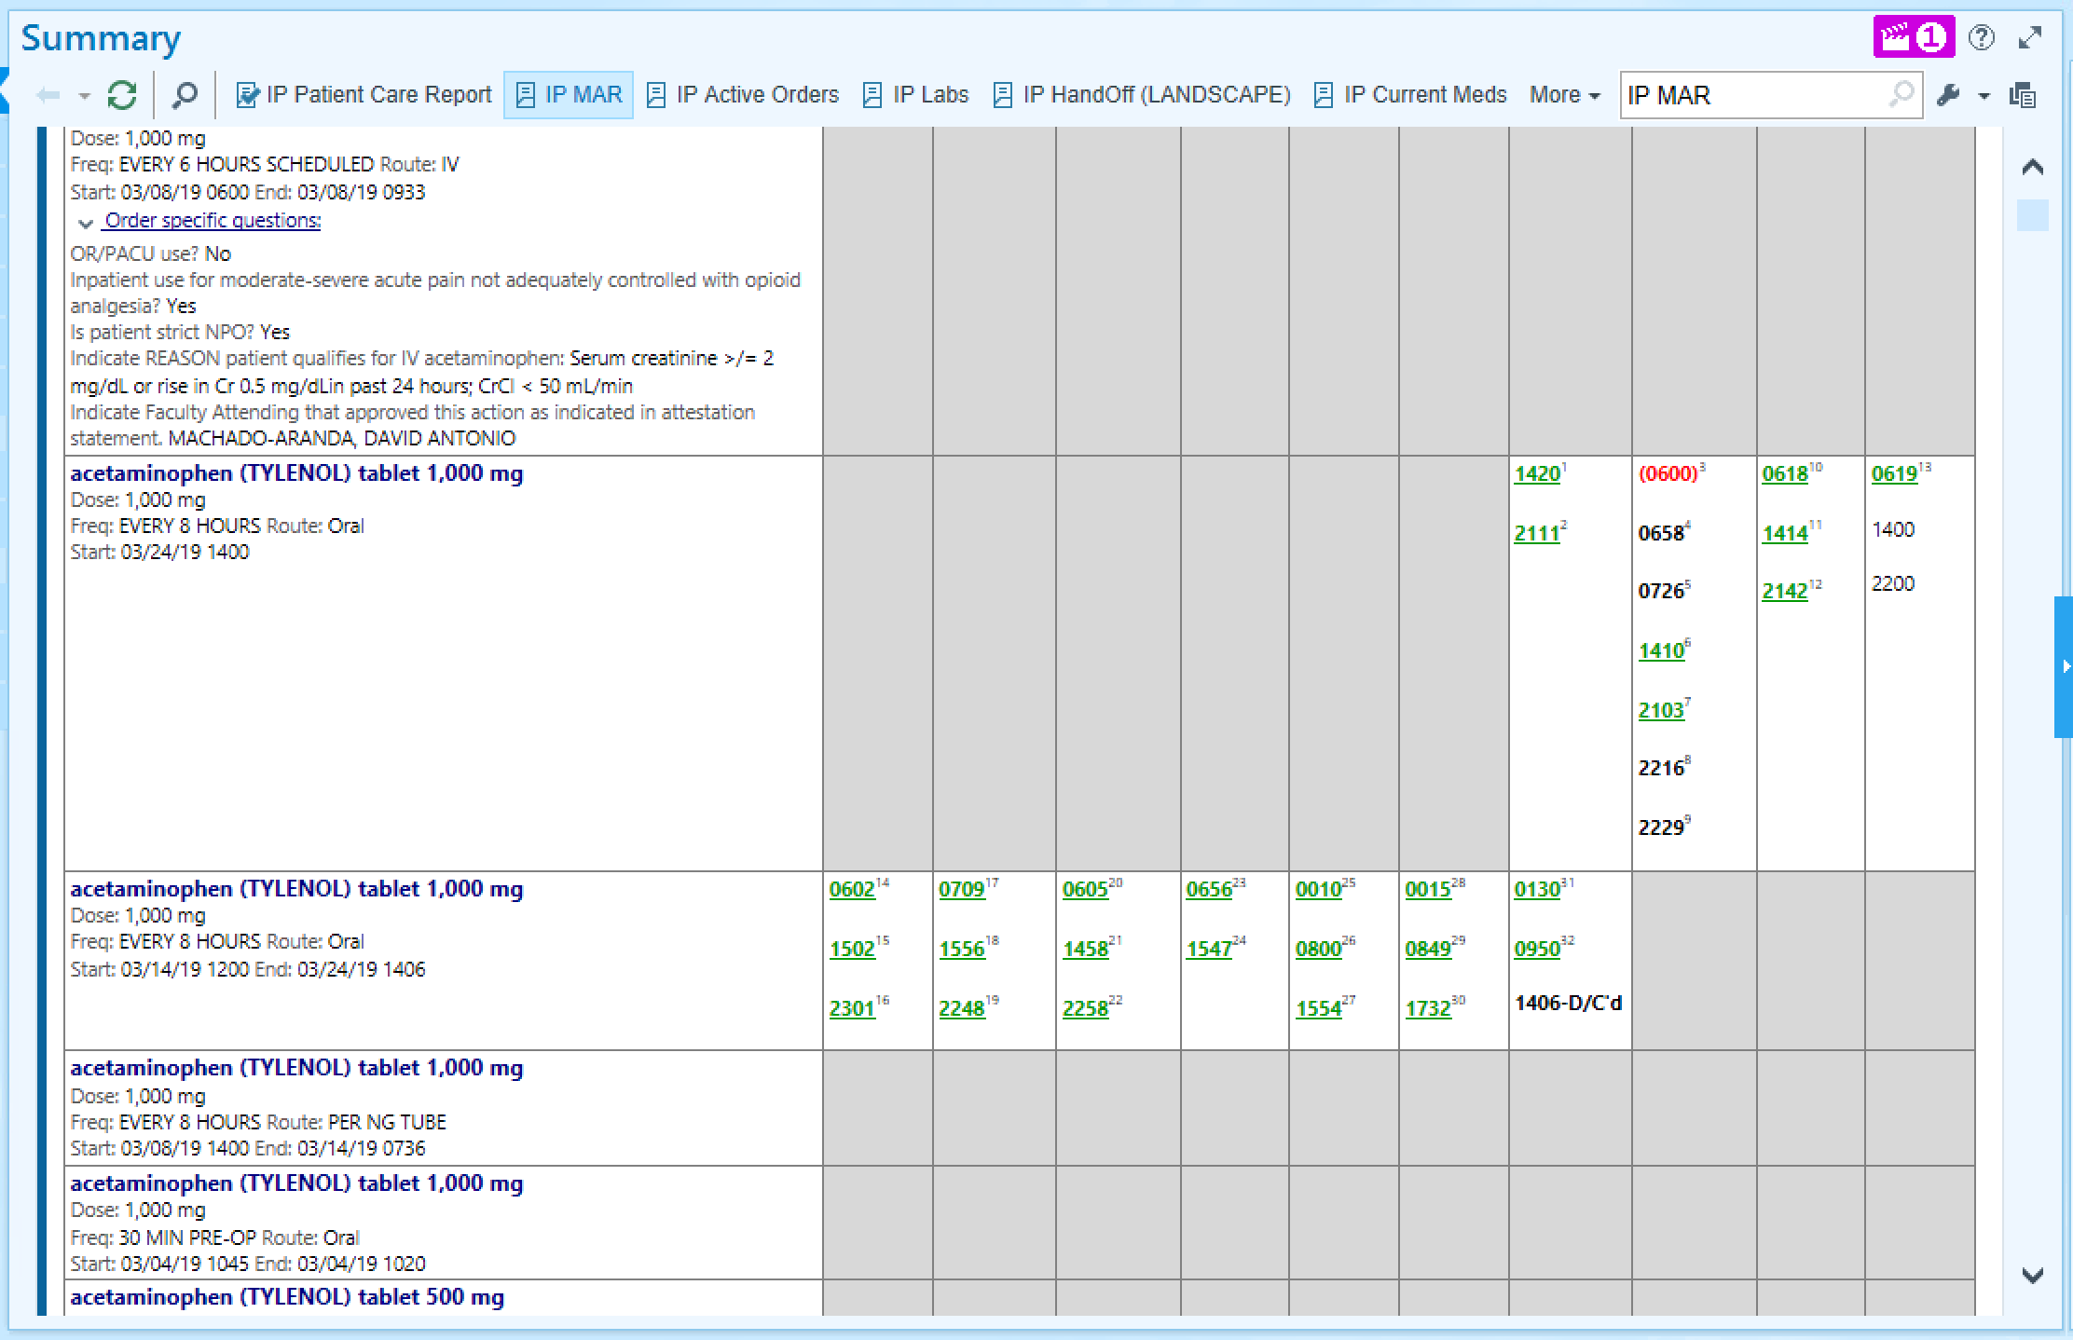
Will lose the date row

Slide 7
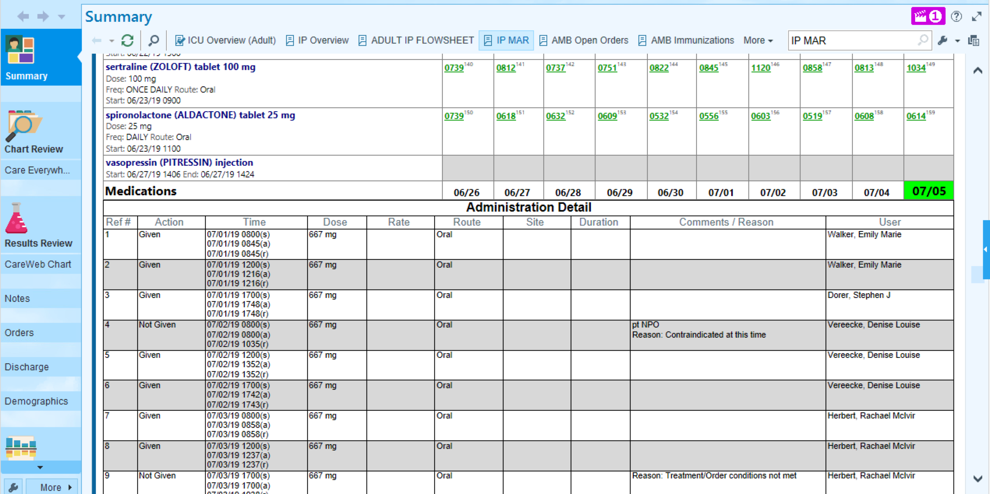
A long administrative table that repeats information

Slide 8
Enhanced IP MAR

Slide 9
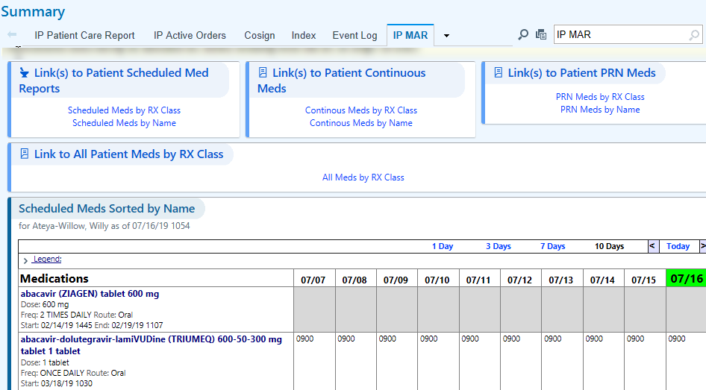
Links to patient scheduled, continuous and PRN meds
Link to all patient meds sorted by RX Class
Maintain original IP MAR report

Slide 10
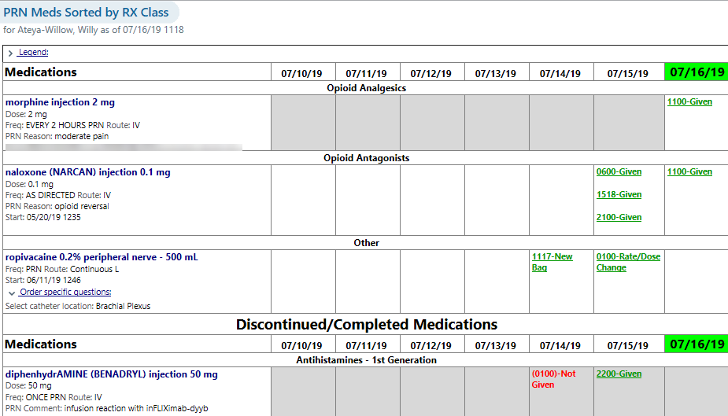
PRN meds organized by RX Class and order status. Note column date repetition.

Slide 11
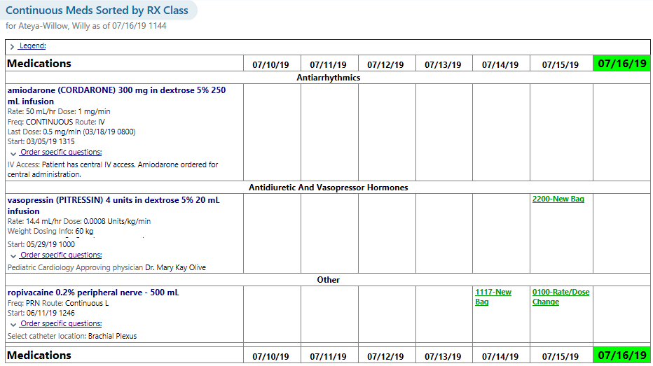
Continuous meds organized by RX Class and order status.

Slide 12
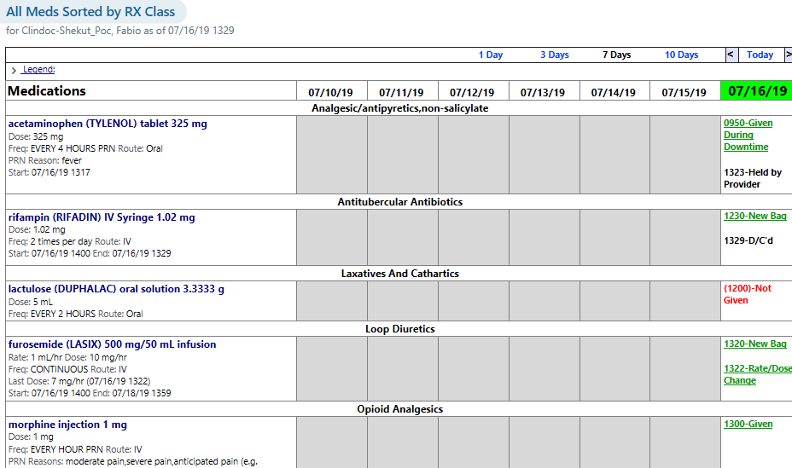
All meds organized by RX Class

Slide 13
Decision: Optimizing the IP MAR for clinical decision making
Decision Point: Should we optimize IP MAR for clinical decision making?
Options: 1. Create new IP MAR Report 2. Enhance Current IP MAR History Report
MiChart Team Recommendation: Option #2
OCI Recommendation/Decision:
Notes:
Options: Can include multiple solutions or ‘no change’ to current design/build
MiChart Recommendation: If a recommendation is known, populate with the appropriate option. If uncertain, leave blank and it will be populated during the meeting
OCI Decision or recommendation: To be populated during meeting

