Slide 1

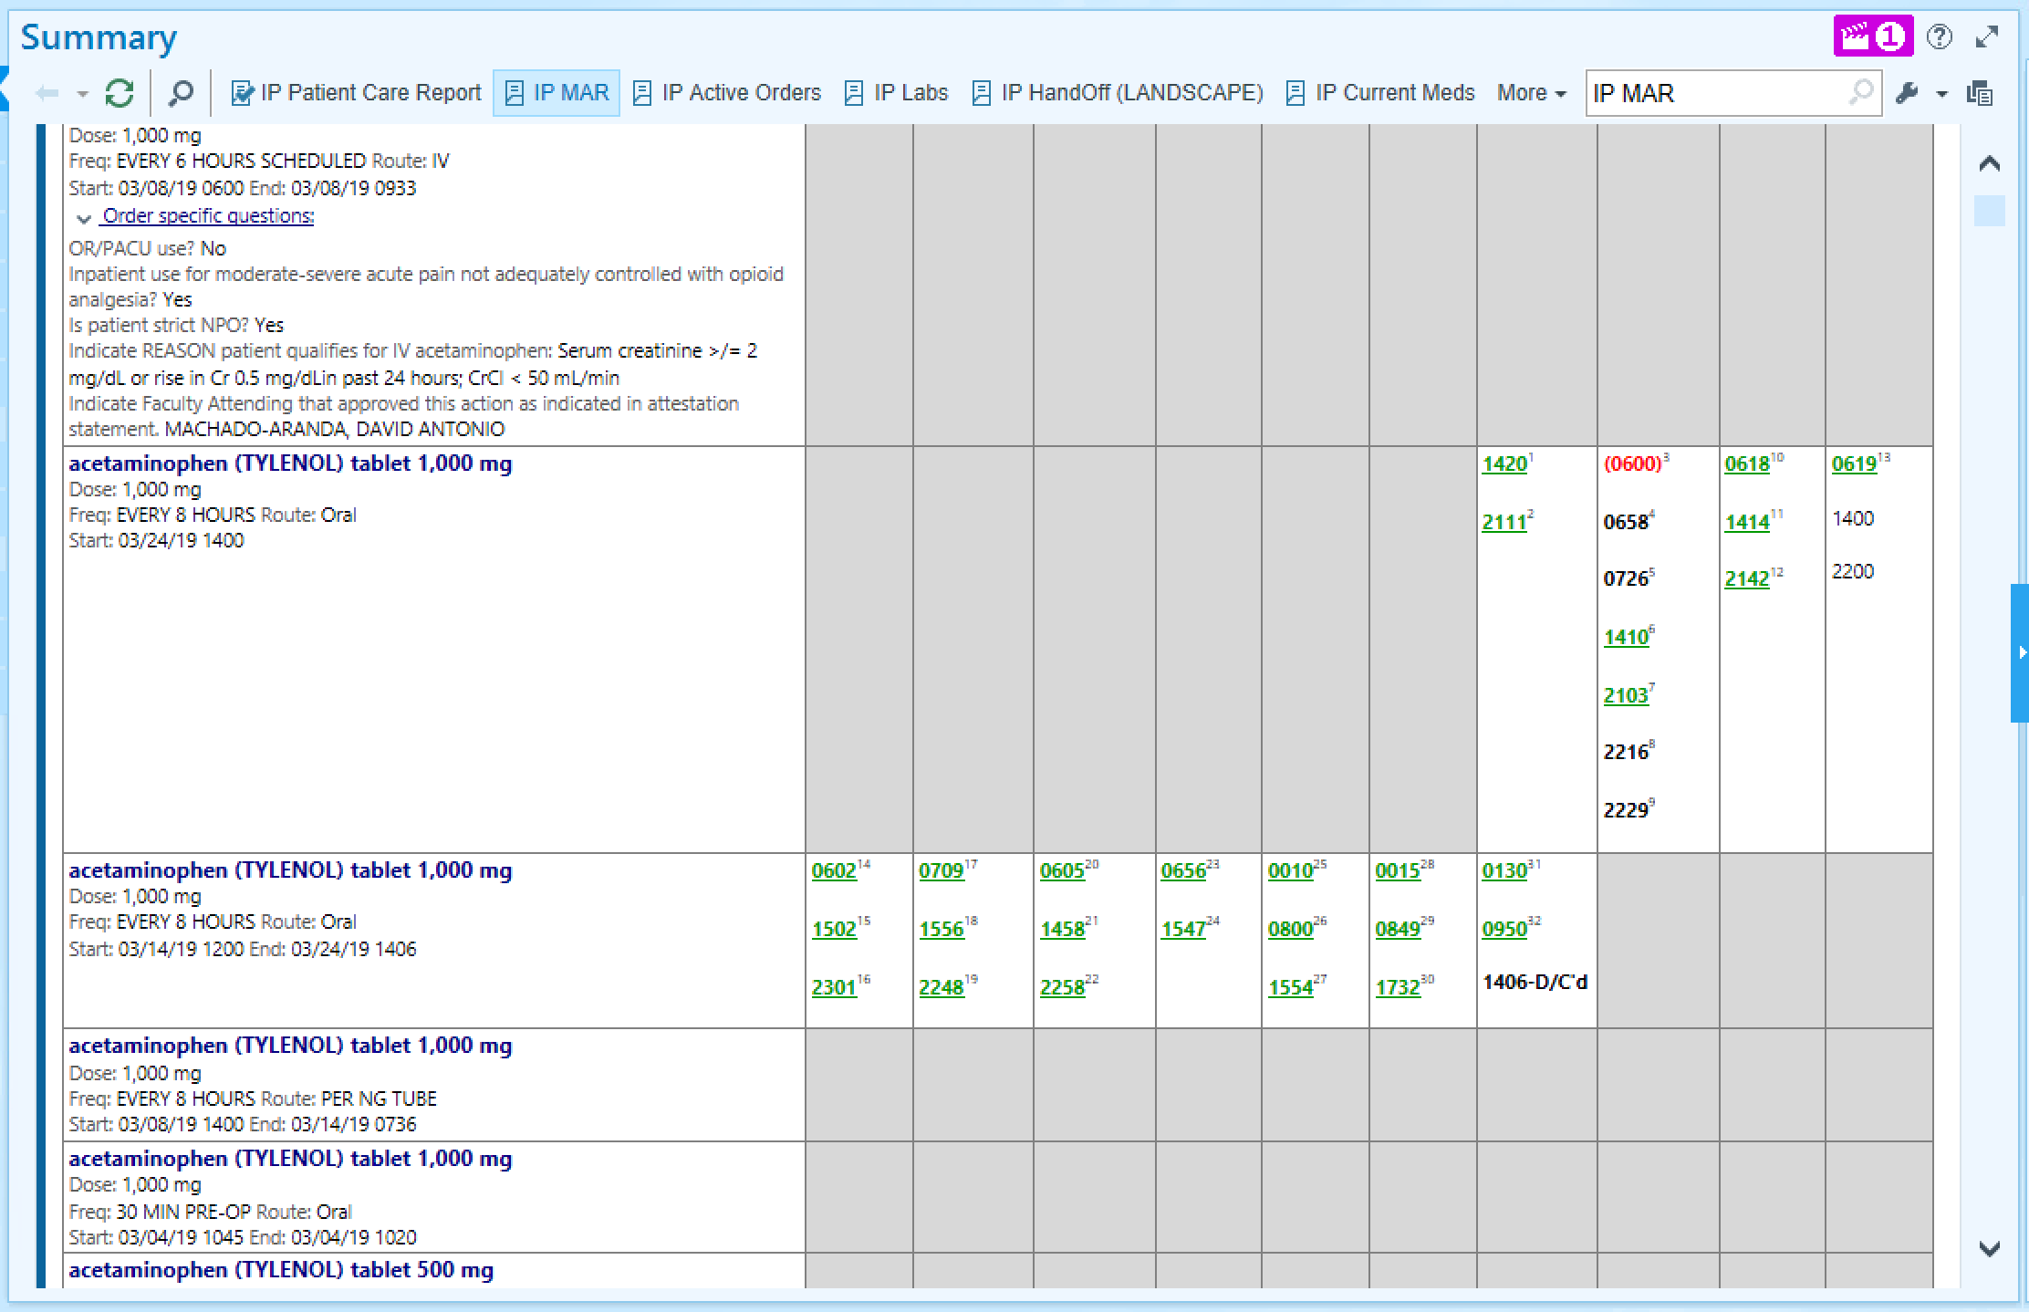
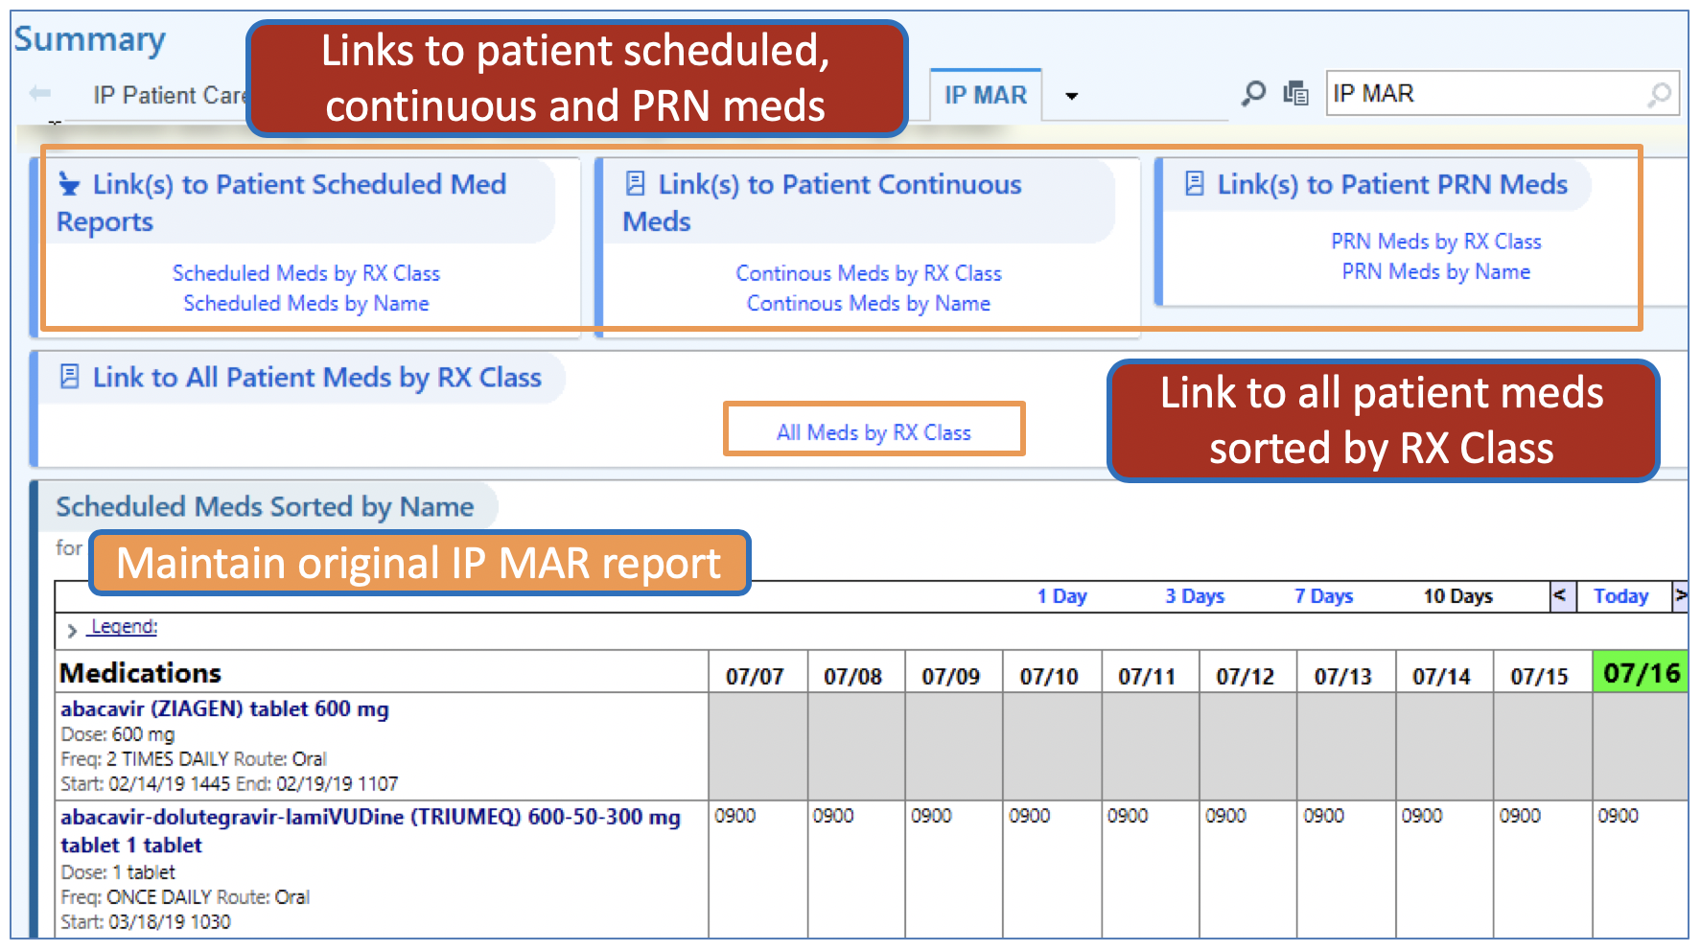
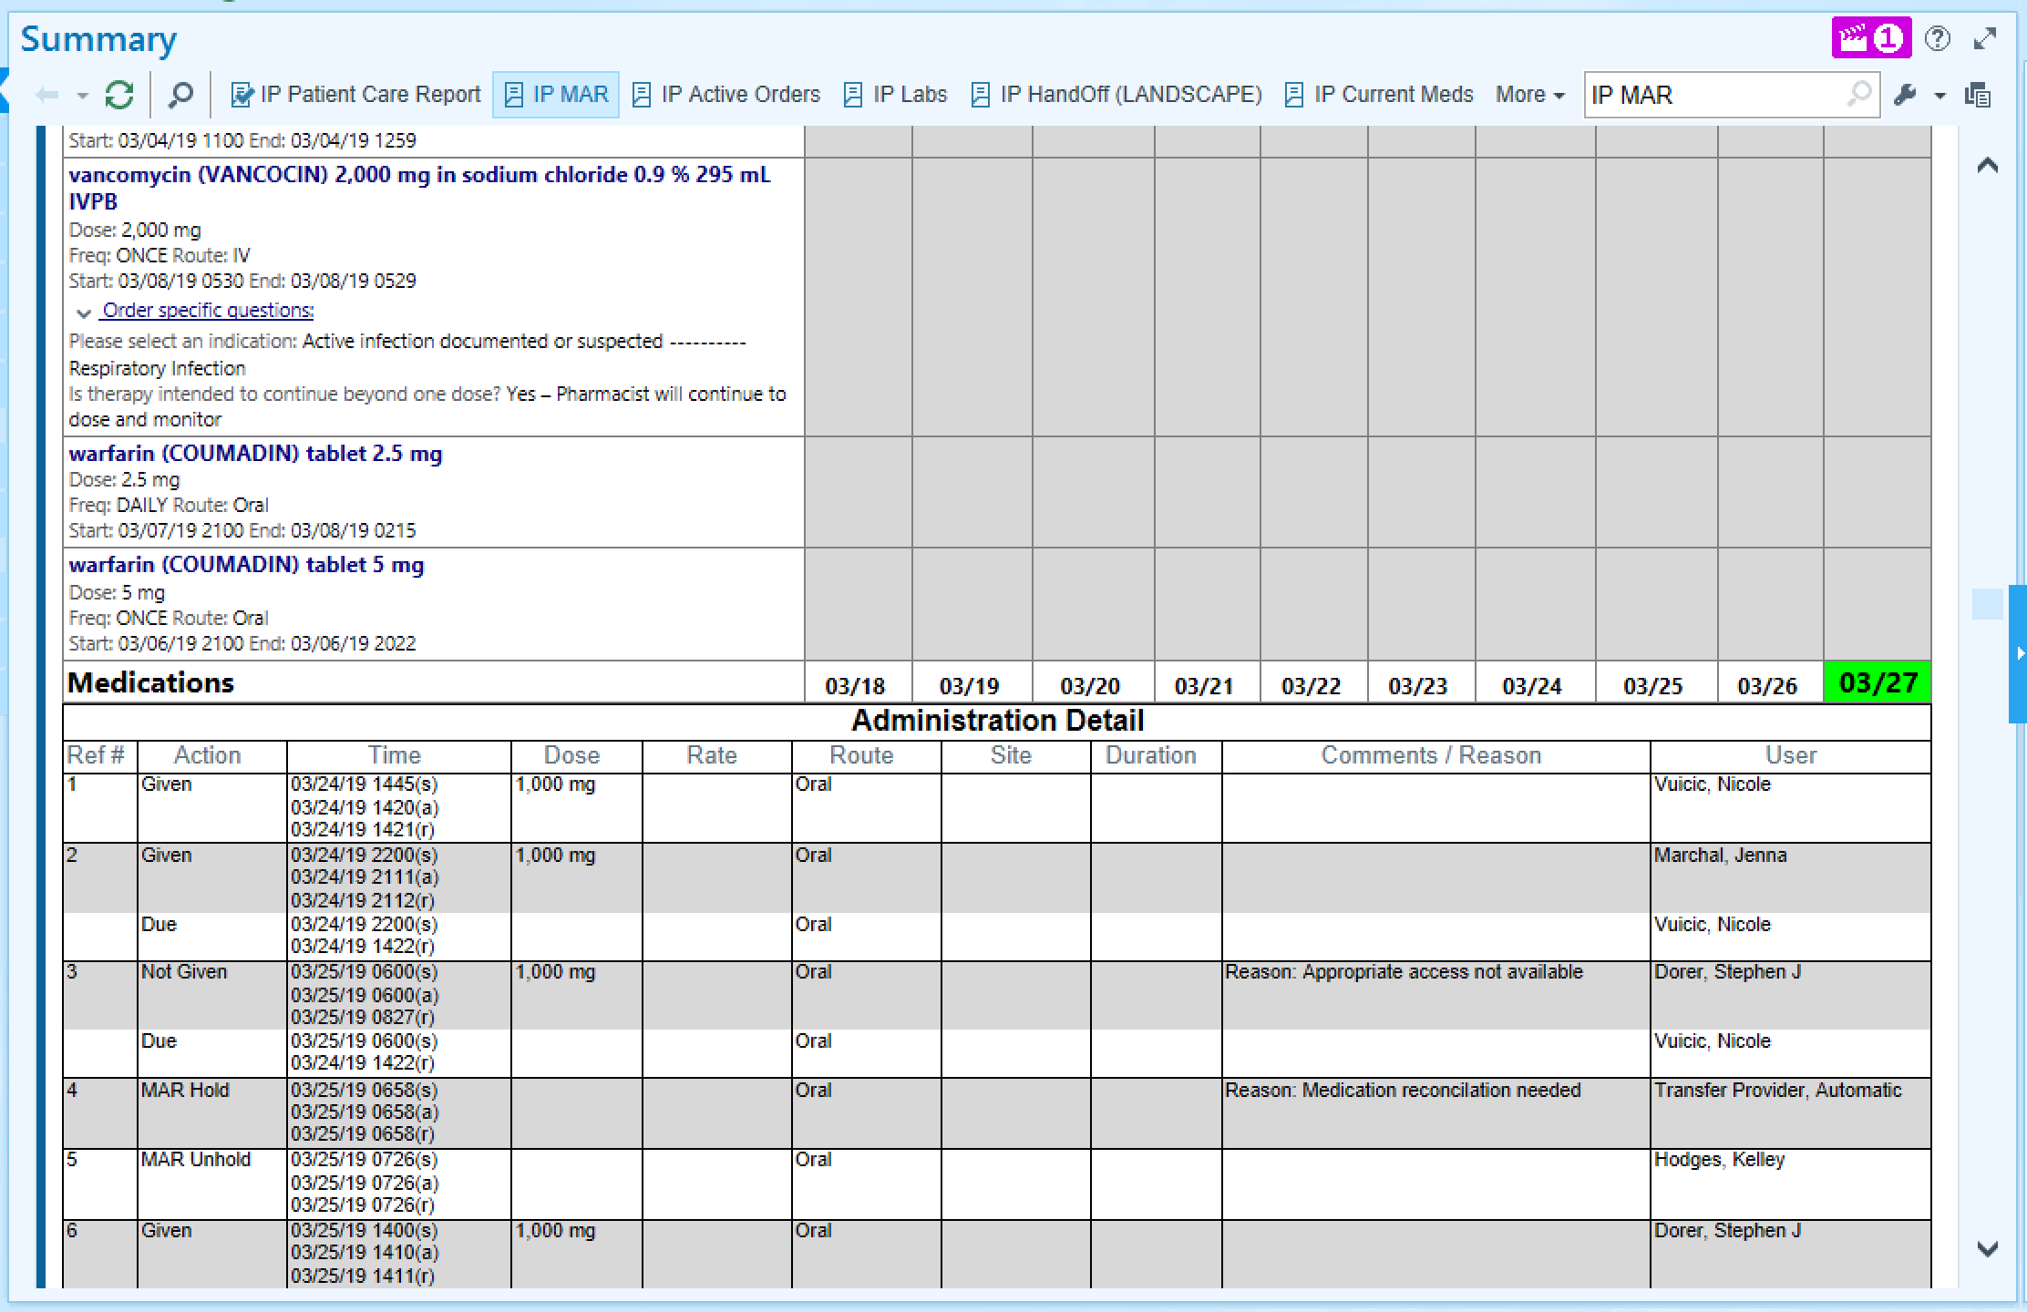
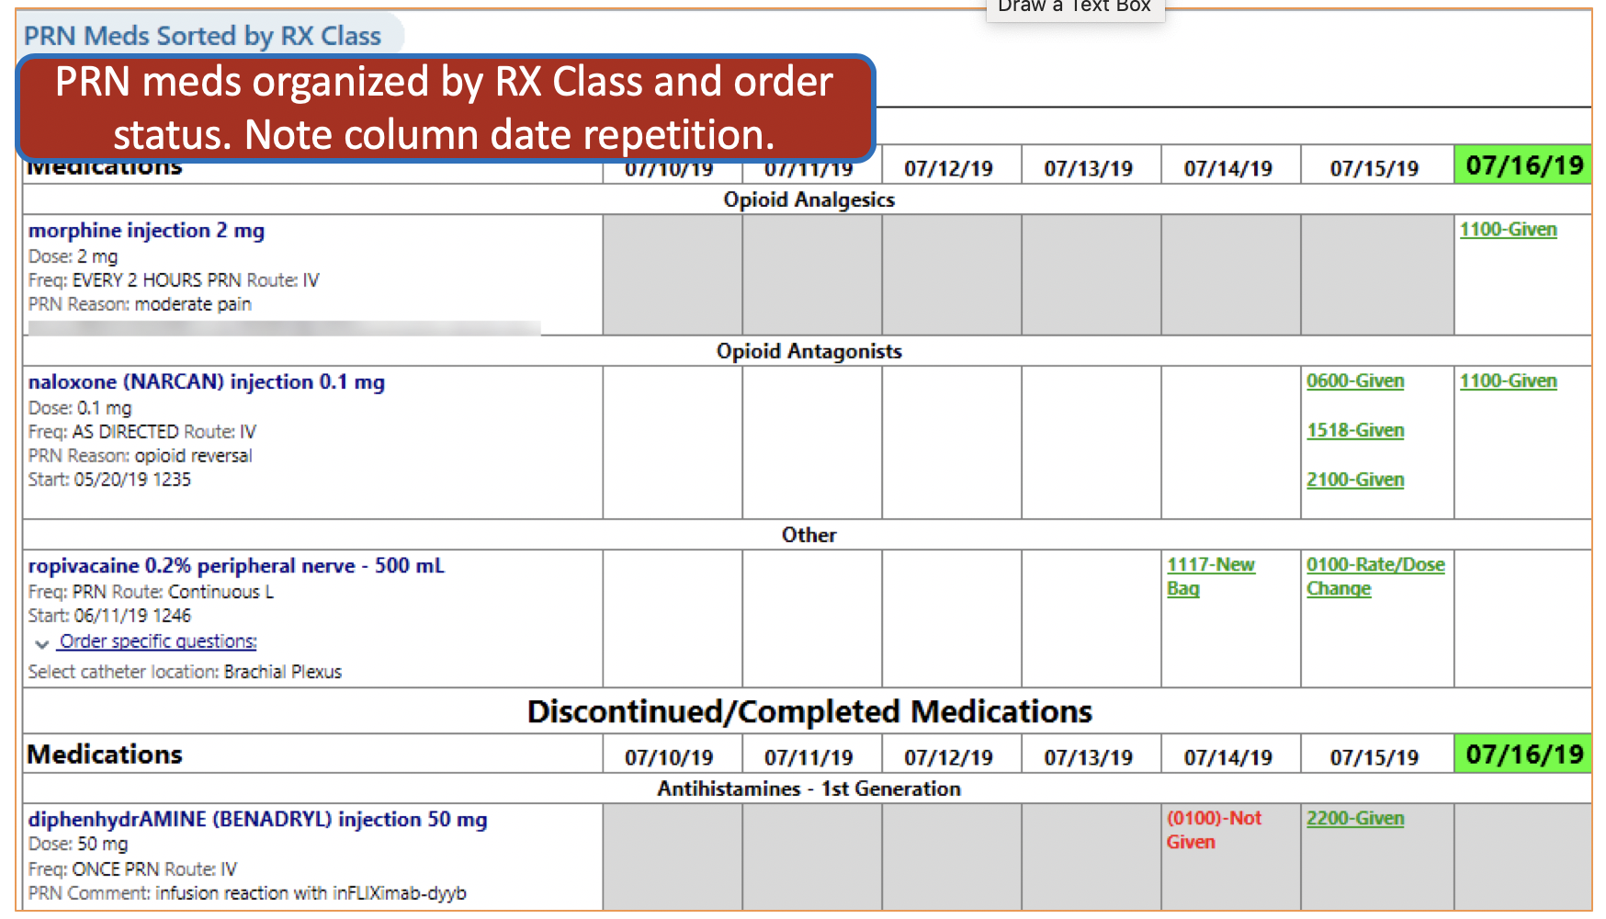
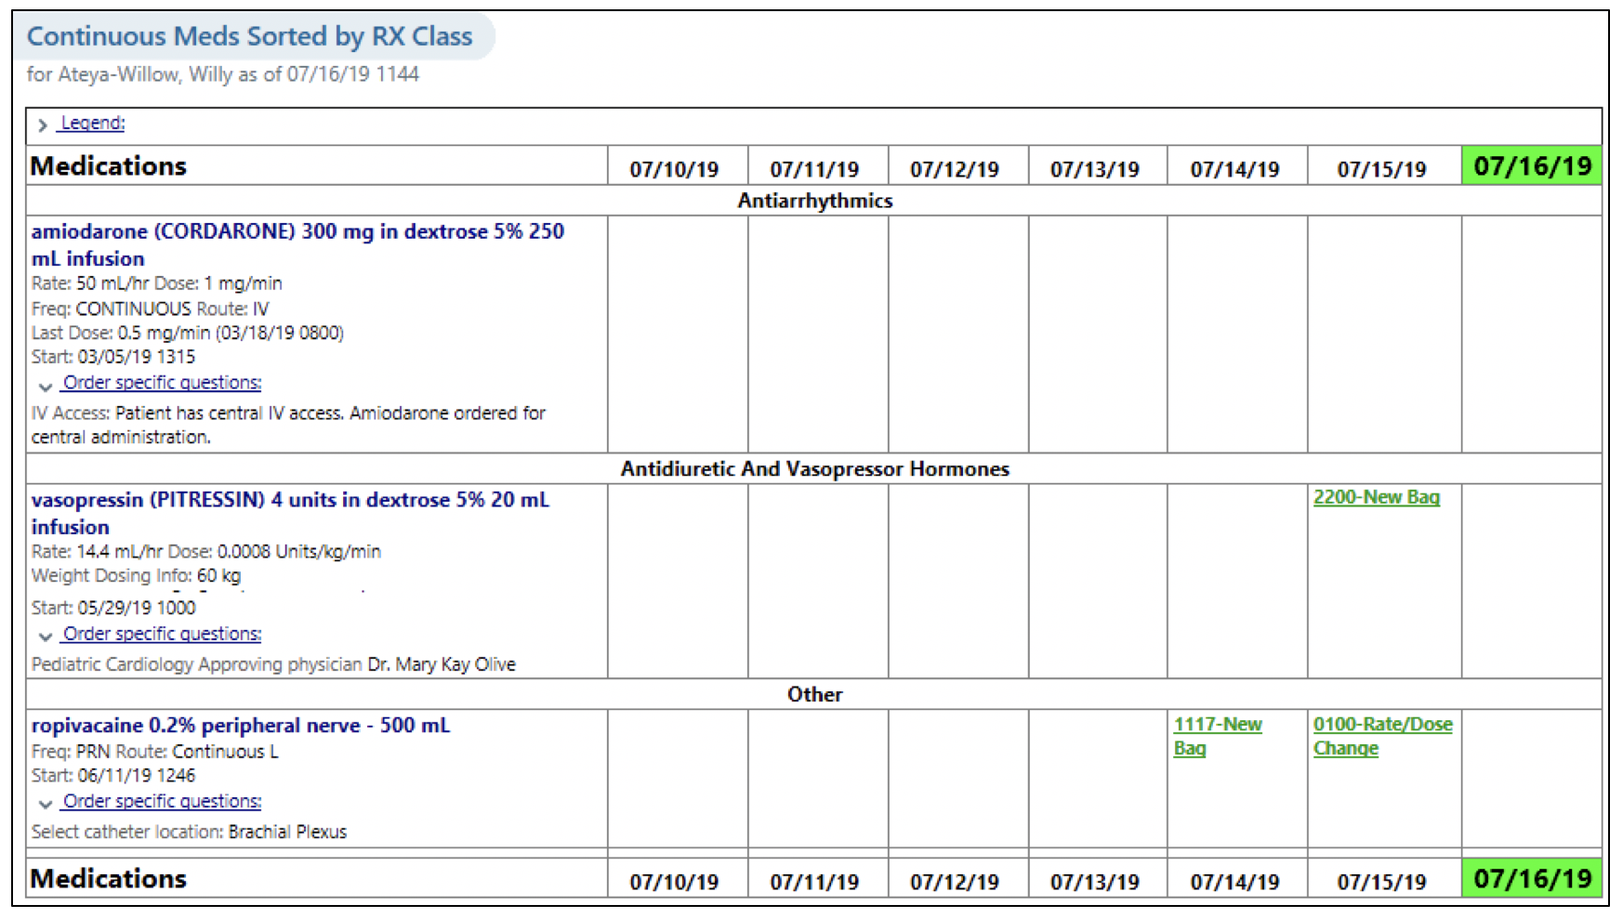
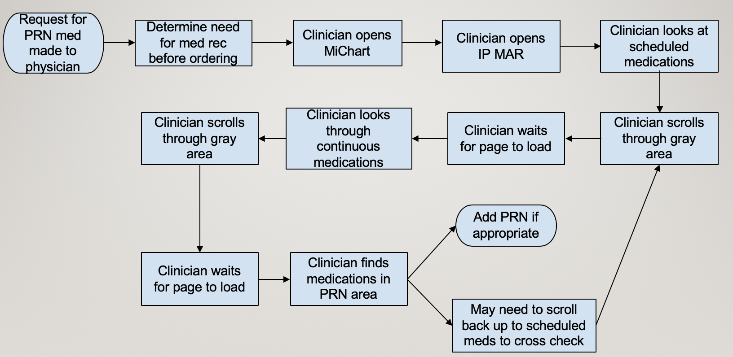
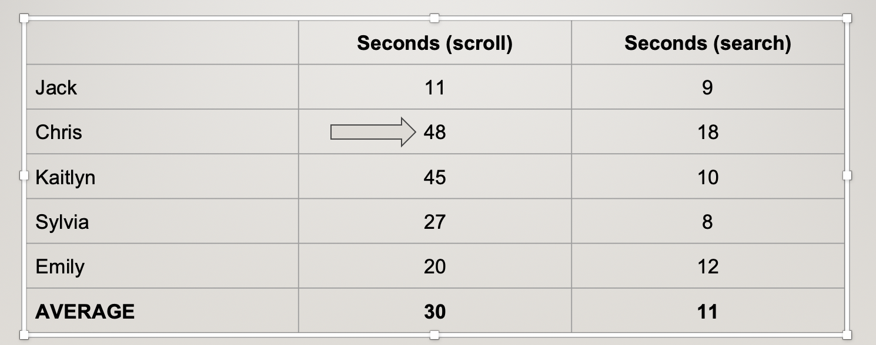
Optimizing the Inpatient Medications Administration Record
Emily Zhao, M4; Robert Chang, MD
University of Michigan Medical School, Michigan Medicine Department of Internal Medicine
Introduction
Objectives
Current Design
Final Product
This is a quality improvement, patient safety project that addresses the current design of an important tool used daily by providers in inpatient medicine. This tool is called the inpatient medical administration record. It is the source of frustration for many providers and sometimes medical errors due to the design of this tool. Since the implementation of EPIC, this tool has been an out of the box feature that needs to be changed to fit the clinical workflow of the providers who use it at Michigan Medicine. The final design was approved and implemented September, 2019.
Overall goal is to improve the IP MAR such that it eliminates or relocates unnecessary information, improve or increase navigation options and include date/time labels throughout the record
Figure 4. Maintain old IP MAR but add additional navigation tools
Figure 1. No date when scrolling.
Approach
The approach of this project is to use the A3 and PDCA cycles.
Create the process flow of how the provider uses the current IP MAR
Quantitatively define an inefficiency of the current design
Identify weaknesses in the design
Propose a new design
Implement the new design
Disclosure
Nothing to disclose from Emily Zhao or Dr. Robert Chang.
Background
Obstacles encountered
Figure 2. Repetitive information.
Figure 5. Visibility of dates
The IP MAR or the inpatient medical administration record is a legal record of drugs administered to a patient in a healthcare facility. Includes medication names, start/stop times, and initials of personal administering the medication. This is originally a legal document but it is now utilized by multiple providers for clinical decision making.
At Michigan Medicine, providers frequently consult the IP MAR to assess scheduled and PRN medication administration, and make decisions about current and future therapy.
The challenges with the current IP MAR are the following:
The medications are organized alphabetically and by categories of continuous, scheduled, and PRN medications. However, these organizations do not match the clinical workflow
There is long loading time in EPIC due to the large amount of data.
This translates to inefficient workflow when a providers tries to look up the medications in question and spends majority of time scrolling up and down the page.
There are anecdotal evidence of medical errors as decisions are made about dosages, frequency, and formula of medication to give or stop.
While there are workarounds to help providers find specific medication quickly such as Ctrl + F, there several design flaws that should be corrected. The current design is an out of the box EPIC tool that has not been customized for Michigan Medicine clinical workflow.
Scope of the project:
  It has been a challenge to identify from clinical providers on what features to improve upon. Every person has their own opinion for the design. We took three of the most common complaints about this tool and brainstormed designs.
  The scope of this project is also affected by what can be accomplished technically. In meeting with the EPIC technician, it became clear that the final design requires compromise on some of the features in order not to break any other functionality in EPIC, to get approval from the Office of Clinical Informatics, and to justify the amount of time that the technician and a physician-builder will require to spend.
  An additional challenge that limited the scope of change is that it was difficult to identify the range of providers who utilize this tool. This requires more informatics and reporting of data that the EPIC technician was unable to do at this time.
Translating the clinical to the technical and vice versa: The EPIC technician does not always have an innate understanding of why we choose the design and why we need to improve upon current functionality. Examples and different use cases helps to clarify this point. Additionally, technical jargon makes it difficult to understand what can and cannot be done technically in EPIC.
Figure 5. Continuous, Scheduled, and PRN meds ordered by Rx class
Figure 3. Clinical Process Flow.
Future Directions
The final product is a hybrid of new functionality with the old design. More can be done to improve the new design of the IP MAR. This includes the following:
Identify providers who use the medications administration table and remove the table
Evaluate and measure the improvements in loading time, efficiency of clinical workflow, and survey providers for other functionality that need improvement
Table 1. Sample Metric to find the PRN

