Slide 1


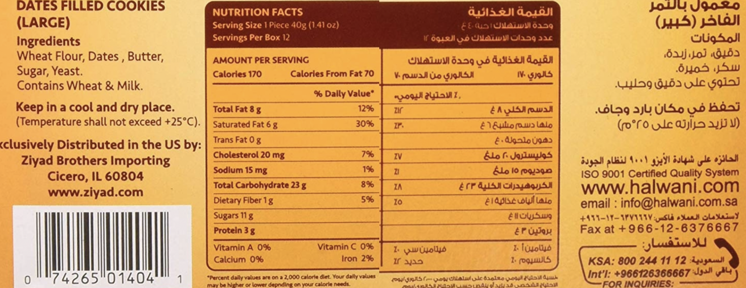
Assessing Health Literacy in the Recent Middle Eastern Refugee Population
of Southeast Michigan
Christina Ceci, BS, Anne Kalinowski, BS, Isabella Anton, Amneah Chaaban, Brent Williams, MD
University of Michigan Medical School, Ann Arbor, MI; University of Michigan-Dearborn, Dearborn, MI
INTRODUCTION
BACKGROUND
RESULTS
DISCUSSION
Background: Previously, refugees living in the United States have been found to be at increased risk for food insecurity, defined as limited ability or uncertainty in accessing adequate nutritious or acceptable foods. Risk factors for food insecurity include poor health literacy and a decreased ability to obtain, communicate, process and understand basic health information. Through a partnership with the Arab Community Center for Economic and Social Services (ACCESS) in Dearborn, Michigan, this study aims to assess the health literacy in recent Middle Eastern refugees living in Southeastern Michigan as compared to their peers.
Methods: Surveys in English and Arabic were distributed to individuals attending the health clinic at ACCESS who were at least 18 years old. Socio-demographic characteristics were collected along with five questions adapted from the validated Newest Vital Sign Scale that assessed prose literacy, document literacy, and numeracy using a bilingual cookie label. Scores of 0-3 and 4-5 were considered at risk for low literacy and high literacy, respectively.
Results: Of the 69 surveys distributed, 39 (56.5%) participants completed the health literacy questions. Upon analysis, 10 (25.6%) were considered refugees. Compared to their non-refugee peers, refugees were not found to be at increased risk for low health literacy (80% v. 58.6%, p=0.224). When compared to participants with high health literacy, the features of those at risk for low health literacy were not significantly different based on gender (p=0.471), age (p=0.152), level of education (p=0.205), household size (p=0.674), or English proficiency level (p=0.082).
Conclusions: These results suggest that despite refugee status, or other socio-demographic factors, low health literacy is a pervasive problem throughout the population that utilizes services at ACCESS. Thus, future health education interventions offered at ACCESS, such as talks and handouts, will be developed to help improve health literacy and promote healthy lifestyles. Limitations to this study include small sample size, response bias, and time limitations. Thus, future studies could incorporate larger population samples and include additional socio-demographic factors such as household income.
Refugees living in the United States have been found to be at increased risk for food insecurity
Risk factors for food insecurity include poor health literacy
Prior to 2017, there was a large influx of Middle Eastern refugees coming to the United States
Limitations:
Small sample size (N=65) due to limited clinic availability & collection times
Language barriers (i.e. difficulty communicating purpose of survey)
Selection bias due to respondents not wanting to disclose refugee status
Conclusions/ Future Directions:
Low health literacy is a pervasive problem throughout the population that utilizes services at ACCESSS.
Future health education interventions offered at ACCESS, such as talks and handouts, will be developed to help improve health literacy and promote healthy lifestyles.
Lessons Learned:
How to take a project from inception to presentation.
Benefits of partnering with a community organization and how to use research to support change in a community.
Acknowledgements:
Funding provided through the Capstone for Impact Grant from University of Michigan Medical School. A special thanks to ACCESS for their partnership and support.
Disclosures:
The authors have no relevant disclosures.
Contact Information:
Christina Ceci
University of Michigan Medical School
cceci@med.umich.edu
OBJECTIVES
To assess the health literacy amongst those utilizing the health clinic at ACCESS, to determine if refugees are at increased risk for low health insecurity, and to assess if there are any socio-demographic factors associated with low health literacy.
Figure 2. Picture of bilingual cookie label used in survey to assess health literacy.
METHODS
Surveys were collected from 65 persons who visited the health clinic at ACCESS; 39 surveys were completed for health literacy section
Refugees were defined as those who self-identify or have resided in the U.S. <10 years
Socio-demographic data & five questions adapted from the validated Newest Vital Sign Scale that assessed prose literacy, document literacy, and numeracy using a bilingual cookie label were collected
Scores of 0-3 were considered at risk for low literacy and scores of 4-5 were considered high literacy
Table 1. Socio-demographic Characteristics of Participants
Characteristic |  | Low Literacy (n,%) | p-value
Refugee Status | Refugee Non-Refugee | 10 (80%) 29 (59%) | 0.224
Gender | Male | 6 (75%) | 0.471
 | Female | 19 (61%)
Age (years) | 18-30 | 6 (50%) | 0.152
 | 31-40 | 12 (86%)
 | 41-50 | 3 (60%)
 | 51-60 | 0 (0%)
 | 61-70 | 2 (100%)
Household Size (# people) | 1 | 1 (50%) | 0.674
 | 2-4 | 8 (62%)
 | 5-7 | 11 (73%)
 | 8+ | 4 (100%)
Level of Education | Less than High School | 3 (100%) | 0.205
 | High School | 14 (74%)
 | College | 6 (55%)
 | Post-graduate Degree | 2 (40%)
English Proficiency | Only know a few words | 2 (67%) | 0.082
 | Comprehend questions about basic needs | 5 (100%)
 | Comprehends at normal speech rate, noticeable accent | 0 (0%)
 | Can handle most social situations | 5 (100%)
 | Ability to understand fluently with rare grammatical errors | 6 (67%)
 | Fluency equivalent of a native | 6 (46%)
Survey Questions Assessing Food Literacy
If you eat the entire container, how many calories will you eat? If you are allowed to eat 70 g of carbohydrates as a snack, how many cookies can you eat? If you usually eat 2500 calories in a day, what percentage of your daily value of calories will you eat in one serving? Pretend that you are allergic to the following substances: Penicillin, dairy, latex gloves, and bee stings. Is it safe for you to eat these cookies? If no, why not?
Low Literacy High Literacy
0-3 correct responses 4-5 correct responses
A p-value of <0.05 was considered significant.

