Slide 1
Factors Associated with Successful Recruitment of Racial and Ethnic Minorities to U.S. Emergency Medicine Residency Programs
Ayana Robinson, M.P.H.
University of Michigan Medical School
NMA Annual Convention July 30th, 2017

Slide 2
Disclosures
No financial disclosures
Funding Sources:
  SAEM Academy of Diversity and Inclusion in Emergency Medicine (ADIEM)
  Robert Wood Johnson Foundation
  Veterans Affairs Administration
The views expressed here do not necessarily reflect the views of these entities.

Slide 3
Background
Provider diversity key to high quality and culturally competent care
Underrepresented minorities in medicine (URMs) more likely to:
  Treat minority patients
  Practice in underserved areas
  Commit time to academic and service pursuits
Racial and cultural concordance associated with:
  Higher levels of trust and respect
  Improved communication
  Increased patient satisfaction

Slide 4
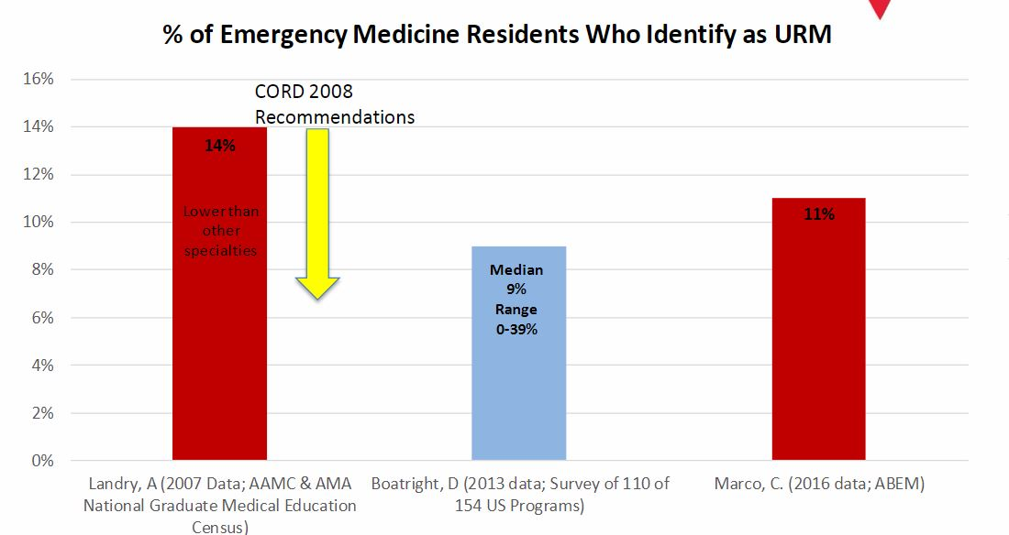
URM Recruitment Remains Stagnant
*
URM% varies widely between programs
  0-39%, median 9%
*URM definition (AAMC) includes Black, Native American, Mexican American, Puerto Rican
Notes:
AAMC “Racial and ethnic populations that are under-represented
in the medical profession relative to their numbers in the
general population”
Boatright 2013 Survey- utilized this data for the purpose of our study
URMs (Black, Native and Latino) comprise:
30% of U.S. population
8.9% of physicians
17% of residents
10% EM residents (2010-15)
FM 18%, IM 15%, OBGYN 22%

Slide 5
Objective
To characterize salient processes, initiatives and institutional cultural factors that enable successful recruitment of URM residents in EM.

Slide 6
Methods
Explanatory Sequential Mixed Methods
        Based on 2013 survey, sampled from top and bottom quartiles for % URM
Conducted semi-structured key informant interviews with Program Directors and Associate/Assistant PDs
        Utilized piloted interview guide
        Recorded, transcribed and de-identified
        Thematic saturation achieved after 25 interviews
          16 top quartile
          9 bottom quartile
Developed qualitative codebook
        Maintained 80% inter-coder agreement
Performed iterative thematic analysis

Slide 7
Results
Top Quartile Themes | Bottom Quartile Themes
Tangible support from leadership | Low self-efficacy addressing diversity
Targeted Recruitment | “Too many applicants as it is”
Holistic review of applicants | “I don’t see them as minorities”
Notes:
Maybe create theme tree, as previously discussed
Targeted: marketing to URMS (attending conferences), pipeline programs, URM specific audition rotations, diversity scholarships, follow-up post interview

Slide 8
Tangible Support
“We were able to negotiate a diversity fund to help recruit and retain diversity applicants... [funding] diversity scholarships for rotating medical students to come from other parts of the country who wouldn’t necessarily be able to.”
“Leadership feels this is valuable enough to the department to say, 'The things that you do on the Diversity Committee count toward that academic time that you can bill for.' I think that's a big component to showing that it's something that's valued and important.”
Notes:
007
022

Slide 9
Low Self-Efficacy
“I think the vast majority of folks think [a diverse residency] is a wonderful idea and probably the vast majority of folks don’t have a clue how to get going... don’t even know what to ask for, or how to ask it, or to whom to ask it.”
“I got a large group of folks... [who] self-identified as Hispanic that seemed to be several generations American... I thought this person looks just the same as all the rest of us… [they should be] first or second-generation or speak Spanish... So, I decided to tweak [the ERAS filter] to look at African-American applicants... seemed to be a truer way to identify, especially for our program, groups that are truly underrepresented.”
Notes:
Uncertainty of knowledge, understanding, or confidence in improving diversity
003

Slide 10
Targeted Recruitment
“We do a pass through our DO... IMG… women… [and] minority applicants… specifically looking again for those top applicants and try to make sure we identify them and recruit them.”
"We also wanted to get involved in mentoring underrepresented minority medical students… We even got involved in talking at high schools and colleges... encouraging underrepresented minorities just to go into the health field in general."
“Too many applicants as it is”
“The reality is that with 800 plus applications for 110 interview spots and 12 residency spots, that there are going to be greater than 98% of the folks are going to be disappointed. They have to realize that there's nothing I can do about that… it's a subjective process and I'm sure that there are people who are left in the bin who are equally and possibly better prepared, but that's okay.”
Notes:
Targeted Recruitment: 001 (PIPELINE PROGRAMS common to high performers), 013
“I don’t see them as minorities”: 009, 014
Include a different strategy in targeted recruitment AND an example of holistic review strategy

Slide 11
Holistic Review
“I have actually gone to a points based system... about a 1/3 is intangibles, about a 1/3 is Emergency Medicine performance and your letters of recommendation, and about a 1/3 is your overall medical school career.”
“I don’t see them as minorities...”
“I see them as applicants. Every applicant is equal, that's my starting gambit. Big, tall, short, small, fat, green, yellow, purple, 11 toes, 12 toes, I don't look, I don't care. I look at that what's on the paper and what people say about you, and that's really as far as we go.”
“The easiest initial screen is looking at Step 1… I want to interview someone who scores 215 or to 220 or above.”
Notes:
Holistic Review: 003 (also DO... IMG… women…), 025, 006
"Into intangibles we have put things like leadership experience, substantial volunteerism including recognition with Gold Humanism, substantial research experience. We’ve also put in a criteria that’s evidence of overcoming adversity which is very broad... I have to say that we can’t, for public institutions, consider your traditional definitions of minorities, or ratios, or racial or ethnic characteristics to the exclusions of others."
“Too many applicants as it is”: 009
004

Slide 12

The Complex Role of Perspective
“My hope is when he leaves, he's always going to talk to people about how [our program] is an open and inclusive place. Which is really what we are aiming for.”
“We are at [this hospital], we are in the South, we're in [this city]... frankly there are other residency programs at [our hospital] that don't quite look [diverse] like ours.”
“Everybody is fighting over the top 10 minority applicants… versus saying, ‘How can we improve, how can we look at people as a whole and improve the way we are approaching this problem... [we could be] actively trying to improve the pool…”
“We tend to lose a lot of our URMs to places with warmth or a better cultural mix.”
“It's bad enough not to have a community of people who are a visible at the health care institution... a second huge barrier for recruitment is working in a city where it's mostly white.”
“[Blacks] are not thinking so much in terms of an academic practice so they’re leaning more towards the community practice.”
Notes:
Modifiable: 014, 013 (consider other examples, i.e. the URM resident who didn’t come but they saw the bright side), 017, 002
Non-modifiable: 010, 012,(focus on sociopolitical/geographic things), 004
OR Perspective matters (we are still looking to describe this phenomenon; glass half-full; can do attitude)

Slide 13
Conclusions
Most programs:
  Felt that their programs valued and desired diversity
  Acknowledged challenges to increasing diversity
Bottom programs expressed concerns about how to address challenges.
Top programs implemented deliberate strategies to recruit diverse residents with tangible support from program leadership.
Programs varied in perspective:
  Top quartile focused on modifiable barriers (programs, policies, protocols)
  Bottom quartile focused on non-modifiable barriers (sociopolitical, geographical)
Notes:
Exception: "I've got to be honest with you, [diversity is] really not my concern on some levels... There's no way in the world that I could offer anybody advise as to how to change, and whether or not there's even an institutional endlist to make that happen. I would have no way of knowing how to make that happen.“ 009

Slide 14
Implications
Descriptions of URM recruitment challenges and evidence-based solutions could:
  Inform revisions to the diversity recruitment recommendations published by the Council of Emergency Residency Program Directors (CORD), which are largely consensus based
  Assist residency program leadership to improve their URM recruitment efforts

Slide 15



Acknowledgements
Diversity in Emergency Medicine Team:
Martina Caldwell, MD, MS
Linda Camaj
Nanci Hambrick, MSW
Timothy Guetterman, PhD
Sheryl L. Heron, MD, MPH
Adrianne Haggins, MD, MS
Federico E. Vaca, MD, MPH
Ava E. Pierce, MD
Dowin Boatright, MD, MBA
Notes:
Image credits:
http://community.saem.org/communities/community-home?CommunityKey=a8136ffe-42c0-4939-956d-fa23d3b786f3
http://www.rwjf.org/
http://www.naus.org/va-makes-changes-to-veterans-choice-program/

Slide 16
References
Nivet MA, Castillo-Page L. Diversity in the physician workforce: Facts & figures 2014. http://aamcdiversityfactsandfigures.org/. Accessed July 28, 2016.
Basco WT Jr, Cull WL, O’Connor KG, Shipman SA. Assessing trends in practice demographics of underrepresented minority pediatricians, 1993–2007. Pediatrics. 2010; 125: 460–467.
Xierali IM, Castillo-Page L, Zhang K, Gampfer KR, Nivet MA. AM last page: the urgency of physician workforce diversity. Acad Med. 2014; 89(8): 1192.
Komaromy M, Grumbach K, Drake M, et al. The role of black and Hispanic physicians in providing healthcare for underserved populations. N Engl J Med. 1996; 334(20): 1305-10.
Landry AM, Stevens J, Kelly SP, Sanchez LD, Fisher J. Under-represented minorities in emergency medicine. J Emerg Med. 2013; 45(1): 100-4.
Rodriguez JR, Campbell KM, Adelson WJ. Poor representation of Blacks, Latinos, and Native Americans inmedicine. Fam Med. 2015; 47(4):259‐63.
Chapman EN, Kaatz A, Carnes M. Physicians and implicit bias: how doctors may unwittingly perpetuate health care disparities. J Gen Intern Med. 2013; 28(11): 1504‐10.
Sabin JA, Nosek BA, Greenwald AG, Rivara FP. Physicians’ implicit and explicit attitudes about race by MD race, ethnicity, and gender. J Health Care Poor Underserved. 2009 Aug; 20(3): 896‐913
Smith-Coggins R, Marco CA, Baren JM, Beeson MS, Carius ML, Counselman FL… Joldersma KB. American Board of Emergency Medicine report on residency training information (2014-2015). Ann EmergMed. 2015; 65(5): 584-94.
Marco CA, Nelson LS, Baren JM, Beeson MS, Carius ML, Chudnofsky CR, et al. American Board of Emergency Medicine Report on Residency and Fellowship Training Information (2016-2017). Ann Emerg Med 2017;69:640-52.
Boatright D, Tunson J, Caruso E, Angerhofer C, Baker B, King R, et al. The Impact of the 2008 Council of Emergency Residency Directors (CORD) Panel on Emergency Medicine Resident Diversity. The Journal of emergency medicine 2016;51:576-83.

