Slide 1

Delays in Antibiotic Administration after Obtaining Blood Cultures in the AAVA ICU
Rizwan Ahmed
MS4 – Blue Medicine

Slide 2
Patient history
65 YO/M, history of T2DM, osteomyelitis of toes s/p amputations, CKD V, HFpEF (50-60%), NASH cirrhosis, OSA not on CPAP, presents with worsening edema and increased weight gain.

Slide 3
Patient history
Admitted to floor for decompensated heart failure.
Day 2: Increasing agitation, tremors, somnolence, AOx2.
  T: 100.0, BP: 120/74, HR 128, RR 28, 93% 3L O2
  WBC: 7.38, Hgb: 7.6, Plt: 75
  Cr 5.48, BUN 105
  ABG: 7.5/39/63/29.5
  Lactic acid: 1.2, Ammonia: 30
Transferred to ICU

Slide 4
Hospital Course
HD 1
Blood cultures drawn
HD 2
2/4 bottles +GPC in pairs and clusters
HD 3
Attempt to re-draw cultures, patient refused
HD 5
Tunneled line for HD

Slide 5
Hospital Course
HD 1
Blood cultures drawn
HD 2
2/4 bottles +GPC in pairs and clusters
HD 3
Attempt to re-draw cultures, patient refused
HD 5
Tunneled line for HD
HD 9
Erythema improved. 4/4 bottles +GPC. Review of past blood cultures reveal HD1 BC +MRSA
HD 8
Temp to 101.4, erythema at line site. Started on Vancomycin, blood cultures drawn from line
HD 6
Transferred to floor

Slide 6
Hospital Course
HD 1
Blood cultures drawn
HD 2
2/4 bottles +GPC in pairs and clusters
HD 3
Attempt to re-draw cultures, patient refused
HD 5
Tunneled line for HD
HD 9
Erythema improved. 4/4 bottles +GPC. Review of past blood cultures reveal HD1 BC +MRSA
HD 8
Temp to 101.4, erythema at line site. Started on Vancomycin, blood cultures drawn from line
HD 6
Transferred to floor
HD 10
Line cultures speciate MRSA.
HD 11
Switched to daptomycin due to renal fx, empiric treatment for endocarditis
HD 14
Added linezolid to help with MRSA bacteremia
HD 21
Proceeded with comfort care.

Slide 7
Hospital Course
HD 1
Blood cultures drawn
HD 2
2/4 bottles +GPC in pairs and clusters
HD 3
Attempt to re-draw cultures, patient refused
HD 5
Tunneled line for HD
HD 9
Erythema improved. 4/4 bottles +GPC. Review of past blood cultures reveal HD1 BC +MRSA
HD 8
Temp to 101.4, erythema at line site. Started on vancomycin, blood cultures drawn from line
HD 6
Transferred to floor
HD 10
Line cultures speciate MRSA.
HD 11
Switched to daptomycin due to renal fx, empiric treatment for endocarditis
HD 14
Added linezolid to help with MRSA bacteremia
HD 21
Proceeded with comfort care.

Slide 8
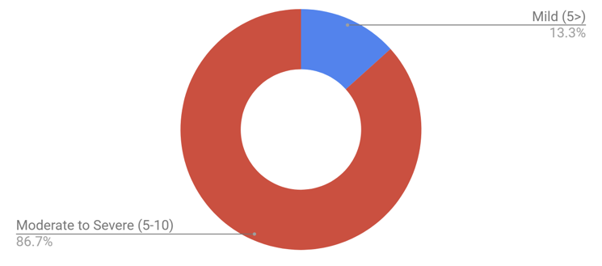
How big of a problem is delayed provider awareness of blood culture speciation?
n=42

Slide 9
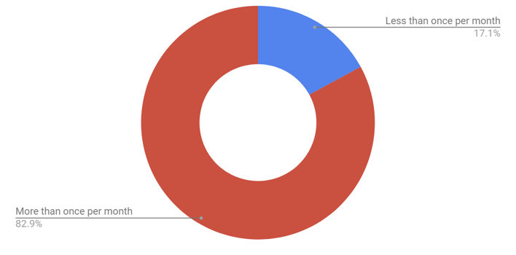
How often do missed culture results lead to a delay (>24 hours) in antibiotic changes?
n=42

Slide 10
Problem
There is delayed provider awareness for positive blood culture speciation and sensitivities, which leads to delayed antibiotic administration.

Slide 11
Blood Culture Process
Blood Culture
Collection
Lab
Provider
Phlebotomist collects sample
Gram stain
Notification
Speciation
Action
Deliver sample to lab
Antibiotic sensitivity
Narrow

Slide 12
Blood Culture Process
Blood Culture
Collection
Lab
Provider
Phlebotomist collects sample
Gram stain
Notification
Speciation
Action
Deliver sample to lab
Antibiotic sensitivity
Narrow

Slide 13
AAVA Contamination Rates
 | JAN | FEB | MAR | 3 month cumulative
Total bottles drawn | 995 | 635 | 732 | 2362
Total positive bottles | 112 | 66 | 75 | 253
Total number of contaminated bottles(*) | 26 | 11 | 8 | 45
Overall contamination rate | 2.61% | 1.73% | 1.09% | 1.91%
Quarterly Contamination by Location | # bottles contam | Total collected* | Rate by unit
ER-DAY | 17 | 463 | 3.67%
ER-PM | 3 | 234 | 1.28%
5PCU | 4 | 98 | 4.08%
MSICU | 8 | 242 | 3.31%
5WM | 8 | 376 | 2.13%
6SM | 1 | 488 | 0.20%
CLC-GEM A | 1 | 48 | 2.08%
5E MED | 1 | 184 | 0.54%
CLC-GEM D | 2 | 8 | 25.00%

Slide 14
Follow-up Culture during possible Contamination
Weinstein MP, Reller LB, Murphy JR, Lichtenstein KA. The clinical significance of positive blood cultures: a comprehensive analysis of 500 episodes of bacteremia and fungemia in adults. I. Laboratory and epidemiologic observations. Rev Infect Dis. 1983;5:35-53.

Slide 15
Blood Culture Process
Blood Culture
Collection
Lab
Provider
Phlebotomist collects sample
Gram stain
Notification
Speciation
Action
Deliver sample to lab
Antibiotic sensitivity
Narrow

Slide 16
Lab Process Map
MD alerted via page by technician
Blood Culture Ordered
Phlebotomy collects
Incubation in Bactalert
Gram Stain performed
Incubated in VITEK 2

Slide 17
Lab Process Map
Blood Culture Ordered
Phlebotomy collects
Incubation in Bactalert
Gram Stain performed
Incubated in VITEK 2
Next day:
10AM: Lab technician checks for speciation/sensitivity
1:00-4:30PM: Results uploaded to VISTA
Uploaded to CPRS
Ordering provider gets inbox message

Slide 18
Lab Process Map
Blood Culture Ordered
Phlebotomy collects
Incubation in Bactalert
Gram Stain performed
Incubated in VITEK 2
Next day:
10AM: Lab technician checks for speciation/sensitivity
1:00-4:30PM: Results uploaded to VISTA
Uploaded to CPRS
Ordering provider gets inbox message

Slide 19
Blood Culture Process
Blood Culture
Collection
Lab
Provider
Phlebotomist collects sample
Gram stain
Notification
Speciation
Action
Deliver sample to lab
Antibiotic sensitivity
Narrow

Slide 20
Provider Pitfalls
Notification
Action
Gram stain
Speciation
Sensitivity
Difficulty tracking culture data
Page
Inbox alert
Poor UI
Multiple modalities
Only to ordering provider
Lost in countless inbox messages in CRPS
Dashboard
CPRS
Essentris

Slide 21
Potential Solutions
high
Lab pages first contact for new blood culture results.
1
1
3
Impact
2
Hire lab personnel as contact to primary team for speciation/sensitivity updates
2
3
Blood culture data extracted from CPRS into dashboard.
low
low
Effort
high
Blood Culture Ordered
Phlebotomy collects
Incubation in Bactalert
Gram Stain performed
Incubated in VITEK 2
Next day:
10AM: Lab technician checks for speciation/sensitivity
1:00-4:30PM: Results uploaded to VISTA
Ordering provider gets inbox message
Uploaded to CPRS

Slide 22
Potential Solutions
Notification
high
5
4
Speciation
Sensitivity
Impact
Gram stain
low
low
Effort
high
Page
Inbox alert
4
Inbox alert forwards to first contact
5
Priority filtering options in inbox
Only to ordering provider
Lost in countless inbox messages in CRPS

Slide 23
Potential Solutions
Action
high
6
7
Impact
Difficulty tracking culture data
low
Poor UI
low
Effort
high
Multiple modalities
6
Single platform for ICU information
7
Blood culture speciation and sensitivity results notification in dashboard.
Dashboard
CPRS
Essentris

Slide 24
CPRS to Dashboard
Blood culture results
Upload to VISTA
Upload to CPRS
Extract to Dashboard
Visual notification for provider

Slide 25
CPRS to Dashboard
Blood culture results
Upload to VISTA
Upload to CPRS
Extract to Dashboard
Visual notification for provider

Slide 26
CPRS to Dashboard
Blood culture results
Collaborate with lab to develop positive speciation and sensitivity-specific keyword.
Upload to VISTA
Upload to CPRS
Extract to Dashboard
Coordinate with Gabe Solomon in development of Dashboard program to recognize lab keyword and flag for notification
Visual notification for provider

Slide 27
Upcoming Plans
Goal:
< 50% surveyed providers will report issues with delayed awareness in blood culture data by February 2020.
Implementation | Who | When | Follow-up
Standardize unique language for each step of micro reporting to automate dashboard system notification. | Iyad Kadorra Mark DeRoo Gabe Solomon | August 2019 | Resend survey February 2020
Coordinate with laboratory and dashboard designers to capture micro results within dashboard system | Iyad Kadorra Mark DeRoo Gabe Solomon | September 2019 | Resend survey February 2020

Slide 28

Thank you Dr. Gupta, Brian Yagi, and Derek Antoku

