Slide 1

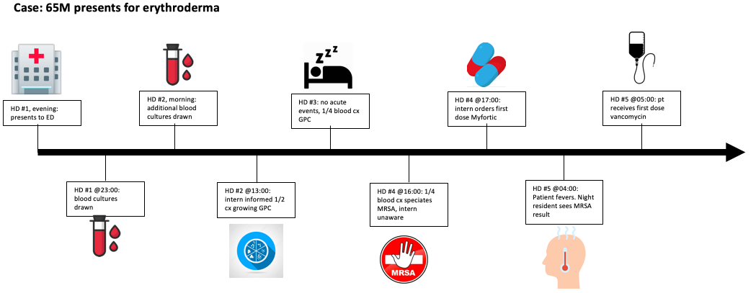
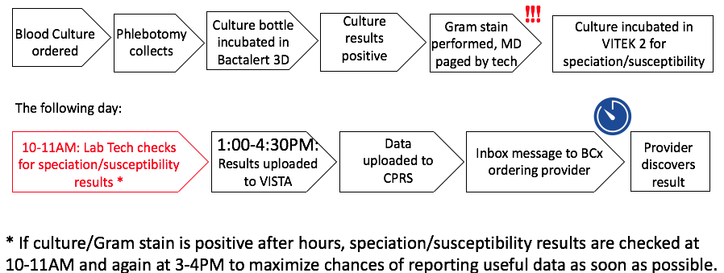
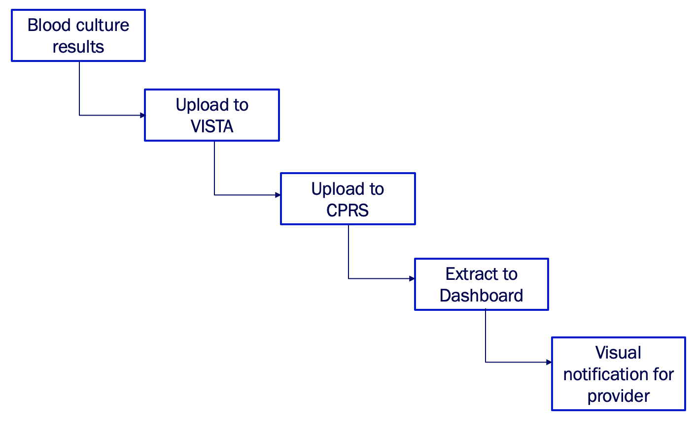
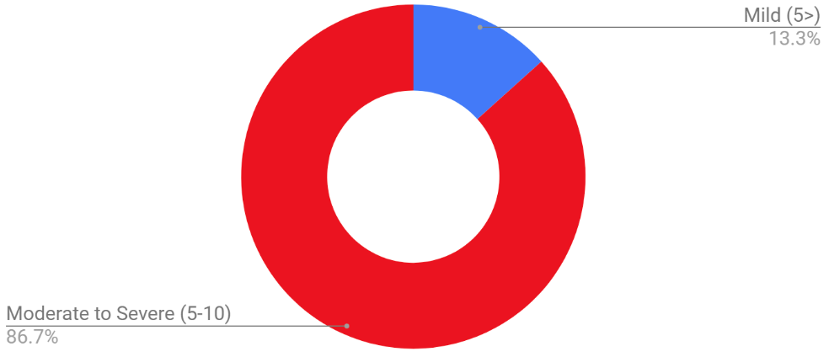
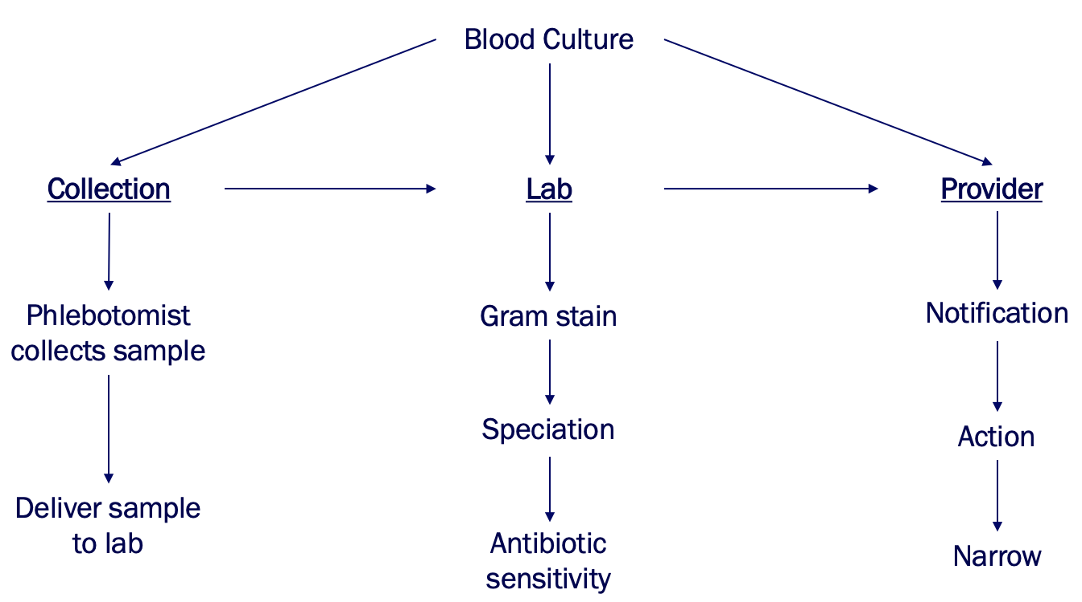
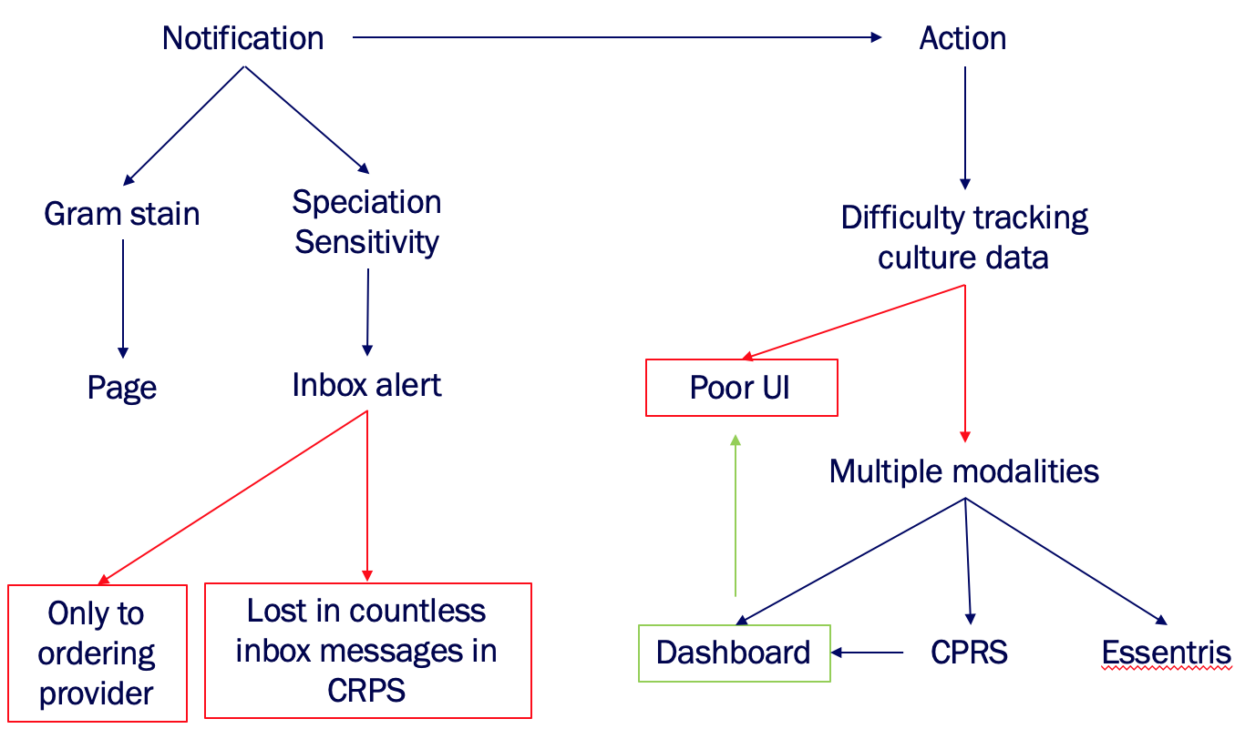
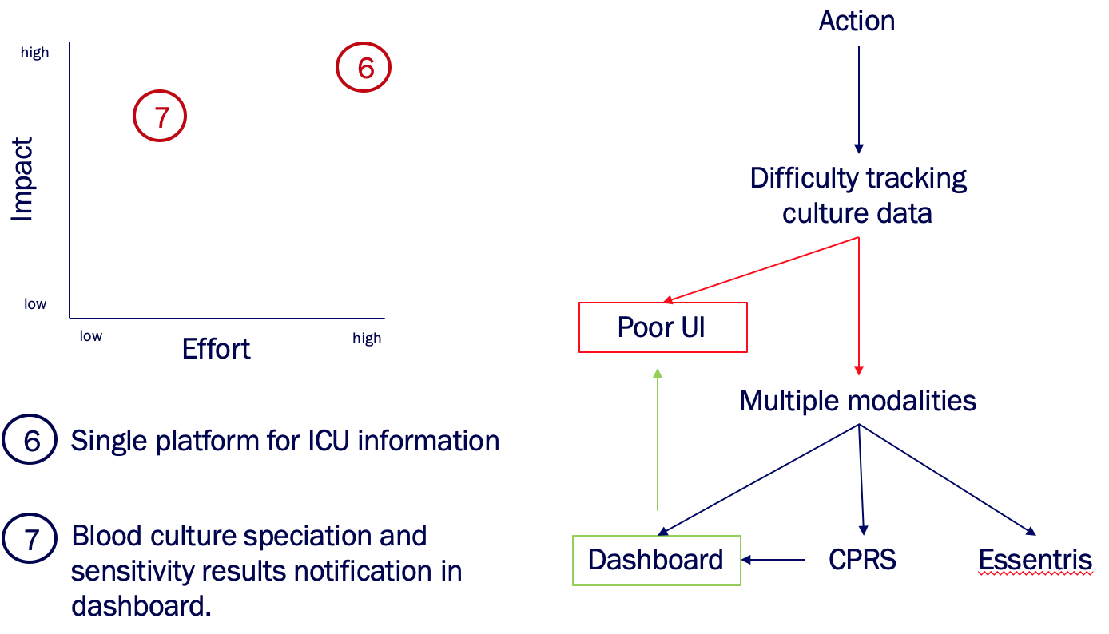
Delays in Antibiotic Administration after Obtaining Blood Cultures in the AAVA ICU
Rizwan Ahmed, Brian Yagi, MD, Derek Antoku, MD
Introduction
Problem Statement
There is delayed provider awareness for positive blood culture speciation and sensitivities, which leads to delayed antibiotic administration.
Process Maps
Delayed awareness viewed as significant problem
Speciation and sensitivities checked 1-2 times daily, usually while prerounding
Root Cause Analysis
Weinstein MP, Reller LB, Murphy JR, Lichtenstein KA. The clinical significance of positive blood cultures: a comprehensive analysis of 500 episodes of bacteremia and fungemia in adults. I. Laboratory and epidemiologic observations. Rev Infect Dis. 1983;5:35-53.
Recommendations
Goal and Follow-up Plan
< 50% surveyed providers will report issues with delayed awareness in blood culture data by April 2020.
Implementation | Who | When | Follow-up
Standardize unique language for each step of micro reporting to automate dashboard system notification. | Iyad Kadorra Mark DeRoo Gabe Solomon | February 2020 | Resend survey April 2020
Coordinate with laboratory and dashboard designers to capture micro results within dashboard system | Iyad Kadorra Mark DeRoo Gabe Solomon | March 2020 | Resend survey April 2020

