Slide 1

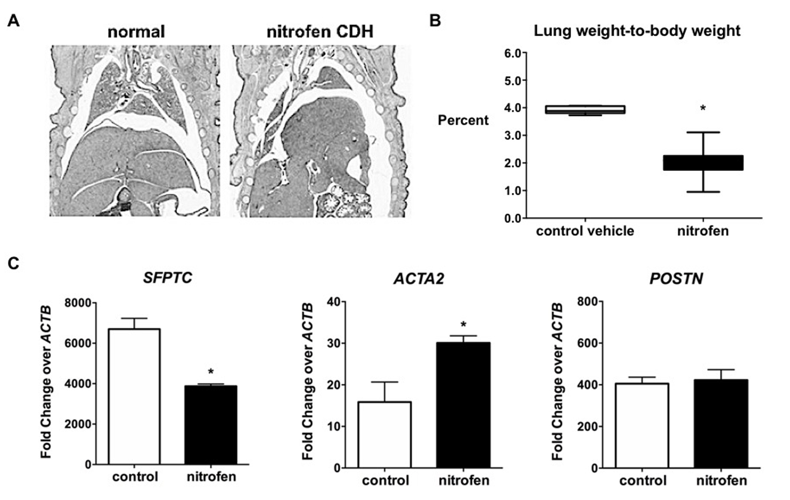
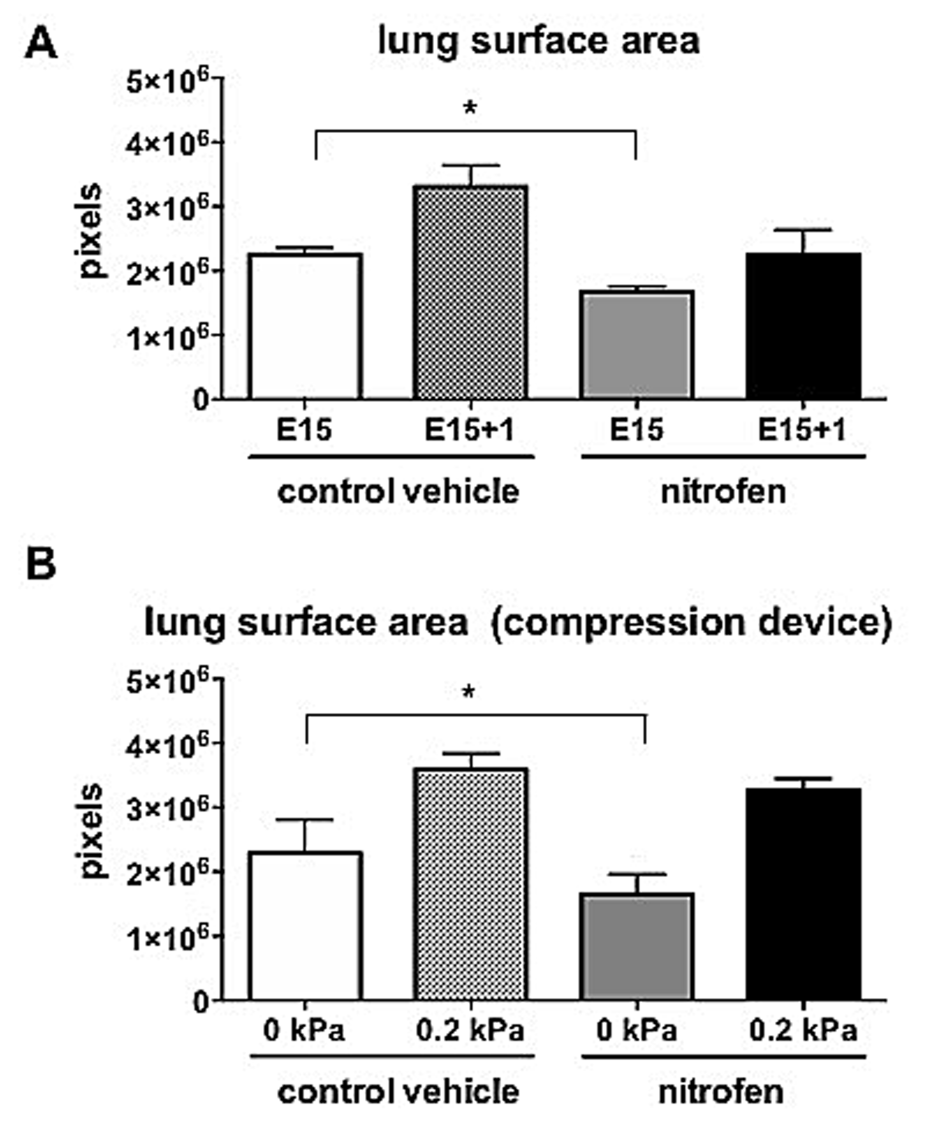
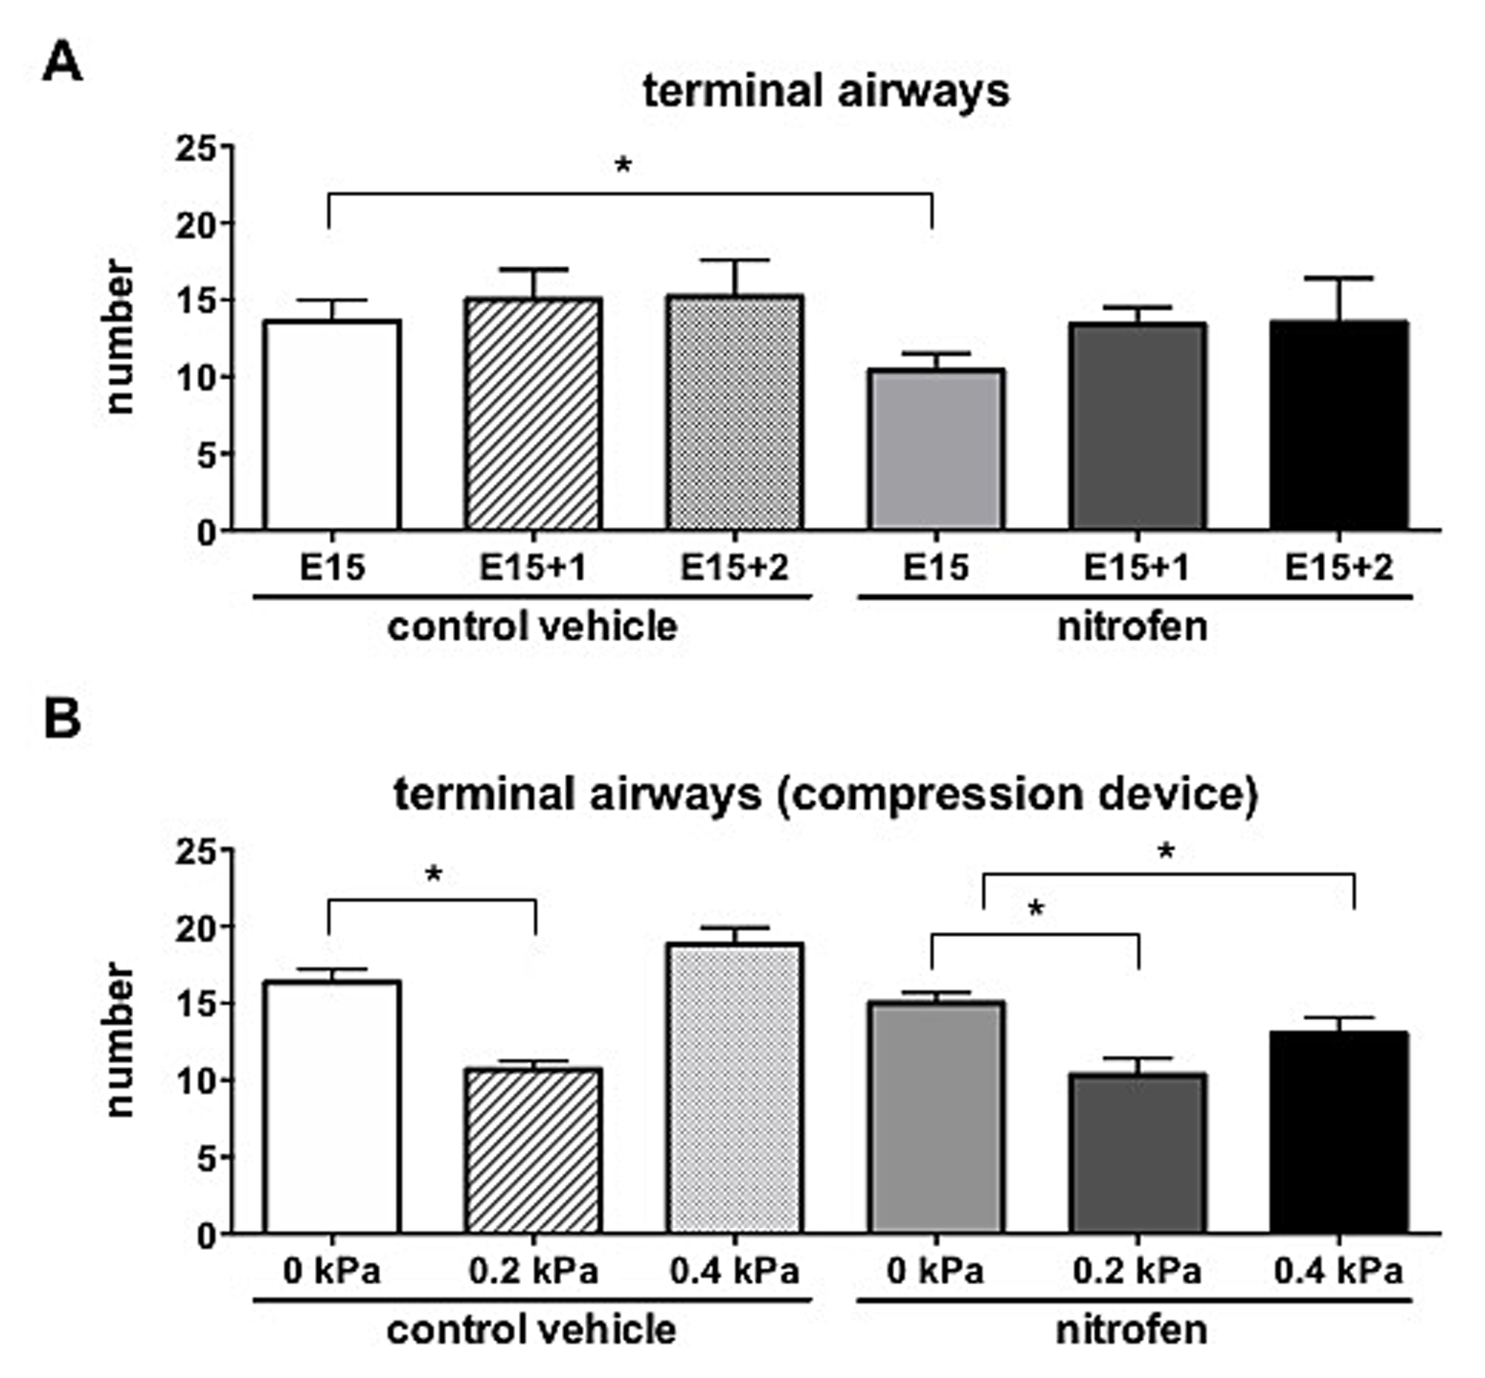
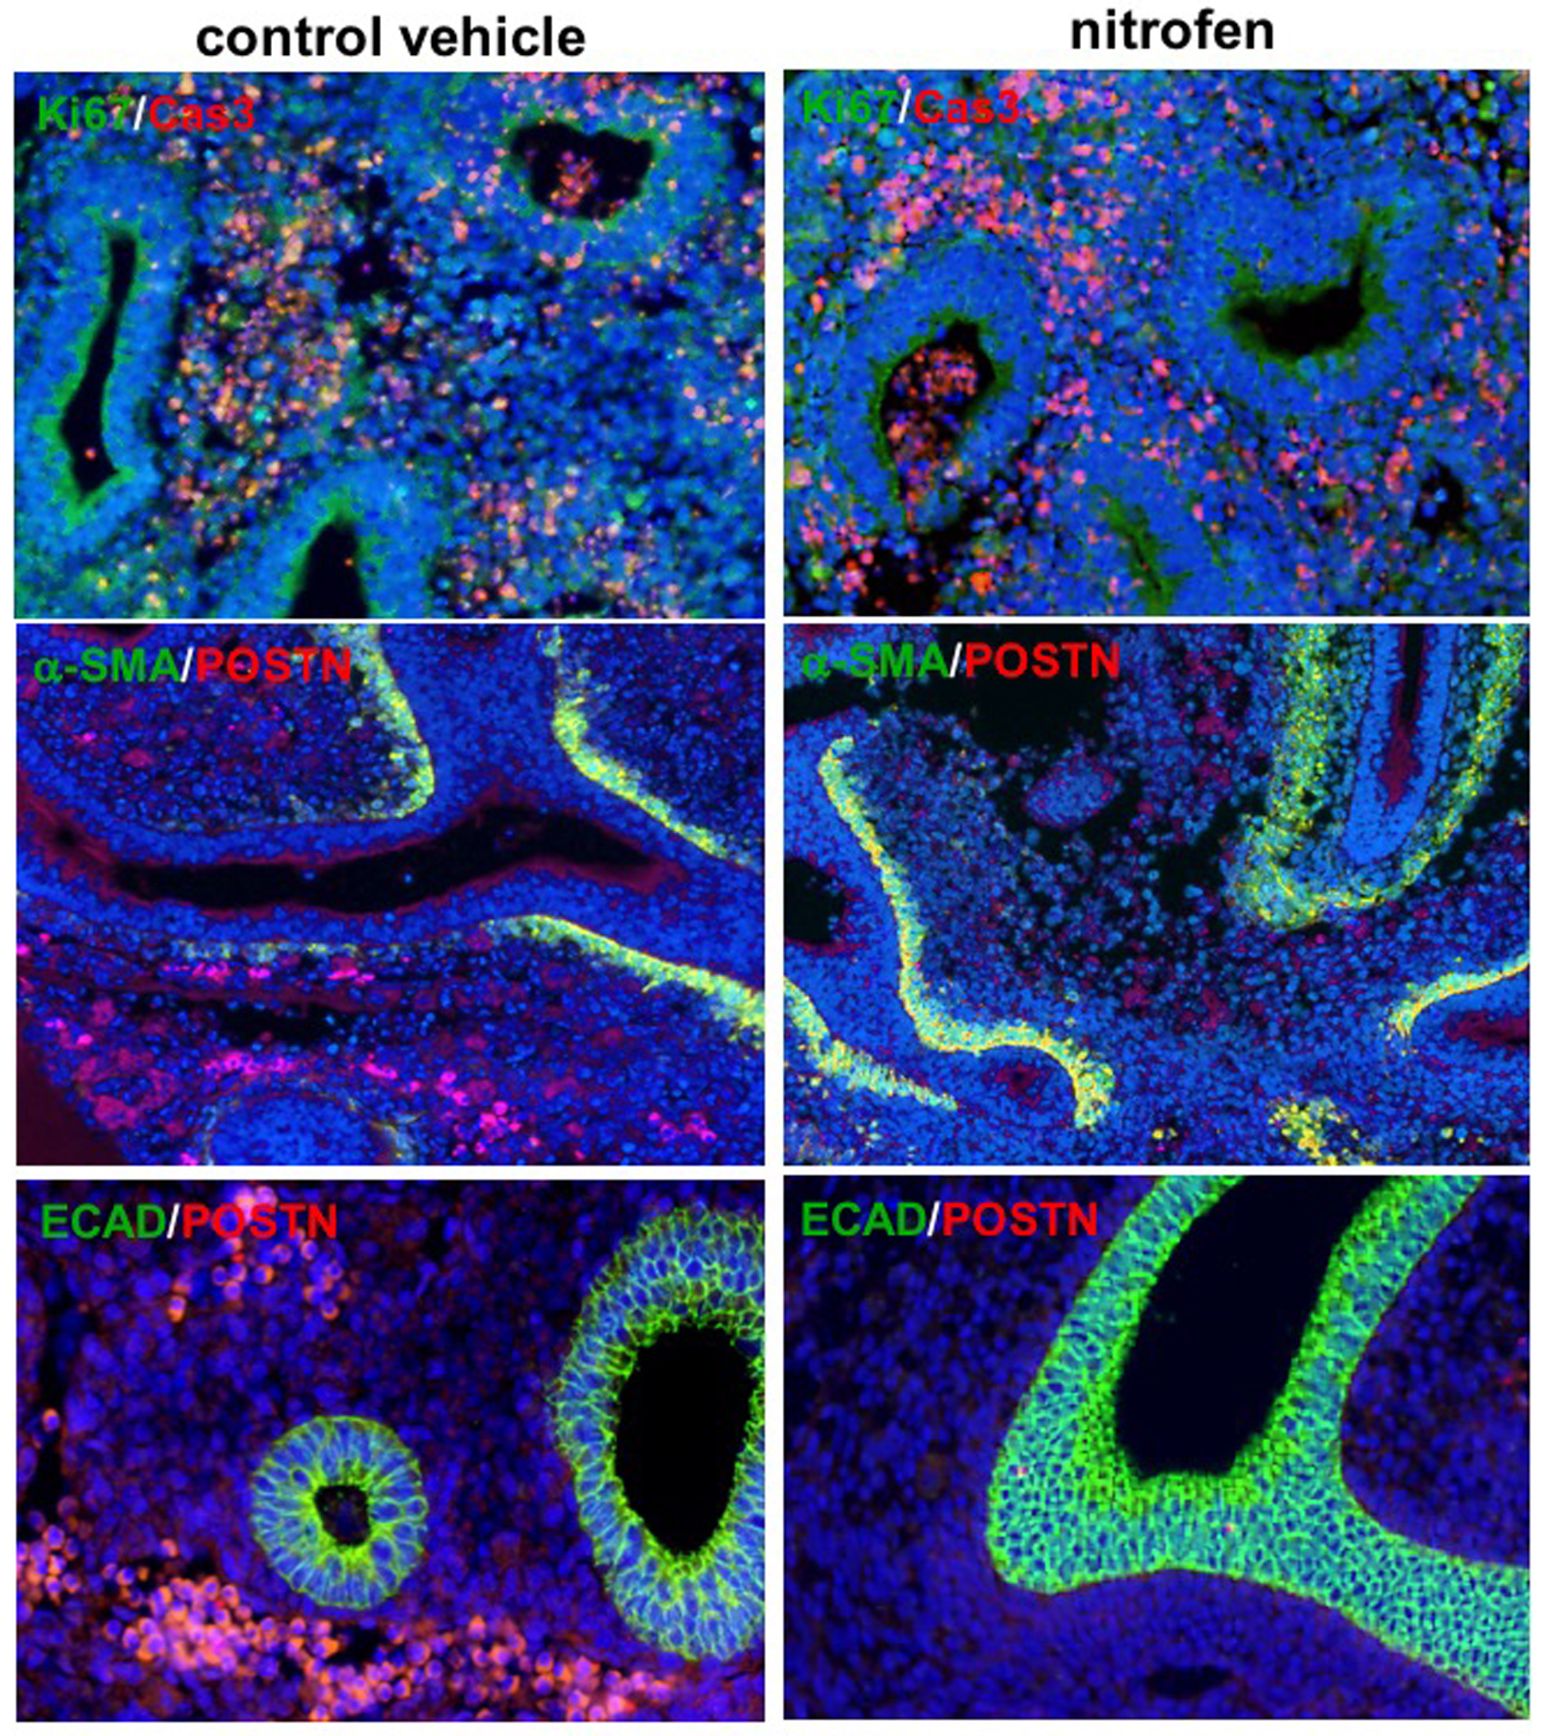
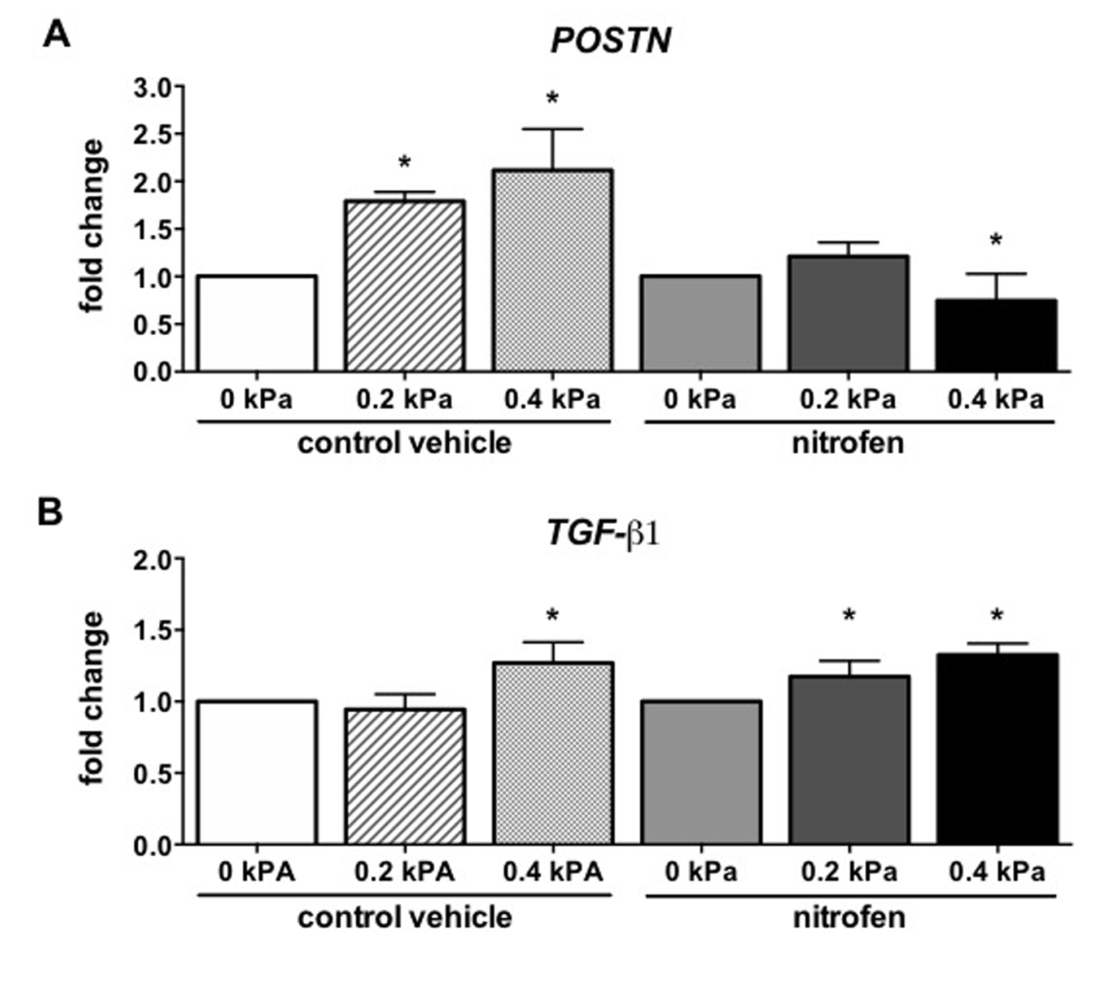
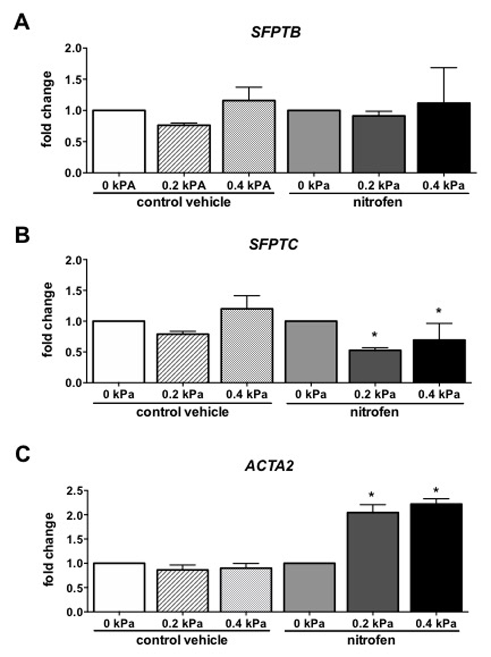
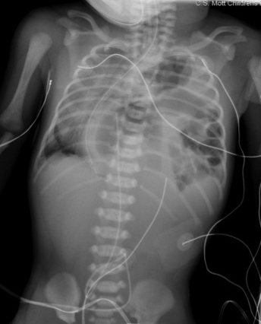
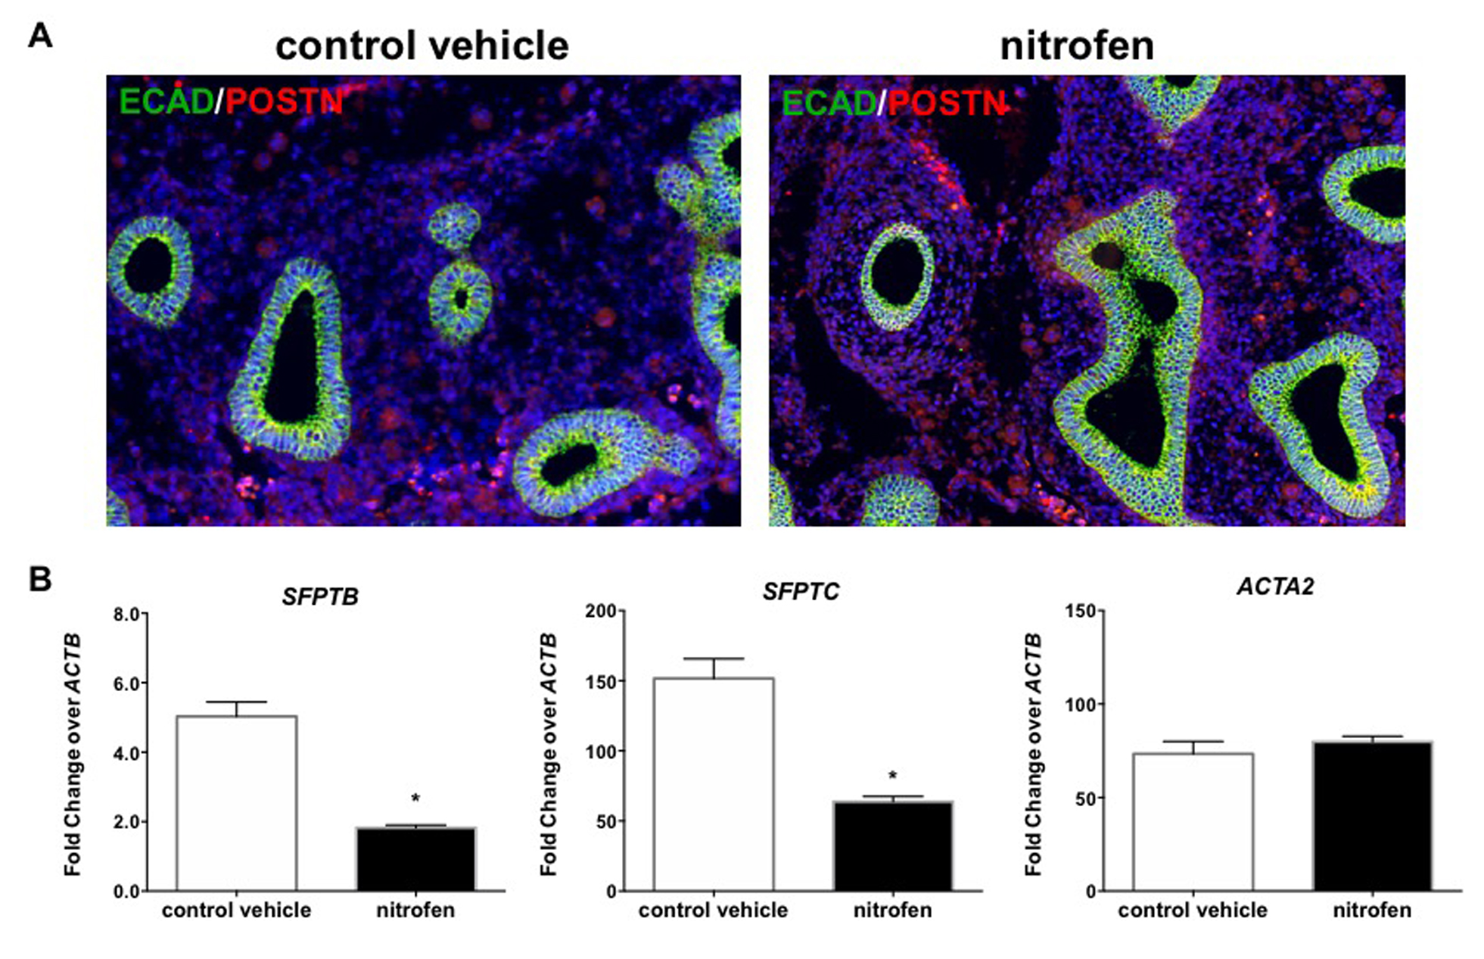
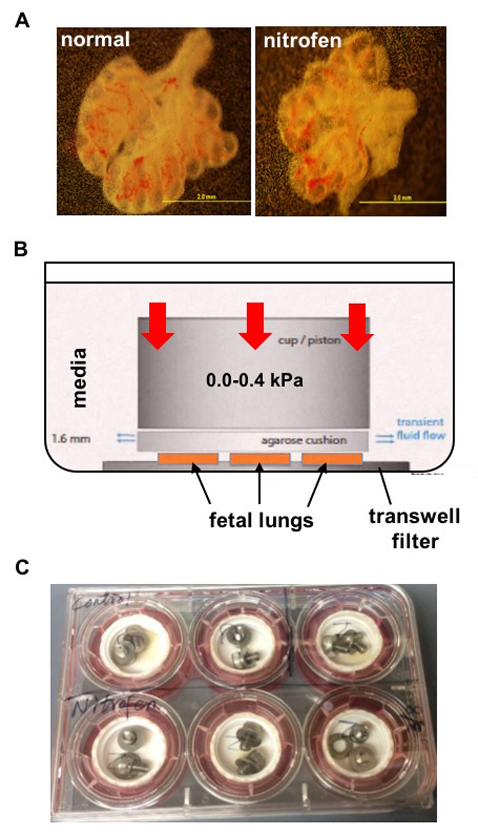
Fetal Lung Transcriptome Patterns in an Ex Vivo Compression Model of Diaphragmatic Hernia
Z.D. Fox^{1,2} , G. Jiang² , K.A. Walker² , K. Ho³ , A.P. Liu³ , S.M. Kunisaki^{1,2} ; ¹University Of Michigan Medical School, Ann Arbor, MI, USA; ²Michigan Medicine, Pediatric Surgery Section, Department Of Surgery, Ann Arbor, MICHIGAN, USA; ³University Of Michigan, Mechanical Engineering, Ann Arbor, MI
Abstract
Results
Results
Background: The purpose of this study was to employ a novel ex vivo lung model of congenital diaphragmatic hernia (CDH) to determine how mechanical compression affects early pulmonary development.
Methods: E15 whole fetal rat lungs (n=6-12/group) from nitrofen-exposed and normal (vehicle only) dams were explanted and cultured ex vivo in compression micro-devices (0.2 or 0.4 kPa) for 12 hrs to mimic physiologic compression forces that occur in CDH in vivo. Lungs were evaluated with significance set at p<0.05.
Results: Nitrofen-exposed lungs were hypoplastic and expressed lower levels of surfactant protein C (SFPTC) at baseline. Although compression alone did not alter a-smooth muscle actin (ACTA2) expression in normal lungs, nitrofen-exposed lungs had significantly increased ACTA2 transcripts (0.2 kPa: 2.04±0.15; 0.4 kPa: 2.22±0.11; both p<0.001, respectively). Nitrofen-exposed lungs also showed further reductions in SFPTC expression at 0.2 and 0.4 kPa (0.53±0.04, p<0.01; 0.69±0.23, p<0.001; respectively). Whereas normal lungs exposed to 0.2 and 0.4 kPa showed significant increases in periostin (POSTN), a mechanical stress response molecule (1.79±0.10 and 2.12±0.39, respectively; both p<0.001), nitrofen-exposed lungs had a significant decrease in POSTN expression (0.4 kPa: 0.67±0.15, p<0.001), which was confirmed by immunohistochemistry.
Conclusion: Collectively, these pilot data in a model of CDH lung hypoplasia suggest a primary aberration in response to mechanical stress within the nitrofen lung, characterized by an upregulation of ACTA2 and a downregulation in SPFTC and POSTN. This ex vivo compression system may serve as a novel research platform to better understand the mechanobiology and complex regulation of matricellular dynamics during CDH fetal lung development.
Lung Morphogenic Analysis – Early Nitrofen exposure results in reduced lung volumes, terminal airway branching, and distal lung epithelial transcripts in embryonic lung development
Molecular Effects of Ex vivo Compression – Compression of nitrofen exposed lungs results in relative decreases in POSTN and SFPTC but increases in TGF-B and ACTA2 expression, while pressure alone results in increased levels of POSTN and TGFB without changes in epithelial markers.
Introduction
Molecular Effects of Nitrofen Exposure – Nitrofen exposure alone does not alter levels of interstitial stress response molecules such as POSTN but results in significant reduction in markers of epithelial maturity such as Surfactant Protein C.
Clinical Significance: Pulmonary hypoplasia and hypertension are major problems in neonates born with congenital diaphragmatic hernia (CDH). Despite advances in care, mortality remain in excess of 30 percent
Purpose: To better understand the relative contribution of mechanical forces in the CDH lung by exploring lung development in the nitrofen rat model using a novel ex vivo mechanical compression micro-device.
Hypothesis: Ex vivo mechanical compression results in greater alteration of pulmonary epithelial and mesenchymal developmental markers in nitrofen exposed compared to control lungs.
Methods
Lungs exposed to control vehicle (top left) or nitrofen (top right) displayed robust evidence of proliferating airway epithelium denoted by expression of Ki67 (green) as well as apoptosis within the interstitium based on expression of cleaved caspase-3 (Cas3, red; magnification, 20x)
Conclusions
Data from this novel, “disease-in-a-dish” ex vivo model of CDH fetal lung development suggests a primary aberration in the pulmonary transcriptome pattern within nitrofen-exposed lungs in response to mechanical stress.
These findings are associated with impaired upregulation of POSTN, a mechanical stress response protein important for normal lung development.
Further investigation of this bioengineering research platform is warranted to help facilitate a better understanding of the effect of mechanical compression on fetal lung growth and matricellular dynamics.
A) Whole fetal rat lung were dissected from Sprague-Dewey dams gavaged with Nitrofen vs control at E9.5 gestation. Lungs were cultured in Hank’s buffered saline.
B) Micro-device was designed to apply compressive stress to fetal rate lung explants.
C) Lungs were encapsulated in Matrigel and place in a transwell 6-well plate on top of a 0.4 um PET transwell filter to allow nutrient and oxygen diffusion. To apply constant stress, a fixed weight was applied over the cushion.

