Slide 1

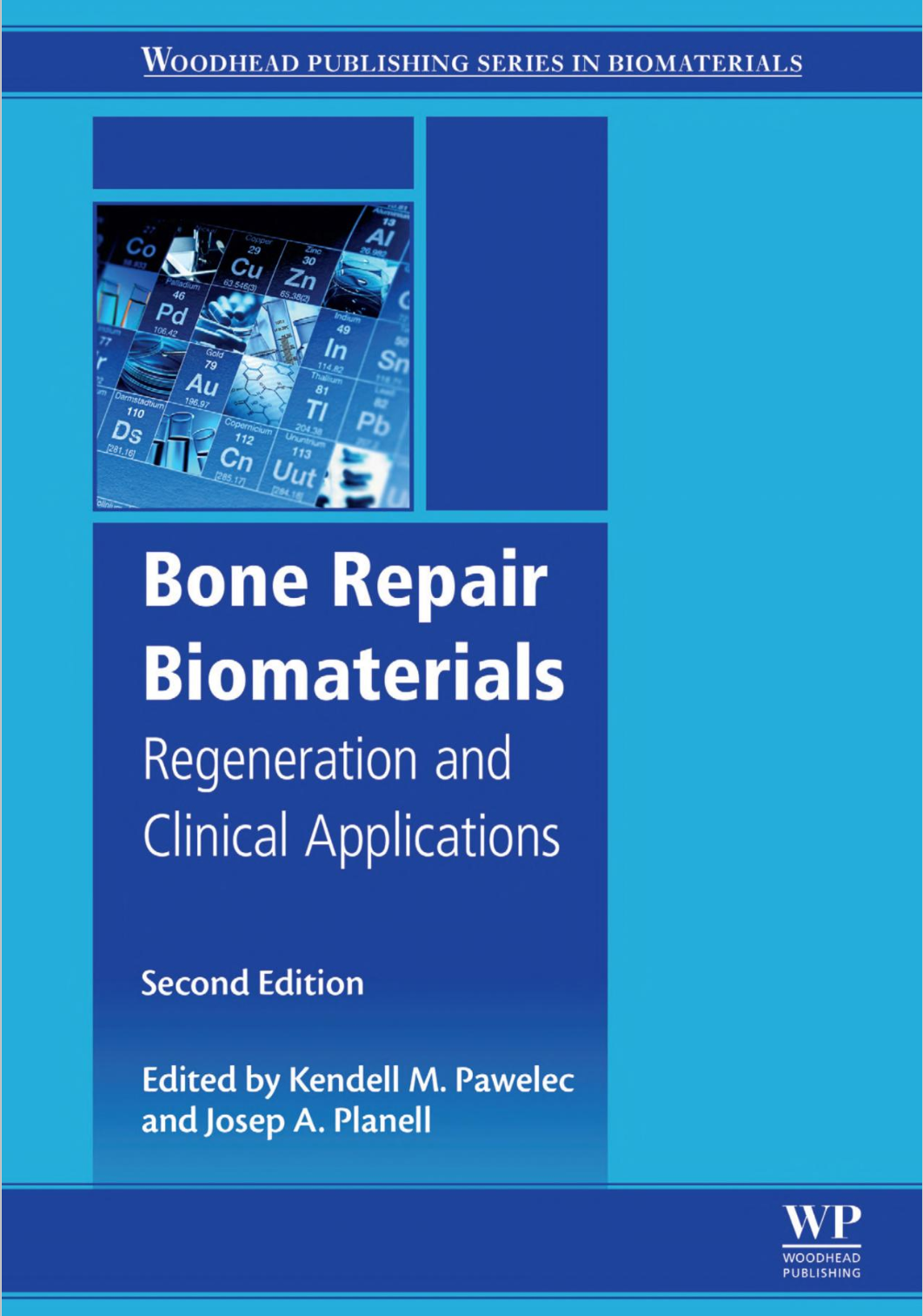
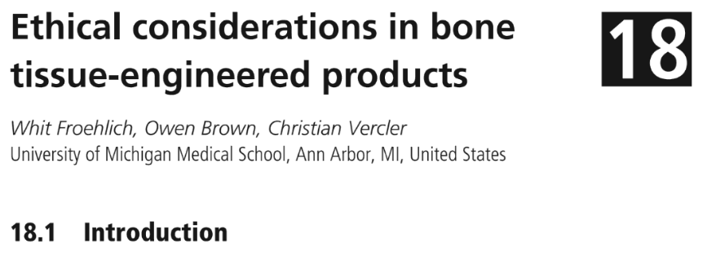
Articulating the “Ethical Considerations in Bone Tissue-Engineered Products”
REPLACE THIS BOX WITH YOUR ORGANIZATION’S
HIGH RESOLUTION LOGO
REPLACE THIS BOX WITH YOUR ORGANIZATION’S
HIGH RESOLUTION LOGO
Whit Froehlich, BA^{1, 2}; Owen Brown, BS¹; Andrew Barnosky, DO, MPH¹; Christian Vercler, MD¹
¹University of Michigan Medical School, Ann Arbor, MI, ²Correspondence to wfroehli@umich.edu
Introduction
Objectives
Approach
Obstacles and Modifications
My Capstone for Impact project is a book chapter that I wrote with a classmate under the supervision of Dr. Christian Vercler, a faculty member within our Path of Excellence in Medical Ethics, which was a collaboration with a colleague in the Department of Mechanical Engineering, Dr. Kendell Pawelec, who edited the book. This project was an opportunity to hone and apply my abilities as an ethicist, and to reflect on the value that the framework of medical ethics has for the conduct of research and clinical practice. I improved my understanding in these areas as well as my academic writing skills, and was reminded of the importance of collaborating across disciplines and departments in the service of stronger scholarship. I hope to be able to apply these skills and insights in my future work and career.
Goals for this project included developing stronger intuition and technical skills in medical ethics, learning about the use of its principles outside of the clinical setting, and improving my writing. It was critical to the successful attainment of these goals to be able to learn from Dr. Vercler, whose greater experience and expertise in these areas informed ongoing and final feedback on the project. Additionally, we intended to be able to contribute to the available base of knowledge on this topic by writing this chapter. We were particularly optimistic in this regard as ours was to be an outlier to much of the book’s content, which covered technical and clinical aspects of the technology. Finally, by collaborating across departments at the University, I hoped to somewhat increase the chance of future similar collaboration, as it is generally mutually beneficial.
Owen and I planned to thoroughly examine the Ethics chapter from the First Edition for content that remained relevant and valid, and consult with our faculty mentor and senior author, Dr. Vercler, to better understand appropriate parameters for the final manuscript. Following this, we anticipated rewriting some portions of the First Edition chapter and adding additional content as needed to bolster it to sufficiency for its intended purpose. We had some uncertainty about the timeline for the project, but hoped to complete it around our competing obligations to ongoing clinical rotations, coordinating, as needed, with Dr. Pawelec. We were comparatively in the dark about the details of the editing and publications process, but expected that these, too, would be communicated at the appropriate time by the project leaders. Finally, I anticipated using this work as my capstone for my work as a student in the Path of Excellence in Medical Ethics, but was not yet aware of the CFI requirement which I am now also using it to fulfill.
After meeting to review and discuss the ethics chapter from the First Edition, we marked it up for revision, realizing as we did so that we might ultimately be walking a difficult line between reuse and rewriting, especially given that we were not in contact with the original authors. We iterated a bit more before concluding that this would be untenable. In consultation with Dr. Vercler, we determined that it would be most appropriate to instead start from scratch with entirely our own work, taking authorship ourselves.
When we then started writing from that point, we found that while comfortable with the principles of medical ethics and their consequences, we were uncertain about relevant aspects of the technology itself. It became clear that we would need to better understand numerous of its details, such as the present use cases and how constituent cells are sourced, in order to accurately characterize their attendant ethical issues. Dr. Vercler was again helpful here, providing both direct experience and suggestions of further reading.
Another challenge of this project was that it had to get done on a timeline outside our control and disconnected from our obligations to clinical rotations. This sometimes meant significant and unpredictable delays as well as the need to complete certain tasks much more urgently (though these requests, too, were unpredictable). We strove to clarify responsibilities so that delays were attributable to busyness rather than miscommunication.
Background
I was fortunate to have been connected through my participation in the Path of Excellence in Medical Ethics with a University of Michigan colleague in the Department of Mechanical Engineering, Dr. Pawelec, a specialist in Materials Science. Dr. Pawelec was at the time editing the second edition of Bone Repair Biomaterials and sought authors to provide an update to the first-edition chapter on ethics. I, along with my classmate Owen Brown, responded to this solicitation when it was relayed by our Ethics faculty as an opportunity for students, with the promise of support in the person of Dr. Vercler. Bone Repair Biomaterials is a book about various technologies employed in surgical bone repair, and the different medical applications of them. Additional chapters add information about complications and newer areas of ongoing development. We intended to add to this overall effort by highlighting some of the ethical issues raised by the use of these bone repair technologies, and providing some guidance regarding appropriate mitigation of them. Our work is based on the core principles of medical ethics, and informed by our own experience with research and clinical practice. It proved useful, also, to do additional reading about the technology, and confer with Dr. Vercler, to best ground our efforts in an accurate understanding of its nature and applications. We also began the project relatively new to academic publishing and so without a strong sense of its scope or pace, and were guided as needed by Dr. Pawelec and the publishers.
Figure 2. Title and Authors for the completed chapter.
Conclusions
This project involved working closely with, and learning from, Dr. Vercler, and more distantly with Dr. Pawelec. As hoped, I found their feedback constructive, and was able to strengthen my ethical reasoning, writing, and research skills. The book has since been published (see “Outcome”), and while I have no illusions that it will reach a broad audience, I am comfortable assuming that for its likelier audience the inclusion of our chapter will be a worthwhile addition. On a personal level, I gained valuable experience through coordinating this project which I anticipate applying in similar situations in the future. I am immensely grateful to Dr. Vercler, my Path of Excellence in Medical Ethic advisor Dr. Barnosky, and the other Path faculty for making this work possible, as well as Dr. Pawelec for leading the overall project.
Outcome
The final book Bone Repair Biomaterials was published on December 6, 2018, and is available through Woodhead Publishing. See Figures 1 and 2 for the appearance of the book and our chapter within it, “Ethical Considerations in Bone Tissue-Engineered Products.” I will also mention that in fulfilling my Path of Excellence capstone obligation and Branches Capstone for Impact obligation, this project has been tangibly productive in my progress towards graduation. I am fortunate that I was permitted to arrange this for work that fit my personal and professional trajectory so well.
Figure 1. The cover of the finished book.

