Slide 1


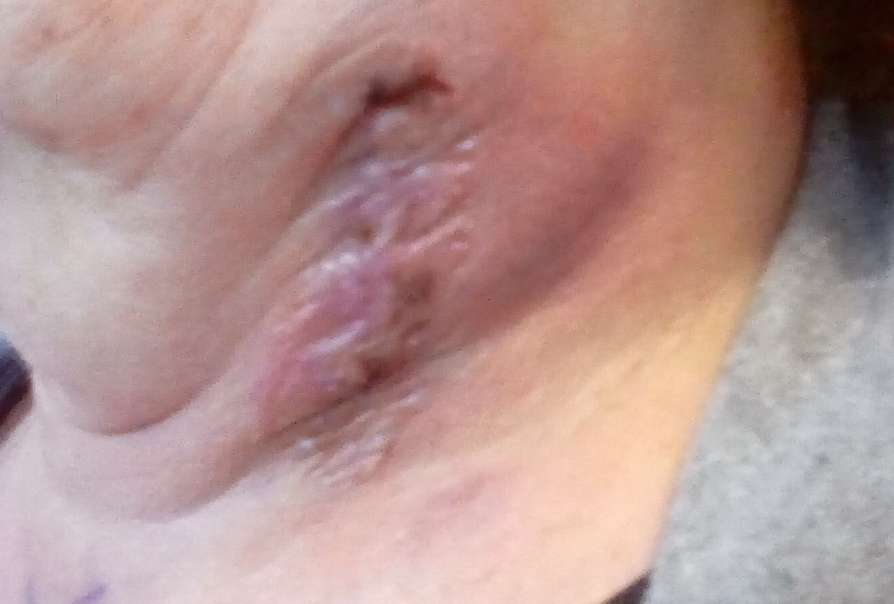
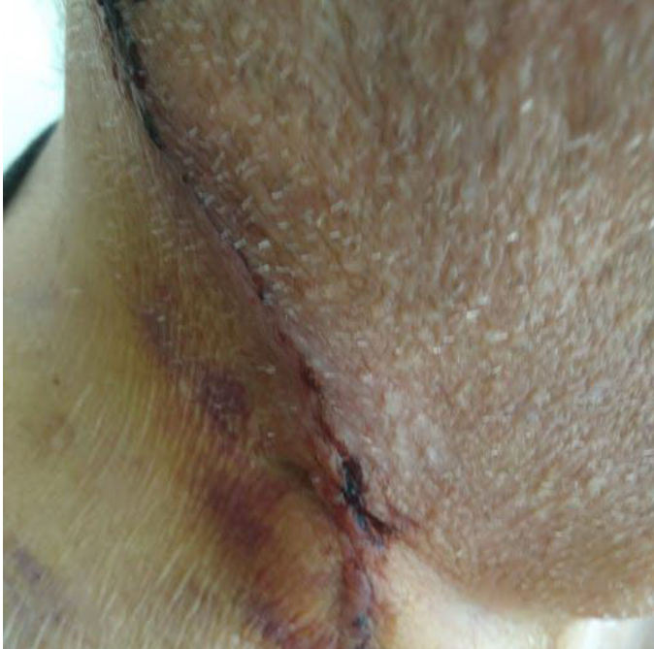
Applying Patient-Generated Communications and Photographs to Smarter Telemedicine Triage and Redesign of Perioperative Educational Materials for Carotid Procedures
Keith Garber; Matthew Corriere, MD; Esther Cho, MD
University of Michigan Health System – Frankel Cardiovascular Center – Division of Vascular Surgery
Abstract
Methods and Materials
Results
Discussion
Mismatch between patient needs and perioperative education can create safety issues, increase administrative burden through calls and related documentation, and result in unplanned visits that may be unnecessary. Patient-generated communications (including telephone, email, and portal queries) were identified from 100 elective carotid procedures and coded by two investigators using a deductive qualitative approach to identify themes. Gaps in communication and understanding identified through these data were used to target refinement of educational materials and processes. Common themes were medications (35%), surgical site issues (26%), scheduling (20%), preoperative testing (18%), and abnormal vital signs (15%). Ten communications preceded emergency department visits, 6 of which were related to potentially avoidable surgical site concerns, and 4 of those visits resulted in readmissions. Patients’ queries can be used as a data repository and applied to refine educational materials targeting their needs.
One-hundred consecutive elective carotid procedures (either carotid endarterectomy [CEA] or trans-carotid stenting [TCAR]) were identified. Patient-generated communications (including telephone, email, and portal queries) were identified through the medical record. Perioperative communications were defined based on the interval from the pre-operative visit to the first planned post-operative appointment.
Data were coded by two investigators using a deductive qualitative approach to identify themes. Additional data collected included patient demographics, unplanned clinic or ED visits, and readmissions. Baseline educational materials were evaluated for understandability and actionability using the Patient Education Materials Assessment Tool (PEMAT). New educational content in the form of Frequently Asked Questions (FAQ) was generated based on theme frequency and actionability.
Mean age was 71.1 ± 9.4 years; 95 patients were white, and 31 were women. Mean distance from patients’ home addresses to medical center was 52.3 ± 116 miles. There were 158 patient-generated communication entries documented. Mean days from preop visit to procedure was 17 ± 24, and mean days from preop visit to patient-generated communication was 30 ± 61, with 65% of communications generated post-operatively. Common themes were medications (35%), surgical site concerns (26%), scheduling (20%), preoperative testing (18%), and vital signs (15%). Ten communications preceded emergency department visits, 6 of which were related to potentially avoidable surgical site concerns, and 4 of those visits resulted in readmissions.
Physician Education Material Assessment Tool (PEMAT) scores were fair for baseline educational materials. Understandability scores for after-visit summaries, post-discharge instructions, and wound care instructions were 77%, 58%, and 69%, respectively. Themes of patient-generated communications that were absent or inconsistent with baseline educational materials were used to develop targeted refinements, specifically high-yield FAQs.
Mismatch between patient needs and perioperative education can create safety issues, increase administrative burden through calls and related documentation, and result in unplanned hospital visits that may be unnecessary. We evaluated patient-generated perioperative communications (including telephone and portal queries) in a cohort of consecutive carotid procedures. Lapses in communication and understanding identified through these data were used to target refinement of educational materials and processes and streamline triage strategies.
Surgical site care is a potentially high yield topic for reducing unnecessary ED visits, while patient-facing resources related to scheduling and medications have the greatest potential to minimize administrative burdens related to patient questions or concerns. Ongoing evaluation of refined content, including FAQ, will include quantified understandability and actionability scores generated using the PEMAT as well as post-implementation effects on patient-generated communications and unplanned visits.
Introduction
An important component of the Triple Aim approach for improving the US healthcare system is the efficiency of care^{1,2}. In line with nationwide efforts to move towards value-based healthcare system, medical societies and policymakers have pushed for strategies that will increase the quality and decrease the care volume and associated costs.^{2,3} There are multiple aspects to health care quality. The Institute of Medicine defines 6 domains of health care quality as safety, effectiveness, patient-centeredness, timeliness, efficiency, and equity of care, and that each domain deserves adequate attention in both assessment and improvement efforts.⁴ However, most quality measures developed and used in studies only address effectiveness and safety. In addition, most of them focus on outcomes, and not processes through which those outcomes are produced.⁵
While outcomes and processes are two parts of Donabedian’s Triad to measure health care quality,^{6,7} but often do not suggest a way to improve the quality of care delivered. For example, the National Surgical Quality Improvement Program has been accepted as the benchmark of quality improvement in surgical care.⁸ It monitors quality measures such as 30-day mortality and readmission rates,⁹but not variables that influence those rates, such as the level of patients’ understanding of postoperative instructions. Moreover, readmission rates only capture inpatient hospitalizations and not observation stays or emergency department visits.¹⁰ Unnecessary utilization of ED is a substantial waste of healthcare budget. In fact, approximately 56% of ED visits in the US are potentially avoidable, yet they cost $38 billion each year.^{11,12}
The quality of postoperative discharge instructions and patient education in the perioperative period is a strong influencer of surgical outcomes. Reducing the mismatch between care given from the providers’ perspective and perceived care from the patients’ perspective can decrease the unnecessary volume of care and associated costs from unplanned visits to clinic or the emergency department. Inefficiency equates to low quality care because wasteful care is either directly harmful to health or indirectly by displacing appropriate healthcare.⁶ Patients often contact the office before or after their procedure, but most often the patient is unknown to the responding provider. Further, calls are usually answered by medical assistants or nurses, who contact the surgeon and wait for a response before advising the patient. This is a substantial use of resources.¹³ Reducing the number of communications and ED visits will permit more efficient use of resources, including the providers’ time and energy. In addition, focused investigation on these process measures can provide effective quality improvement strategies as they are readily available and amenable to change.^{6,7,14}
Table 1. Patient Demographics
 |  | % of Total
Sex | Female | 31
 | Male | 69
Age (years) | >85 | 8
 | 75 - 84 | 29
 | 65 - 74 | 37
 | 55 - 64 | 24
 | <55 | 2
Race | White | 95
 | Black | 3
 | Native American | 1
 | N/A | 1
Distance from Hospital (miles) | <5 | 5
 | 5-10 | 10
 | 11 - 20 | 27
 | 21-30 | 15
 | 31-40 | 11
 | 41-50 | 10
 | 51-75 | 7
 | 76-100 | 6
 | 101-150 | 2
 | 151-200 | 2
 | >200 | 5
Conclusions
Patient access to clinicians through electronic medical record (EMR) portals, email, and smartphones allows sharing of text and photographs in addition to voice content. These capabilities have expanded communication and documentation burdens for clinicians, especially when patients experience unanticipated problems or have unanswered questions. Patients’ queries can be used as a data repository and applied to refine educational materials targeting their needs. In the future, we aim to demonstrate post-implementation effects on patient communication modems, unplanned emergency department visits, and re-admissions.
Chart 1. Relative Frequency of Patient-Generated Concerns
Figure 1. Example of Patient-Generated Photo Related to Surgical Site Concern.
Figure 2. Example of Patient-Generated Photo Related to Surgical Site Concern.
Contact
References
Keith Garber
University of Michigan Medical School
Email: garberk@med.umich.edu
Phone: (269) 953 - 3145
1.Berwick DM, Nolan TW, Whittington J. The triple aim: care, health, and cost. Health Aff (Millwood). 2008;27(3):759-769.
2.Asch SM, Kerr EA, Keesey J, et al. Who is at greatest risk for receiving poor-quality health care? N Engl J Med. 2006;354(11):1147-1156.
3.McGlynn EA, Asch SM, Adams J, et al. The quality of health care delivered to adults in the United States. N Engl J Med. 2003;348(26):2635-2645.
4.Institute of Medicine Committee on Quality of Health Care in A. Crossing the Quality Chasm: A New Health System for the 21st Century.Washington (DC)2001.
5.Medicine Io. Performance Measurement : Accelerating Improvement.Washington, D.C.: National Academies Press; 2006.
6.Donabedian A. The quality of care. How can it be assessed? Jama. 1988;260(12):1743-1748.
7.Donabedian A. Evaluating the quality of medical care. Milbank Mem Fund Q. 1966;44(3):Suppl:166-206.
8.Raval MV, Pawlik TM. Practical Guide to Surgical Data Sets: National Surgical Quality Improvement Program (NSQIP) and Pediatric NSQIP. JAMA Surg. 2018;153(8):764-765.
9.American College of Surgeons. ACS National Surgical Quality Improvement Program. https://www.facs.org/quality-programs/acs-nsqip. Accessed June 4th, 2019.
10.Wadhera RK, Yeh RW, Joynt Maddox KE. The Hospital Readmissions Reduction Program —Time for a Reboot. New England Journal of Medicine.0(0):null.
11.Telem DA, Yang J, Altieri M, et al. Rates and Risk Factors for Unplanned Emergency Department Utilization and Hospital Readmission Following Bariatric Surgery. Ann Surg. 2016;263(5):956-960.
12.Finnegan MA, Shaffer R, Remington A, Kwong J, Curtin C, Hernandez-Boussard T. Emergency Department Visits Following Elective Total Hip and Knee Replacement Surgery: Identifying Gaps in Continuity of Care. J Bone Joint Surg Am. 2017;99(12):1005-1012.
13.Warren LE, Kim MB, Martin NE, Shih HA. Analysis of After-Hours Patient Telephone Calls in Two Academic Radiation Oncology Departments: An Opportunity for Improvement in Patient Safety and Quality of Care. J Oncol Pract. 2016;12(4):e487-494.
14.Porter ME. What is value in health care? N Engl J Med. 2010;363(26):2477-2481.

