Slide 1

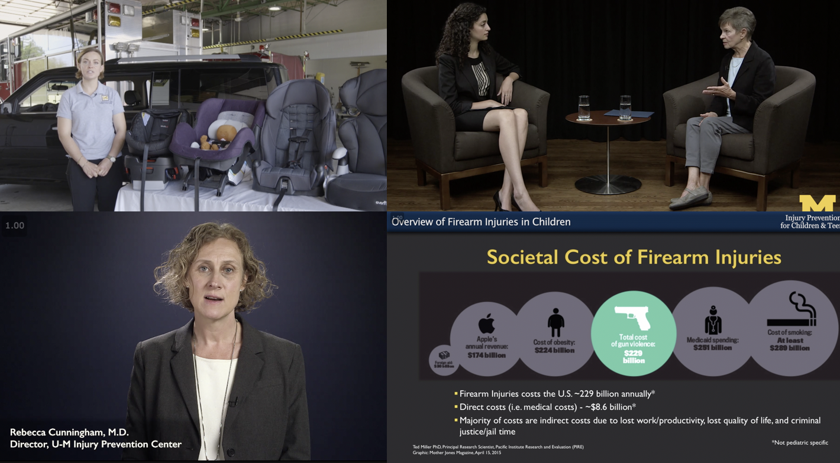
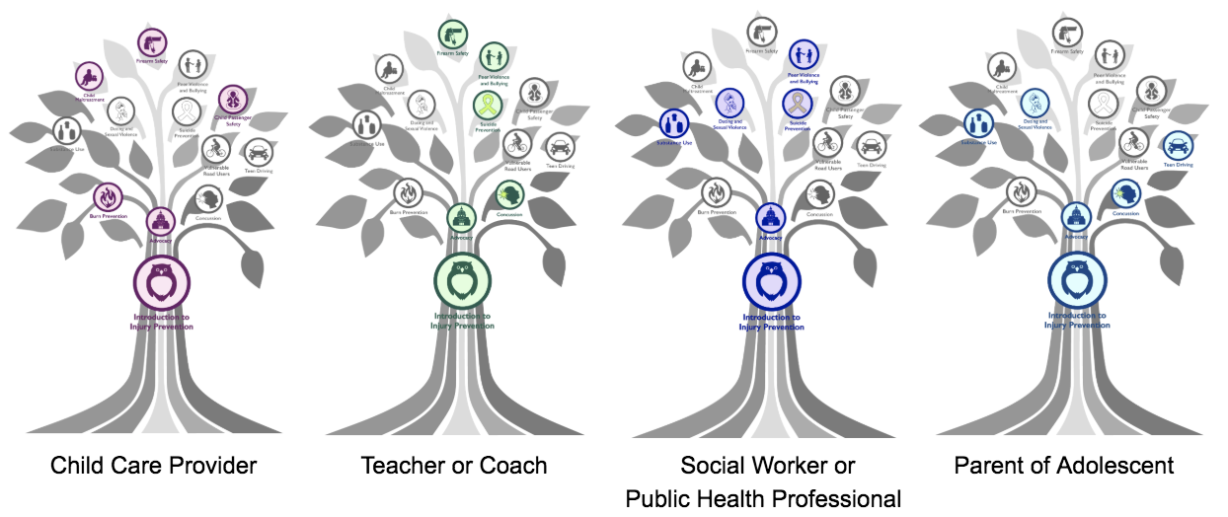
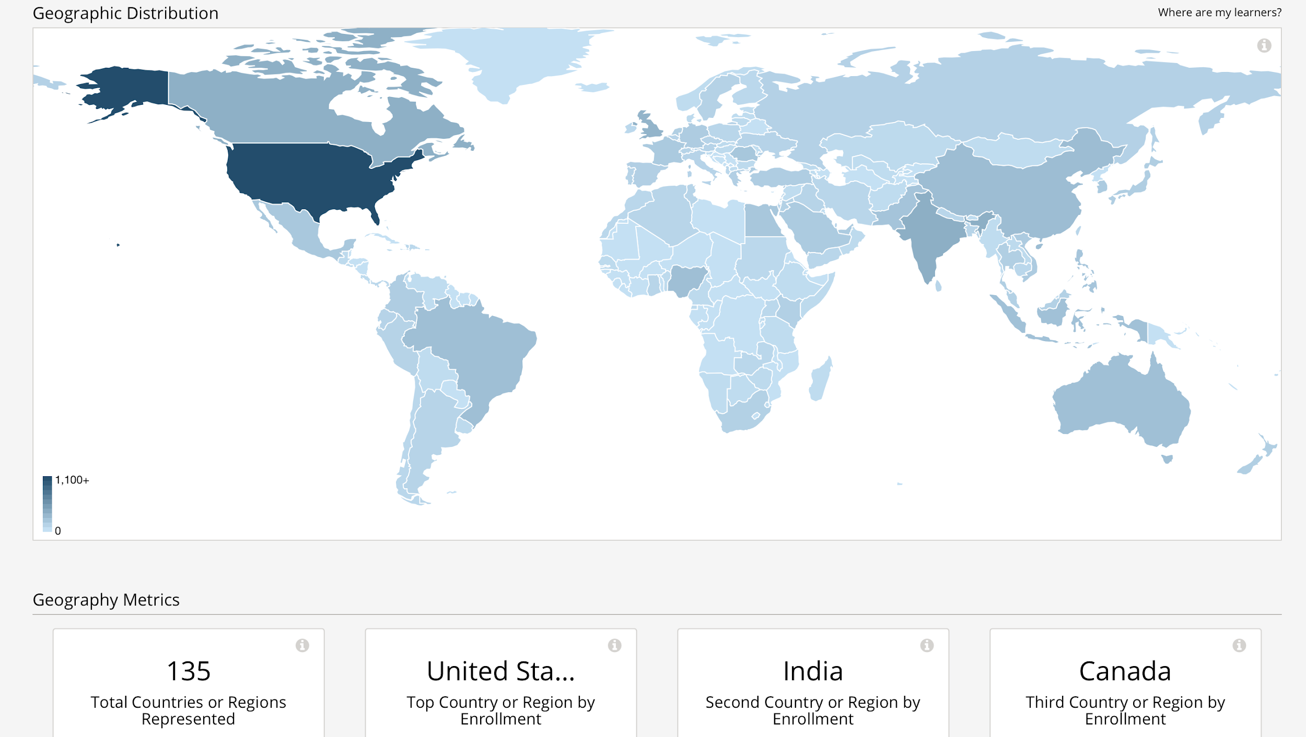

Pediatric Injury Prevention: Tailored Medical Education Delivered as a Massive Open Online Course (MOOC) and a Small Private Online Course (SPOC)
N. Ibrahim, BS.,
L. Bohm, M.D., J. Roche, MPH, S. Stoddard, PhD, RN, CNP, J. Vetter, BAA., R. Quintana, PhD., J. Bennett, B.S., MSc., B. Costello, MBA., P. Carter, MD., R. Cunningham, MD., A. Hashikawa, M.D
Abstract
Methods and Materials
Results
Discussion
Purpose: Medical schools and residency programs do not consistently provide injury prevention didactics to trainees and there is a lack of online courses on the subject. We therefore created the “Injury Prevention in Children and Teens” course to address the gap in medical education.
Methods: The course has eight distinct modules with CME credits. The course has two formats: 1) non-linear MOOC for global distribution; 2) Linear SPOC for student cohorts. Both survey and demographic data of learners was captured.
Evaluation: 170 medical students enrolled in the SPOC and 2,900 learners from 135 countries in the MOOC. 80% rated the SPOC as very good or excellent. 86% felt the SPOC somewhat or significantly changed their perception of injury prevention. 177 physicians and 1,700 non-physician providers enrolled in the MOOC for CME credits. 34.4% were male, 64.8% were female.
Discussion: The combined format makes the course versatile within medical education, residency training, immediate information retrieval, and patient education while optimizing the curriculum for learners who benefit from content customization.
Course development was led by the CDC-funded University of Michigan Injury Prevention Center and the Office of Academic Innovation.
The MOOC is available free to the general public through two large online course hosting platforms, EdX and Michigan Online. Learners can select any or all topics that are of most interest, in any order.
The course is also designed as a SPOC, a structured comprehensive linear course for medical students and residents. The SPOC is available for credit through the University of Michigan Medical School as a two-week elective available to third- and fourth-year medical students. For pediatric residents, the SPOC is offered during their required community health month during their second- or third-years of years of residency.
Data captured includes the number of learners accessing the course, the geographical location of learners, their age, and their level of educational attainment. In addition to the platform tracking, the team developed both a formal and informal evaluation of learners who accessed the SPOC.
The final course has 8 modules with 59 video learning segments, and the average video clip length is about 11 minutes.
The MOOC offers 1 to 9.75 CME credits for each module, with 25.5 total CME credits. Over about 15 months (June 2018 to November 2019), about 2900 learners enrolled in the MOOC from 135 countries (Figure 2). Of those who received CME credits, 177 were physicians and almost 1,700 were non-physician providers. Among learners, 34.4% were male, and 64.8% female. Median age of learners was 32 and 22.7% were over the age of 41. 23% of learners held a high school diploma or less, 43% had college degrees, and 30% had advanced degrees.
The SPOC, over 18 months, was taken by the 172 medical students enrolled at the University of Michigan Medical School from the Class of 2019 and 2020. 80% of respondents rated the quality of the course as very good or excellent. 86% felt the course somewhat or significantly changed their perception of injury prevention.
Pediatric injury is the leading cause of childhood morbidity and mortality, yet there was previously no online education available for a broad audience. The “Injury Prevention for Children and Teens” MOOC and SPOC is a novel response to the gap in medical education and resource availability in injury prevention for infants, children, and teens. The online course is unique in its dual role as both a SPOC for medical students (used as part of an elective curriculum in medical schools) and a MOOC (which allows for the delivery of injury prevention science content that meets the needs of a wide audience).
A novel aspect of our MOOC was the design as a “choose-your-topic” course instead of a week-by-week linear course, which was uniquely different compared to other MOOCs. This design also allows the MOOC to add additional topics to the course without having learners return and go through the entire course again.
The MOOC also presented an opportunity to address widening gaps in how users obtain CME credits. One of the goals of developing this MOOC was to create a free curriculum that was flexible and tailorable, accessible, widely-used, and effective at educating key individuals at the forefront of injury prevention for children.
Introduction
Conclusions
Injuries are the leading cause of morbidity and mortality for children and teens in the United States¹. Medical professionals play a key role in delivering injury prevention interventions to patients and their families^{2,3}; however, there is a lack of injury prevention science education delivered to medical students, residents, and the medical community due to a lack of resources and competing time commitments⁴⁻⁸. With evolving technologies and restrictions on student time, online courses are playing an increasingly important role in the effective delivery of medical education⁹⁻¹².
One well-recognized format for online education is the MOOC, which is a course format where learners access free content online and provides a flexible way to deliver educational experiences on a large scale to learners at their own pace. In 2018, about 101 million learners enrolled in MOOCs¹³.
Despite pediatric injury being the largest cause of morbidity and mortality for children, as of March 2018 the leading online course platforms did not offer any courses on pediatric injury prevention. This disparity demonstrated a profound unfilled need for a MOOC that addresses pediatric injury prevention strategies.
This project focuses on the creation, development, and launch of the “Injury Prevention for Children and Teens” online curriculum, a novel and necessary response to a clear gap in medical education.
The “Injury Prevention for Children and Teens” online curriculum is unique in its flexibility, tailorable in its delivery, and fills a critical gap in offering injury prevention education both regionally and globally. The online curriculum presents a wide-range of topics that are presented with corresponding national content experts and emphasizes interprofessionalism, and makes use of creative lesson formats, including demonstrations, interviews, and videos.
This novel use of an online course presents an opportunity to identify areas of curricular need and shape the future of medical education delivery for the benefit of our patients.
The “Injury Prevention for Children and Teens” MOOC is available on edX and through Michigan Online^{14,15}.
Figure 3. Pathways for our highest impact users. Child Care Providers have different needs than teachers, coaches, parents, or social workers. Each diagram suggests then what videos would be best for each group. Learners have the option of selecting different branches.
Figure 1. Course includes on-site demonstrations, in-person interviews, group table interviews, all combined with engaging didactic lectures
The course team has developed course pathways in the MOOC based on different learner profiles, including: Child Care Providers, Teachers or Coaches, Social Workers or Public Health Professionals, and Parents of Adolescents (Figure 3). These suggested pathways offer learners suggestions for a certain learner profile, if the learner did not have the capacity to take the entire MOOC.
Figure 2. Learners enrolled in the MOOC from 135 different countries
Contact
References
Nadine Ibrahim
University of Michigan Medical School
Email: ibrahimn@med.umich.edu
Cunningham, R. M., Walton, M. A., & Carter, P. M. (2018). The Major Causes of Death in Children and Adolescents in the United States. New England Journal of Medicine, 379(25), 2468–2475
Simon TD, Phibbs S, Dickinson LD, et al.. Less anticipatory guidance is associated with more subsequent injury visits among infants. Ambul Pediatr. 1996; 2--6; 6:318-25
Gittelman, M. A., Pomerantz, W. J., & Schubert, C. J. (2010). Implementing and evaluating an injury prevention curriculum within a pediatric residency program. Journal of Trauma - Injury, Infection and Critical Care, 69(SUPPL. 4), 239–244.
AAMC. Training future physicians about injury. Washington DC: Association of American Medical Colleges. December 2005.
Anglin D, Hutson HR, Kyriacon DN. Emergency medicine residents’ perspectives on injury prevention. Ann Emerg Med 1996;28:31e3.
Villaveces, A., Kammeyer, J. A., & Bencevic, H. (2005). Injury prevention education in medical schools: An international survey of medical students. Injury Prevention, 11(6), 343–347.
Zavoski, RW, Burke GS, Lapidus GD, et al. Injury prevention training in pediatric residency programs. Ach Pediatr Adolesc Med. 1996; 150: 1093-6
Phelan, M. B., Falimirski, M. E., Simpson, D. E., Czinner, M. L., & Hargarten, S. W. (2007). Competency-based strategies for injury control and prevention curriculums in undergraduate medical education. Injury Prevention, 13(1), 6–9.
Harder, B. (2013). Are MOOCs the future of medical education? BMJ (Clinical Research Ed.), 346(April), 2–4. https://doi.org/10.1136/bmj.f2666
Robinson, R. (2016). Delivering a medical school elective with massive open online course (MOOC) technology. PeerJ, 4, e2343.
Mehta, N. B., Hull, A. L., Young, J. B., & Stoller, J. K. (2013). Just imagine: New paradigms for medical education. Academic Medicine, 88(10), 1418–1423.
Vaysse, C. et al. (2018). The impact of a small private online course as a new approach to teaching oncology: Development and evaluation. Journal of Medical Internet Research, 20(3).
Subjects. Class Central. https://www.classcentral.com/subjects.
MichiganX (Producer). (2018). Injury Prevention for Children & Teens [MOOC]. Retrieved from https://www.edx.org/course/injury-prevention-for-children-teens
University of Michigan Injury Prevention Center (Producer). (2018). Injury Prevention for Children & Teens [MOOC].

