Slide 1


Casimir Klim, Jessica Winkels, Emily Zhao

Slide 2

BACKGROUND:
HEALTH AND HOMELESSNESS
Mortality rates up to 10 times greater than the general population
More likely to seek care in the ER, less likely to access primary care
Average hospital stay is twice as long
Notes:
Avg life expectancy of chronically homeless person: 47 years
Homeless persons cost their local healthcare system an average of $22,000 per year per person

Slide 3
BACKGROUND: STREET MEDICINE
Teams provide:
  Care for acute medical problems
  Health screenings
  Connections to long-term healthcare and housing options
Reducing unnecessary ED usage lowers healthcare costs
Notes:
- Street medicine programs address the unique social and medical needs of people experiencing homelessness by providing assessment and treatment where they live and gather.
- Able to reach people unable or unwilling to access more traditional free clinics
- Staffed by physicians, nurses, health professions students.
- Started by Dr. Jim Withers in PIttsburgh in early 1990s (Operation Safety Net) now teams operating nationwide.

Slide 4
LOCAL NEEDS
Washtenaw County:
  284 people*
  No street medicine team
  Need for prevention/screening, management of chronic illness
Metro Detroit:
  1,965 people*
  Street medicine programs at WSU and MSU
    Large areas of the city not covered
    Student leaders welcome collaboration
Limited opportunities for clinical volunteering
Notes:
- Numbers from PIT counts, January 2019. Detroit area = Detroit, Hamtramck, Highland Park. Underestimates if anything. Done during coldest time of year, doesn’t cover people paying to stay in hotels, staying with friends/family, or unsheltered homeless people in low-visibility areas.
- Early student leaders (now resident physicians) did an informal needs assessment
- Mention how Cas/Anita were coordinators at Delonis, lg amt of interest, had to do lottery based system.

Slide 5
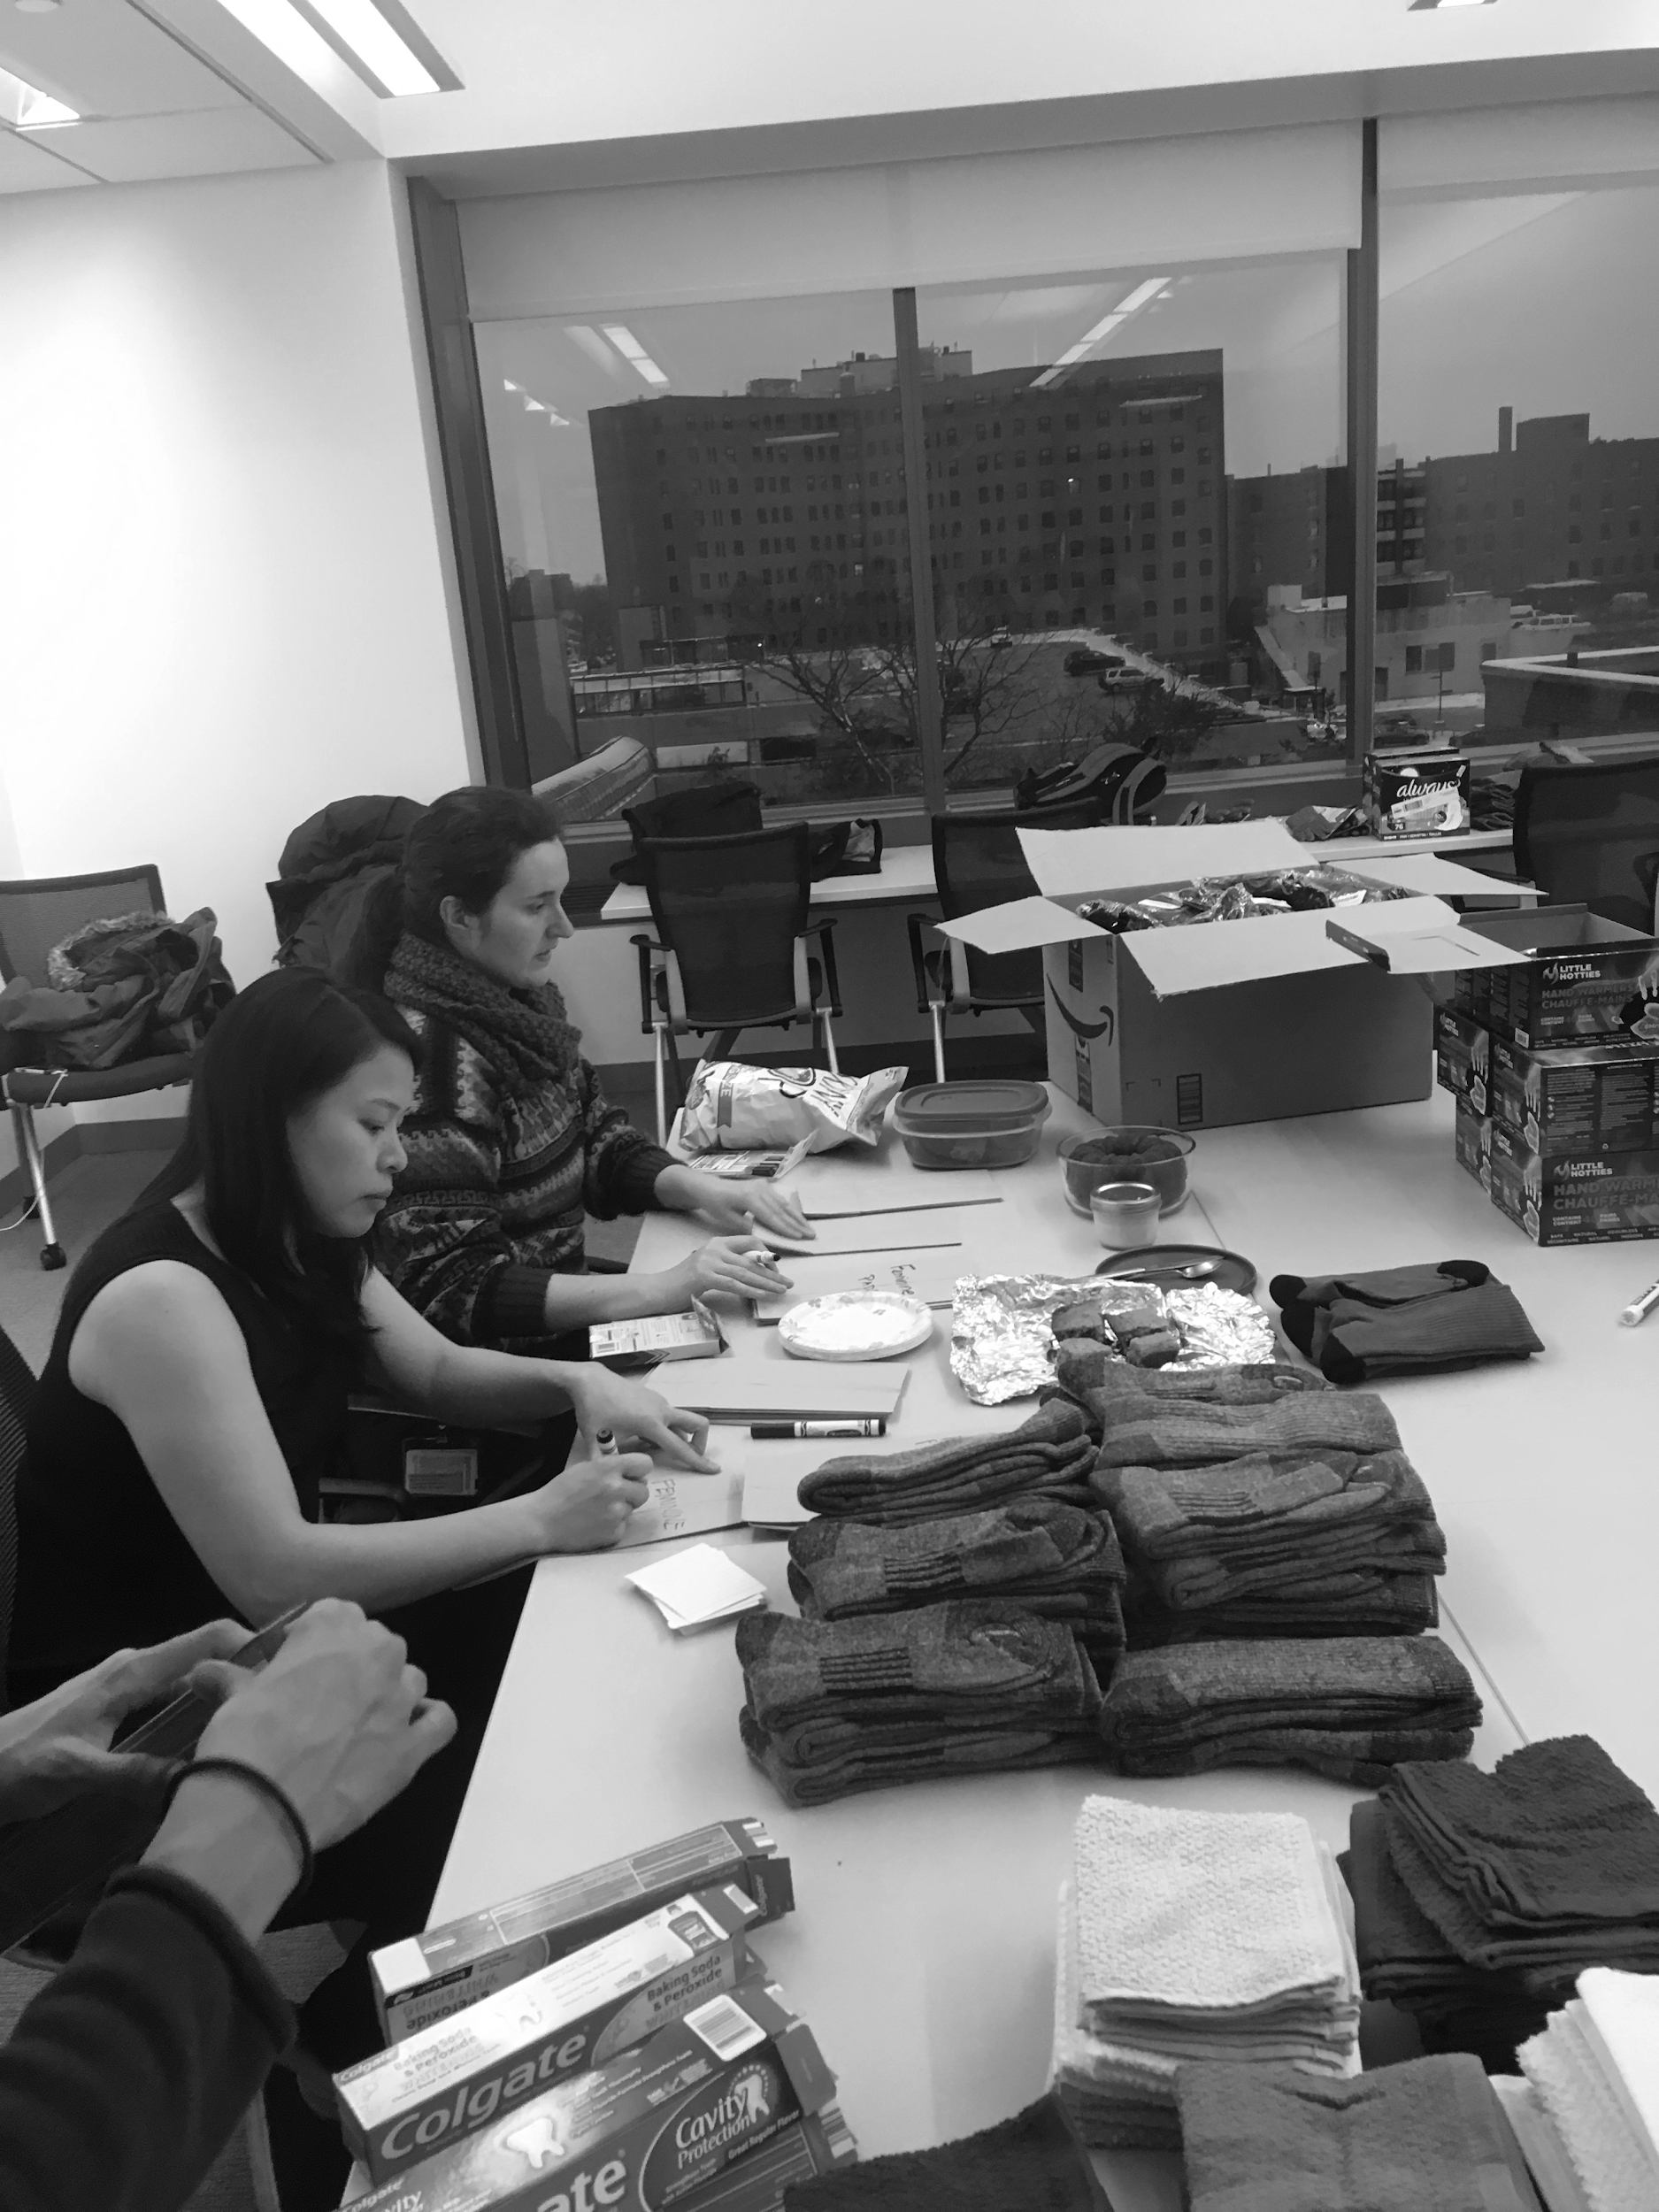
WOLVERINE STREET MEDICINE
Founded in 2017
Our Mission:
  Improve health of the homeless community
  Educate medical students on best practices in care and treatment of homeless persons
  Raise awareness of health challenges associated with homelessness
Notes:
Founded at Michigan by students passionate about health disparities, want to learn more about how best to care for people in the community facing homelessness

Slide 6
CLINICAL IMPACT
Common interventions:
Blood sugar monitoring and foot care for diabetic patients
Blood pressure screenings
Triage and referral to community clinics and other resources
Provision of hygiene products and winter gear
Notes:
On this page we can tell a few stories.

Slide 7
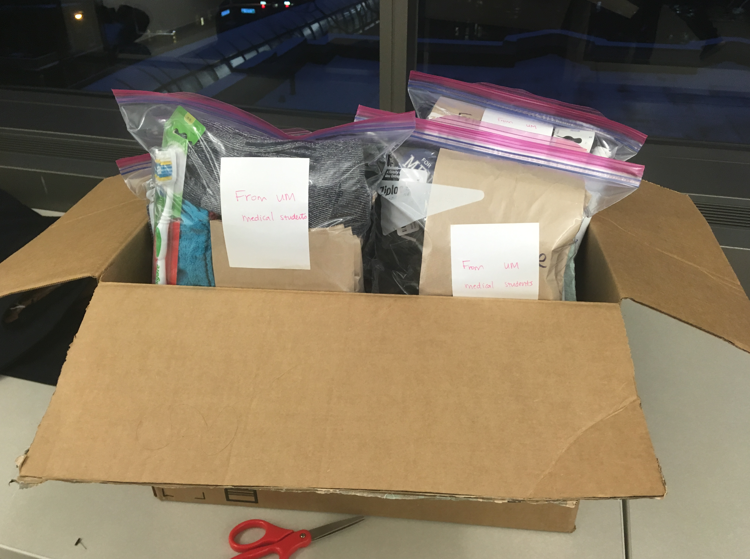
CLINICAL IMPACT
Notable cases
On-site burn care:
  Wounds dressed
  Transport arranged
  Follow-up scheduled
Infection management:
  Drainage
  Antibiotics
  Dressing changes
Polar Vortex 2019 response:
  Frostbite care
  Safety checks
Notes:
On this page we can tell a few stories.
Can mention that we bring people these packs and sandwiches that Jim makes as a way to approach patients.

Slide 8
EDUCATIONAL IMPACT
Service learning on the streets
  Preclinical students take vital signs and perform basic first aid
  Clinical students assess patients and form treatment plans
Health and Homelessness clinical elective
  Curriculum designed entirely by WSM student leaders
  Recently got final approval!
Seminars
  Overdose reversal with Narcan
  Trauma-informed care

Slide 9
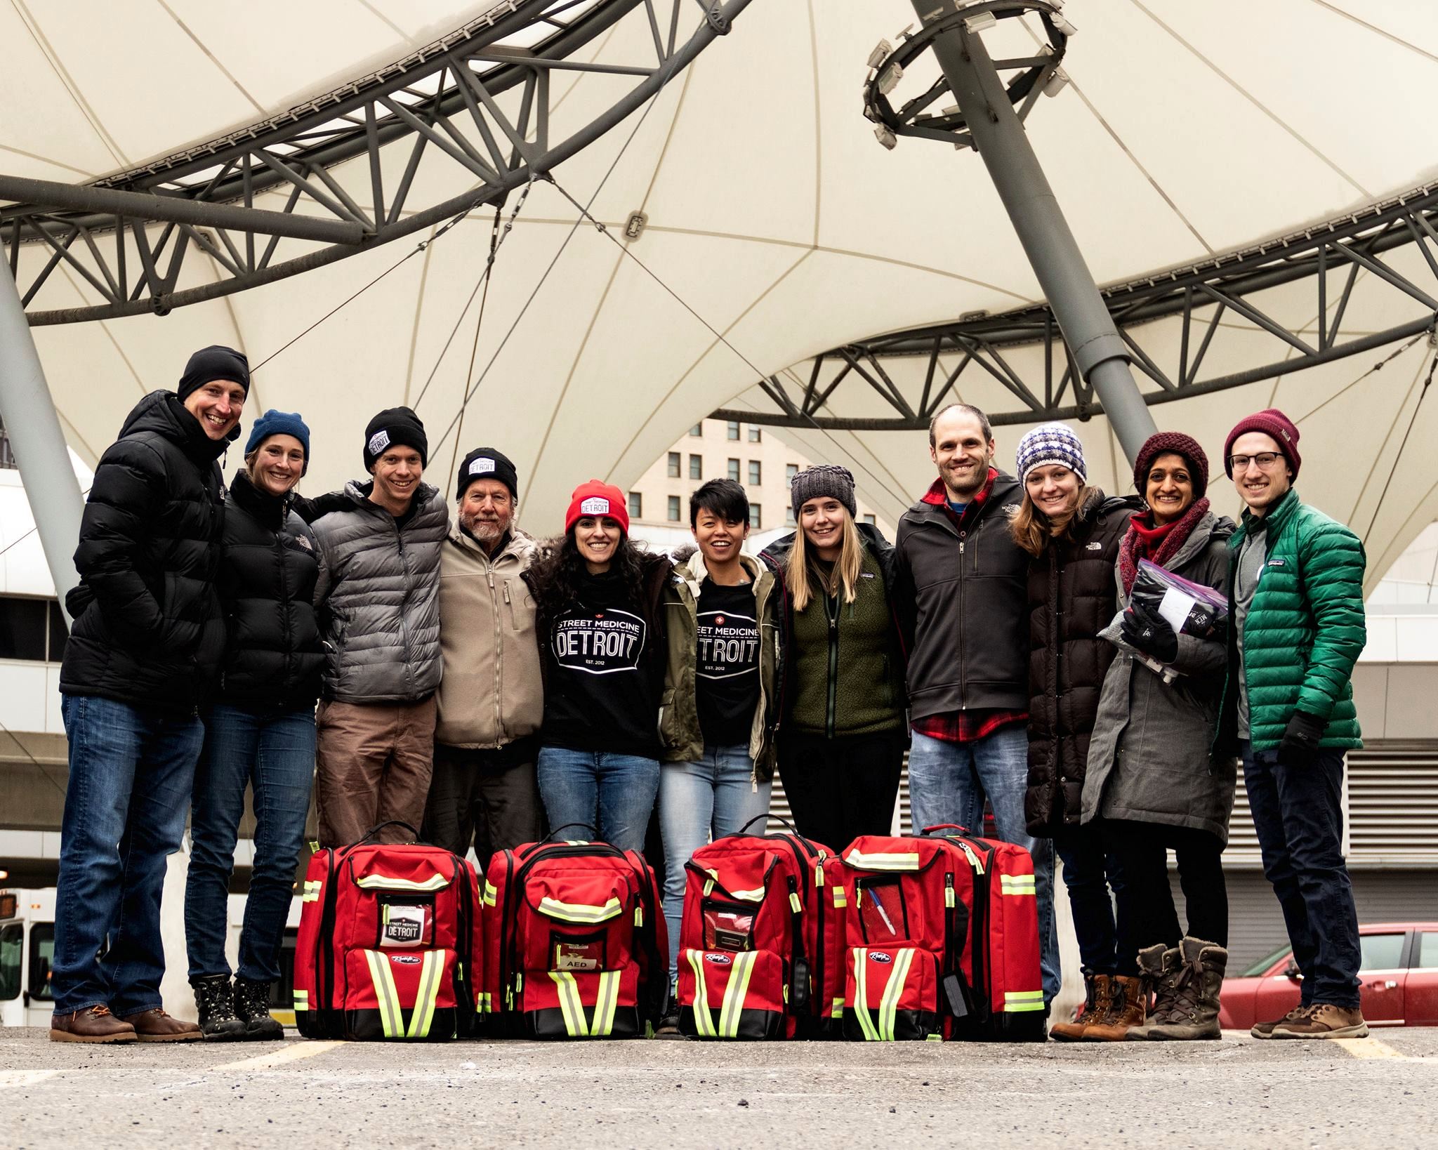
STUDENT EXPERIENCES
“This reminds me of why I went into medicine”
Students learn:
Basic clinical skills
Chronic illness management
Orientation to
community
resources
Notes:
On this page we can tell a few stories

Slide 10
WSM GOALS 2019-2020
Service
  Weekly runs in Detroit and Ann Arbor
  M1-M4 medical student volunteers
  Faculty: Russ Pajewski, MD, Jim Bastian, RN
Education and Research
  Speaker Series open to the medical school
  Medical school curriculum
  Needs assessment, medical documentation
Street Medicine Collaboration
  Joint runs with WSU and MSU
  Partnership with CMH and PATH
Notes:
Community partners include Neighborhood Service Organizations (day shelters w/ some services), faith-based orgs

Slide 11






FUTURE DIRECTIONS
Improve inventory
  Basic life support equipment
  Stock and store critical supplies
Improve documentation
  Electronic Medical Record
Interprofessional collaboration
Expand partnerships
Notes:
Stable funding - Jessica could tell story of 3-day-old GSW, used all of wound care supplies
Improved documentation
export this as a ppt file (looks weird on different monitors)

Slide 12
REFERENCES
*Estimates of area homeless population counts via Washtenaw County and Detroit Area Point-in-Time Counts, January 2019
Baggett TP, Hwang SW, O’Connell JJ, et al. Mortality Among Homeless Adults in Boston: Shifts in Causes of Death Over a 15-Year Period. JAMA Intern Med. 2013;173(3):189-195. doi:10.1001/jamainternmed.2013.1604.
Buffardi AL, Thomas KK, Holmes KK, Manhart LE. Moving upstream: ecosocial and psychosocial correlates of sexually transmitted infections among young adults in the United States. Am J Public Health. 2008;98(6):1128-1136. doi:10.2105/AJPH.2007.120451.
Hwang SW, Orav EJ, O’Connell JJ, Lebow JM, Brennan TA. Causes of death in homeless adults in Boston. Ann Intern Med. 1997;126(8):625-628.
Kushel MB, Vittinghoff E, Haas JS. Factors Associated With the Health Care Utilization of Homeless Persons. JAMA. 2001;285(2):200-206. doi:10.1001/jama.285.2.200.
McGinley, L. (2017, November 22). In the woods and the shadows, street medicine treats the nation’s homeless. The Washington Post. Retrieved April 28, 2019.
https://www.sccpre.cat/show/xmwJRh_jpg-transparent-library-clip-art-medication-black-and/
https://www.sccpre.cat/show/iibTioJ_jpg-transparent-library-card-address-book-line-svg/
Notes:
On this page we can tell a few stories

Slide 13
THANK YOU!

