Slide 1
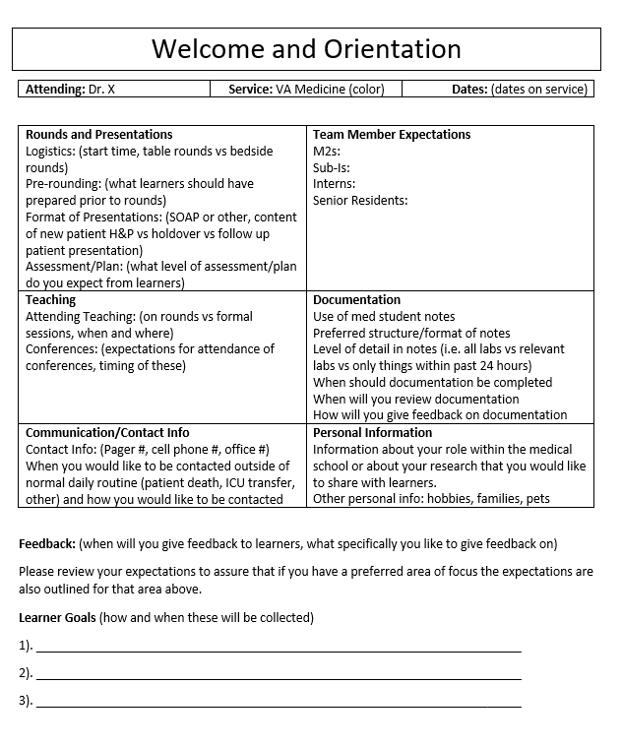







Expectation Setting on the Clinical Wards and Its Impact on Feedback
Evan Merryman¹, Jocelyn Schiller^{1,2}, Nathan Houchens^{1,3}, and Sarah Hartley^{1,3,4}
¹University of Michigan Medical School, ²University of Michigan Department of Pediatrics, ³VA Ann Arbor Healthcare System Medical Service, ⁴University of Michigan Department of Internal Medicine
Background
Data
Template
Expectation setting is crucial in educational environments, including the clinical environment.
Mismatch between expectations and reality for workers correlates with high rates of burnout (Figure 1).^{1,2}
Setting clear expectations:
  Can circumvent uncertainty, confusion, and stress for medical students working with different faculty members.
  Is an important tool to facilitate improvements in feedback.³
Improvement in feedback has implications for learner wellness.
  A lack of timely and proper feedback correlates with an increase in depressive symptoms in residents.⁴
We explored clerkship students’ perceptions of how often faculty set expectations and the content students feel is most useful to include.
Excellent
Very Good
Good
Fair
Poor
Poor
Fair
Good
Very Good
Excellent
Figure 2. Post-clerkship evaluation data comparing clarity of expectations for student and quality of feedback they received. The correlation between these two scores was 0.608 (p-value <0.001 and 95% CI 0.582 – 0.634).
Expectation = Reality
Expectation ≠ Reality
X
34.9%
of attendings set expectations for medical students within 48 hours
19.8% written expectations
X
Help!
Expectations
Expectations
80.2%
verbal expectations
ONLY
Figure 1. The effects of expectation-reality discrepancy (ERD) on learners. On the left, the learners have no ERD and their expectations are able to act as a “shield” against stressors. On the right, there is significant ERD and the surrounding stressors are enhanced leading to burnout.⁵
Figure 6. Sample expectation setting template developed based on student preferences.
Figure 3. Student reported frequency of expectation setting.
Figure 4. Student reported means by which attending physicians set expectations.
Conclusions
Methods
At one academic center, faculty expectations were infrequently communicated and were even less frequently communicated in written form.
A sample expectation document was created based on student needs.
  We are currently piloting use of this document by attending physicians on both the internal medicine and pediatric clerkships for future implementation.
  Data is being collected to determine if its use will improve expectation setting for medical students and their perceptions of faculty feedback.
Structure and logistics of rounds
(84.5%)
Roles of individuals on team
(79.3%)
Post-clerkship evaluation data was collected from the 2016 to 2018 which included three classes of medical students.
  Responses regarding the clarity of expectations for student performance and the overall quality of feedback were examined.
  A correlation coefficient was calculated in SPSS to analyze their relationship
An electronic survey was distributed in November 2018 to third year medical students who recently completed core clinical clerkships.
  Questions included frequency faculty set expectations, modalities faculty used to share expectations, and content students felt would be most valuable for faculty to share.
Student documentation
(78.4%)
Desired Expectation Topics
Learner’s expectations and goals
(74.1%)
Teaching during the rotation
(63.8%)
Faculty supervision and role
(62.9%)
References
¹ Maslach C, Schaufeli WB, Leiter MP. Job Burnout. Annual Review of Psychology. 2001;52:397-422.
² O’Donnell H. Expectations and voluntary attrition in nursing students. Nurse Education in Practice. 2011;11(1):54-63.
³ Ramani S, Krackov SK. Twelve tips for giving feedback effectively in the clinical environment. Med Teach. 2012;34(10):787-91.
⁴ Pereira-Lima K, Gupta RR, Guille C, Sen S. Residency Program Factors Associated with Depressive Symptoms in Internal Medicine Interns. Academic Medicine. June 2018:869-875.
5 Spadafore M, Merryman E, Daniel M. Rapid expectation-setting for learners in the Emergency-Department. Academic Emergency Medicine. (In review.)
Figure 5. Student preferences regarding areas in which they would like attending physicians to set expectations.

