Slide 1


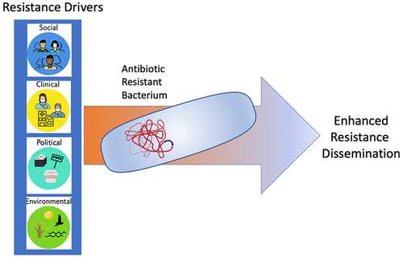
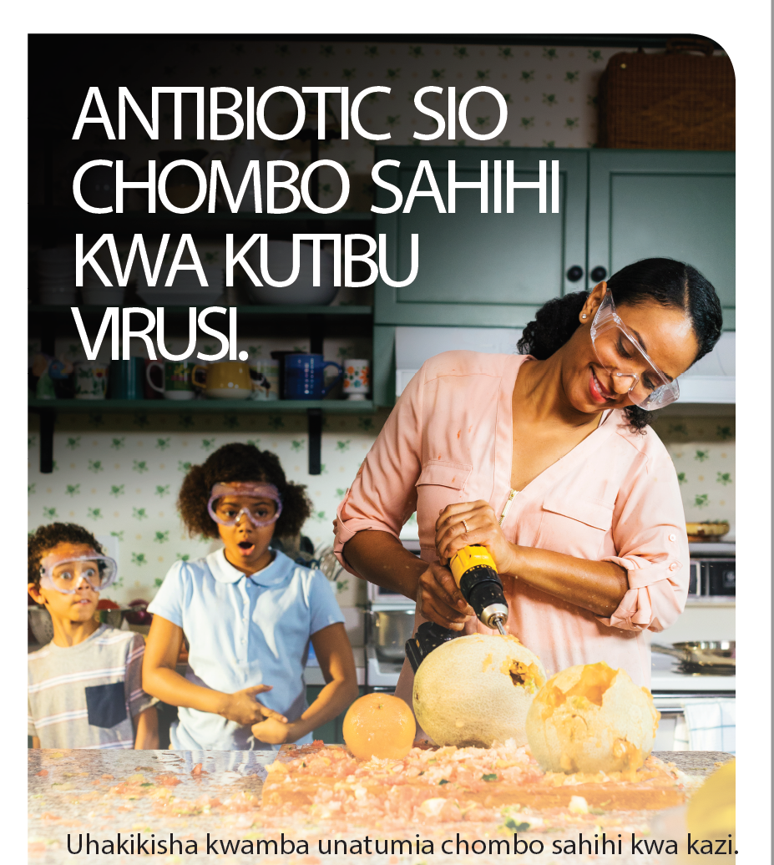




Antimicrobial Stewardship in Northern Tanzania
Carol Noronha, BS¹, Payal Patel, MD, MPH ^{1,2}
¹University of Michigan Medical School
²University of Michigan Department of Internal Medicine, Division of Infectious Diseases
Introduction
Approach
Proposed Outcomes
What promotes the development of antimicrobial resistance (AMR) in low and middle income countries (LMICs)?¹⁻³
What unique factors promote AMR in northern Tanzania?
In March-April 2020, the MS4 will collaborate with the ASC at in piloting a rural community intervention comprised of 10 sessions in Swahili language conveying fundamental concepts of AMR through discussion and interactive games.
Contribute to existing antimicrobial stewardship activities including provider education, community educational campaigns, data collection for ongoing research.
Outcomes will be assessed using pre- and post- surveys.
We predict that participants will demonstrate increased knowledge about AMR and commitment to stopping the spread of AMR by improving antibiotic use practices.
Future directions: Adapt for other settings, disseminate across multiple LMICs by training Peace Corps Volunteers and their host country counterparts to deliver interventions.
Figure 1. Drivers of antimicrobial resistance development and dissemination in LMICs (Vikesland et al., 2019)
A
Key
Human body
Good bacteria
Bad bacteria
Virus
Antibiotic
92.3%
percent of pharmacies in Northern Tanzania dispense antibiotics without a prescription⁴
C
Disclosure
Funding for this project is generously provided by: Global Health and Disparities Scholarship and Capstone for Impact Grant.
Background
B
The Kilimanjaro Christian Medical Centre (KCMC)-Duke University Health Research Collaboration has pioneered an antimicrobial stewardship committee (ASC).
Interests:
  prevalence of self-treatment with antibiotics
  etiologies of febrile illnesses⁶
  provider antimicrobial stewardship education
Good Bacteria
Bad Bacteria
Objectives
Participants will be able to define and be able to explain the concept of AMR, identify the mechanisms of good and bad bacteria in the body, illustrate complications of AMR in the community, and strategize and commit to stopping the spread of resistant pathogens.
Virus
Antibiotic
Figure 3.
A: Schematic of a sample game conveying a core stewardship concept
B: T-shirt labels for participants for sample game.
C: Sample Community education visual aid (adapted from CDC)
Questions? Email: noronhac@med.umich.edu
Notes:
CONTENT GUIDELINES: Poster entries should include/incorporate the following:
1) a title that is sufficiently descriptive
2) credited collaborators, if applicable
3) an apparent problem statement
4) appropriate background for the problem statement
5) articulated study aims or question
6) clear methodology
7) clear results
8) a conclusion and next steps, if appropriate
VISUAL/DESIGN GUIDELINES: Display boards are large and will accommodate most sizes. We recommend posters be printed in landscape (horizontal) format, 4 feet wide by 3 feet high. Final submitted posters should include the following:
1) clearly delineated sections (e.g., problem statement, background, methodology, etc.)
2) appropriate use of pictures, tables and/or figures, if appropriate
3) balanced text size, word count and color scheme to ensure readability

