Slide 1

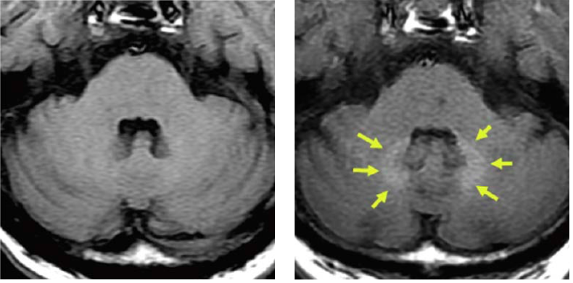
Cancellation of ordered gadolinium-based contrast media following 2017-2018 guidance from the US Food and Drug Administration
Laura S. O’Donohue, BA, Prasad R. Shankar, MD, Elizabeth Downs, BS, Matthew S. Davenport, MD
University of Michigan Medical School, Ann Arbor, MI
Capstone for Impact
Introduction
Purpose
Data
Gadolinium-based contrast medium (GBCM) is the sole MRI contrast available (1) and is used in 1/3 of MRIs (2). Contrast-enhanced MRI are crucial diagnostic tools for certain diseases and for populations vulnerable to radiation from CT such as children and pregnant women.
GBCM consists of gadolinium (Gd) (toxic in its free form), attached to a stabilizing chelation molecule. GBCMs are classified as linear or macrocyclic depending on the chelate, and as Group I, II, or III depending on their association with cases of nephrogenic systemic fibrosis (NSF). Macrocyclic agents are generally more stable than linear, and comprise the majority of Group II agents. Group II agents are associated with the fewest, if any, cases of NSF. For these reasons, Group II agents are used in the majority of contrasted MRIs, including at Michigan Medicine (1).
In 2014, it was discovered that a small amount of gadolinium is retained in the tissue of all patients independent of renal function (3). No adverse outcomes have been identified, but there is a need to understand potential long term consequences.
In 2015, the FDA began evaluating GBCM safety. During 2017 - 2018, they provided guidance for a patient medication guide and called for GBCM manufacturers to conduct further research. A medication guide was approved alerting patients to gadolinium retention and the unknown clinical risks. The FDA suggests that patients receive this guide prior to their first outpatient MRI with GBCM.
Following FDA guidance, Michigan Medicine began implementing a GBCM medication guide at outpatient MRI centers in January, 2018.
To assess the rate of and rationale for cancellation of ordered GBCM following updated 2017-2018 guidance from the U.S. Food and Drug Administration (FDA).
Contrast Cancelled By
Methods
Number of studies
Data was obtained from the EHR and radiology information system over a 9-month period (May 2018 – January 2019) following new guidance from the FDA that patients receive a medication guide on gadolinium retention prior to an MRI with GBCM.
Included MRIs were those initially protocolled as “with IV contrast” or as “per protocol” and were subsequently performed without GBCM.
Studies for which GBCM was cancelled because contrast was not clinically indicated “per protocol” (n=196) were excluded.
The remaining MRIs were coded and analyzed for 9 potential causes of GBCM cancellation.
Descriptive statistics were performed. Process control charts were generated to evaluate trends in cancellation over time.
Reason for Contrast Cancellation
Number of studies
Results
Of 37,156 contrast-enhanced MRI examinations performed during the study period, 129 (0.35%) relevant cancellations were identified.
The frequency of cancellations did not significantly vary during the study period (i.e., only common cause variation was detected).
Patients initiated 35 of 129 cancellations (27.1% [95% CI: 19.5-34.8%]).
Zero (0% [95% CI: 0-2.8%]) were recorded as a patient-stated concern for gadolinium retention.
“Renal concerns” was the most common recorded reason indicated GBCM was withheld (N=37; 28.7% [95% CI: 20.9–36.5%]).
Cancellations by Month
Gd retention on non-contrast mri
Conclusions
References
1. AF F. Update on FDA approach to safety issue of gadolinium retention after administration of gadolinium-based contrast agents. In: FDA, editor. Pediatric Advisory Committee2018.
2. McDonald RJ, Levine D, Weinreb J, Kanal E, Davenport MS, Ellis JH, et al. Gadolinium Retention: A Research Roadmap from the 2018 NIH/ACR/RSNA Workshop on Gadolinium Chelates. Radiology. 2018;289(2):517-34.
3. Kanda T, Ishii K, Kawaguchi H, Kitajima K, Takenaka D. High signal intensity in the dentate nucleus and globus pallidus on unenhanced T1-weighted MR images: relationship with increasing cumulative dose of a gadolinium-based contrast material. Radiology. 2014;270(3):834-41.
Patient-initiated cancellation of ordered GBCM remains low following 2017-2018 FDA guidance.
Zero cancellations occurred due explicitly to concern for gadolinium retention or the medication guide.
Ongoing data collection of pre-policy contrast cancellation will help us better understand changes in GBCM cancellation rates and the potential impact these new medication guides.
Non-contrast MRI shows high signal intensity in the dentate nucleus and globus pallidus correlating with the number of previous GBCM exposures. Signal intensity is secondary to retained gadolinium (3).
Acknowledgments
University of Michigan Medical School
Michigan Medicine Department of Radiology

