Slide 1

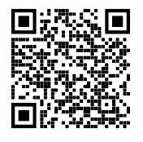
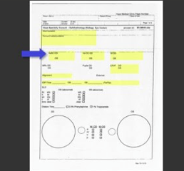
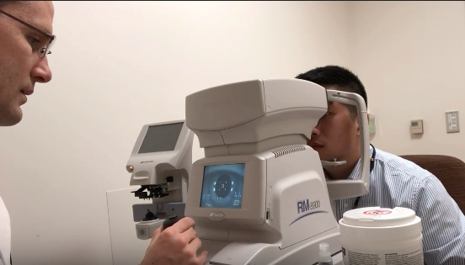
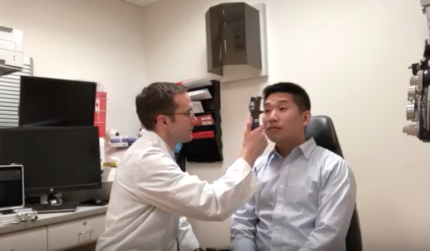
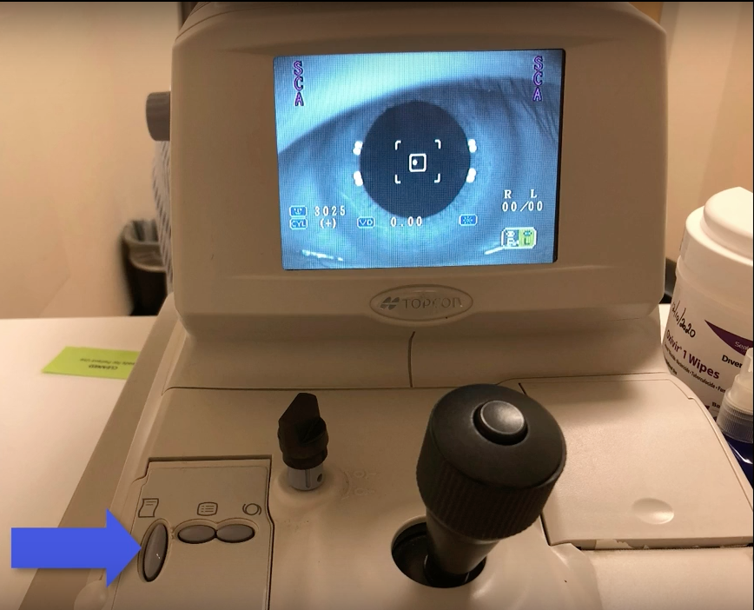
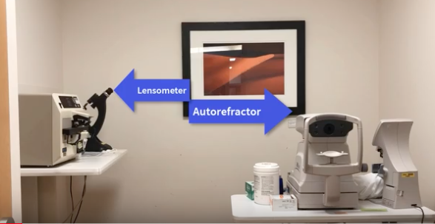
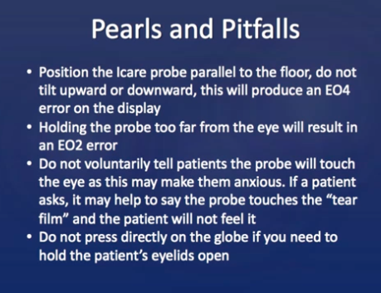
Hope Ophthalmology Free Clinic: Training Videos and Website
Benjamin Otte, MPP¹
Advisor: Paula Anne Newman-Casey, MD, MS²
¹University of Michigan Medical School, ²University of Michigan Kellogg Eye Center
Introduction
Approach
Final Product
Conclusions/Next Steps
This project involved creating a series of videos for Hope Clinic volunteers demonstrating eye exam skills, documentation, and proper equipment use to streamline training and provide an educational resource that could be referred to at the volunteers’ convenience.
Disclosure Statement: I have no disclosures or conflicts of interest associated with this project.
1. Met with ophthalmology technicians and faculty to establish the scope of the videos.
2. Drafted a script for each video, which was reviewed in an iterative process by Kellogg Eye Center staff.
3. Filmed each exam maneuver with a fellow student volunteer; demonstrated proper use of equipment.
4. Edited the videos in the medical school’s video editing suite. Added voiceovers, step-by-step documentation instructions, and slides with “pearls and pitfalls” to emphasize key points.
5. Draft videos reviewed by multiple Kellogg staff members and revised based on input.
6. Created a website with links to each video that is accessible via both computer and mobile device. Kellogg Eye Center also published the videos on their YouTube channel and now includes links to them in the ophthalmology elective/rotation resources.
7. Editable versions of the videos saved to MBox for further additions/updates.
This project resulted in eight (8) educational videos that can be accessed at the following site: https://sites.google.com/view/hope-clinic-videos/home or on the Kellogg Eye Center’s YouTube channel, one of the videos currently has over 2100 views.
Below are the titles of the eight training videos:
Introduction
Basic Eye History and Paper Chart
Visual Acuity
Confrontation Visual Fields
Extraocular Movements
Intraocular Pressure
Auto-refraction
Lensometer
These educational resources reduce the burden of staff needed to train new volunteers.
They eliminate an obstacle to volunteering by allowing students to access training on their own schedules and refresh forgotten skills. Hopefully this translates into an improved patient experiences as students are able to efficiently and correctly screen patients.
Editable videos are saved to Mbox for updates as Hope Clinic practices change and can be expanded with videos covering additional skills as student responsibilities increase.
Background
The Hope Ophthalmology Clinic provides free eye care to the community and is staffed by volunteers including medical students, technicians, residents, and physicians.
Medical student volunteers complete the initial screening portions of the exam, including using special equipment to check intra-ocular pressure, auto-refraction, and patients’ current prescriptions with a lensometer.
Identified Problem: Students need training prior to volunteering, and often forget exam skills, how to document, or how to use equipment in the months between free clinics. Arranging training sessions for the constant turnover of new volunteers or refresher training was a burden on staff and was difficult to coordinate among schedules.
Scan QR code to view videos
on your mobile device.
Figure 1: Screenshot from Autorefraction video
Figure 3: Screenshot from Intraocular Pressure video
Obstacles/Modifications
Figure 5: Videos walk through correctly charting
patient encounters
-The original script called for two videos, a basic skills video and an advanced skills video; this was revised to a series of eight shorter videos for each individual skill.
-Technical issues involving mobile device access to the website were resolved by loosening access permissions and making the website publicly available.
-The scope of the videos was limited to cover current medical student responsibilities; additional skills in the draft script such as pupil examination were omitted.
Objectives
Create concise, educational videos to supplement initial volunteer training and replace refresher training.
Include instructions on how to document/chart patient encounters, including abnormal findings.
Show step-by-step examples of how to use equipment.
Make the videos accessible online.
Include videos in student resources for rotating ophthalmology students.
Figure 4: Screenshot showing room/equipment orientation
Figure 2: Screenshot from Autorefraction video
Figure 6: Key points are emphasized in a slide at
the end of each video
Contact
Acknowledgements:
Benjamin Otte
University of Michigan Medical School
Email: botte@umich.edu
Andy Chen, UMMS medical student, provided assistance with script review and video acting
Beth Hansemann, Continuous Improvement Specialist Kellogg Eye Center and Hope Clinic Volunteer Trainer- script/video review
Karen Ward, Allied Health Senior Supervisor, Kellogg Eye Center – script/video review
Dr. Paula Anne Newman-Casey, Assistant Professor of Ophthalmology and Visual Sciences, Kellogg Eye Center- script/video review
Marc Stephens, Health Information & Technology Services – videography assistance
Chris Chapman, Health Information & Technology Services – website design assistance

