Slide 1


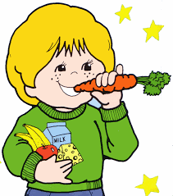
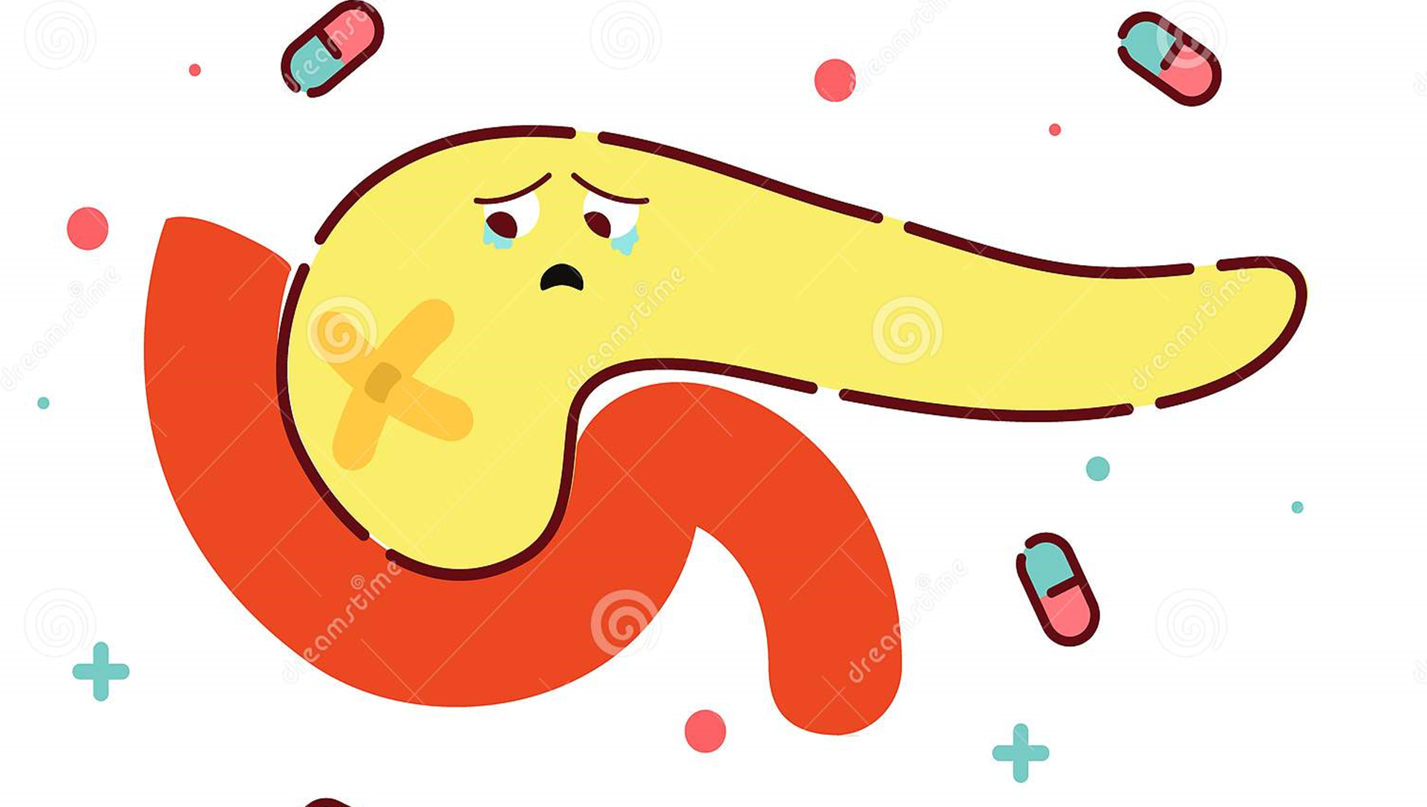
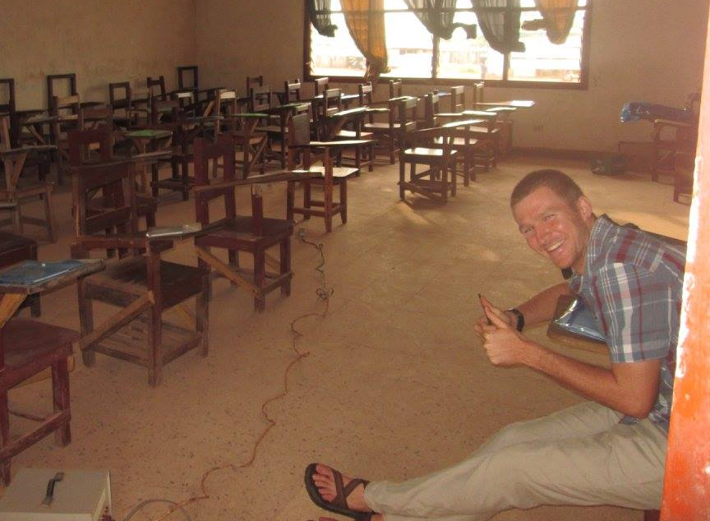

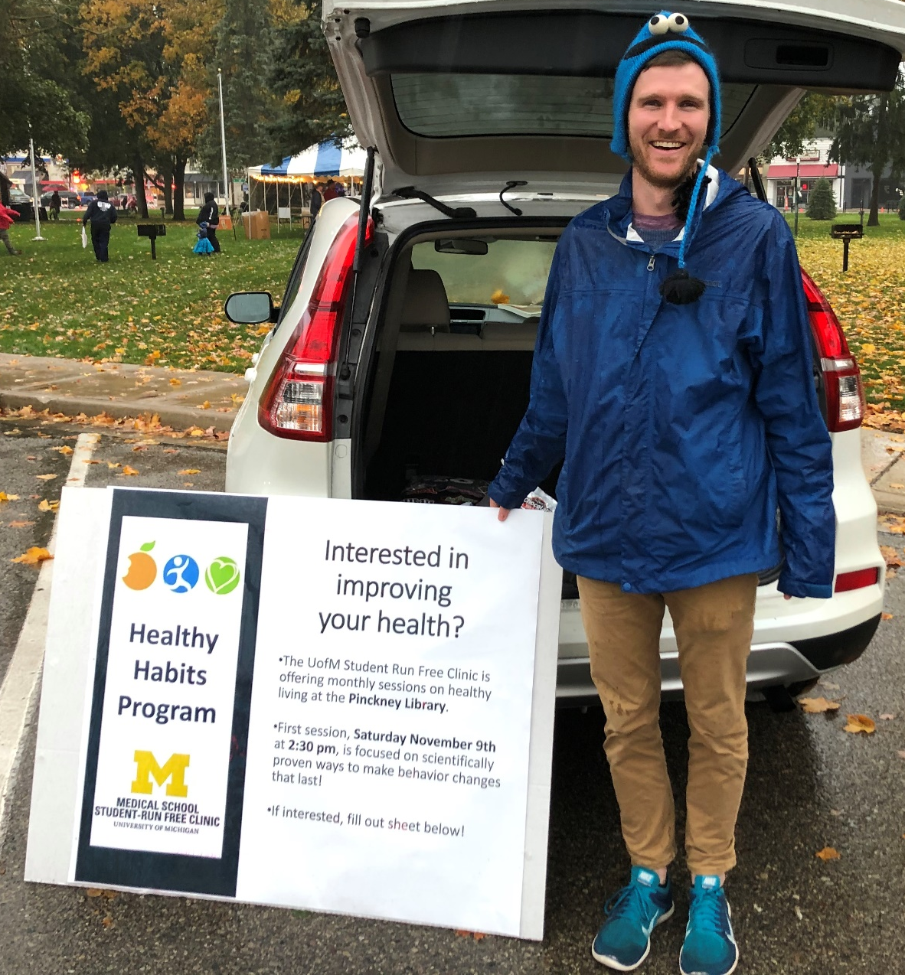



Healthy Habits Program
Luc Overholt
University of Michigan Student Run Free Clinic, Pinckney Community Public Library
Introduction
Healthy habits is a monthly support group and source of education for residents of Pinckney who are interested in healthy behavior changes.
Objectives
Provide support for members of the Pinkney Community interested in making healthy behavior changes.
Foster inter-professional collaboration between future physicians, social workers, physical therapist and dieticians.
Provide health professionals in-training with experiences in promoting healthy behavior changes
Session outline
10 minutes reviewing previous sessions and proving tips/refreshers on ways to make lasting behavior changes
10-20 minutes discussing how participants attempts at behavior change went the previous week
20 minute discussion form content area specialist (physical therapist, dietician student, social work student)
10 minutes for participants to form a goal for the coming month
Obstacles/Modifications
Initially the UMSRFC was awarded a grant to provide educational sessions to patients with diabetes and pre-diabetes.
The program was expanded to all patients due to recruiting difficulties
Support group component was added after feedback that education alone is a poor motivator for behavior change.
No participants showed up to the
first session.
Back to the drawing board:
Changed session time
Partnered with the library to host sessions
Increased community outreach
We have now hosted 2 sessions. Each with 4-5 participants. First session was focused on scientifically proven ways to make behavior changes that last. Second, on mindfulness and stress management.
Next Steps
Grow membership:
-keep each session interesting and useful as not to loose any participants
-continue to work on community outreach
Accountability buddy program:
-Healthy habits participants would be paired with students who are also attempting to make a behavior change.
-Dyads support each-other in their respective behavior change attempt

