Slide 1

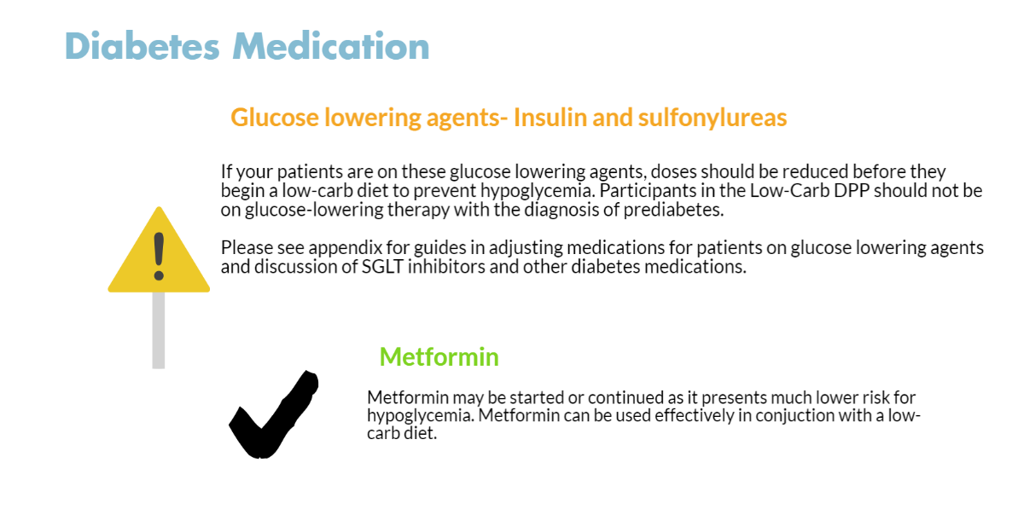
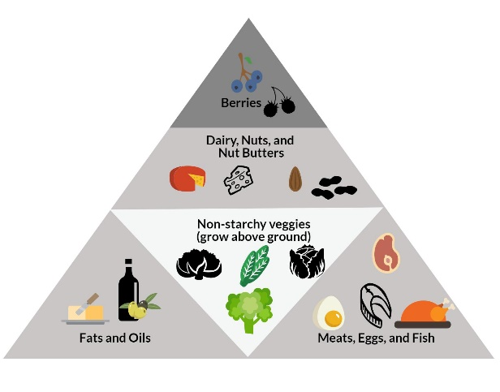

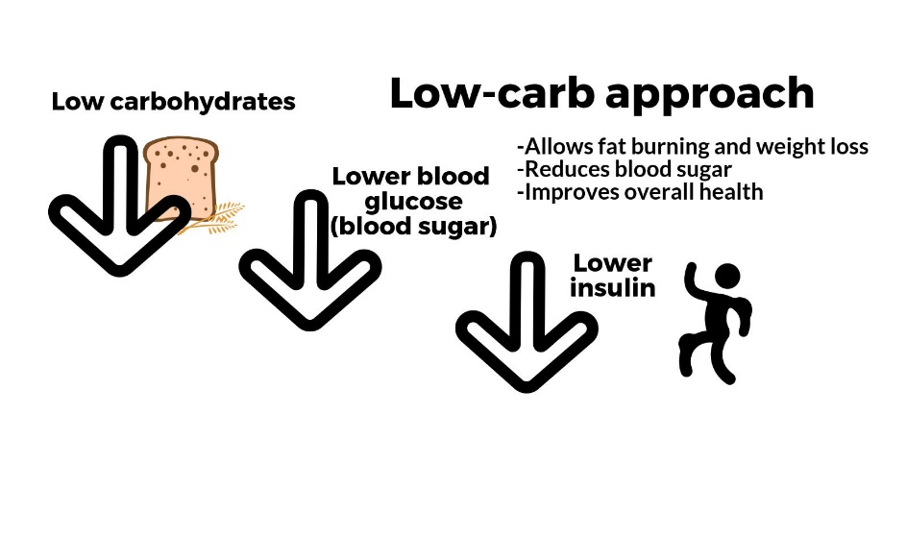
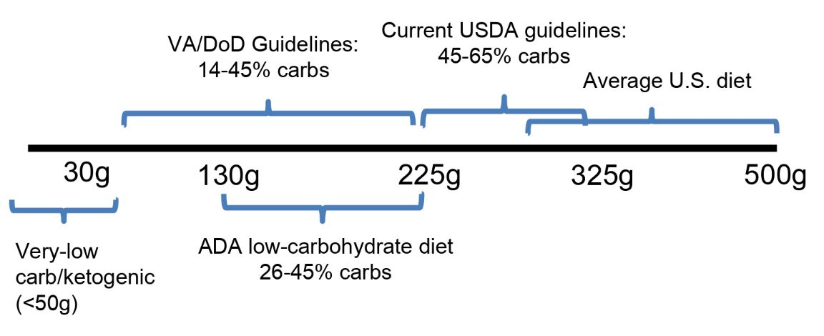
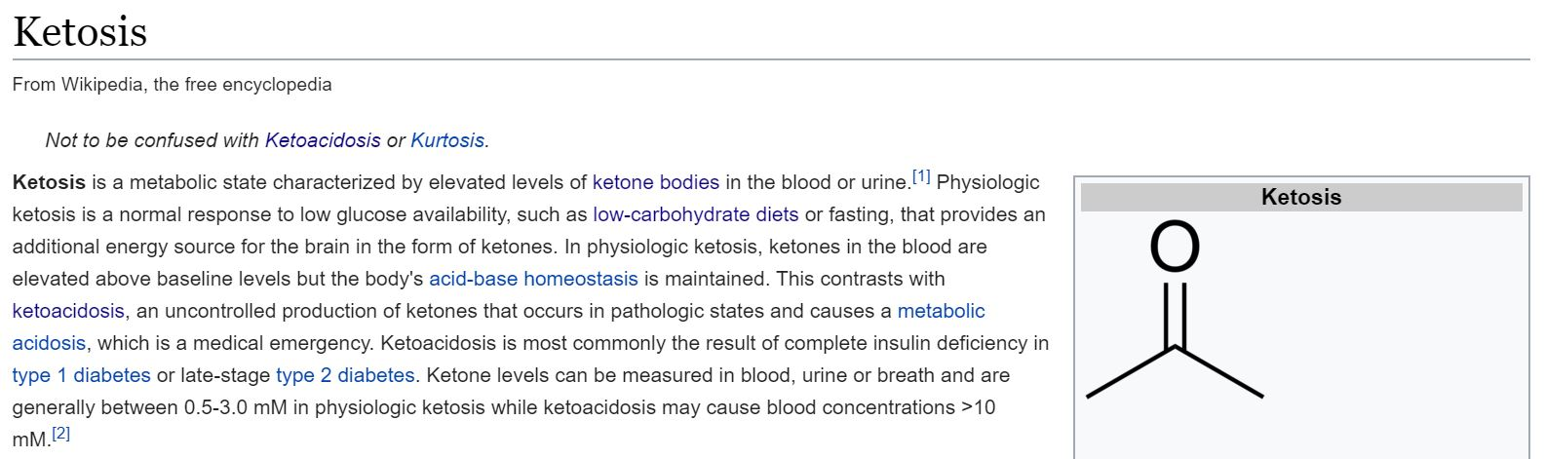
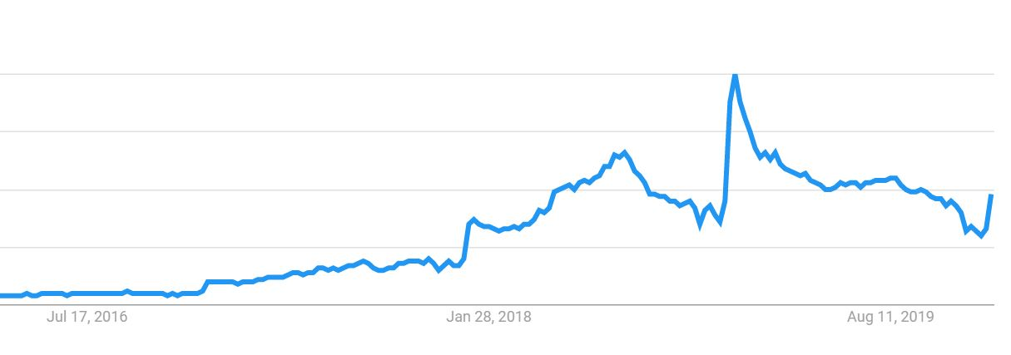

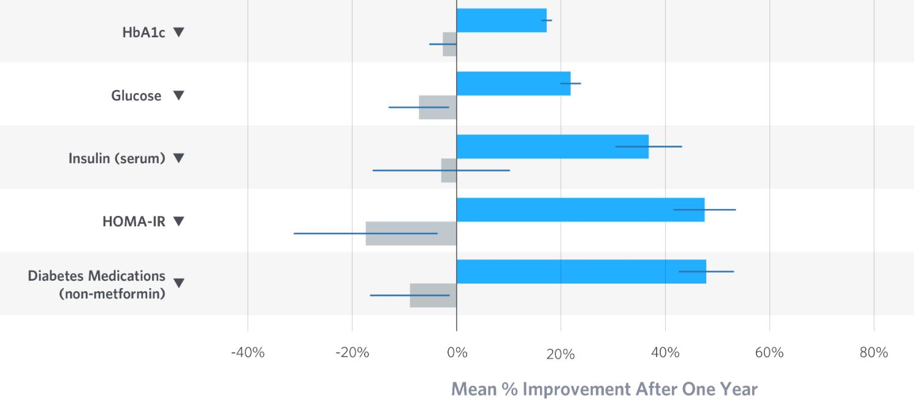

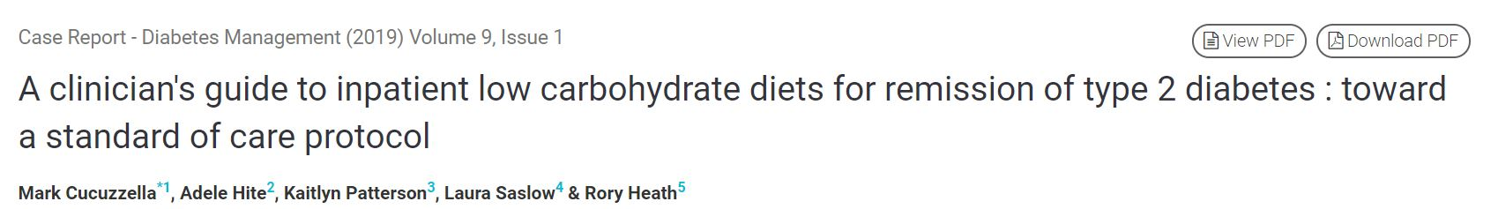


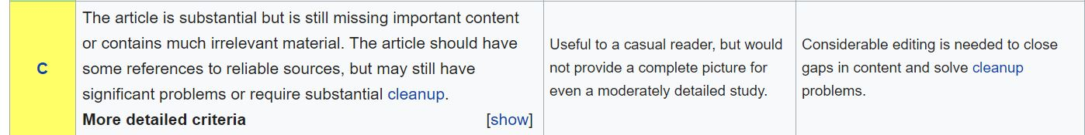

Development of Educational Resources for
Very-Low Carbohydrate, Ketogenic Diets
Kaitlyn Patterson, Dina Hafez-Griauzde MD, Laura Saslow PhD
University of Michigan Medical School, University of Michigan School of Nursing
Objective
Methods
Results
Sample Materials
My Capstone for Impact involved developing educational resources on very-low carbohydrate diets for the general population, people with prediabetes or diabetes, and healthcare providers. This included creation of a group-based lifestyle curriculum, clinical resources, a peer-reviewed publication and revision of Wikipedia pages.
Literature on the efficacy, safety, clinical effects and physiology of very-low carbohydrate, ketogenic diets were reviewed and guided resource development.
Low-Carb Diabetes Prevention Program
-The Diabetes Prevention Program (DPP)
is an established evidence-based group lifestyle program for people with prediabetes that is currently available in communities around the United States (7)
-The traditional DPP curriculum teaches fat and calorie restriction and 150 minutes of exercise per week. This curriculum was adapted to teach a low-carbohydrate eating pattern while retaining the group-based structure and exercise recommendations.
Clinician Resources
A clinician guide was developed in collaboration with physician experts and was distributed to primary care physicians of participants of the lifestyle program. The guide included information on the diet details, medication management and side effect palliation.
These resources were utilized in a pilot study
of a Low-Carbohydrate Diabetes Prevention
Program held at Canton Health Center from
October 2017 to September 2018. Qualitative feedback was gathered from the lifestyle coach, program participants and primary care providers receiving the clinician guide in the form of interviews and surveys.
Wikipedia Pages
Wikipedia was identified as an accessible resource potentially utilized by the general population as well as healthcare providers (8). The page view data, edit histories, and ratings of Wikipedia articles were reviewed to identify pages central to low-carbohydrate physiology or clinical applications that were rated as low-quality articles.
A range of resources were developed for patients with prediabetes, primary care providers and the general public. This included the following:
Low-Carb Diabetes Prevention Program Curriculum
-24 sessions of handouts & the accompanying lifestyle coach manual were adapted and delivered over one year to 22 participant in the pilot study
-Average 5.9% body weight loss at 12 months compared to 4.2% average in traditional DPPs
-Participants reported ease of understanding the
curriculum and enjoyment of the program without side effects.
-Participants reported frustration with conflicting messaging from the media, healthcare providers and other resources regarding low-carbohydrate eating patterns and dietary fat.
Clinician Resources
-Physicians of the pilot study participants (n=9) had low engagement with the clinician guide and the subsequent survey (2 completers).
- The physicians reported they were already recommending
general carbohydrate restriction to their patients and that a
different method of dissemination would Increase engagement with the resource.
-The clinician guide was expanded in collaboration with physicians using low-carbohydrate approach in various clinical settings and published a stepstone to clinical practice guidelines (9)
Wikipedia Pages
“Ketosis” and “Ketoacidosis” were identified as relevant articles rated as “C” or “Start” in quality.
“Ketosis” page received an average of 1500 views per day and “Ketoacidosis” received 780 per day from 1/2019-12/2019. Content and citations were updated, and the articles are under review for an updated quality rating.
Background
-Public interest in low-carbohydrate, ketogenic diets has increased dramatically in the past three years.
-Very low-carbohydrate, ketogenic diets (20-50g carbs/day) can improve glycemic control and reduce dependence on medication in individuals with type 2 diabetes (2,3,4)
- Low-carbohydrate approaches have shown promise in improving metabolic markers (5) and may reduce progression to type 2 diabetes in people with prediabetes (6).
- Misunderstanding of the physiology, clinical impacts and safety remain among the general population as well as healthcare professionals.
- Healthcare provider knowledge and access to resources to guide patients following a ketogenic diet may be insufficient for scalability and longitudinal success and safety of the approach.
Sample images from Low-Carbohydrate Diabetes Prevention Program participant handouts
Samples from clinician guide for primary care physicians
Number of Google searches for “Ketogenic diet” 2016 to present
Introduction for revised Wikipedia article
Conclusions
Low-carbohydrate lifestyle interventions can be a powerful approach for people with prediabetes or diabetes, but will require accessible, reputable resources for patients and clinicians. Continued development of high-quality resources as well as evidence- based lifestyle programs will be crucial to widespread uptake and safety of this approach.
Outcomes of online based, low-carbohydrate lifestyle program compared to standard care over one year in patients with diabetes.
Hallberg et al 2018.
Future Directions
- Low-carbohydrate Diabetes Prevention Program in the Ann Arbor VA. Given the burden of metabolic disease in the veteran population as well as the potential for integration
with primary care and scalability across
VA sites
- I hope to continue this work in my career in Physical Medicine and Rehabilitation. People with disabilities have a high prevalence of diabetes and may have challenges to
exercising.
Contact
References
1. Snorgaard, O., Poulsen, G. M., Andersen, H. K., & Astrup, A. Systematic review and meta-analysis of dietary carbohydrate restriction in patients with type 2 diabetes. BMJ Open Diabetes Research & Care. 2017; 5(1), e000354.
2. Feinman, R. D., Pogozelski, W. K., Astrup, A., Bernstein, R. K., Fine, E. J., Westman, E. C., … Worm, N. Dietary carbohydrate restriction as the first approach in diabetes management: Critical review and evidence base. Nutrition. 2015. 31(1), 1–13.
3. Hallberg SJ, McKenzie AL, Williams P, et al. Effectiveness and Safety of a Novel Care Model for the Management of Type 2 Diabetes at One Year: An Open Label, Non-Randomized, Controlled Study. Diabetes Therapy. 2018; 9(2): 583-612.
4. Athinarayanan SJ, Adams RN, Hallberg SJ, et al. Long-Term Effects of a Novel Continuous Remote Care Intervention Including Nutritional Ketosis for the Management of Type 2 Diabetes: A 2-year Non-randomized Clinical Trial. Frontiers in Endocrinology. 2019; 10:348.
5. Hu, T., Mills, K. T., Yao, L., Demanelis, K., Eloustaz, M., Yancy, W. S., … Bazzano, L. A. Effects of low-carbohydrate diets versus low-fat diets on metabolic risk factors: a meta-analysis of randomized controlled clinical trials. American Journal of Epidemiology. 2012; 176 Suppl 7, S44-54.
6. Humphrey. The Effects of a Six-Week Low Carbohydrate Diet Among Patients With Prediabetes. University of Arizona. 2016. http://hdl.handle.net/10150/621794
7. Group DPPR. Reduction in the Incidence of Type 2 Diabetes with Lifestyle Intervention or Metformin. New England Journal of Medicine. 2002;346(6):393–403.
8. Schmidt, T. Informal education of medical doctors on the Internet. Studies in Health Technology and Informatics. 2013; 160, 92-94.
9. Cucuzzella, Hite, Patterson, Saslow, Heath. A clinician's guide to inpatient low carbohydrate diets for remission of type 2 diabetes : toward a standard of care protocol. Diabetes Management. 2019; 9(1), 7–19.
Kaitlyn Patterson
University of Michigan Medical School
pattkait@umich.edu

