Slide 1

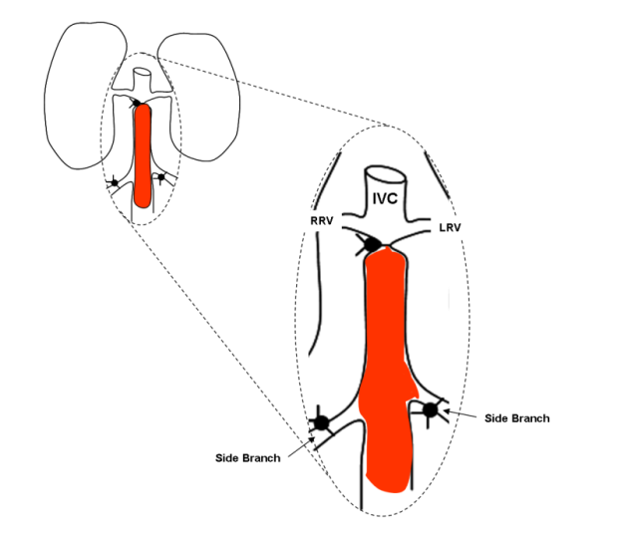
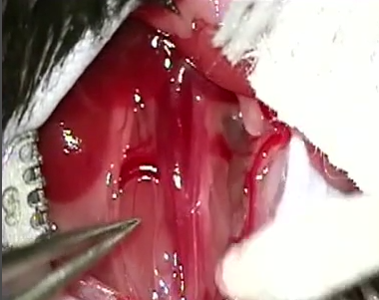
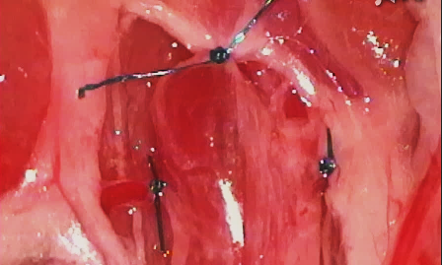
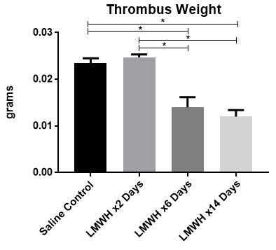
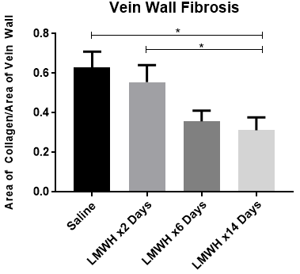
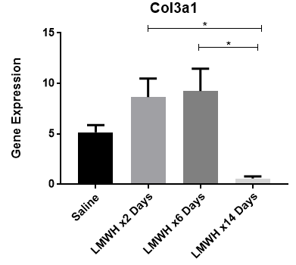

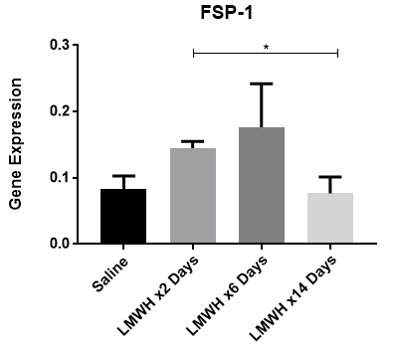
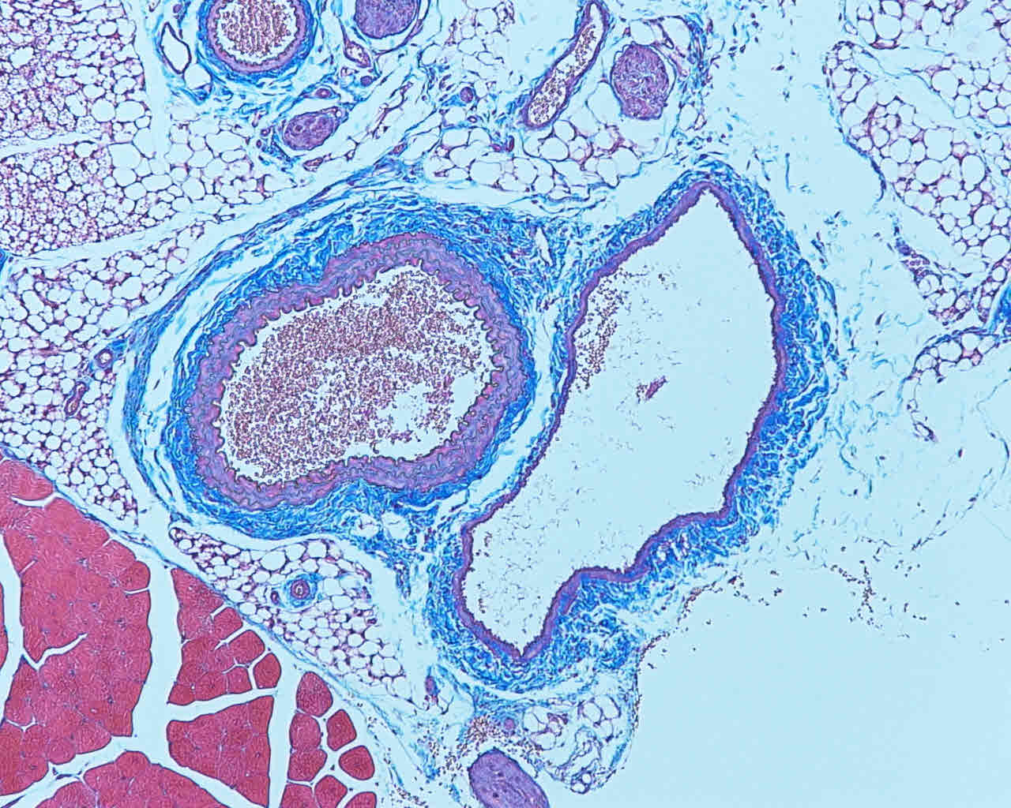
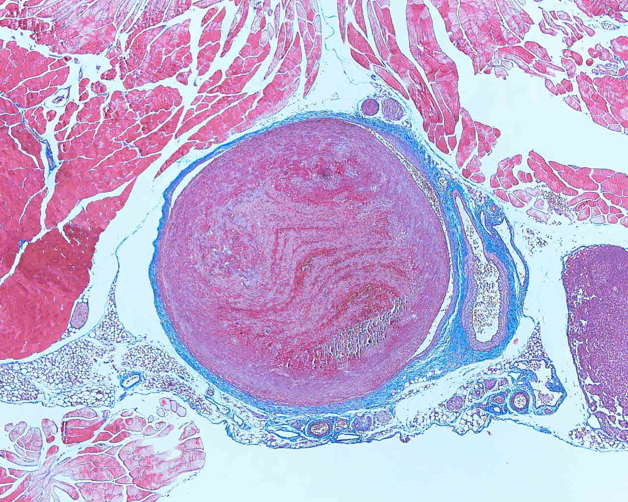
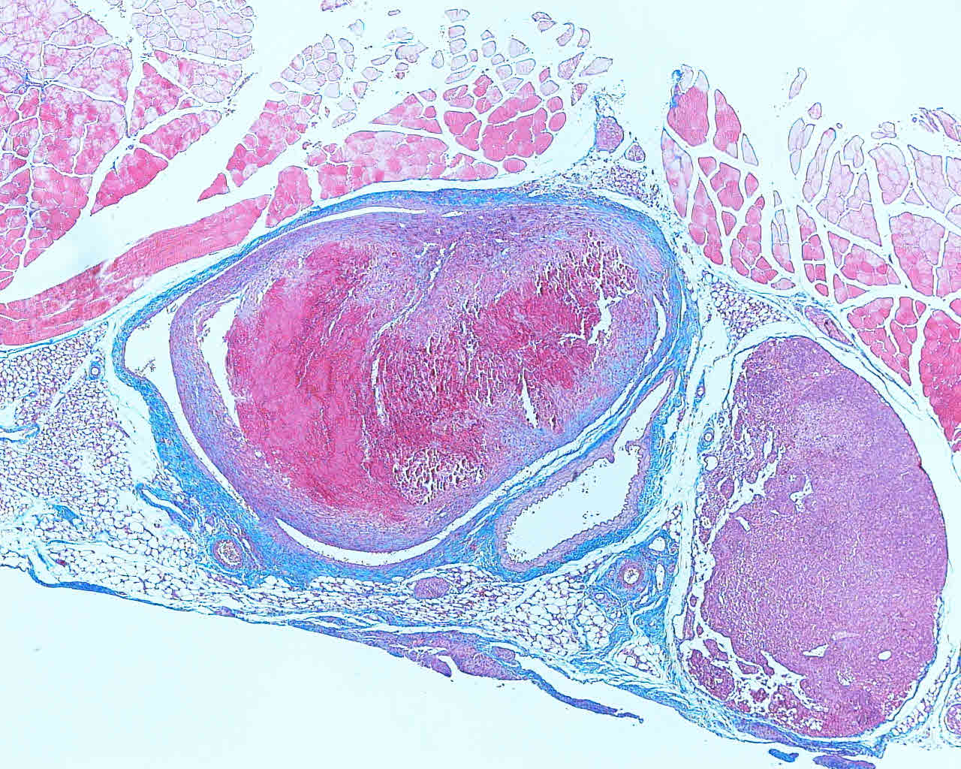
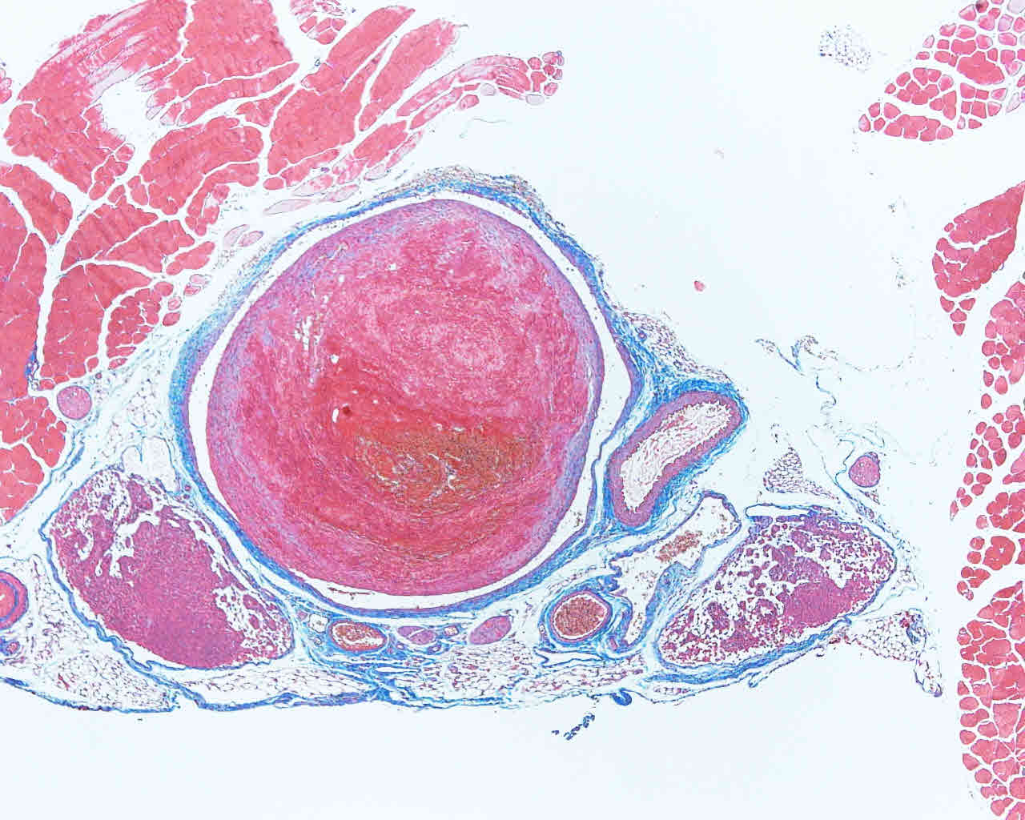
The Effects of Prolonged Anticoagulation with Low Molecular Weight Heparin on Fibrotic Vein Wall Remodeling in a Murine Model of Venous Thrombosis
Joshua P. Rainey^{1,3}, Olivia R. Palmer², Cathy Luke³, José A. Diaz³
¹University of Michigan Medical School; ²Department of Biomedical Engineering, University of Michigan, Ann Arbor, MI; ³Conrad Jobst Vascular Research Laboratories
ABSTRACT
IVC Ligation Model
Purpose: As many as 50% of patients who undergo anticoagulation therapy for an un-provoked acute vein thrombosis (VT) develop within two to eight years post thrombotic syndrome (PTS), a fibrotic complication. There is a current debate whether prolong anticoagulation can reduce PTS. The aim of this study was to determine if prolonged anticoagulation using low molecular weight heparin (LMWH) reduces fibrotic vein wall remodeling in a murine model of VT.
Methods: Male, 10-12 weeks old, C57BL/6 mice underwent the Inferior Vena Cava (IVC) model and received standard anticoagulation (LMWH x 6 days + Saline + 8 days) or prolonged anticoagulation (LMWH X 14 days). LMWH dosing was 5.5 mg/kg twice daily, subcutaneously, post-surgery. Day 14 post-thrombosis blood was drawn, and the IVC/thrombus was weighed and harvested for further evaluation with qRT-PCR of fibrotic markers (Col1a, Col3a1, TGF-beta1, FSP-1, MMP-2 and MMP-9) or histology with Masson’s Trichrome staining.
Results: Thrombus weight was significantly decreased for both LMWH x6 days (14mg ± 0.89mg) and LMWH x14 days (12mg ± 0. 52mg) when compared to LMWH x2 days (25mg ± 0.26mg) and saline groups (23mg ± 0.55mg). There was no difference in thrombus weight between the LMWH x6 days and LMWH x14 days groups. The mean vein wall collagen area to vein wall area ratios decreased as the anticoagulation treatment was prolonged (saline 0.631 ± 0.078; LMWH x2 days 0.555 ± 0.086; LMWH x6 days 0.357 ± 0.054; LMWH x14 days 0.313 ± 0.065). The collagen deposition of the LMWH x14 days treatment group was significantly decreased in comparison to both the saline and LMWH x2 days groups. There was no significant difference in gene expression of MMP-2, MMP-9, Col1a1, and TGF-beta1 among all four groups. However, Col3a activity was significantly decreased for LMWH x14 days at 0.59 ± 0.21 when compared LMWH x 2 days and LMWH x 6 days (saline 5.16 ±0.72; LMWH x 2 days 8.64 ± 1.85, LMWH x6 days 9.24 ± 2.22). FSP-1 expression was also significantly decreased for LMWH x 14 days at 0.0767 ± 0.248 when compared to LMWH x 2 days (0.145 ± 0.010).
Conclusions: Extending anticoagulation decreased mean vein wall fibrosis. Thrombus weight, collagen deposition, Col3a1 and FSP-1 were significantly decreased with prolonged anticoagulation of LMWH x 14 days. Thus, extending anticoagulation decreases fibrotic vein wall remodeling in a mouse model of occlusive VT.
IVC Anatomy
IVC Pre Ligation
IVC Post Ligation
RESULTS
OBJECTIVES AND HYPOTHESIS
The aim of this current study is to determine if prolonged anticoagulation (14 days) with LMWH reduces fibrotic vein wall remodeling in a murine model of DVT as opposed to shorter term anticoagulation (2 days) with LMWH. This proposal attempt to parallel the clinical scenario: anticoagulation for a short period of time (6 months) and PTS developing in a longer period of time (between 2 to 8 years).
For patients who have suffered a VT episode, there is a significant relationship between subtherapeutic INR control with a vitamin K antagonist and the occurrence of post thrombotic syndrome PTS, even excluding patients who have suffered recurrent DVTs. Thus, we expect to see less fibrotic vein wall remodeling with prolonged anticoagulation treatment with low molecular weight heparin (LMWH) in a murine model of DVT. This should be manifested by decreased vein wall fibrosis by histological examination as well decreased expression of Col1a, Col3, TGF-beta, FSP-1, MMP-2 and MMP-9 by quantitative real-time PCR.
Saline
LMWH x2 Days
LMWH x6 Days
LMWH x14 Days
MATERIALS & METHODS
  Animals: 10-12 week old male C57BL/6 mice were used.
  Inferior Vena Cava Ligation Model: Mice were anesthetized through inhalation of 2% isoflurane with 100% oxygen. A midline laparotomy was performed with externalization of intestines. Lumbar branches were cauterized and side branches were ligated with 7-0 PROLENE. Finally, the IVC was ligated below the renal veins. 5-0 Vicryl sutures were used for abdominal muscle closure, and surgical glue was used for closure of skin.
  Thrombus Weight: At time of sacrifice, the IVC and associated thrombus were removed. These were weighed and measured in length. Thrombus weight was defined as weight of thrombus plus weight of vein wall.
  Quantitative real-time PCR: qRT- PCR was performed on the vein wall specimens to examine gene expression of the following genes related to fibrotic remodeling: Col1a, Col3, TGF-beta, FSP-1, MMP 2 and MMP 9.
  Histology: Masson’s Trichrome staining was performed on IVC vein wall samples and ImageJ software was used to quantify the amount of fibrotic staining per slide.
  Statistics: All statistical analyses were performed using GraphPad Prism for Windows. Student’s T tests with Welch corrections and one-way ANOVA with a Tukey’s multiple comparison test were performed to determine statistical differences between groups. A value of P ≤ .05 was considered significant, and data are reported as mean ± standard error of the mean
CONCLUSIONS & FUTURE STUDIES
Extending anticoagulation decreased mean vein wall fibrosis in a mouse model of occlusive VT.
Thrombus weight, collagen deposition, Col3a1 and FSP-1 were significantly decreased with prolonged anticoagulation of LMWH x 14 days.
As this study examined gene expression at day 14 for all treatment groups, future studies would investigate the natural history of gene expression of fibrotic markers at multiple time points for mice treated
with LMWH versus saline.

