Slide 1


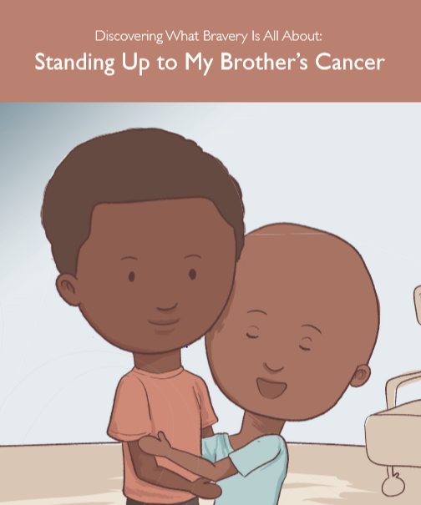
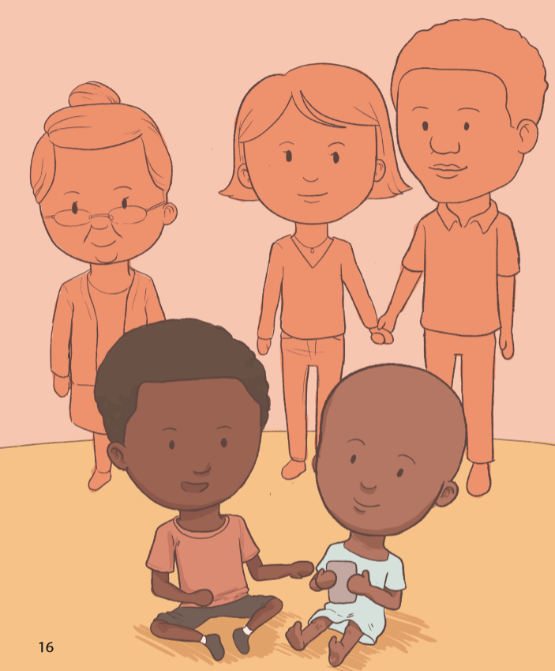
Development of a Novel Children’s Book for Siblings of Pediatric Oncology Patients
REPLACE THIS BOX WITH YOUR ORGANIZATION’S
HIGH RESOLUTION LOGO
Adam René Rosenbaum¹; Allyssa Benedict^{2,3}; Nancy Tena⁴; Beth Stuchell⁴; Thomas Michniacki^{1,4}; Rama Jasty^{1,4}
¹University of Michigan Medial School, ²University of Michigan Stamps School of Art and Design, ³University of Illinois Chicago College of Applied Health Science, ⁴University of Michigan Division of Pediatric Hematology/Oncology
Project Objectives
Methods
Results
Obstacles Encountered
The objective of this project is to design, create, and produce a novel children’s book designed specifically for the siblings of pediatric oncology patients. The goal of the book is both to provide siblings with a written example reflecting their potential experiences and emotions, as well as to provide parents with a resource that can be used to help discuss the diagnosis with other children in the family. The book is written to help explain the cancer diagnosis, provide education, as well as suggest ways for siblings to support their sick brother or sister. It can also serve as a reflection of the potential of the potential thoughts or emotions that siblings have. It is our hope that, following completion of the story, parents and siblings will be able to engage in meaningful dialogue regarding the experiences, emotions, thoughts, and questions that siblings may have surrounding a new cancer diagnosis.
Phase 1: Assess Need and Discuss with Stakeholders
Research existence of current materials for siblings of children diagnosed with cancer
Meet with pediatric oncology faculty, social work, nursing, child life, and education specialists to learn about the new diagnosis education process and assess potential topics to include in text
Discuss proposed topics with U of M Pediatric Hematology Oncology Advisory Council to receive feedback and hear directly about the experience discussing a cancer diagnosis with siblings
Phase 2: Write and Illustrate the Book
Create a general overview plot that touches upon topics outlined
Select targeted age group for the text
Write the text and undergo multiple versions of edits following feedback from different stakeholders about content and age-appropriateness
Work with illustrator to select illustration designs to create age-appropriate, inclusive, and inviting images for children and parents
Phase 3: Publication
Obtain Capstone for Impact Grant to assist with production costs
Collaborate with University of Michigan Publishing to produce the book
Format the text to fit the printing requirements set up by the publisher
Begin printing copies of the final text within 2020
We have produced an original 18-page story following a boy as he goes to visit his younger brother who has cancer, in the hospital. The story has been written and the illustrations have been designed for a 3rd grade reading level.
In the story, the reader learns how the protagonist’s life has changed following the diagnosis of his brother: he doesn’t see his brother or parents as much, his parents no longer attend his basketball games, and family members cry more frequently. The reader also learns about various aspects of cancer treatment: chemotherapy, losing hair, feeling nauseous, and getting infections. The protagonists shares with the reader some ways in which he tries to help his brother feel better, such as visiting him at the hospital weekly to play with him and writing him daily notes.
The reader also learns about the protagonist’s difficulties in living with the diagnosis. The protagonist is scared, wants to see his family more, and wants his life to resume normalcy. He has questions but doesn’t know who he should ask.
After seeing his brother vomit during a visit to the hospital, the protagonist and his mother have a conversation about his fears. His mother shares that his strength is inspiriting to the family and that he brings up his brother’s mood all the time. He and his mother decide to dedicate more time to talking about his feelings and questions.
As they reunite with the rest of the family, the protagonist's brother is ready to keep playing. In this moment, the narrator learns that in his bravery, he is standing up to cancer.
At the beginning of the project, the idea was largely to provide medical education to siblings regarding a cancer diagnosis. In conversation with the Pediatric Hematology-Oncology Advisory Council, we learned that the larger need was to reflect the daily emotional experience that siblings can have.
We decided to write the story for a 3rd grade reading level, knowing that this would make it easy for parents to read the book to both younger and older kids. With this goal, we needed to work to make our text language.
As we received and made edits to the text, we needed to share the new story with the illustrator. This occasionally led to confusion but would resolve with discussion.
As conversations with the publisher began, certain aspects of formatting for the pages and colors needed to be improved. As most changes were made by the illustrator, the author needed to carefully relay information from one party to the other.
Due to limitations of time and money, distribution will need to start on a local scale, with potential to explore to more widespread distribution at a later time, based on the receptivity of the book locally.
Background
A cancer diagnosis in a child is one of the most difficult situations that families can encounter. So much is left to the unknown and the entire lifestyle of the family is uprooted as they prepare to combat the disease. Given all the new demands to care for the sick child, often siblings can feel forgotten, as they too try to understand what this new diagnosis means.
There are many programs in place to help siblings cope with the new diagnosis, including summer camps and support groups, but frequently these experiences are mediated by health care professionals and often require the families to plan around their already busy commitments with the sick child. While these programs are not to be devalued , we believe that parent-child dialogue to be helpful as well. Identifying a need for tools designed specifically to help parents and oncology siblings engage in dialogue, we have created an original story that can be read by parents and siblings together to help learn about and understand a new cancer diagnosis.
Next Steps
At present, we are working to establish the correct formatting required for printing as specified by the guidelines from U of M Publishing.
Following printing, there will be a book launch, at which the author will present the final copy to interested parties and explain how the book can be distributed to families following a new pediatric cancer diagnosis.
We hope to establish a focus group with families that have used the book to assess the utility and helpfulness of this product. We would like to also learn about conversations that happen between parents and children following completion of the book.
We are going to explore contacting national pediatric oncology organizations to see if they would like to aid in funding and distribution of potential future copies.
Contact:
Acknowledgements
Adam René Rosenbaum
University of Michigan Medical School
Email: aprosenb@med.umich.edu
Phone: 5174023451
This project was funded by the University of Michigan Capstone for Impact Grant. We’d like to thank Dr. Michael Englesbe for his support of this project. We’d also like to thank the University of Michigan Pediatric Hematology-Oncology Advisory Council and Lauren Stachew at University of Michigan Publishing for her assistance in this project.

