Slide 1


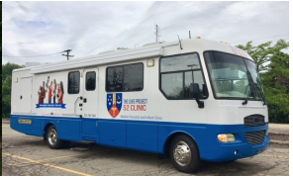
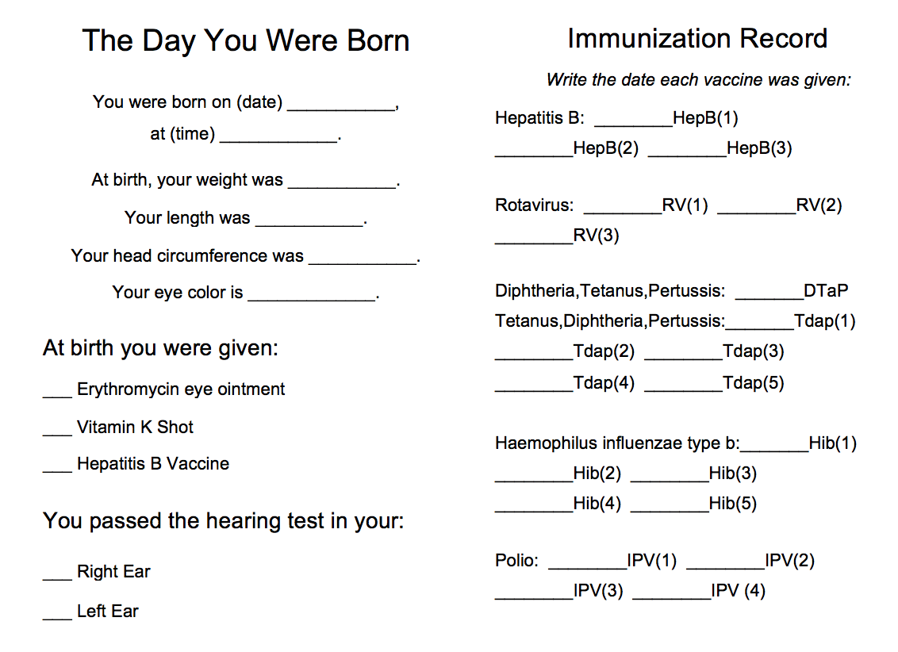
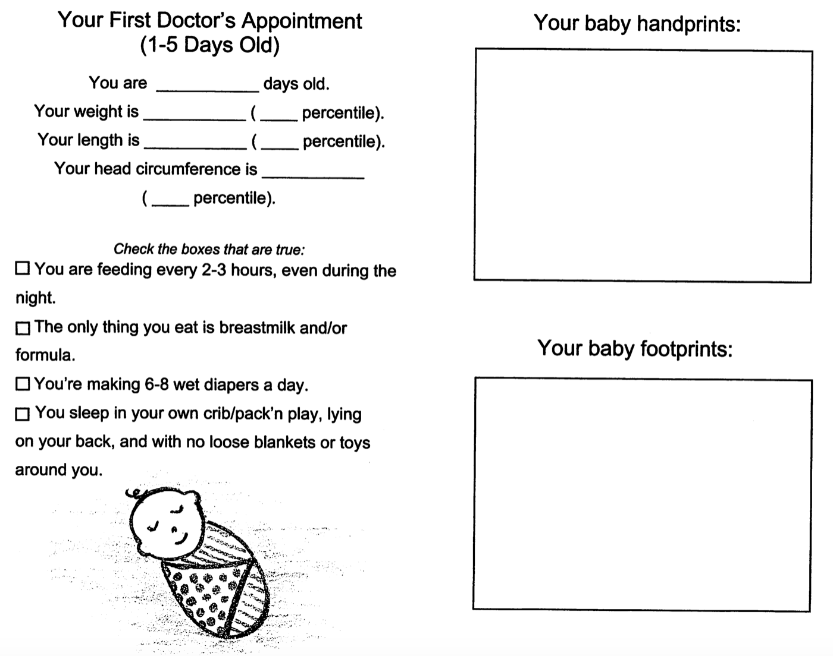
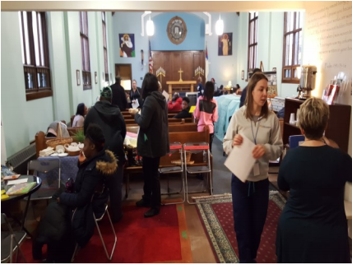
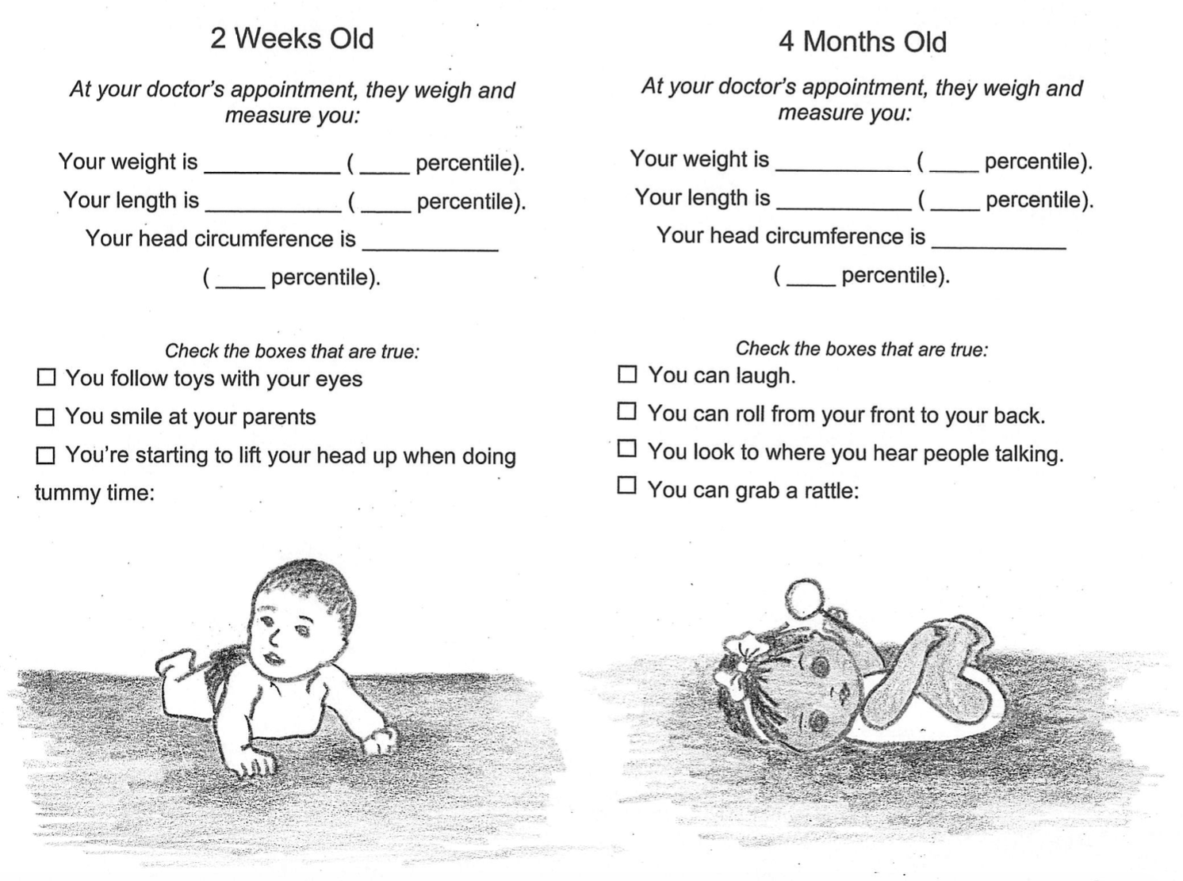
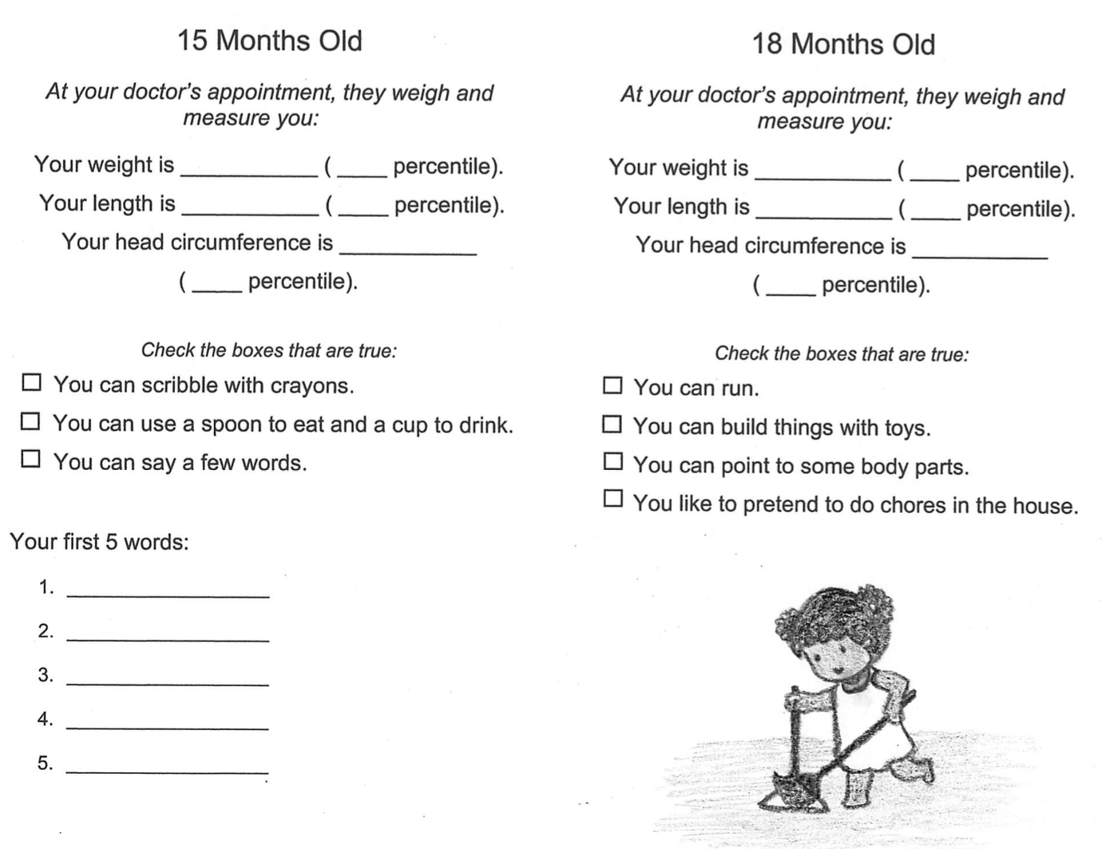
The Luke Project 52 Clinic Baby Book For Developmental Milestones
Meghan E. Rowe
BACKGROUND
APPROACH
OVERVIEW & NEXT STEPS
While volunteering at the Luke Project 52 Clinic, a free perinatal and neonatal clinic in downtown Detroit, I worked with families who have limited access to medical care. Some children seen at the clinic will go for years without seeing a physician for routine check-ups. When children are seen by health care providers, their visits often took place at various health care systems, making it challenging to access information from past visits.
Over several sessions of volunteer work at the Luke Clinic, I interviewed parents regarding the most helpful medium for providing both health care education. While there is a national move toward digital health applications, several of the mothers did not own a smart phone or had limited access to the internet. I decided to create a physical ‘Baby Book’ where basic health information and developmental milestones can be documented. The book also has drawings showing basic milestones. I included spaces for parents to record their child’s handprints, footprints, and photographs. These are meant to initiate fun activities that can be completed during the child’s health appointments at the Luke Clinic, which will hopefully encourage parents to bring the book to each pediatric appointment.
Creation of the baby book was inspired by my volunteer work at the Luke Project 52 Clinic in downtown Detroit. The population that utilizes the Luke Clinic face health and economic disparities that limit regular well-child appointments at the surrounding hospitals. This book is intended to help providers and parents track basic developmental milestones, to serve as a reminder for parents to bring their children to well-child visits, and to provide some basic health education. T
The utilization of the book will be studied by rising M4s throughout the following year, and edits/additions will be made based on these studies and patient feedback. Additionally, I will be translating the book into Spanish.
RESULTS
REFERENCES
Figure 1. Luke Clinic Mobile Unit
Bureau USC. Poverty in the United States: The 25 Most Populous Metro Areas 2018.
Michigan Department of Health and Human Services. Table 5: Number and Rate of Infant Deaths by Race for Residents of Michigan, Detroit City, Wayne County (Excluding Detroit City) and Michigan (Excluding Wayne County), 1990- 2016 Available at: https://http://www.mdch.state.mi.us/pha/osr/InDxMain/Tab5.asp
Samuels RC, Ward VL, Melvin P, et al. Missed Appointments: Factors Contributing to High No-Show Rates in an Urban Pediatrics Primary Care Clinic. Clin Pediatr (Phila). Sep 2015;54(10):976-982.
Rhodes SD, Mann L, Siman FM, et al. The impact of local immigration enforcement policies on the health of immigrant hispanics/latinos in the United States. Am J Public Health. Feb 2015;105(2):329-337.
Michigan Department of Health and Human Services. Michigan Health Equity Status Report: Focus on Maternal and child Health: a joint report of the Practices to Reduce Infant Mortality through Equity Project and the Health Disparities Reduction and Minority Health Section. Available at: http://www.michigan.gov/documents/mdhhs/HE_Status_Report_506754_7.pdf.
Kaiser Family Foundation. Key Facts about the Uninsured Population. San Francisco, CA 2017.
Bornstein MH, Putnick DL, Bradley RH, Lansford JE, Deater-Deckard K. Pathways among Caregiver Education, Household Resources, and Infant Growth in 39 Low- and Middle-Income Countries. Infancy. 2015 Jul-Aug;20(4):353-376. PubMed PMID:26273231; PubMed Central PMCID: PMC4530992.
Busey S, Schum TR, Meurer JR. Parental perceptions of well-child care visits in an inner-city clinic. Arch Pediatr Adolesc Med. 2002 Jan;156(1):62-6. PubMed PMID: 11772192.
Anderson, Monica, and Madhumitha Kumar. “Digital Divide Persists Even as Lower-Income Americans Make Gains in Tech Adoption.” Pew Research Center, Pew Research Center, 7 May 2019, www.pewresearch.org/fact-tank/2019/05/07/digital-divide-persists-even-as-lower-income-americans-make-gains-in-tech-adoption/
Selden TM. Compliance with well-child visit recommendations: evidence from the Medical Expenditure Panel Survey, 2000-2002. Pediatrics. 2006 Dec;118(6):e1766-78. PubMed PMID: 17142499.
Raspa M, Levis DM, Kish-Doto J, Wallace I, Rice C, Barger B, Green KK, Wolf RB. Examining Parents' Experiences and Information Needs Regarding Early Identification of Developmental Delays: Qualitative Research to Inform a Public Health Campaign. J Dev Behav Pediatr. 2015 Oct;36(8):575-85. doi:10.1097/DBP.0000000000000205. PubMed PMID: 26414090; PubMed Central PMCID:PMC4633015.
Figure 2: Luke Clinic During Operation Hours
OBJECTIVES OF PROJECT
I saw the need for a manner of both keeping track of basic health information, such as height and weight, and an opportunity to provide important education for parents surrounding child development.
Acknowledgments: Thank you to all of the hard working staff and volunteers at Luke Clinic, Dr. Katherine Gold for supporting my longitudinal volunteer experience, and all of the families who come to Luke Clinic for medical care and community

