Slide 1


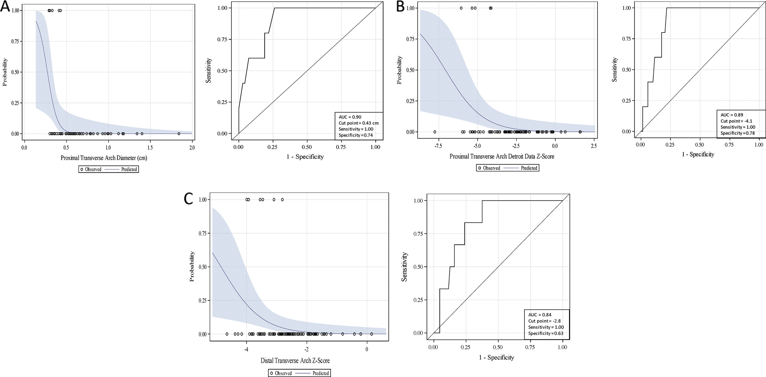
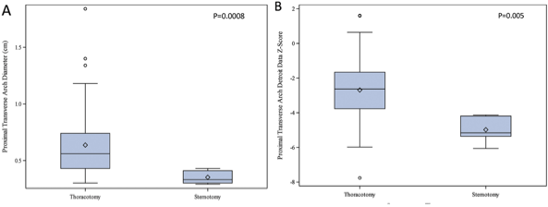
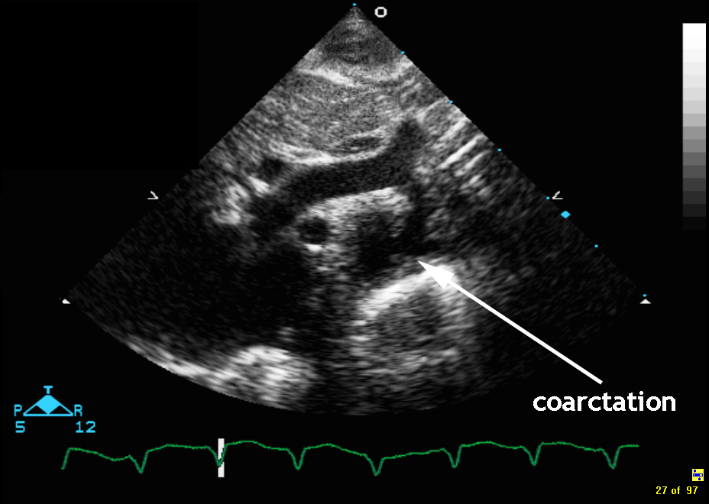
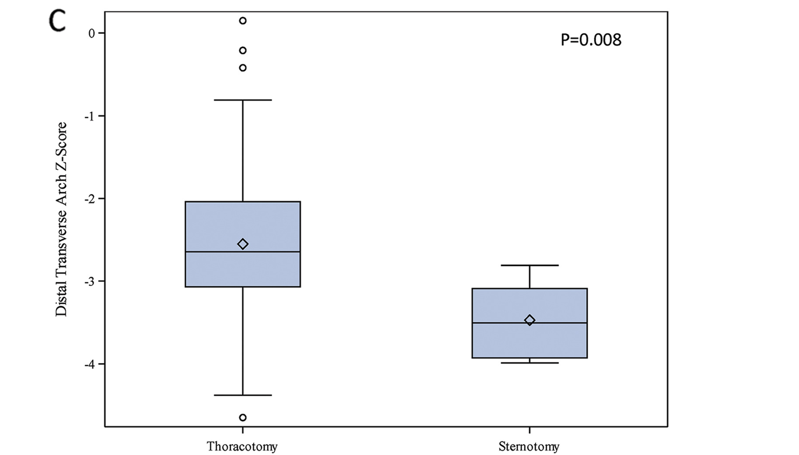
Capstone 2020: Long-Term Outcomes of Coarctation Repair Through Left Thoracotomy
William Russell
Lurie Children’s Hospital and Mott Children’s Hospital
Introduction
Clinical Questions
Results
Results (continued)
Discussion
Aortic coarctation (CoA) is aortic narrowing distal to left subclavian, usually near the ductus arteriosus.
It is associated with other cardiac malformations: arch hypoplasia, bicuspid aortic valve, intracardiac lesions (AV canal, ASD, VSD, etc).
In utero, two-thirds of cardiac output of the fetus goes through the ductus arteriosus, which typically bypasses coarctation, and thus fetus is asymptomatic.
As a neonate, there is decreased prostaglandins, the ductus arteriosus closes, and now blood must pass through coarctation, which is when the narrowing becomes clinically relevant
Clinically, these patients present with chest pain, cold extremities, claudication with exertion, headache, heart failure
On physical exam, you may see brachiofemoral delay, differing BP in arm and leg, hypertension, systolic murmur at left scapula
Diagnosed by Echo, MRI, CT
Treatment with catheter-based balloon or stent. Or operations via median sternotomy or lateral thoracotomy (usually an end-to-end anastomosis procedure).
The chosen operation is surgeon dependent. Generally median sternotomy is used for coarctation with associated intracardiac defects or extensive arch hypoplasia
Traditionally, extended coarctations or coarctations with associated intracardiac anomalies are repaired via median sternotomy. A distal or small coarctation can be repaired with lateral thoracotomy
However, there is no consensus on the degree of hypoplasia that necessitates median sternotomy
What are the predictors of Surgical Approach: Lateral thoracotomy vs median sternotomy?
What are the complications of end-to-end anastomosis repair via lateral thoracotomy? Are they significantly different from median sternotomy?
Presence of a VSD is predictor of median sternotomy (p=0.0001)
Figure 1: Kaplan-Meier freedom from reintervention curve following end-to-end anastomosis coarctation repair
Figure 2: Predictors of median sternotomy vs lateral thoracotomy
  A: Smaller proximal arch predictive of repair with median sternotomy (cm)
  B: Smaller distal arch predictive of repair with median sternotomy (cm)
  C: Smaller distal arch predictive of repair with median sternotomy (z-score)
Our hypothesis is that the smaller the aortic arch diameter is, the more likely the surgeon is going to choose a median sternotomy.
We then wanted to look at the point (diameter of arch), where, retrospectively, surgeons changed from doing median sternotomy repairs to lateral thoracotomy.
Figure 3: creation of cut points
  A: Proximal arch diameter cut point: 0.43cm
  B: Proximal arch z-score cut point: -4.1
  C: Distal arch z-score cut point: -2.8
VSD or significant arch hypoplasia can lead to choice of median sternotomy over left thoracotomy
We recommend a median sternotomy if the proximal arch has a z-score of -4.1 or the distal arch has a z-score of -2.8 (Otherwise: lateral thoracotomy recommended due to absence of CPB and DHCA)
Other complications include late systemic hypertension (18% at median follow up of 5.4 years), reintervention 2%
End-to-End anastomosis is likely the best repair for coarctation with the fewest complications
Methods
Retrospective analysis for all patients who underwent isolated CoA repair or simultaneous repair of CoA and ventricular septal defect repair by end-to-end anastomosis
Patients with complex congenital heart disease were excluded.
Measured proximal and distal arch lengths to assess what length predicted median sternotomy
Transverse arch hypoplasia was defined as echocardiographic z-score lower than −2 or by documentation in medical or operative reports.
Analyze rates of reintervention and recoarctation
Lessons Learned
ECHO familiarity
Clinical Research Experience
Experienced and Caring Mentorship
Grant-writing Skills
Reference Paper
M. R. F. Gropler, B. S. Marino, M. R. Carr, W. W. Russell, H. Gu, O. M. Eltayeb, M. C. Mongé and C. L. Backer: Long-Term Outcomes of Coarctation Repair Through Left Thoracotomy. Ann Thorac Surg 2019; 107:157-164
Acknowledgements
Dr. Bradley Marino
Dr. Michael Carr
Dr. Thomas Shanley
Dr. Melanie Gropler
https://pedecho.org/library/chd/coarctation-aorta/suprasternal-notch
Sciencedirect.com
Semantic Scholar
Cleveland Clinic

