Slide 1
Intro to U-M
Library Resources
REMS Summer Program 2021
Rebecca Welzenbach
Information Science and Research Impact Librarian

Slide 2
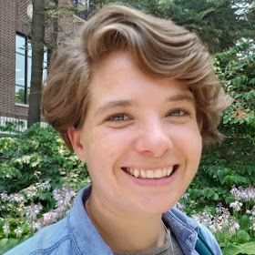
This is me:
I’ve been with the U-M Library since 2009 (when I graduated from UMSI!)
Work in scholarly communications, online journals, digital humanities projects, open access publishing, research impact, and more.
I am the librarian for UMSI students, faculty, and researchers—for the duration of this program, that’s all of you!
Rebecca Welzenbach | rwelzenb@umich.edu
During COVID-19: please email!
Not onsite or available by phone.

Slide 3
You have access to the collections, services, resources and—most importantly!—expertise available in the library!

Slide 4
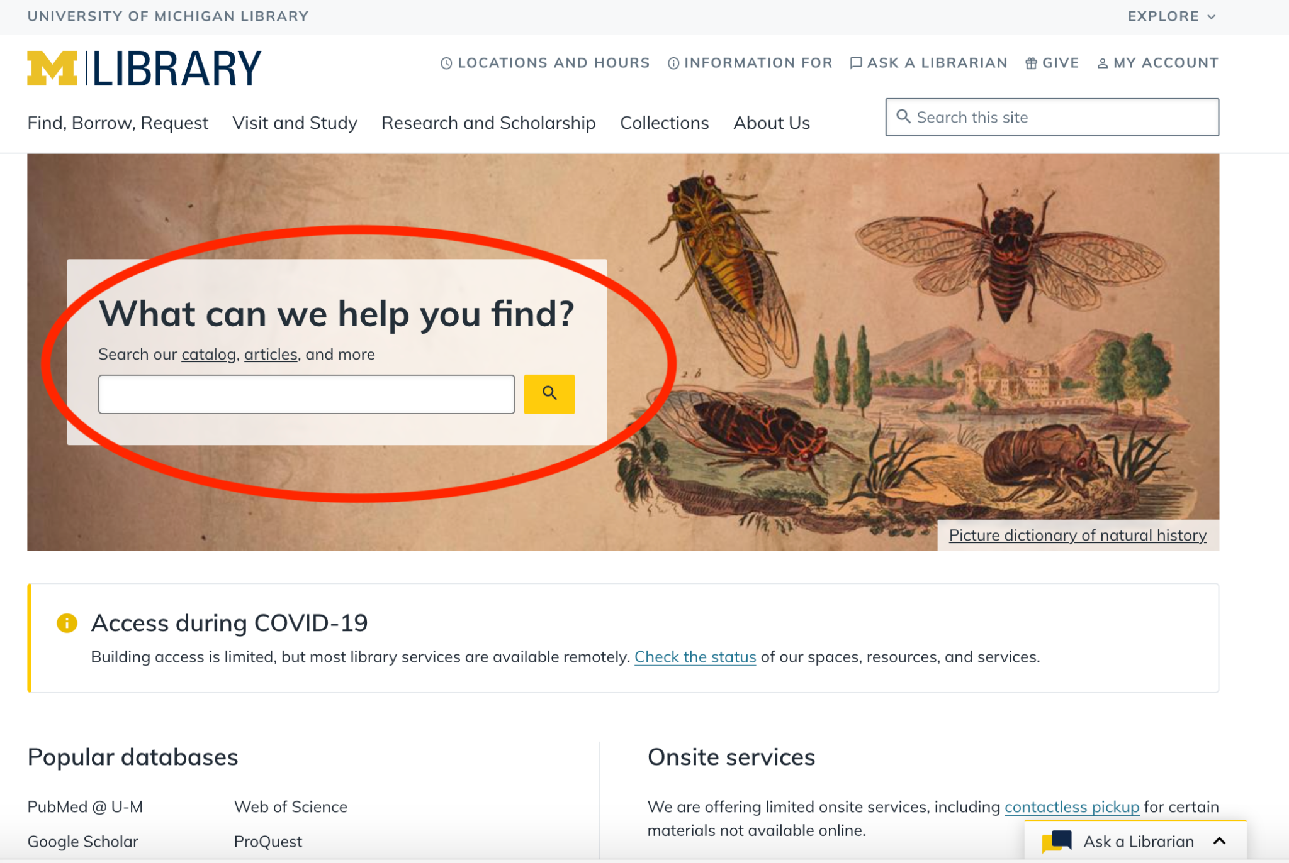
Quick demo of the University Library Website

Slide 5
Relevant Research Guides
Information & Library Science
Master’s in Data Science (MADS)
Research Methods for Information Professionals (Lit Review)
Scholarly Publishing

Slide 6
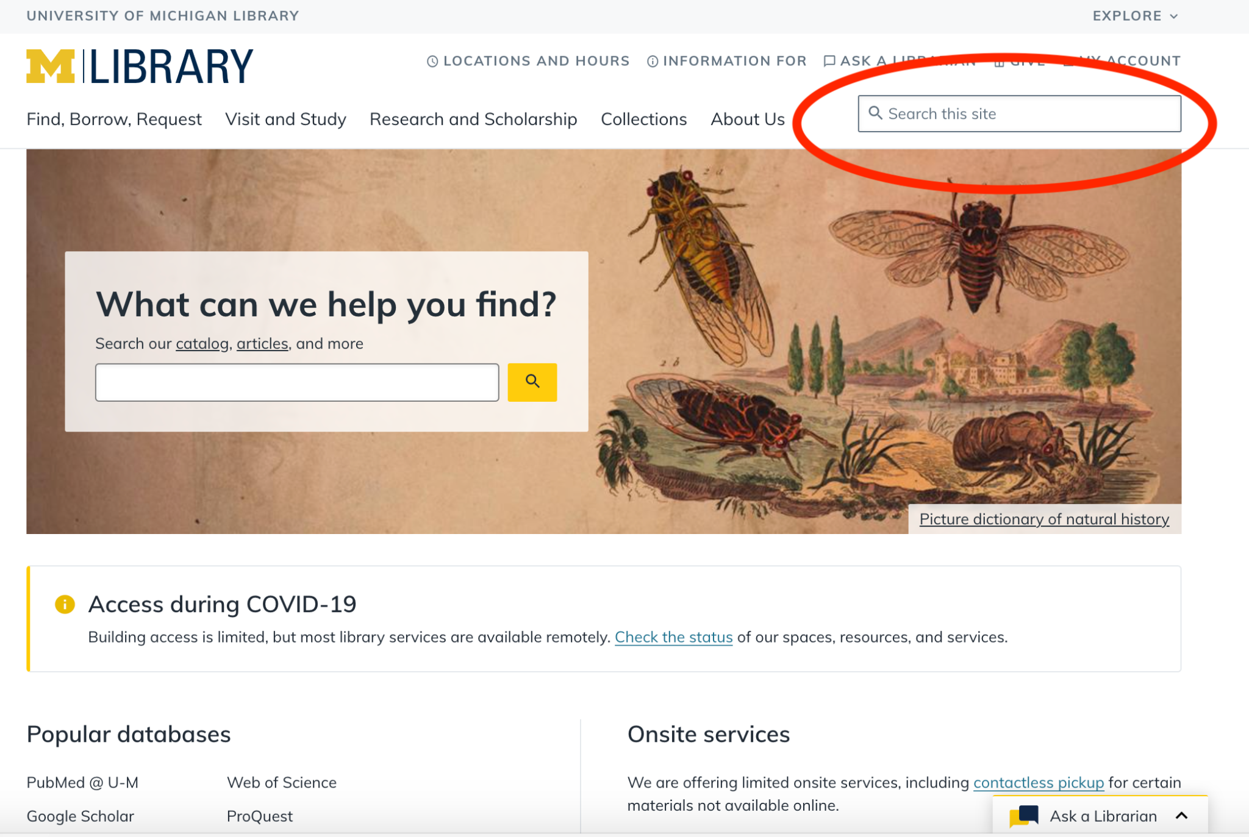
Additional resources
Create & Design
Digital projects and planning
Research data services
Copyright
Data visualization
GIS

Slide 7
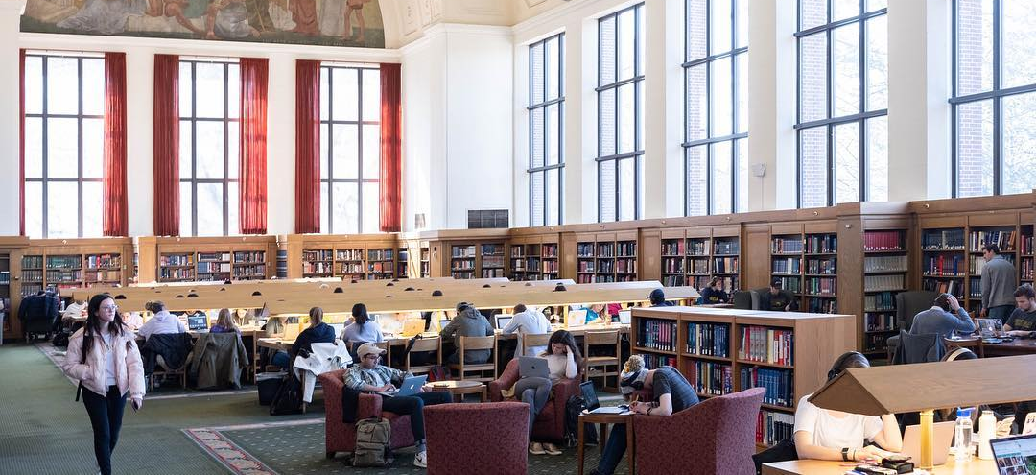
Thank you! Please be in touch!
Ask a Librarian!
Rebecca Welzenbach | rwelzenb@umich.edu

