Slide 1


Role of the PCP - Beyond Behavioral weight loss interventions in older adults
Shenbagam Dewar, MD, ABOM
University of Michigan
Division of Geriatric and Palliative Medicine

Slide 2
Disclosures
I have no financial disclosures.

Slide 3
Objectives
Obesity demographics and prevalence
Obesity-related conditions and challenges
Obesity-centric care
Need for team approach
Focus on function, comorbidities along with weight management

Slide 4
Role of Primary Care in Obesity management
Obesity affects nearly half of older adults (43%)
Obesity trained physicians are limited, just ~5200 in 2021 (US and Canada)
Primary care geriatricians are more positioned to treat obesity
PCP’s have a major role associating the causal effect of obesity-related medical problems to “obesity” as the primary driver

Slide 5
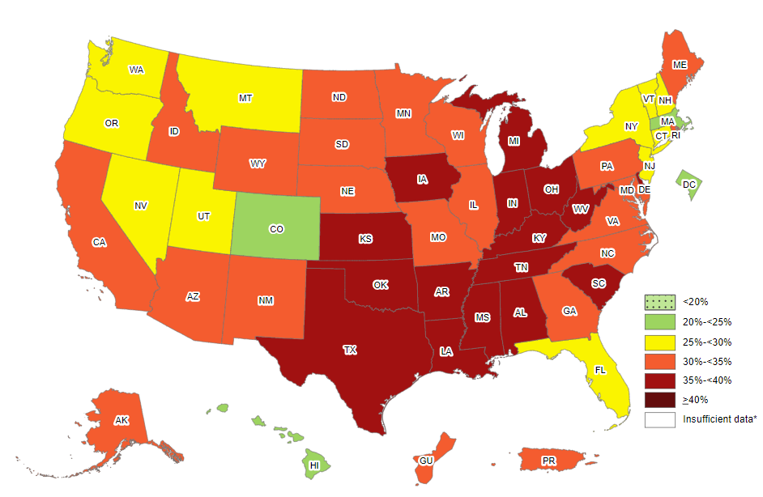
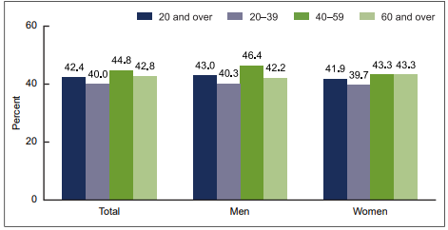







Obesity demographics
CDC 2020 obesity prevalence in adults, BRFSS data
2017-2018 NHANES survey-Age distribution
37.5 39.4
2013 - 2014 NHANES

Slide 6


Disparities in obesity rates
Race/ethnicity
Racial and ethnic minorities
Higher in non-Hispanic black women
Gender
Higher in women than men
Rural/Urban
Higher in rural
Socio-economic status
Low Income (Low SES)
Higher in Hispanic men>75
Over 10-yr period: Increase in food insecurity from 5.5% to 12.4% (2007 to 2016) (Cindy, W JAGS, 2021)

Slide 7
Impact of Aging with Obesity
Multimorbidity
Impaired physical function
Decreased Health-Related Quality of Life (HRQoL)
Increased mortality
Early institutionalization

Slide 8

Comorbidities and Challenges
Obesity-related medical problems
Challenges: High health care utilization
Cardiovascular: HTN/ Dyslipidemia/CHF/CAD/Atrial Fib/stroke
Pulmonary: COPD/Asthma/OSA/Pul HTN
Endocrine:T2DM, Hypothyroidism, hyperuricemia
GI: GERD
Hepatic: NAFLD
Renal: CKD/Episodes of AKI
Extremity: Lymphedema, Venous statis
Oncology:13 different obesity-related cancers
CHF, Arrythmias, CV events
COPD exacerbation, Acute on chronic respiratory failure
PAD/ischemic limb issues
Cirrhosis with decompensation
AKI on CKD
Cellulitis
Malignancy related complications
Continued

Slide 9
Comorbidities and Challenges
Obesity-related medical problems
Challenges: High health care utilization
Orthopedic: Various joint arthritis
  Shoulder
  Back
  Hip/Knees
Psychiatry:
  Anxiety/Depression
Uncontrolled pain
Joint surgeries and post-operative complications
Inpatient psychiatry admissions
  Mood disorder
  Pain control

Slide 10

Interventions
Behavioral
Lifestyle
Dietary
Physical activity
Pharmacotherapy
Bariatric procedures
Access community resources
Control Pain
Enable mobility/ function
Manage Chronic conditions
Taper weight gain medications
Obesity-centric interventions
SDOH needs
Multimorbidity
Polypharmacy
Severity of OA
Multi-morbidity

Slide 11

Geriatric Weight management
Needs a multicomponent intervention
Need to address obesity, multimorbidity and functional limitation (Lynch D, Batsis J JAGS 2022)
Evidence supporting weight reduction in older adults leading to improvements in physical function and quality of life - “low-moderate quality” (Batsis J, JAGS, 2017)
Caloric restriction without exercise can lead to sarcopenia and bone loss (Batsis J, BMC Geriatr 2015)

Slide 12
Obesity-centric care
Nutrition intervention:
  Diet: DASH or Mediterranean diet
  (Hypocaloric Diet in older adults( challenge): -500 to-750 kCal deficit)
  protein supplementation 1.0 to 1.2 g/kg/d (older adults in general)
  1000 IU vitamin D or high-dose supplementation (if necessary)
  Referral to dietician
Physical activity:
  Exercise (150 minutes of aerobic exercise/week, 2 to 3 days of weight-bearing exercises/wk) (Garber CE, ACSM, Med Sci Sports Exerc. 2011)
  Referral to PT→ before transition to self-directed PA→ exercise prescription
Behavioral: ie. eating disorders mgmt
Comorbidities mgmt: CV risk reduction
Deprescription of weight promoting medications
Weight loss pharmacotherapy: careful selection
Bariatric Surgery

Slide 13

Medication-related weight gain
One weight-promoting medication increases BMI:
  by (0.37 vs 0.27kg/m2) over 3 years (Stanford, Menopause. 2020;)
1 in 5 adults use obesogenic prescription medication (NHANES 2017-2018)
Drug Classes
Anti-diabetic agents
Anti-depressants
Anti-psychotics
Neuropathic agents
Betablockers
Anticonvulsants
Anti- inflammatory agents (corticosteroids)
Pharmacological Management of Obesity: An Endocrine Society Clinical Practice Guideline, 2015

Slide 14
Challenges in primary care
Acute decompensation of medical problems
Typical clinic visit - not allow time
weight loss meds – coverage issues under insurance plan
Care Fragmentation

Slide 15
Need for Team based approach
Chronic diseases, ie DM, CHF in adults, dementia and falls in older adults
Nurse managed protocols, (Shaw RJ, AIM, 2014)
NP co-management, Reuben (DB, JAGS, 2013)
Care management programs, (Tan ZS, JAGS, 2021)
Role of community-based health service for adult obesity prevention
Need for system level approach, (Pearce C, BMC Health Serv Res. 2021)
Older adults with obesity need a physician led, team-based care which needs to be obesity- and patient-centered
care focused on risk factor reduction, chronic medical problems optimization, mobility and function improvement along with weight control
Chronic conditions
Mobility impairment
SDOH needs
Caregiver Needs

Slide 16
Multidisciplinary Team management
Dietician
Physical therapist
Social worker
Psychologist
Specialists
Community agencies

Slide 17
Summary
Obesity in older adults is a fast-growing challenge
Comorbidities and functional impairment needs focus along with weight management
Need a multi-component intervention with a team approach
Deprescription of obesogenic medications need to be a priority
Role of pharmacotherapy and bariatric surgery.

