Slide 1
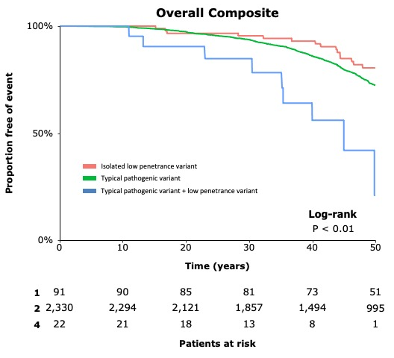


Low Penetrance Sarcomere Variants Indicate an Additive Genetic Risk Model in Hypertrophic Cardiomyopathy
Eric Smith, Brynn Elder, Gabriela Chen, Yao-chang Tsan, John Stendahl, Jodie Ingles, Victoria Parikh, Samuel Wittekind, Steven Colan, Neal Lakdawala, Anjali Owens, Daniel Jacoby, Sharlene Day, Christopher Semsarian, Iacopo Olivotto, Carolyn Ho, Mark Russell, Sara Saberi, James Ware, and Adam Helms
Introduction
Results
Genetic hypertrophic cardiomyopathy (HCM)
Autosomal dominant inheritance
Primarily caused by sarcomere gene variants
Marked clinical variability
10 putative low-penetrance variants identified
Gene | Variant | OR | Pop. Freq.
MYBPC3 | c.2429G>A | 27.6 | 4.8 x 10⁻⁵
TNNI3 | c.485G>A | 21.4 | 4.8 x 10⁻⁵
MYBPC3 | c.442G>A | 15.7 | 6.5 x 10⁻⁵
TNNI3 | c.484C>T | 15.6 | 4.01 x 10⁻⁵
MYH7 | c.976G>C | 9.7 | 8.8 x 10⁻⁵
TNNT2 | c.832C>T | 9.0 | 3.5 x 10⁻⁴
MYH7 | c.5326A>G | 8.5 | 3.5 x 10⁻⁴
MYH7 | c.3637G>A | 7.4 | 4.6 x 10⁻⁵
MYH7 | c.3158G>A | 6.5 | 6.0 x 10⁻⁵
MYH7 | c.4377G>T | 5.1 | 2.9 x 10⁻⁴
6384 individuals
507 unique sarcomere variants
Could the observed clinical variability be due, in part, to additive effects from low penetrance sarcomere variants otherwise dismissed due high population prevalence?
Additive risk for composite adverse events if patients
carry a typical pathogenic mutation + low penetrance variant
Methods
Sarcomeric Human Cardiomyopathy Registry (SHaRe)
was queried for low penetrance HCM-associated sarcomere gene variants versus the general population (gnomAD).
HCM threshold for enrichment was defined by an Odds Ratio:
Variants were then filtered by population prevalence greater than the most common HCM pathogenic variant, MYBPC3 R503W (4x10⁻⁵).
Clinical variables and time to event analysis was performed from SHaRe data.
Family members of low penetrance variant carriers less likely to have HCM vs MYBPC3 R502W carriers
35/171, 20% vs 44/113, 39%, p<0.005
Age of diagnosis > in patients with isolated low-penetrance variants compared to those with pathogenic variants.
42 ± 19 vs 37 ± 18, p=0.005
OR =
SHaRe variant count / SHaRe total individuals
gnomAD variant count / gnomAD total individuals
Conclusion
Disclosures:
J. Ingles: Research Grant, Significant: MyoKardia
N. K. Lakdawala: Other, Modest: MyoKardia, Array Biopharma, Pfizer, Sarepta Therapeutics
A.T. Owens: Other, Modest: MyoKardia, Cytokinetics
D.L. Jacoby: Research support, Modest: MyoKardia. Honoraria, Modest: Abbott, Research Support, Modest: Alnylam
S. Day: Research Grant, Significant: MyoKardia. Honoraria, Modest: MyoKardia.
I. Olivotto: Research Grant, Significant: MyoKardia, Sanofi Genzyme, Menarini International, Research Grant, Modest: Shire, Bayer, Boston Scientific.
C. Ho: Honoraria, Significant: MyoKardia. Honoraria, Modest: Ambry, Novartis.
S. Saberi: Honoraria, Modest: MyoKardia
J.S. Ware: Research Support, Significant: MyoKardia. Honoraria, Modest: MyoKardia.
A.S. Helms: Research Support, Modest, MyoKardia.
The other authors have no disclosures to report.
A subset of low-penetrance sarcomere gene variants are tolerated in the general population at higher-than-expected proportions for HCM and may exert an additive pathogenic effect. These findings support an oligogenic risk model of HCM.
Eric Smith: @EricSmithMD
Michigan Cardiology: @UmichCardiology

