Slide 1
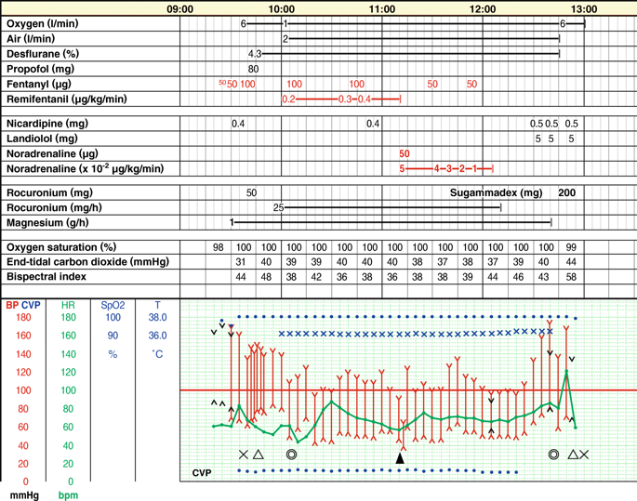
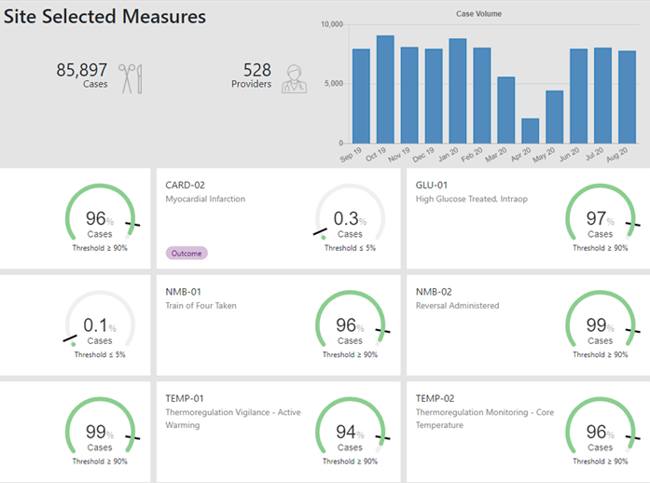

The Journey of MPOG:
Using Data to Improve Perioperative Care
Michael Mathis, M.D.
Assistant Professor of Anesthesiology
Affiliated Faculty, Department of Computational Medicine & Bioinformatics
Research Director, Multicenter Perioperative Outcomes Group
Notes:
Cardiac anesthesiologist at University of Michigan
Research Director of the Multicenter Perioperative Outcomes Group
Advocate for using data in intelligent, transparent, agile & reproducible ways to inform clinical care

Slide 2
Disclosures / COI
No personal financial, consulting, or contractual relationships with any vendor
Research sponsored by grants
  NIH – NHLBI, NLM, NIDDK
  Department of Defense
  PCORI
University of Michigan is the coordinating center for MPOG

Slide 3
Goals for Today
Function/history of Multicenter Perioperative Outcomes Group (MPOG)
MPOG clinical quality measures & feedback dissemination
  Data Pipeline & Processing
  Measure development & refinement
  QI Measure Visualizations & Tools
MPOG framework for local or multicenter clinical outcomes research

Slide 4
Goals for Today
Function/history of Multicenter Perioperative Outcomes Group (MPOG)
MPOG clinical quality measures & feedback dissemination
  Data Pipeline & Processing
  Measure development & refinement
  QI Measure Visualizations & Tools
MPOG framework for local or multicenter clinical outcomes research

Slide 5

About MPOG
Formed in 2008
  Pediatric program est. 2019
Non-profit academic and community hospitals
Aggregate EHR data & complementary data sources
Dual mission of Quality & Research
Notes:
So just a quick intro about Multicenter Periop Outcomes Group, or MPOG for short
Founded in 2008
It’s a collaborative of over 50 academic & community US hospitals
In which aggregate EHR data from preop→PACU are collected, for any case requiring an anesthesiologist to be present, along with other complementary sources
Transmitted to a central repository every month
And with appropriate protections/data governance policies in place
Has been used to develop clinical Quality Improvement measures, including individualized performance feedback emails Sent to >7,000 anesthesiology faculty, residents, and nurse anesthetists across the US each month
As well as perform multicenter outcomes research

Slide 6

MPOG
Research
BCBSM funded program
Quality
(ASPIRE)
Not drawn to scale
Notes:
MPOG originally started as a group interested in conducting large scale multicenter observational trials, but now has a dual focus…

Slide 7
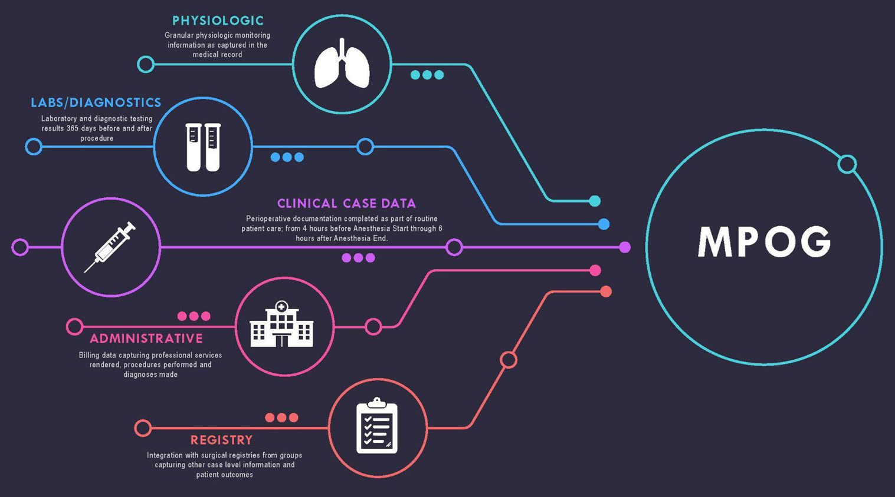
Notes:
Here’s a broad picture of the data flowing into MPOG
With access protected through appropriate IRBs, DUAs, and anesthesiologist oversight
Minute-to-minute physiologic data (vital signs, ventilator)
Lab values (365 days preop to 365 days postop)
Medication, fluid, blood product, perioperative intervention data available as part of routine care
Administrative billing data
And for select approved projects, MPOG data integrated with surgical registries such as NSQIP, STS

Slide 8
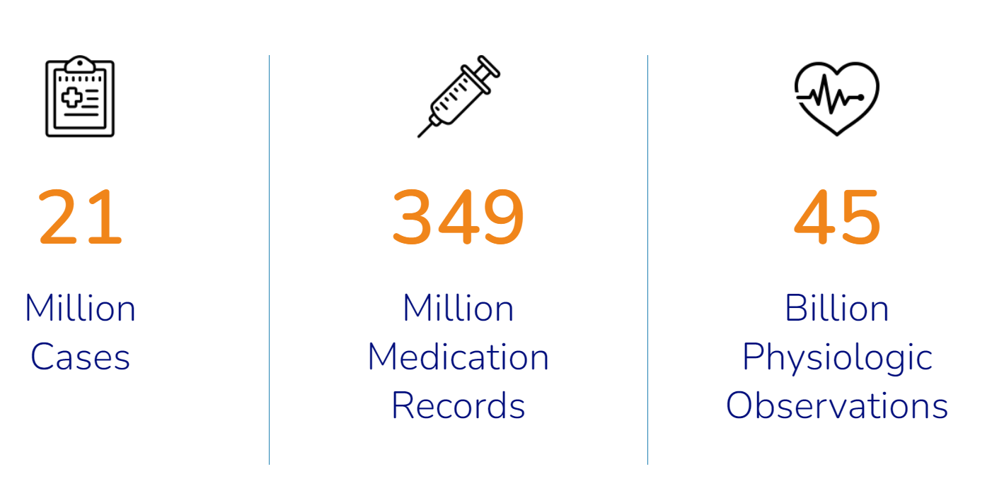
Notes:
Lots of data
No longer an issue of study power for research, or adequate capture of variation in care processes for QI
More an issue of how to make data quality better → going for completeness, accuracy, and relevance to the clinician end user
Not everything that is measurable matters, and vice-versa
And so we are continuously re-evaluating
how do we stay true to the MPOG QI & Research missions
and best serve the interests of participating institutions which serve as our guiding north star…

Slide 9
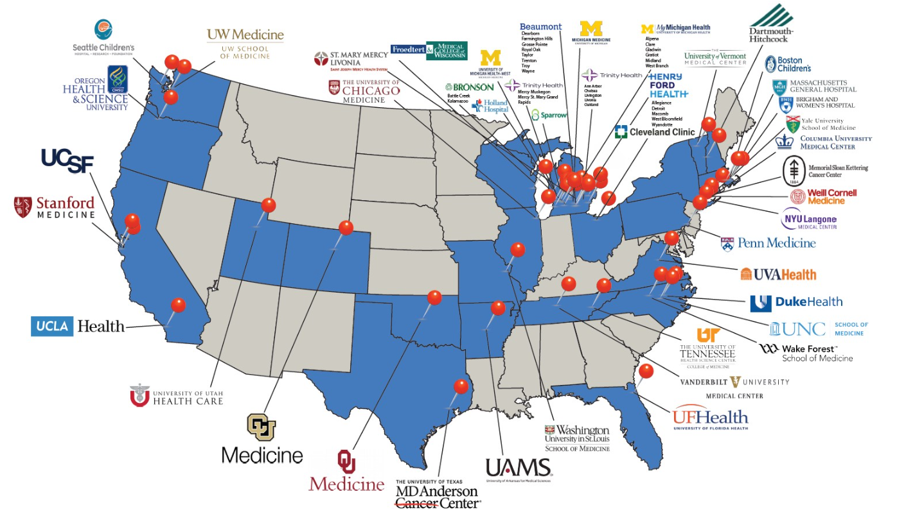
Notes:
Beyond the size of the database, and speaking to the breadth of participation…
Here’s a map of MPOG, >50 hospitals working together, to help improve care for patients undergoing surgery. There about 20 hospitals in the consortium from the state of MI, and about 30 hospitals outside the rest of the country, and 2 in Netherlands…
All MPOG sites have an electronic health record, and extract data from their EHR to a local database. The data is then checked for accuracy and scrubbed of PHI, and send to the coordinating center.

Slide 10
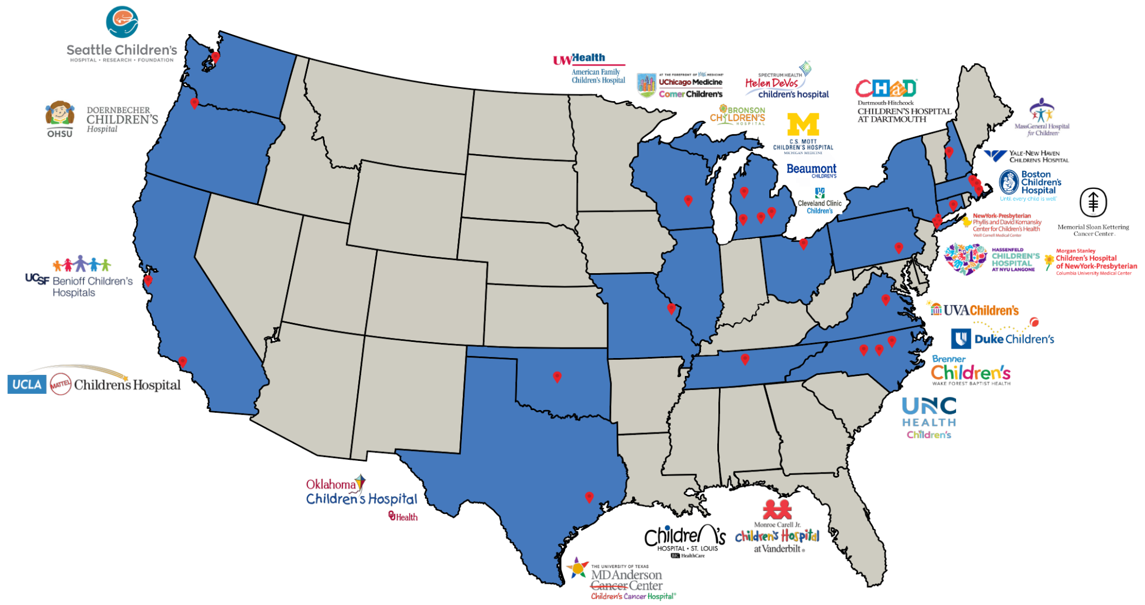
Pediatric Hospitals
Notes:
Many pediatric hospitals as well
*CLICK*
Including this hospital familiar to this audience
Again humbled and excited to have the great minds here, thinking about how we can provide better perioperative care to our patients, thinking about how MPOG can aid in this process, to the fullest extent possible

Slide 11

Age | Group | Case Count
0 | Preterm Neonate | 6,082
<28 days | Term Neonate | 39,012
1-12 months | Infant | 263,919
1-2 years | Toddler | 180,445
2-5 years | Child (Early) | 604,968
6-11 years | Child (Middle) | 551,589
12-18 years | Adolescent (Early) | 755,760
Pediatric Cases in MPOG
2,401,775
*data pulled 1/10/23
Notes:
Pediatric case volumes here
Often pediatrics can get left behind in anesthesiology research & QI, but just want to dispel the concern, and speak not only today to how MPOG can contribute to QI and research,
but also pediatric-focused QI and research

Slide 12



Thank you
Morgan Brown, MD
Lauren Madoff, MD
Joseph Cravero, MD
…and Alyssa Teves, Mark Breibart, Max Aaronson, Jocelyn Booth and others
Notes:
Takes a village… and where care processes get better, is locally on the front line
Morgan Brown – Pediatric subcommittee champion, Research champion
Quality Champion Lauren Madoff
Chair Joseph Cravero
And many other anesthesiologists, nurse quality reviewers, IT leads, some named here but list I’m sure is going to become too long to cover in a slide

Slide 13
Goals for Today
Function/history of Multicenter Perioperative Outcomes Group (MPOG)
MPOG clinical quality measures & feedback dissemination
  Data Pipeline & Processing
  Measure development & refinement
  QI Measure Visualizations & Tools
MPOG framework for local or multicenter clinical outcomes research
Notes:
So that’s MPOG’s past,
Let’s talk now about where perioperative QI and research is going, and how MPOG can contribute

Slide 14
Goals for Today
Function/history of Multicenter Perioperative Outcomes Group (MPOG)
MPOG clinical quality measures & feedback dissemination
  Data Pipeline & Processing
  Measure development & refinement
  QI Measure Visualizations & Tools
MPOG framework for local or multicenter clinical outcomes research

Slide 15
Our mission (and challenge) is to adopt measures and implement programs to inform & improve care

Slide 16

Notes:
This has been a 15-year journey of moving forward, making mistakes, learning from them, and moving forward again…
We learn together
Practices evolve as evidence supporting new best practices come to light
EHR documentation patterns change → quality of the data may go from modest → good, or vice-versa
New sites join MPOG, often with great ideas… MPOG central, or current members don’t claim to have all the answers
Don’t reinvent the wheel, learn from the high performers
“What is it about your site, that makes you have the lowest rate of PONV
Data helps identify the variation, but the stories are where the learning happens

Slide 17
Pillars of MPOG Quality Improvement
QI Measures
50+ measures
15+ domains of care
Process + outcome
Benchmarked nationally
Provider Feedback
Monthly feedback
Benchmarked locally
Link performance to case
MOCA
Quality Committees
Governance
Ideas
Expertise
Collaboration
Sub-speciallty
Web + in-person meetings
Implementation
Toolkits
Site Visits
Notes:
4 pillars… *CLICK*
QI measures informed by best available evidence
Ideally tie processes → outcomes (antiemetic dosing → PONV; hypotension avoidance → AKI)
Measures are meaningless, unless getting back to the frontline … *CLICK*…
Monthly feedback → site level, to QI champion; individual clinician level, to faculty, residents, and CRNAs
Benchmarked locally → although there are general practice guidelines, every site has their own nuanced practice patterns / patient populations, so as to enable within-site comparisons, in addition to across-site comparisons (both are meaningful/useful, but in different ways)
Feedback linked to a specific case → makes measures tangible, and precise about what exactly could be improved
“Fresh” → last month’s cases
Linked to MOCA → the ABA has a range of different ways to maintain certification, and MPOG reinforces this through providing one avenue to do so, through reviewing individual cases
Quality Committees… CLICK
QI measures can fail to gain clinician trust, if they don’t keep up with the pace of evidence and newly developing best practices
To keep up with the nuances to how best care is delivered → which requires specialty-specific expertise
Peds QI committee is one example
Get together, and (i) sites learn from one another, and (ii) share ideas about how measures might be developed, refined, or retired
Implementation… CLICK
Reinforce the feedback, with toolkits that provide evidence & ideas for systems-based practice and individual practice change
Site visits, like today, but also circling back in future, to assess how things are going, and brainstorm ways that MPOG could better serve your needs

Slide 18
How do we build our measures?
Idea
Discussion with Quality Committee
Create Specification
Approval by QC
Build by MPOG team
Test and Refine
Publish to QI Reporting Tool and email
Incorporate into QI program/build toolkit
Notes:
Needs to be meaningful to the clinicians who will receive the feedback
Starts with Idea: by clinicians, for-clinicians
Discussion within QI committee → De-centralized, QC comprised of representatives across MPOG sites
Create measure spec, building from existing MPOG datastreams…
Approved by QC, and then built into MPOG; round of beta testing/refinement
Finally published to QI reporting tool / provider feedback emails
And when fully mature → build a toolkit summarizing evidence & sharing ways MPOG sites have learned to improve their practice

Slide 19
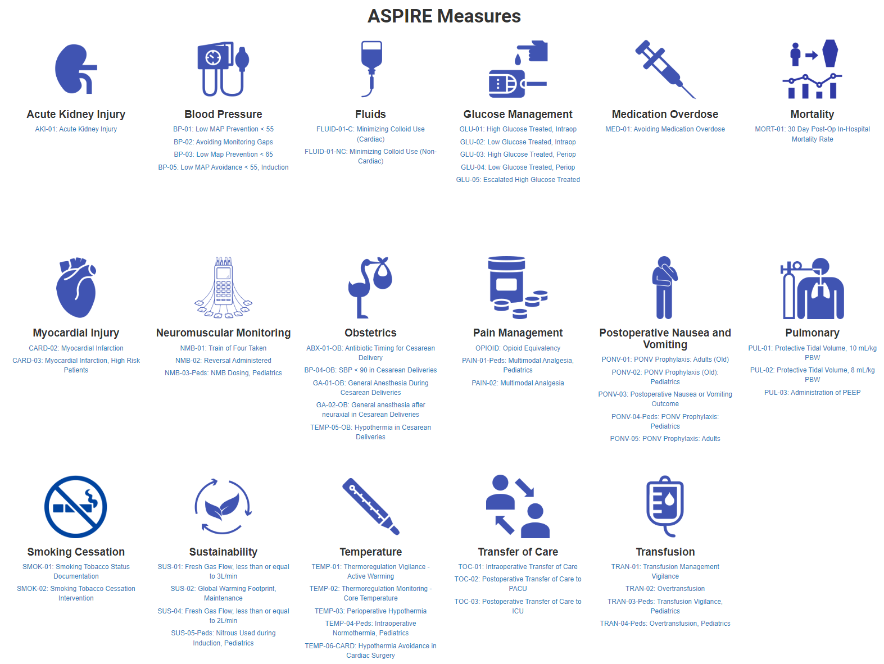
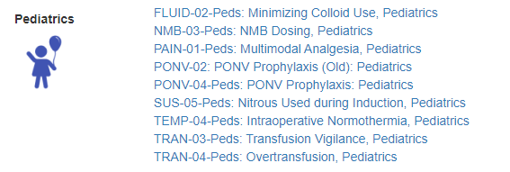
>50 process & outcome metrics covering myriad aspects of perioperative care

Slide 20
ASPIRE Performance Emails:
Clinician-level Feedback
Notes:
Now to talk about how performance feedback emails work
Happens at both the individual clinician level, and also entire site level

Slide 21
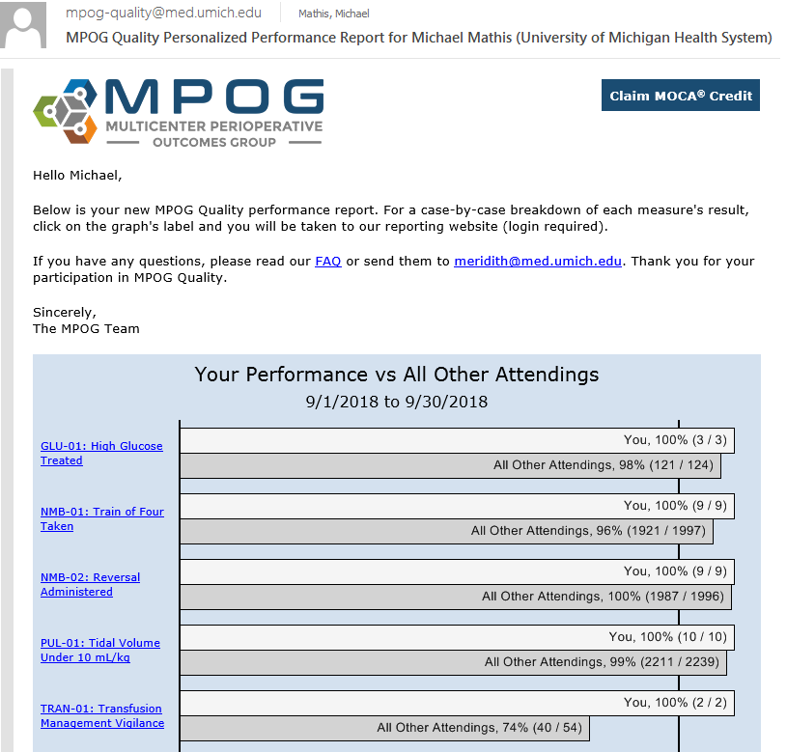
Individual Performance Feedback Email
Automated emails from central MPOG server
Sent every month to ~7,000 providers nationwide
“Fresh” – last month’s patients
Easy access to case review
MOCA credit available
Notes:
Sites also can opt into sending feedback emails to providers
- Here’s me on a good month

Slide 22
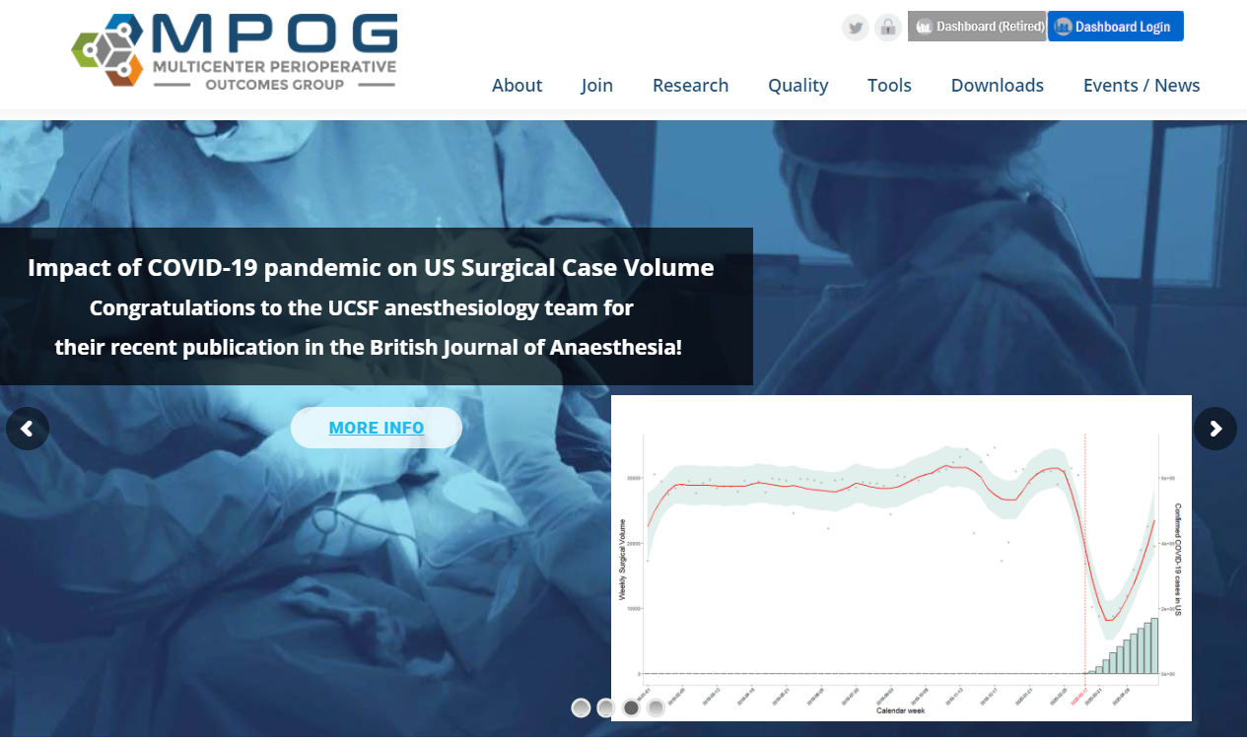
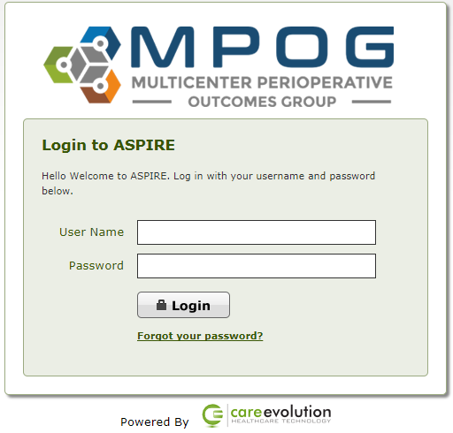
Individual Clinician Dashboard Access
Go to MPOG Website: https://mpog.org/ and click on blue Dashboard Login button:
Notes:
Email feeds into a performance dashboard which can either be logged into on MPOG website shown here..

Slide 23
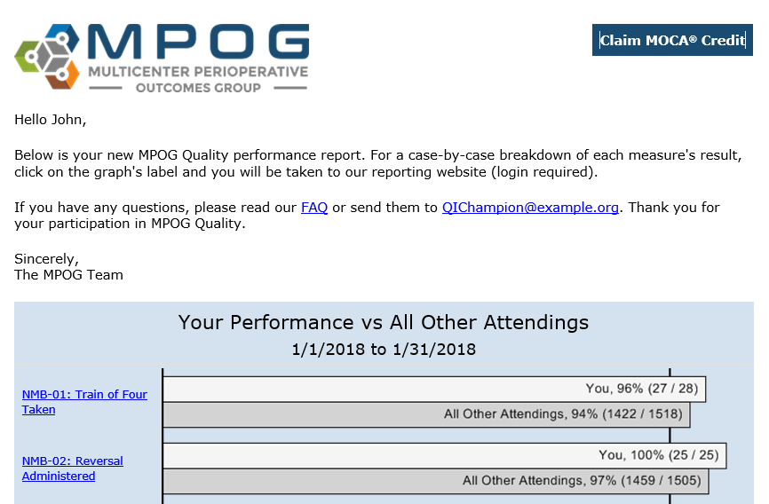
…Or access dashboard via feedback E-mail
Clicking on the measure brings up that measure in the dashboard
Notes:
Or just directly in the email, shown here

Slide 24
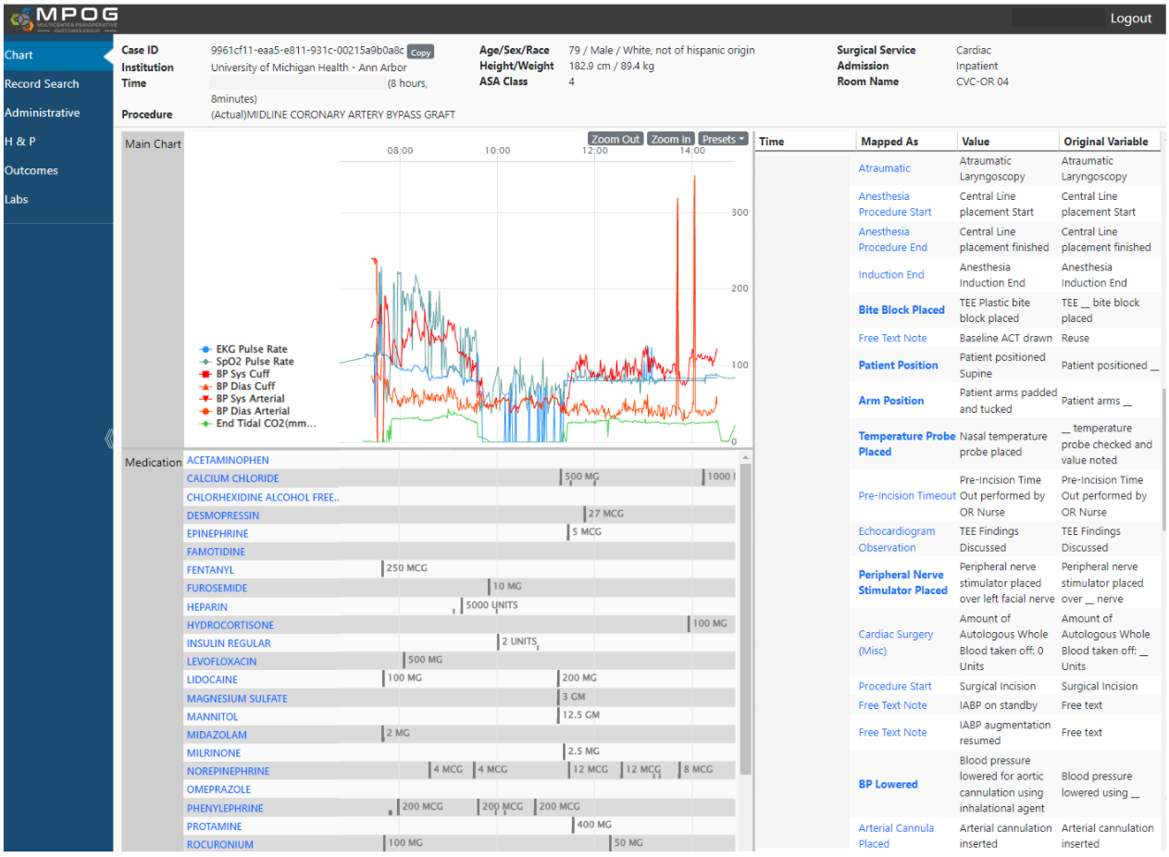
Review individual cases and measure performance through MPOG version of EHR
Notes:
Case-by-case review
MPOG version of EHR → optimized to show data specific to measure (e.g. PONV measure review, looks different from normothermia measure review)

Slide 25
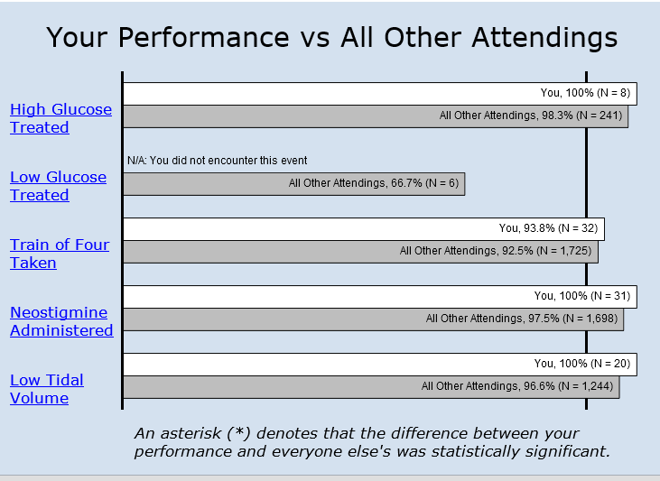
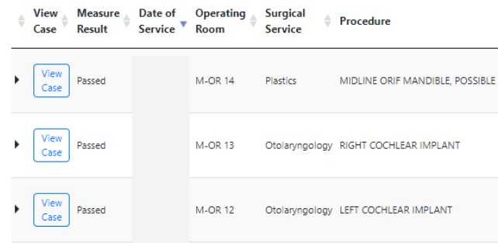

Enable clinicians to understand why cases did not pass a measure:
1
2
3
Notes:
Design of our performance visualizations, linked to specific cases, has a goal of being intuitive, rapidly informative
Passing a measure is only a starting point → opportunity to reflect on the case
Pass along the value judgment to the QI champion at your site, and most importantly, yourself as clinicians committed to upholding excellent clinical care
Sometimes there is an opportunity to improve, “yes, I missed giving this patient with known history of PONV, optimal prophylaxis”
Other times, there wasn’t, but still often a useful reflection exercise. “Yes, the patient received a transfusion during the case, and wound up with a postoperative hemoglobin of 10.5, suggesting potential over-transfusion, but at the time of the blood loss, it was acute and not sure if the surgical bleeding was going to be rapidly controlled”
Take the measures seriously, but not personally

Slide 26
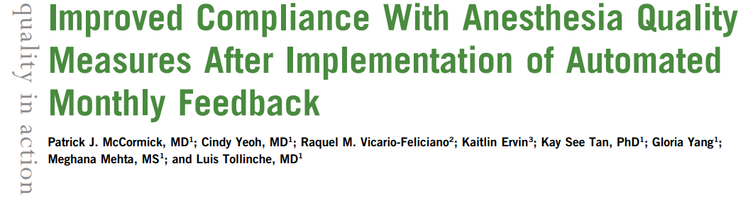
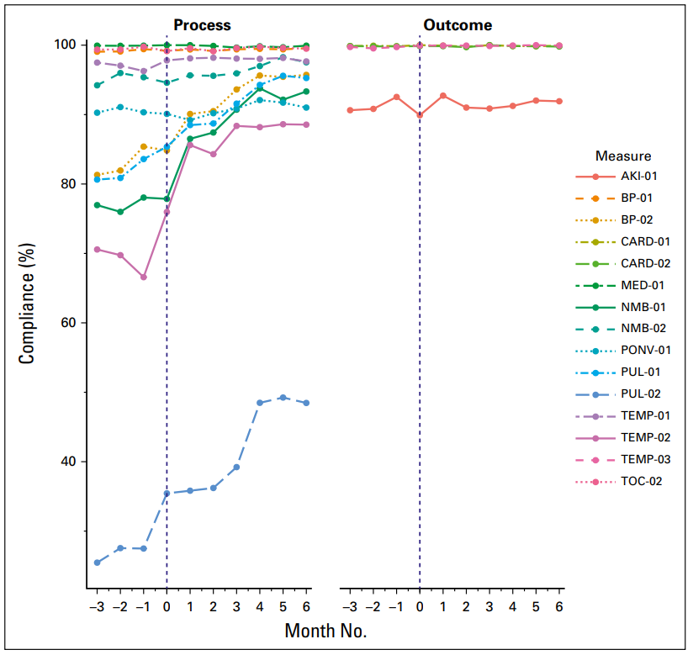
McCormick et al., 2019
Notes:
Do these performance feedback emails really work?
Fairly convincingly yes
All measures showed improved compliance in the post-implementation phase compared with the pre-implementation phase. Of the 11 process measures, 7 demonstrated statistically significant improvements.

Slide 27
ASPIRE Performance Emails:
Clinician-level Feedback
MPOG Reporting Dashboard:
Practice-Level Feedback
Notes:
Switch gears, from clinician-level feedback… to *CLICK*
Institution-level feedback

Slide 28
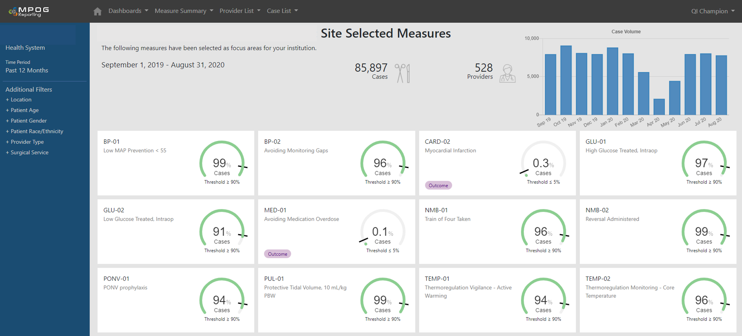
QI Reporting Tool
Notes:
Snapshot of QI Reporting Tool
Many of the features are best illustrated by clicking around/using it, *CLICK*…

Slide 29
QI Reporting Tool
Specialty Dashboards
One click navigation
Updated Filters
Measure labels
Improved visualizations
Notes:
… but to highlight a few features
One-click navigation to specialty-specific dashboards
Filter by patient, surgery, and site characteristics
Compare peds cardiac → peds cardiac, rather than peds cardiac → ear tubes
Compare neonates → neonates
Ambulatory / medical procedure rooms → other ambulatory
QI Measures important to site displayed on dashboard, with appropriate visualizations & labels
Process measure
Outcome measure
Informational measure → no value judgment, but can see variation in care patterns & identify outliers (which may or may not represent warranted variation)

Slide 30
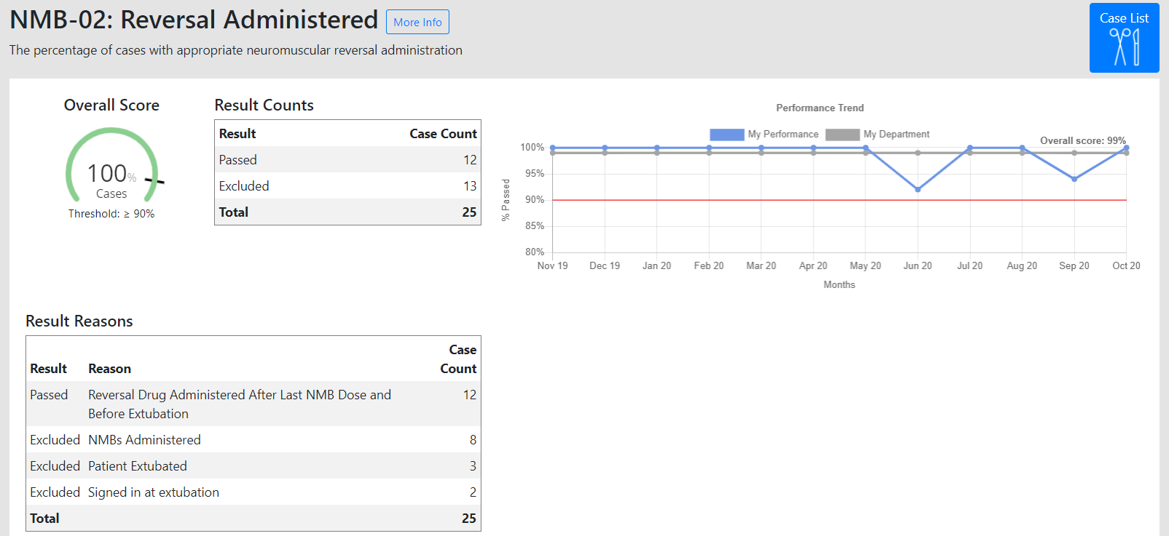
Click on measure → overview, trend, and primary causes of measure results

Slide 31
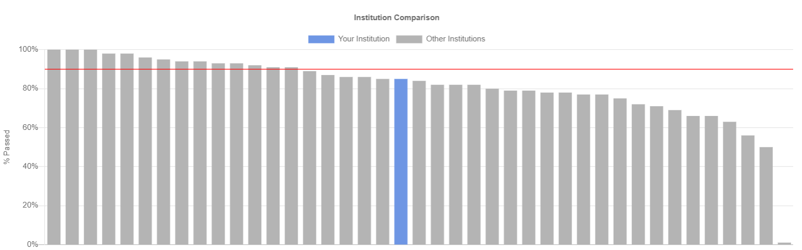
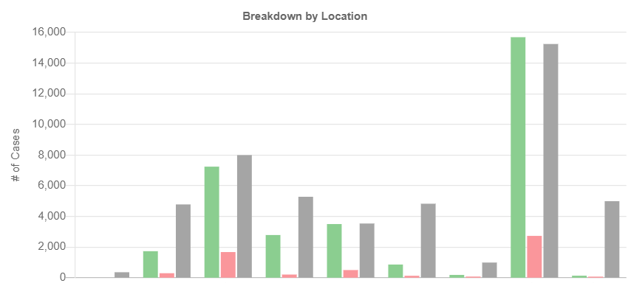
Updated Benchmarking
Intra-institutional comparison
Notes:
Inter-institutional comparisons → see how your site, compares to other similar MPOG sites for a particular QI measure
Intra-institutional comparisons → see how different surgical services / locations / patient demographics / clinicians compare to one another

Slide 32
Sugammadex or Neostigmine across MPOG?
Notes:
MPOG practice pattern variation is indeed wide → and if determined to be unwarranted variation, potentially represent an opportunity for improvement
One illustrativee example: sugammadex vs Neostigmine for NMB reversal
As a cardiac anesthesiologist… choice of intorope…

Slide 33
Goals for Today
Function/history of Multicenter Perioperative Outcomes Group (MPOG)
MPOG clinical quality measures & feedback dissemination
  Data Pipeline & Processing
  Measure development & refinement
  QI Measure Visualizations & Tools
MPOG framework for local or multicenter clinical outcomes research

Slide 34
Goals for Today
Function/history of Multicenter Perioperative Outcomes Group (MPOG)
MPOG clinical quality measures & feedback dissemination
  Data Pipeline & Processing
  Measure development & refinement
  QI Measure Visualizations & Tools
MPOG framework for local or multicenter clinical outcomes research

Slide 35
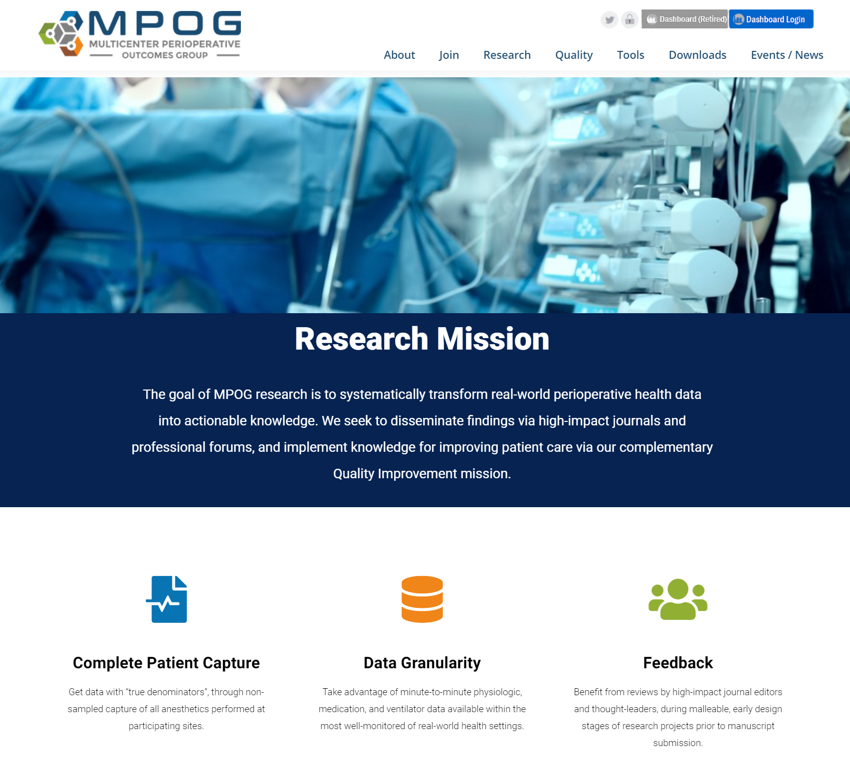
MPOG Research
Mission: Transform real-world perioperative EHR data into actionable knowledge
Governance: Perioperative Clinical Research Committee (PCRC)
Outputs:
  40 publications in national peer reviewed scientific journals
  Evidence basis for some QI Measures

Slide 36
How does this work?
Collaboration: monthly multicenter meetings (virtual)
Dissemination: journal publications, MPOG retreat before ASA
High quality data:
  Phenotypes
  Integrated surgical registries
Democratized Access: MPOG research tools
  Intuitive research tools which enable access to clinically-minded end users

Slide 37
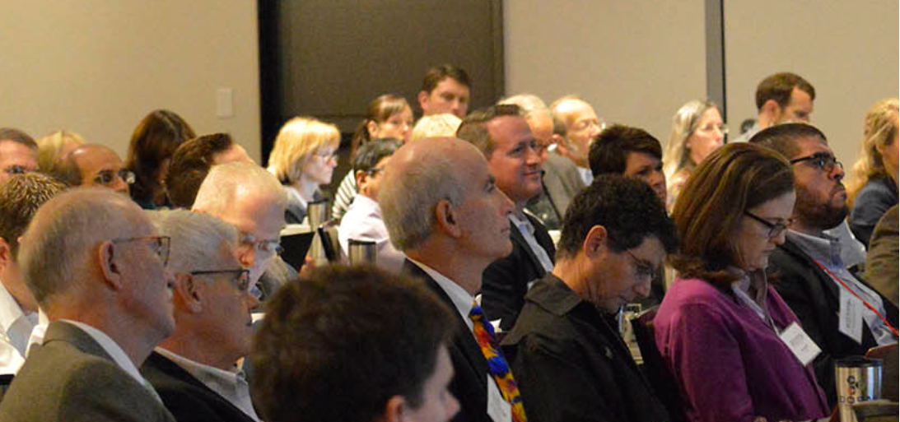
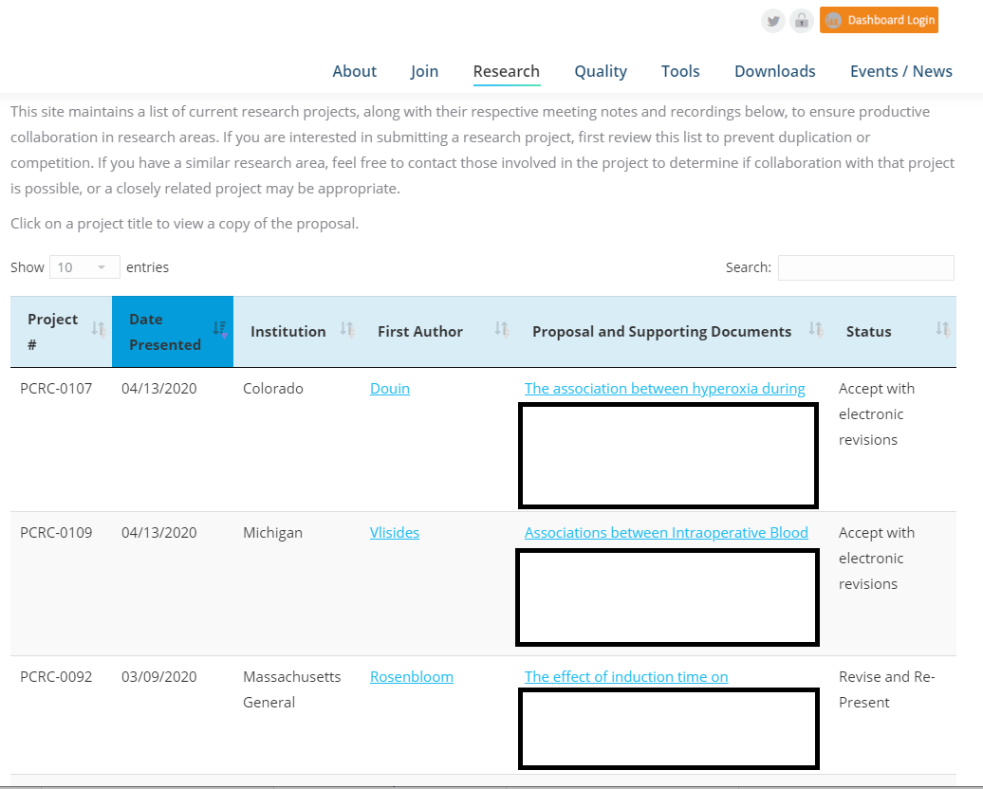
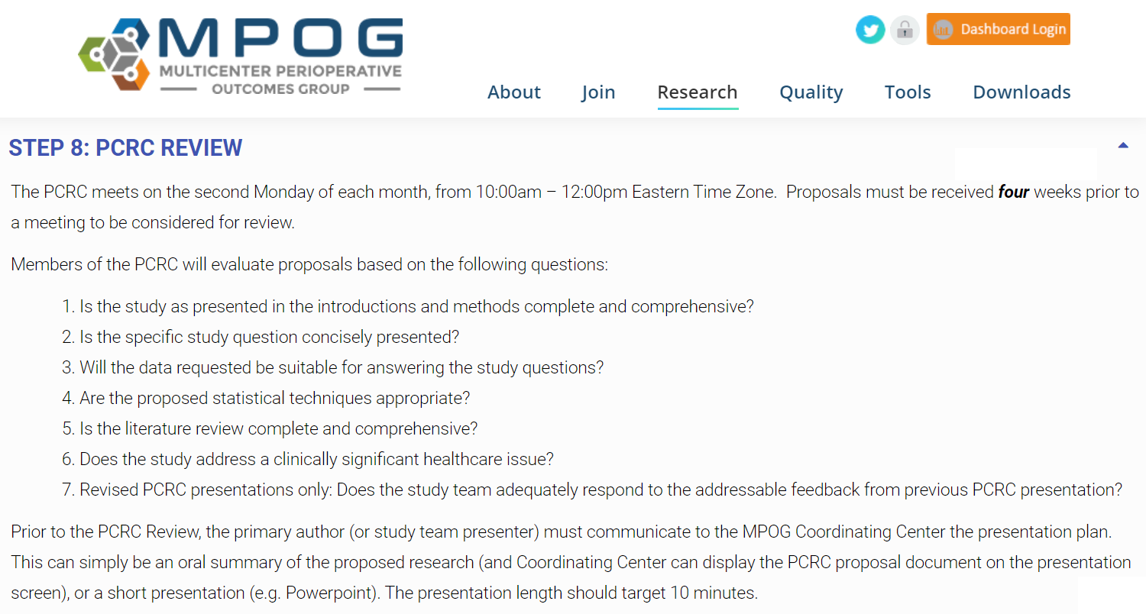

Collaboration - PCRC Community of Peers
Notes:
To facilitate collaboration – MPOG is host to the Perioperative Clinical Research Committee (or PCRC),
- group of research collaborators across all MPOG centers, committed to the success of its peers
through providing feedback over email
at monthly web meetings,
And at annual professional anesthesiology research forums
Members comprising the PCRC committee include anesthesiologist clinician investigators who are though-leaders in our field, and lead journal editors.
Whereas *Local* research requires no additional approval beyond your own site’s IRB process,
Multicenter Research projects benefit from research proposal review/approved by PCRC, is getting high-quality feedback from pre-eminent researchers in our field, while your research project remains in malleable, early stages, importantly before journal submission.
On our website we have a step-by-step playbook on how to take a project all the way from an idea on a one-page coversheet, to a manuscript publication
Oftentimes starting with a consultation with the MPOG central team – we know there are clinician researchers at Boston Children’s who are far more knowledgeable/talented at what they do than I can ever be
But what I can do – and MPOG central team – is rapidly bring up to speed about how the MPOG research process is done most efficiently, and pass along where the opportunities and pitfalls are

Slide 38

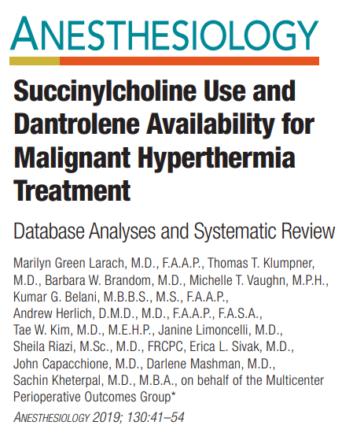
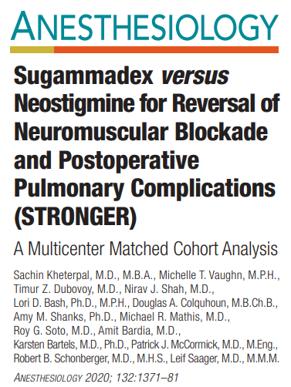
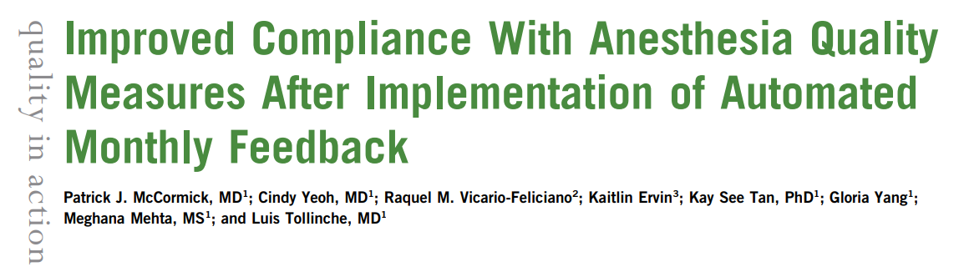
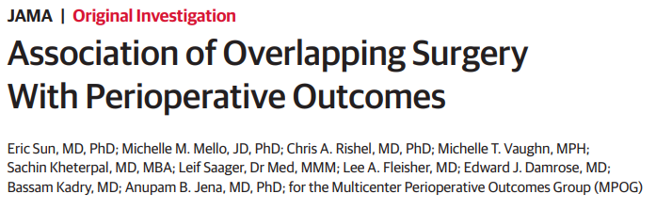
Dissemination - publications
Notes:
Dissemination of MPOG research findings – to high-impact clinical journals
Over the past several years, MPOG is proud to report a high acceptance rate at high-impact journals within our field this is in recognition of talent our research community brings, and the unique advantages of MPOG dataset
Several including sugammadex versus neostigmine
Intraoperative hypotension and AKI
- Interesting practical studies, not just rooted in physiology or pharmacology, although we can do that, but getting into higher level structural factors which might impact care on a day-to-day basis
Overlapping surgery
Surgeons who operated the night prior
Anesthesiologist staffing ratios

Slide 39
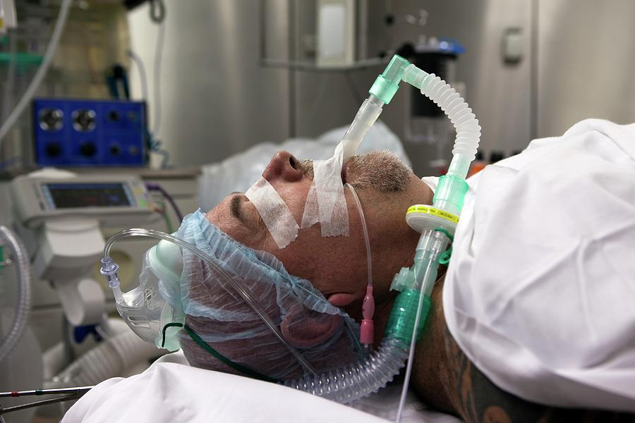

“Easy” research question:
How has the use of general anesthesia for hip fracture surgery changed over time?
High Quality Data - Phenotypes
Notes:
How do we ensure high-quality research?
Well, starts with high-quality data, which requires some post-processing of real world EHR data to reach an acceptable standard to perform rigorous research.
To illustrate just one example of data processing that MPOG does automatically for researchers, I’ll highlight this seemingly simple research question…
..how has the use of GA for hip fx changed over time?
So obviously for this research project, we need to reliably identify patients under GA.
This sounds simple enough, right? After all, when we walk into an OR, it’s extremely obvious whether a patient is under general anesthesia… here’s what it looks like
Sometimes general anesthesia can even happen to an ENTIRE group of people too… here’s another example
BUT the electronic representation of GA, is more than meets the eye

Slide 40
Ways to “detect” general anesthesia?
Approach | Pros | Cons
Airway Note Documentation | (Usually) accurate when entered | Multiple ways to document Occasionally mislabeled
Ventilator/Physiologic Data | Automated capture | Detection of trace inhalational gases Subject to artifact Exception Cases
Neuromuscular Blocker Used |  | Commonly, but not always, used
Free Text Notes |  | Natural Language Processing required to ‘unlock’ the data
Notes:
Airway notes
Ventilator
Artifact: masking; PPV
Exceptions: ECMO

Slide 41
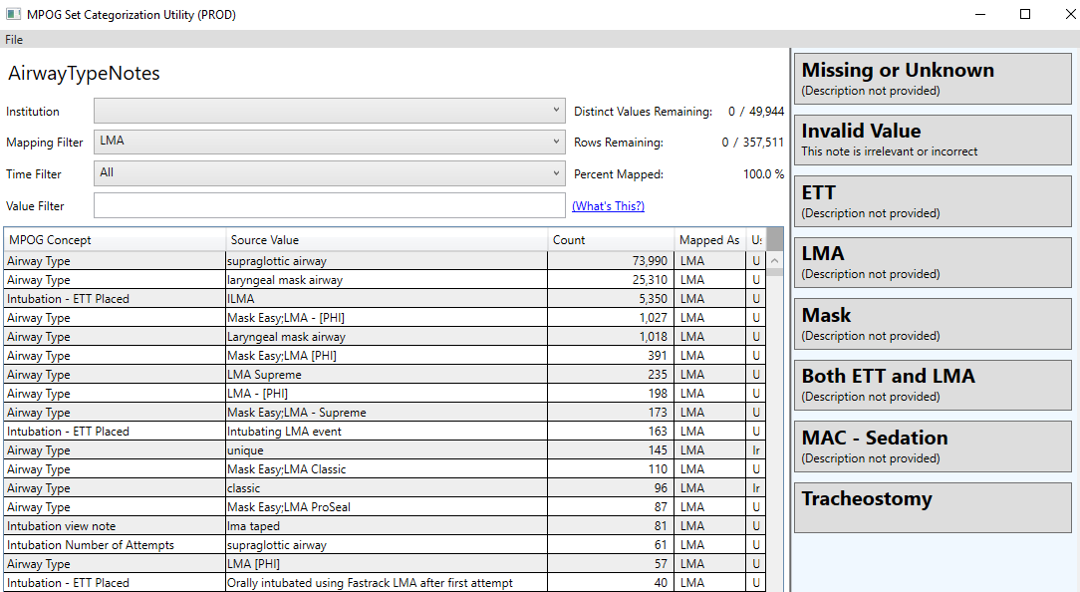
Number of ways to document an airway across MPOG…
49,944!
Notes:
Just how many ways is an airway documented across MPOG sites?
Do you want to figure this out, every time we do a research project which wants to look at general anesthesia as a variable?
No way –
MPOG central does this for research, through processes known as concept and collation mapping
Getting the language of the EHR into one universal language, and then removing ALL of the synonyms

Slide 42
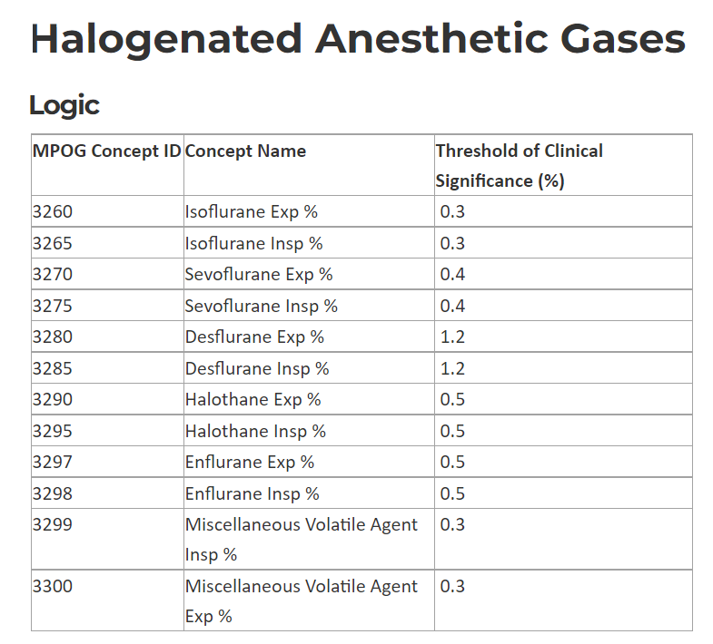
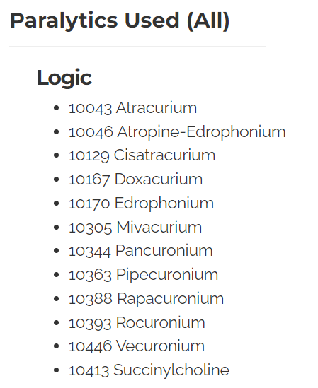
Triangulate the “GA” signal with other data…
Notes:
Did this for airway notes…
… do something similar for muscle relaxants, and volatile anesthetic gases

Slide 43
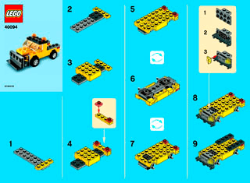
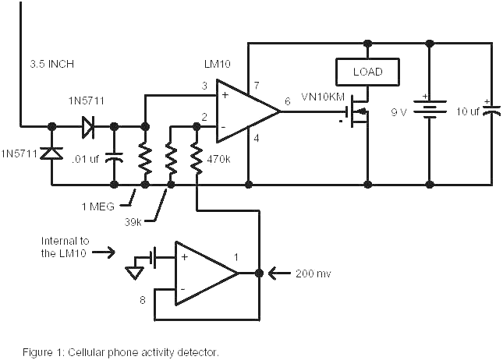
Digital Phenotyping
Raw Electronic Health Data
ICD-10 | Labs | Physiologic
Meds | Demographics | CPTs
Registry | Radiology/ Pathology | Testing
Digital Phenotypes
Patient under general anesthesia
Baseline blood pressure
Cardiopulmonary bypass used
…

Slide 44

Phenotypes outside of MPOG…
Shareable, reproducible algorithms (derived from EHR data) precisely defining a patient characteristic or clinical event
1. Richesson, R. L., et al. JAMIA. 20, no. e2 (2013): e226–e231.
Notes:
broadly, a phenotype is a composite representation of an individual observable traits
- As applied to electronic health records, these are a composite representation of patient characteristics and/or clinical events, as manifested in the EHR
Zebra → four hooves, tail, black and white stripes, found in the Serengeti

Slide 45
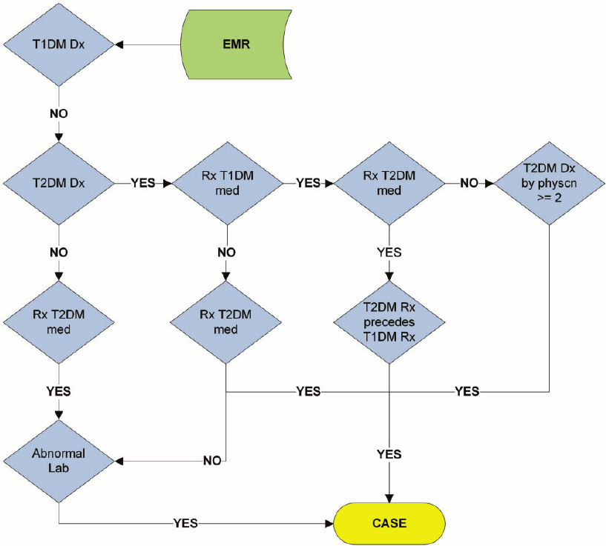
Phenotypes outside of MPOG…
Type 2 Diabetes
Notes:
Here’s Diabetes
Found in the EHR by a (1) diagnosis of diabetes (most obviously)… but ALSO by a (2) high glucose, or (3) medication uniquely for diabetes
- And so for research, it’s often NOT the raw data that you clinicians are interested in, but the reproducible, pre-computed phenotypes, serving as clinically useful, higher-order inferences sitting on top of the data, that are at the core of a research study

Slide 46


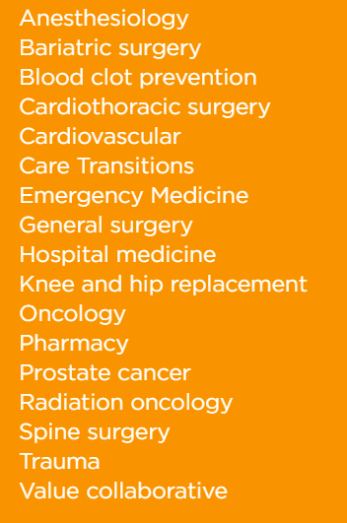


High Quality Data – Surgical Registries
Notes:
Switching gears away from phenotypes,
Another component of high quality data is Surgical Registries

Slide 47



Intra-op
Physiologic / Vent
Times/Providers
Meds/Fluids
Interventions
Administrative
ICD-9/10
Pre/Post-op
Structured H&P
Surgical Procedure Details
Outcomes
Laboratory / Testing
Demographics
Notes:
Strengths/unique features of MPOG data
Intraop
Granularity
Minute-to-minute physiologic, ventilator, medication/fluid; timestamps, providers, and interventions
Also access to administrative data → pro fee diagnosis codes, administrative discharge ICD-9/10 codes
Strength/unique feature STS NSQIP
Preop and Postop
Quality from painstaking manual review/patient follow-up
Detailed structured history/physical, surgical procedure details
Very importantly, outcomes data → mortality, hospital LOS, organ system complications

Slide 48
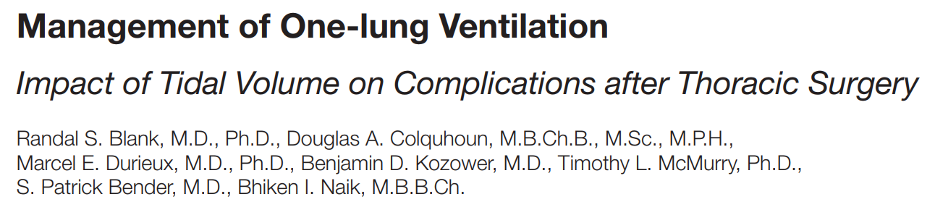

Opportunities via database integration:
Intraop Practice Patterns & Postop Outcomes
MPOG
Physiologic Inputs/Outputs
Medications Intraop Events
Central Repository
Surgical Registry
H&P / Outcomes
Notes:
If successfully integrating this data, can achieve opportunities for research/QI unable to be achieved by either database alone
Can work to integrate surgical registry & MPOG data into one location
Accessible to both groups with appropriate monitoring of data access & peer review
Through combining high-quality processes of care data through MPOG, and high-quality outcomes data through surgical registries
Can generate innovative studies like this one lead by Thoracic Anesthesiologist Randy Blank, Thoracic Surgeon Benj Kozower and the UVA team
Positive externalities – engages surgeons, reinforces relationships that start in the OR, takes them into realms of collaborative research & QI

Slide 49
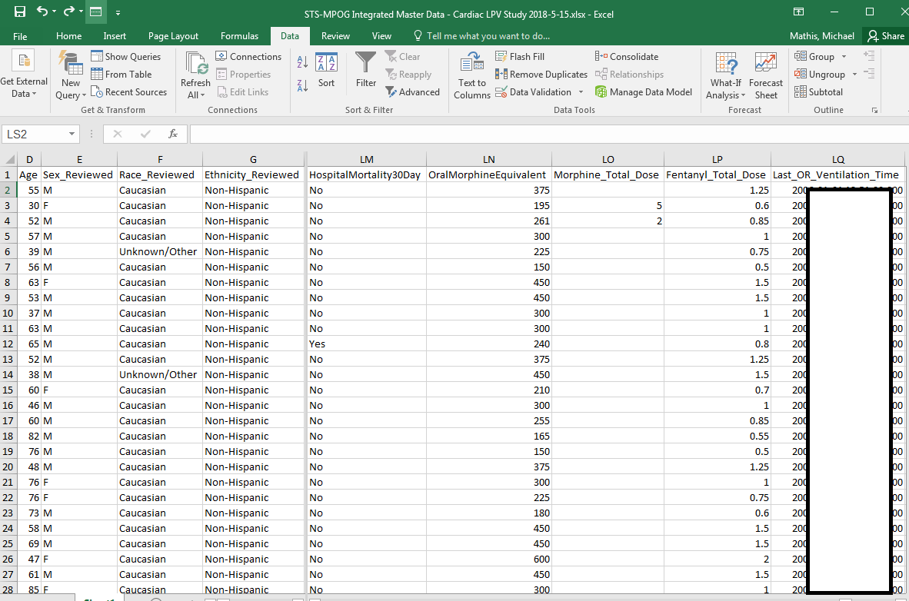
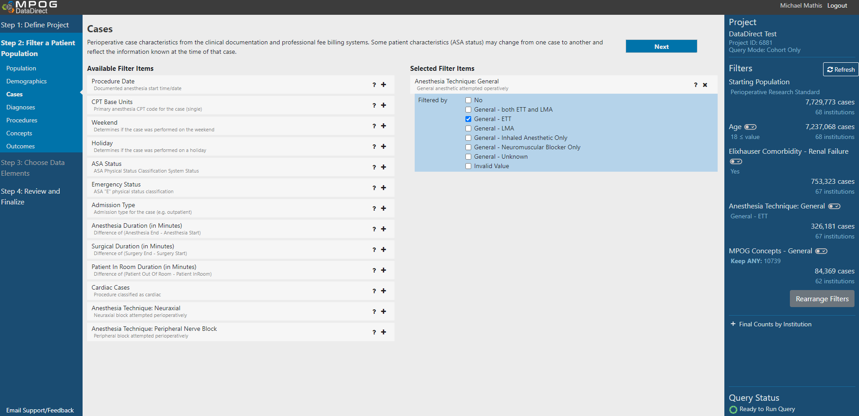
Democratized Access – MPOG DataDirect
How many…
…adults…
…with renal failure…
…underwent surgery with general anesthesia…
…and received sugammadex?
Notes:
Want to finish the research component of this talk with a few words on how we actually get research data
At the fingertips of qualified clinicians, who again we recognize as being extremely talented folks, but whom we also recognize are not always computer scientists, or a 1st degree relative of your hospital’s chief medical information officer
What success looks like for MPOG research, is if a clinician researcher doesn’t spend 90% of their time on a research project, simply getting access to the data, and 10% doing the analyses/interpreting/publishing results
… but instead the opposite
Our solution for that is MPOG DataDirect

Slide 50
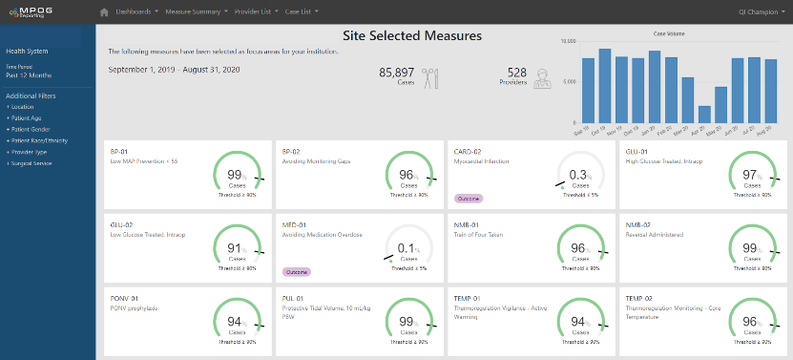
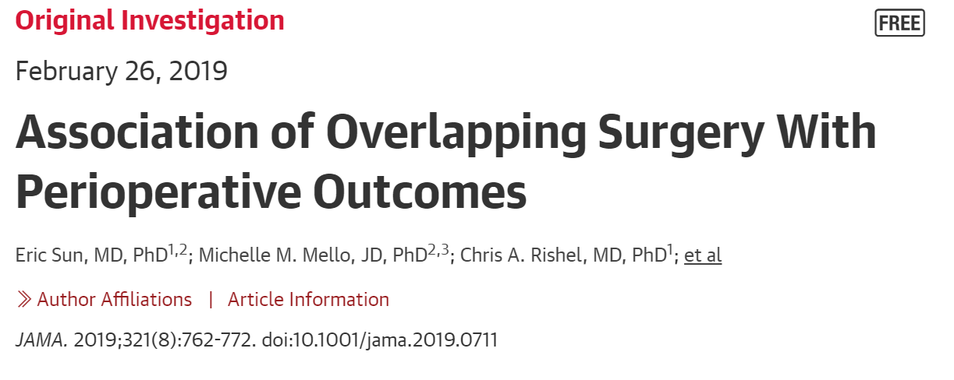

Local Data Enables Local Projects
Source
MPOG Local
EHR
registry
MPOG Registry
billing
EHR
registry
billing
EHR
registry
billing

Slide 51
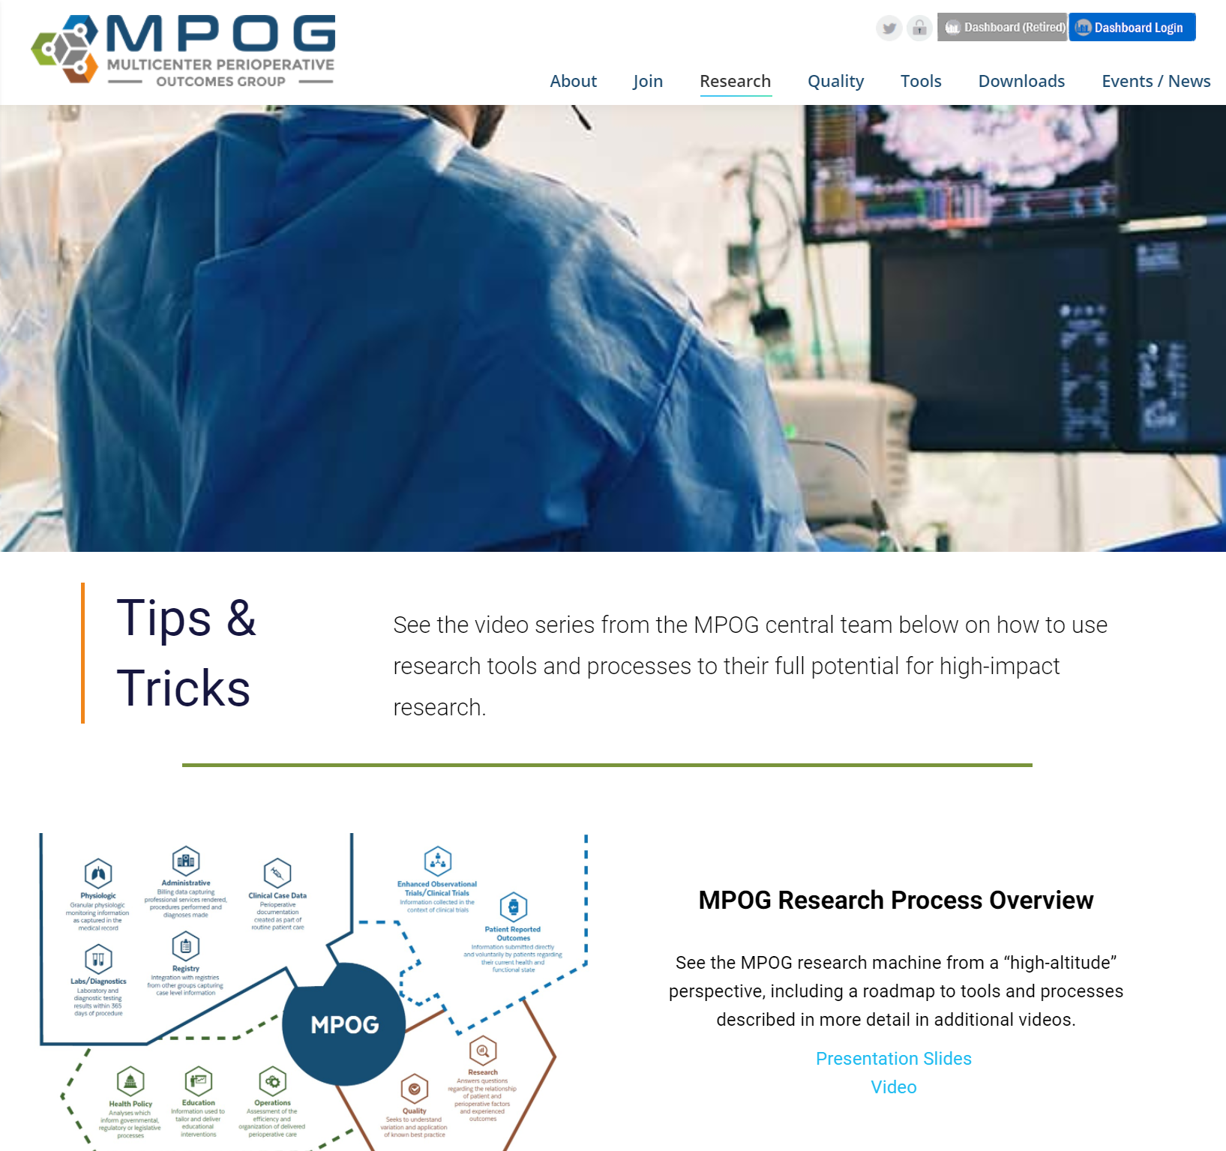
Learn More via MPOG Tips & Tricks
  MPOG research process overview
  Developing a research question
  Using DataDirect
  Developing a research proposal
  Understanding Phenotypes
  Curating MPOG data
  Big data management
  Statistics for large database research

Slide 52

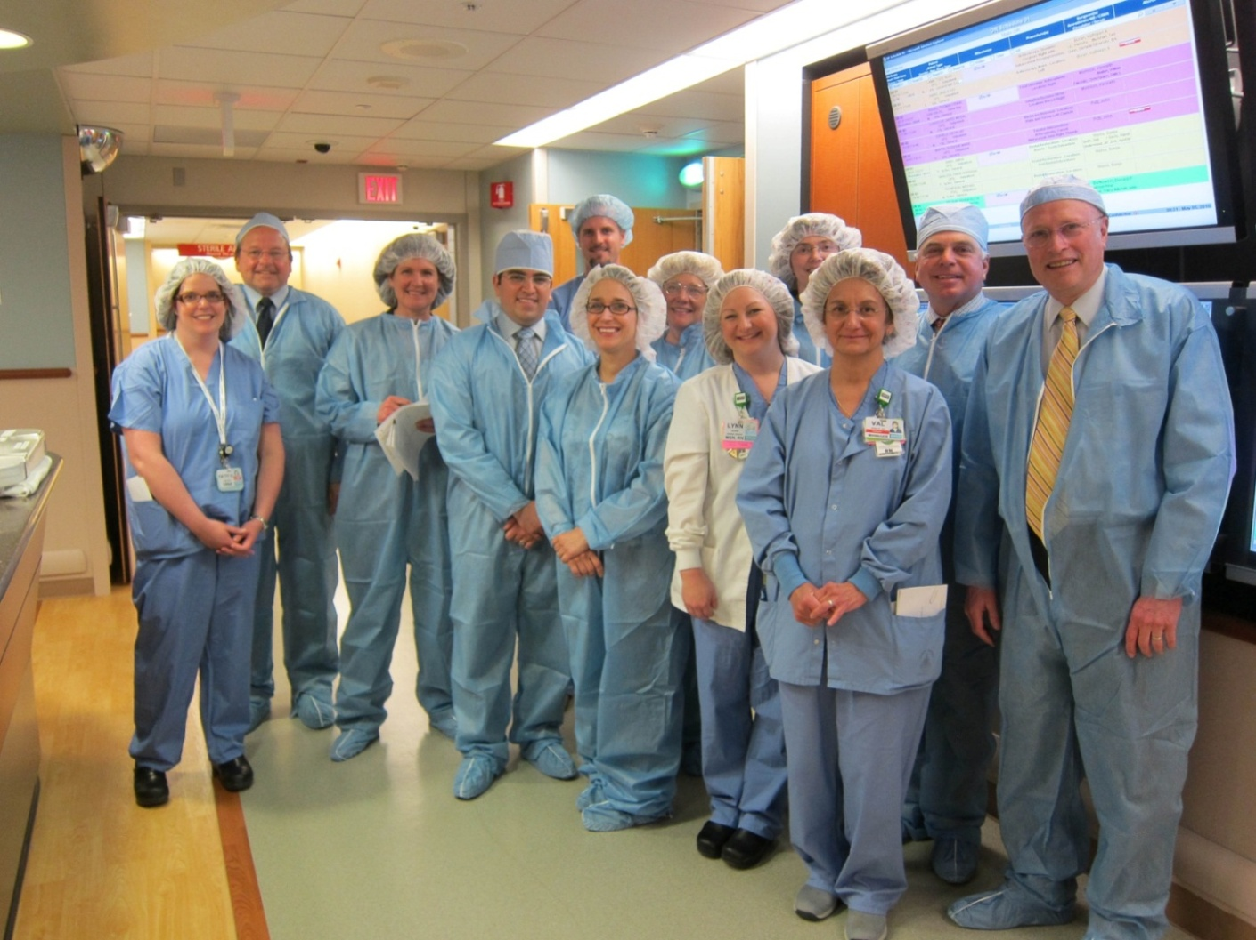

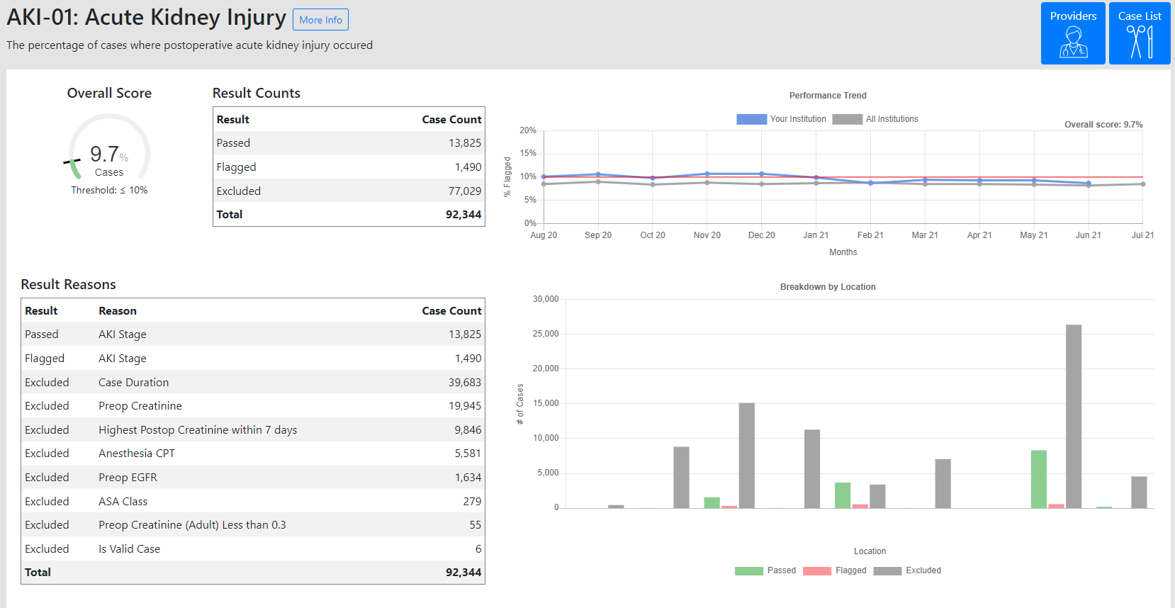
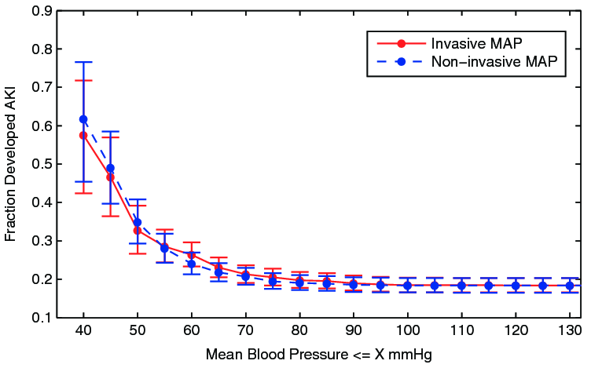
Putting it all together…
Notes:
So putting this all together, what does the ideal learning health system look like -- in part aided by MPOG but driven by committed, local clinicians across hopitals?
*
- Well, to sum this up, we start with the practicing clinician, caring for patients and generating electronic health data
We take that data, and we clean it, and analyze it
And we can test hypotheses that may lead to a research publication
These publications informing best practices can then be discussed at MPOG quality committee meetings
In which quality measures are designed and refined
And then locally implemented by a team of institution-specific anesthesia quality champions
Circling back to the clinician improving anesthesia care

Slide 53
Thank You / Questions

