Slide 1

Treating Overactive Bladder in Parkinson’s and Multiple System Atrophy
John Stoffel MD
Lapides Family Research Professor
Chief, Division of Neurourology/Pelvic Reconstruction
Department of Urology, University of Michigan
Movement Disorder Conference
2/8/23

Slide 2
Disclosures
Neurogenic Bladder Research Group (Leadership)
NeuroUrology Urodynamics Journal (Editorial Board)
Flume Catheter (Scientific Advisor)
Spine X (Scientific Advisor)

Slide 3
Goals for Today
What is Overactive Bladder?
Why does it occur in PD and MSA
How to Diagnose OAB (and gauge severity) in PD and MSA
Treatment options (more options than you think....)

Slide 4
Definitions and Physiology

Slide 5
OAB Definition
What is Overactive Bladder?
  International Consultation on Incontinence Research Society (ICI-RS)
  “[urinary] urgency, with or without urgency incontinence, usually with increased daytime frequency and nocturia”
  Clinical Description of symptoms
  Subtype – Neurogenic Overactive Bladder
    Associated with an underlying neurologic condition

Slide 6


OAB Vs Stress Incontinence
OAB
Stress Incontinence
Pathophysiology – uninhibited bladder contraction
“ I can’t delay urinating”
“ I have an urgency to get to bathroom”
Unpredictable
Pathophysiology – loss of urethral sphincter strength
“I leak with coughing, jumping”
“No urgency to get to bathroom”
“Predictable”

Slide 7
How is OAB different from other Bladder Conditions?
Interstitial Cystitis
Overactive Bladder
Important Point:
PD and MSA cause both sensory and motor changes in the bladder
Sensory
Motor
Urinary Frequency
Urge incontinence
Pain
Urinary Urgency

Slide 8
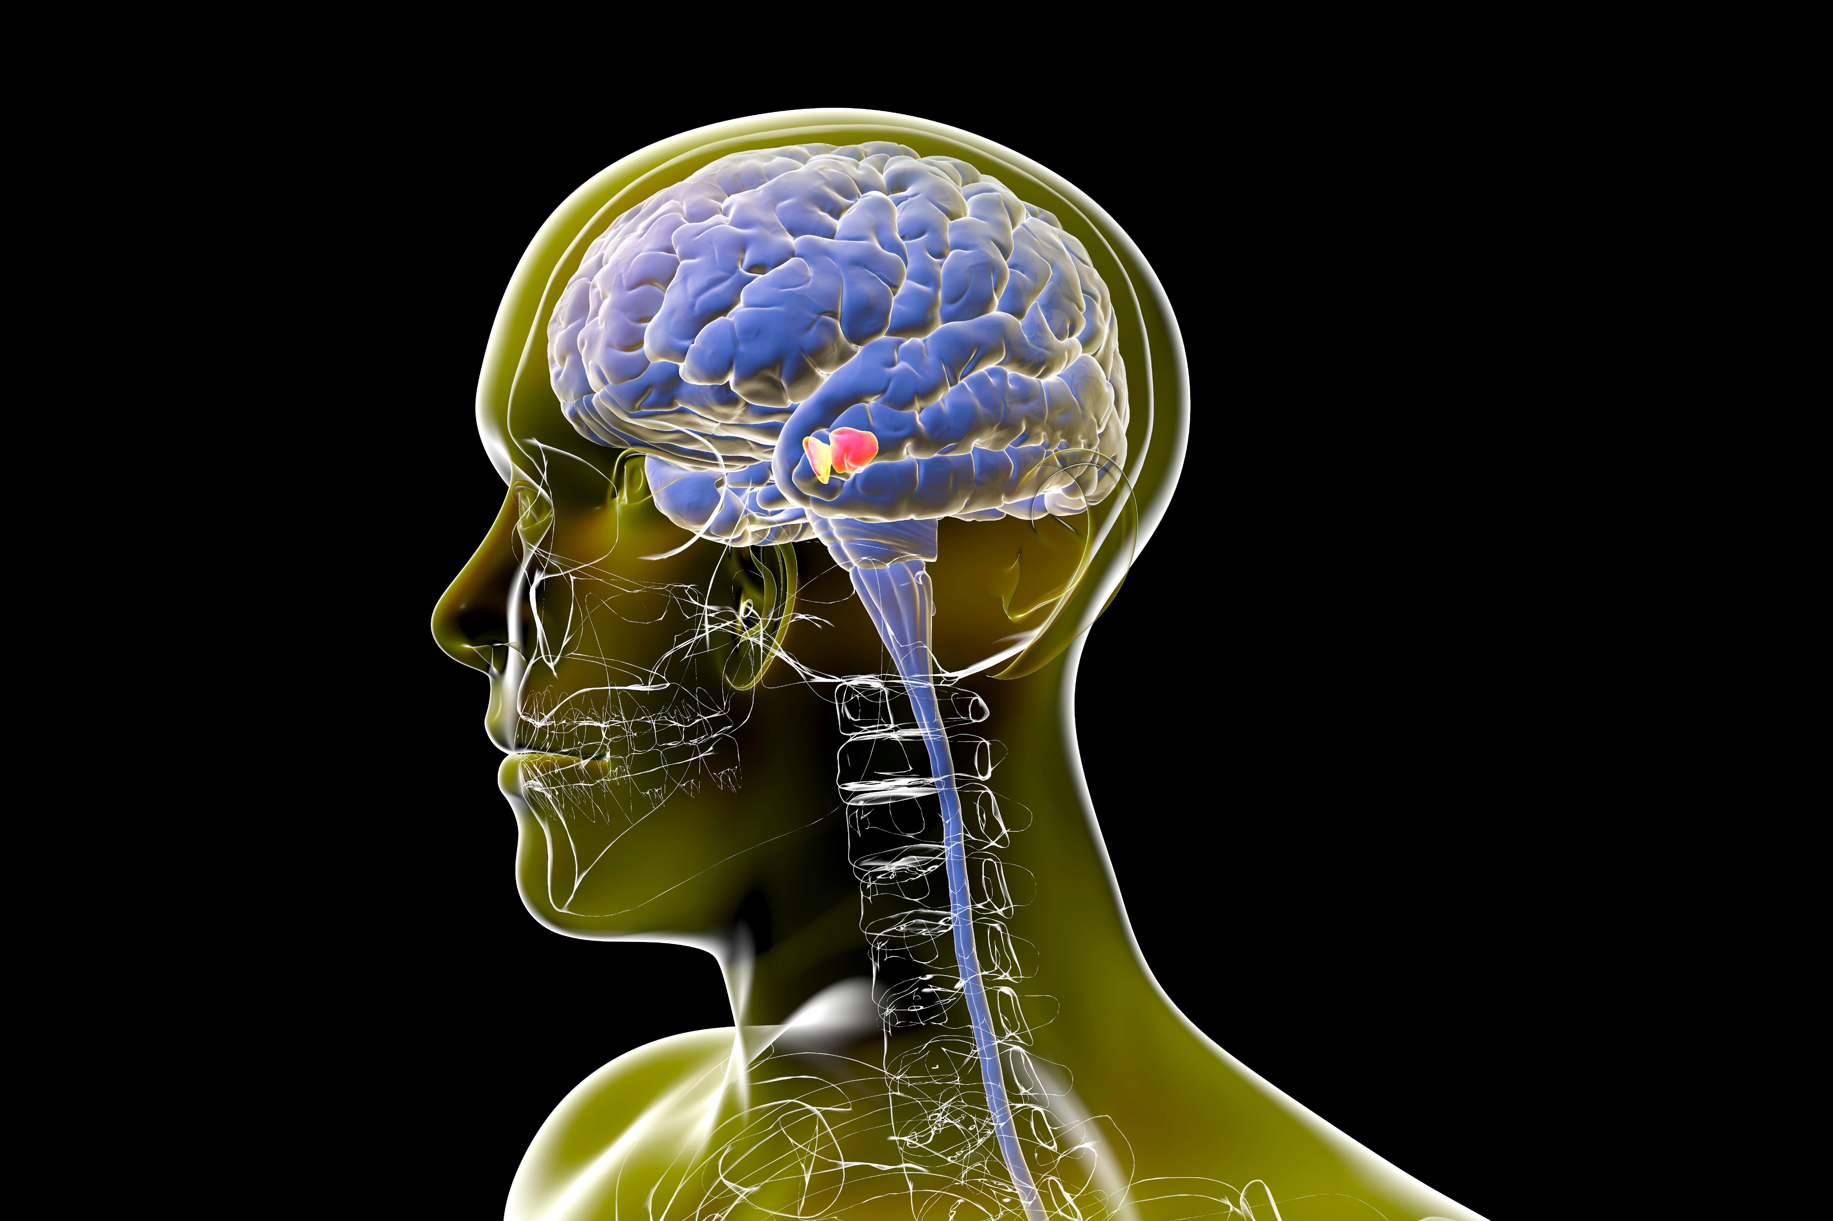
PD and Lower Urinary Tract Sx
  Approximately 60% report urinary sx
    Urinary urgency 36%
    Urinary frequency 32%
    Urge incontinence 28%
    Urinary Retention is Rare
Sakakbara 2012, Jain 2011, Campeau 2011, Fowler 2007
Notes:
Sx are not just aging these are neurogenic bladder

Slide 9
Urinary Symptoms as Prognostic Marker For PD?
Overactive Bladder Symptom Score (OABSS) in PD relates to poor performance of frontal lobe executive function, REM sleep behavior disorder in Chinese Patients
  Xu et al 2019

Slide 10

Sleep and Parkinson’s
The most common urinary symptom is PD => Nocturia 57%
Cause or Effect from REM Sleep disorder in PD?
  Michael J Fox foundation studying sleep disturbances
    Nocturia as variable?

Slide 11
Multiple System Atrophy (MSA)
MSA-P (most parkinson’s symptoms)
MSA-C (Cereberal)
More Severe Urinary Symptoms than PD
Both storage and emptying
Urgency, Frequency dominate
Post Void Residual is higher than PD
Rapidly progressing urinary symptoms

Slide 12
PD vs MSA Urinary Symptoms
 | PD | MSA
First Sx Urinary? | No | Yes (Frequency/Urgency, retention)
Time of Onset Urinary sx | 5 years after Dx | Less than 2 years
Incidence of LUTS | 50-70% | >90%
Elevated Post Void Residual | no | yes
Cystogram | Closed bladder neck | Open Bladder neck
Sakakibara 2018, Vichayanrat 2021

Slide 13

Neurologic Map of Bladder Function
Inhibits during filling
BRAIN
Neurologic Control of Bladder Storage and Emptying
PMC
PAG
ACC, PFC
Emotion
Perception
No inhibit during emptying
Sympathetic (T10-L2)
Bladder storage
Spinal Thalamic Tract
Parasympathetic (S2-S4)
Bladder emptying
Bladder
Sacral Spinal Cord
Afferent Nerves
Pudendal, pelvic, hypogastric nerves
A and C fibers
AUA Core Curriculum, Neurogenic Bladder 2016

Slide 14
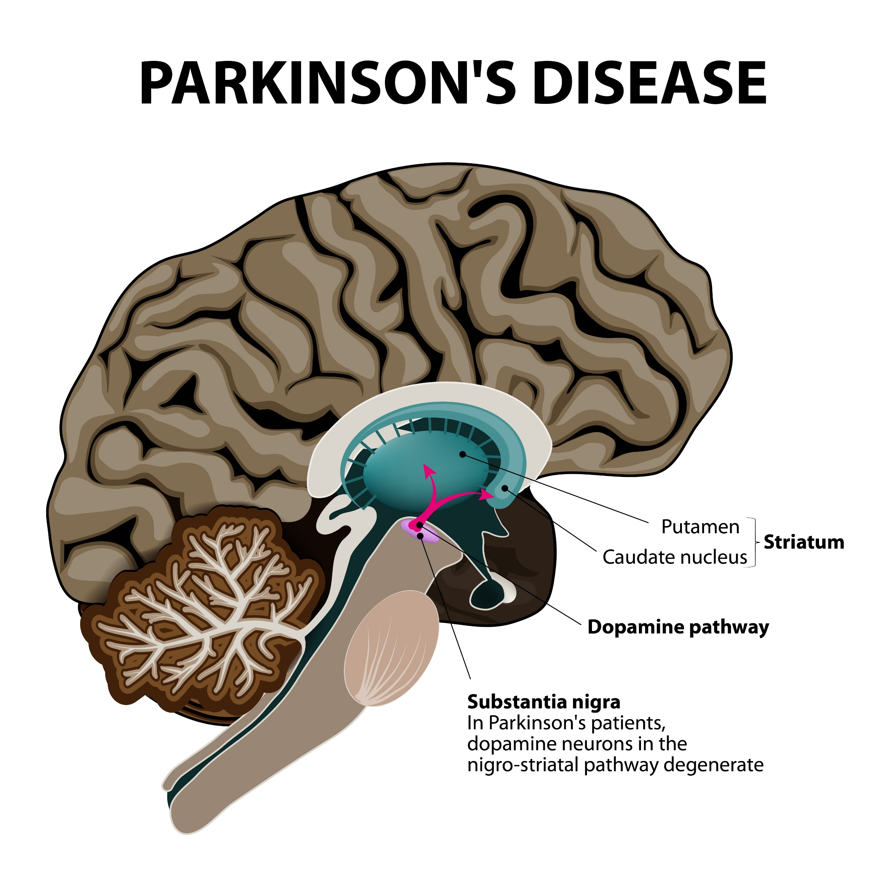
PD and MSA

Slide 15
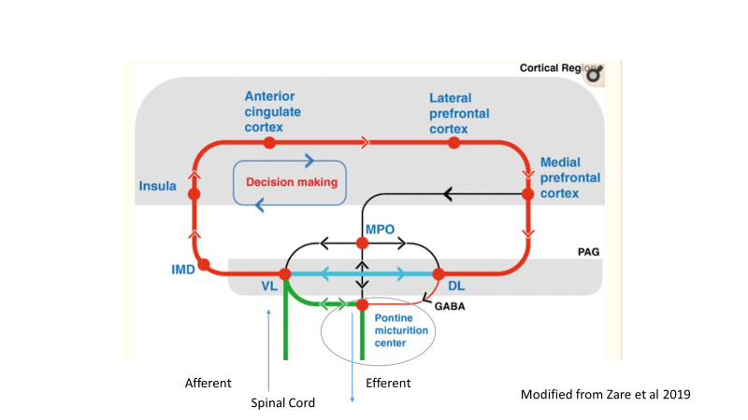
Most Important Point –PAG vs PMC
Periaquductal Grey region (PAG) receives from bladder
  Inhibits PMC
Pontine Micturition complex (PMC) flips switch between bladder storage and emptying
  parasympathetic activation
Time/Space
Stress!
Social Contex

Slide 16
Why Does PD Cause OAB?
ACC
Error processing
Motor movements
PFC
Executive functioning
Short term memory

Slide 17
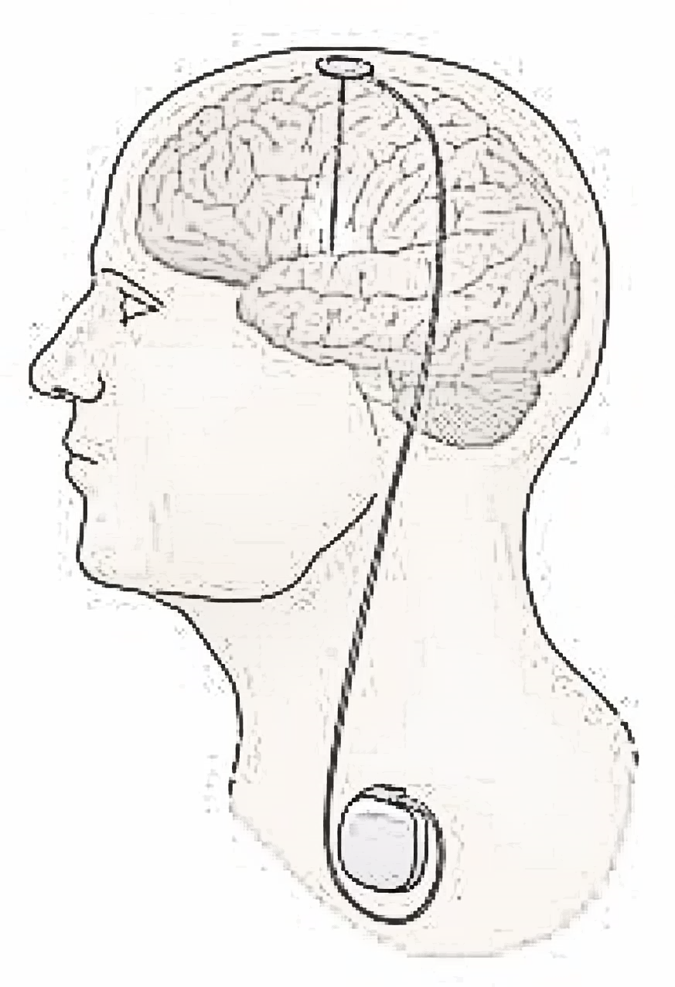
Discussion – Parkinson’s
Deep Brain Stimulation impact on Bladder symptoms
  Yamamoto et al 2018
  28 patients
  The mean OABSS and IPSS did not change significantly at any follow-up periods postoperatively.
  Improved ADL may contribute to perceived improvement in urinary QOL
Image modified from ninds.nih.gov

Slide 18
Diagnosis

Slide 19
Diagnosing OAB
Overactive Bladder Guidelines (AUA)
  Physical Exam
  Urine Analysis
  Voiding Diary
  Clinical!
Neurogenic Bladder Guidelines (AUA)
Post void residual should be obtained to assess for urinary retention/Overflow as cause of symptoms
Lightner DJ, et al: Diagnosis and treatment of overactive bladder (non-neurogenic) in adults: AUA/SUFU Guideline amendment 2019.
Ginsberg D , et al: Neurogenic Bladder Guidelines AUA 2021.

Slide 20
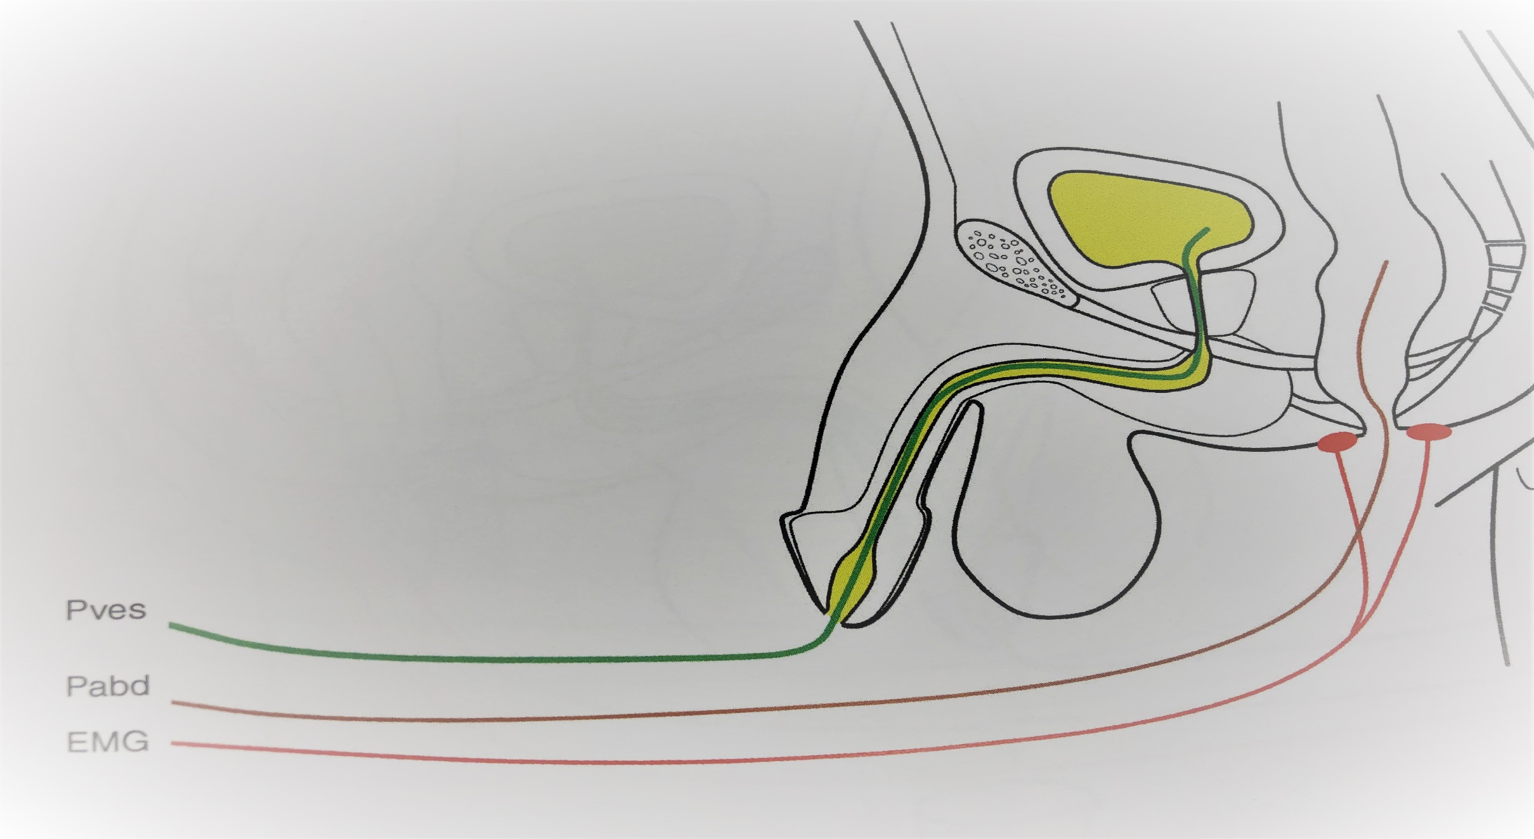
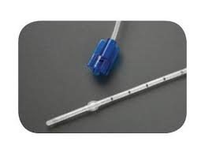
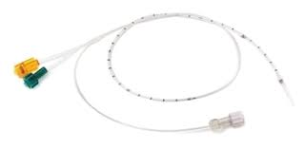
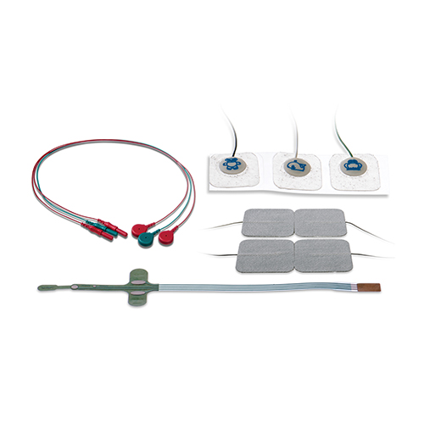
Urodynamic Testing
Puro
From Oh, Interpretation of Urodynamic studies 2018

Slide 21
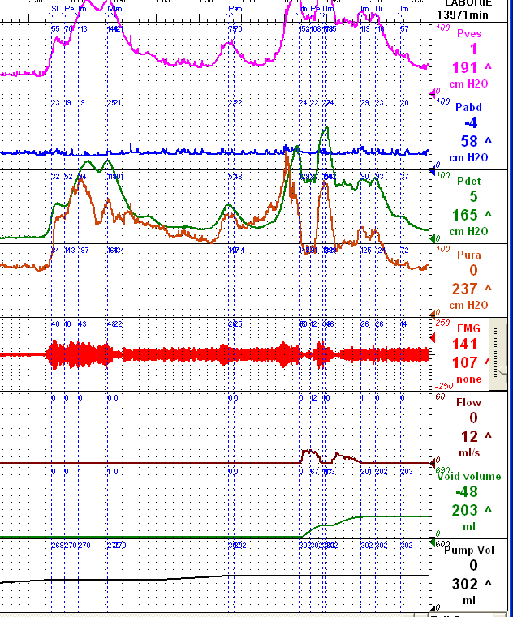
Urodynamics can be helpful for Dx OAB
Detrusor Overactivity: Any symptomatic 5cm H20 rise during study
DO More likely with Incontinence
  Prospective study(Chung 2011)
  65 M, 125 W
  OAB plus incontinence (94%)
  OAB no incontinence (64%)
Negative study does not rule out OAB!
Notes:
Fundatmentals of Good urodynamic practice – Drake et al Neuro Urol Urodynam 2018; Chung et al Neurourol urodynam, 65 men/125 women

Slide 22
Basic Urodynamics
Test of bladder physiology
1
Evaluate Storage/emptying
2
“What is your Question?”
3

Slide 23
Safety: Urodynamic Screening
Who Needs Initial Urodynamics for LUTS?
Neurogenic Bladder Type | Initial Screening for all? | Reason for Screening
Spinal Cord Injury | Yes | Low Bladder Compliance DSD Impact on AD
Spinal Bifida | Yes | Low Bladder Compliance DSD
Multiple Sclerosis | No* | Clinically Significant DSD QOL ? (SUI vs OAB)
Parkinson’s | No | Understanding symptoms, not Safety

Slide 24
A Better Way to help follow OAB longitudinally
Patient Reported Outcome Measures (PROMS)
  (I) cross-sectional: evaluation of patients at 1 point in time
  (II) predictive: predicting improvement or decline in a patient characteristic
  (III) change over time: evaluation of a patient characteristic over time
    (Clark and Welk, Transl Androl Urol. 2016 Feb; 5(1): 22–30)

Slide 25
Urodynamics not always Differentiate Impact of Urinary symptoms (MS Patients)
 | RR (n=57) | SP (n=61) | P value
Urodynamic Capacity | 128ml | 139ml | 0.7
With DO | 30 (57%) | 34 (56%) | 0.7
With DSD | 13 (23%) | 15 (25%) | 0.4
Acontactile | 12 (21%) | 20 (33%) | 0.8
Low compliance | 4 (7%) | 7 (11%) | 0.4
. J Neurol Neurobiol 1 (2): 2015 http://dx.doi.org/10.16966/2379-7150.105
Cox L et al

Slide 26
Perception of Symptoms Different!
 | RR = 57 | SP = 61 | p
Age | 49 | 56 | 0.005
Gender (F) | 77% | 64% | 0.1
Chronic UTI | 18 (32%) | 18 (30%) | 0.9
AUASI (total) | 21 | 15 | 0.004
CIC | 19 (33%) | 18 (30%) | 0.7
Cox et al. J Neurol Neurobiol 1 (2):2015 http://dx.doi.org/10.16966/2379-7150.105

Slide 27
Urology QOL Questionnaires
Assume sensate population
Do no address bladder management (catheters)
Neurogenic Bladder Symptom Score (Welk 2020)
  The first question – bladder management
  8 questions cover the 3 domains of incontinence, storage and voiding, and consequences.
  The final question is the same overall quality of life question

Slide 28
TREATMENT OF OAB IN PD AND MSA

Slide 29
Context is Important in Treatment Ladder
Ability and Willingness to manage bladder
Safety
Natural History of Disease
Impact on Care Plan
Resources Available
QOL

Slide 30
Treatment Ladder for OAB in PD/MSA
Behavioral Therapy
Pharmacologic
Very Rare – Bladder Augment or Diversion
Onabotulinum Neuromodulation
Suprapubic Tube
Hospice
Mild symptoms
Refractory OAB

Slide 31
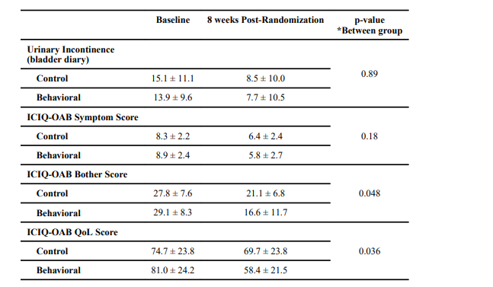
Behavioral Therapy
43 PD patients randomized to observation vs 8 weeks behavioral therapy
Timed voiding, fluid management, kegals
Vaughn et al 2019

Slide 32
OAB Pharmacology – Targets receptors in Detrusor
M = Muscarinic
N = Nicotinic
α = α₁ and α₂ -Adrenergic
β = β₃-Adrenergic
Detrusor
muscle (M, β)
B3 receptors – storage (sympathetic)
Muscarinic – emptying (parasympathetic)
Trigone (α)
Pelvic floor (N)
Bladder neck (α)
Urethra (α)
Notes:
Distribution of Cholinergic and Adrenergic Receptors
Neurologic control of micturition occurs through the release of neurotransmitters
The receptors for these transmitters are located in the detrusor muscle (muscarinic and ß₃-adrenergic), the trigone (α_{1 and 2}-adrenergic), bladder neck (α_{1 and 2}-adrenergic), urethra (α_{1 and 2}-adrenergic), and pelvic floor (nicotinic)

Slide 33
Muscarinic Receptors
Parasympathetic Muscarinic Receptors
80% Receptors in bladder M2
M3 more selective for bladder contractions
M2 may reset bladder for relaxation
Subtype | Location
M1 | Brain
M2 | Bladder/Gut
M3 | Bladder/Brain
M4 | Forebrain
M5 | Brain

Slide 34
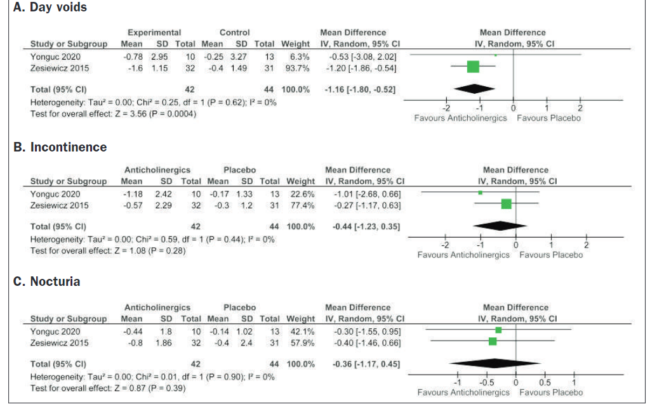
LUTS- Parkinson’s
Anticholinergics
  Zesiewicz et al 2015→ solifenacin dbl blind RCT, 23 pts
    no significant improvement in frequency, urgency,
    decrease in urge incontinence episodes
    ?concerns about changes in cognition
  Yonguc et al 2019 → festoterodine dbl blind Rct (4 weeks); 65 pts
    Significant improvement in urgency, urge incontinence
    No improvement in nocturia
    No changes in cognition
Meta-analysis fomr Bapir et at 2020

Slide 35

Which Anticholinergic Works Best for PD?
Extended release anticholinergics have fewer side effects than immediate release
No clear advantage of non-specific vs M3 specific
? Absorption differences?

Slide 36
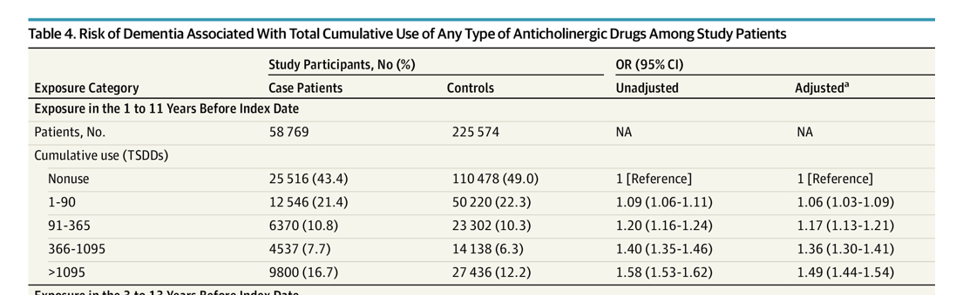
Dementia and Anticholinergics
There was nearly a 50% increased odds of dementia associated with total anticholinergic exposure of more than 1095 TSDDs within a 10-year period.
→Equivalent to 3 years’ daily use of a single strong anticholinergic medication at the minimum effective dose.
Slide courtesy of Dr Giulia Lane
Richardson et al, BMJ 2018

Slide 37
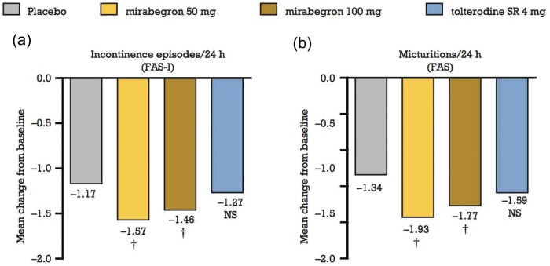
B3 agonist
Most commonly reported adverse reactions 50 mg:
  Hypertension
  nasopharyngitis
  UTI
  headache
  CYP2D6 inhibitor
From:Ther Adv Urol. 2012 December; 4(6): 315–324

Slide 38
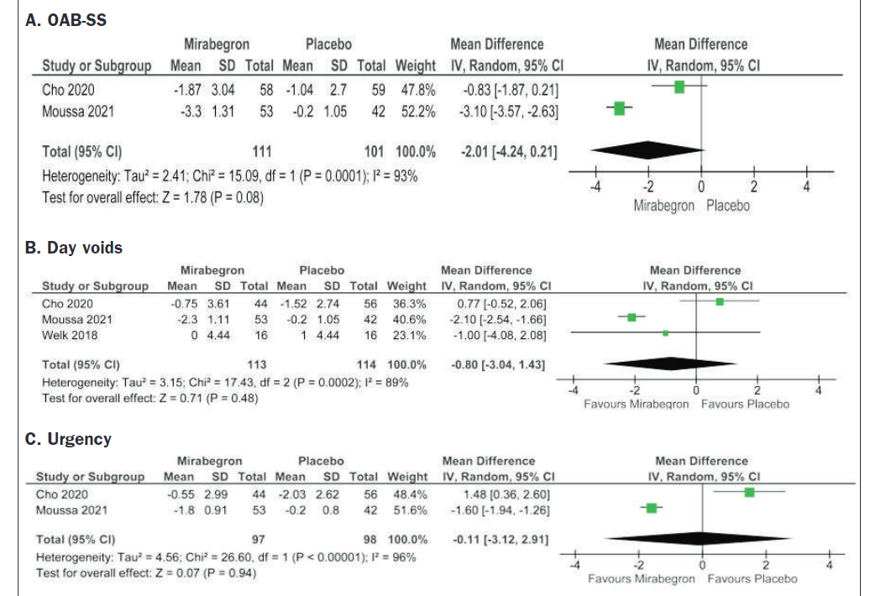
Mirabegron and PD
Brucker et al 2018→ 50 patients retrospective study,
  50% showed improvement
  11% complete resolution
  cho et al 2020 -> placebo, dbl blind study with 117pt
    Significant improvement mirabegron over placebo (20% improvement)
    Greatest improvement between weeks 2-4
    No additional improvement after week 5

Slide 39
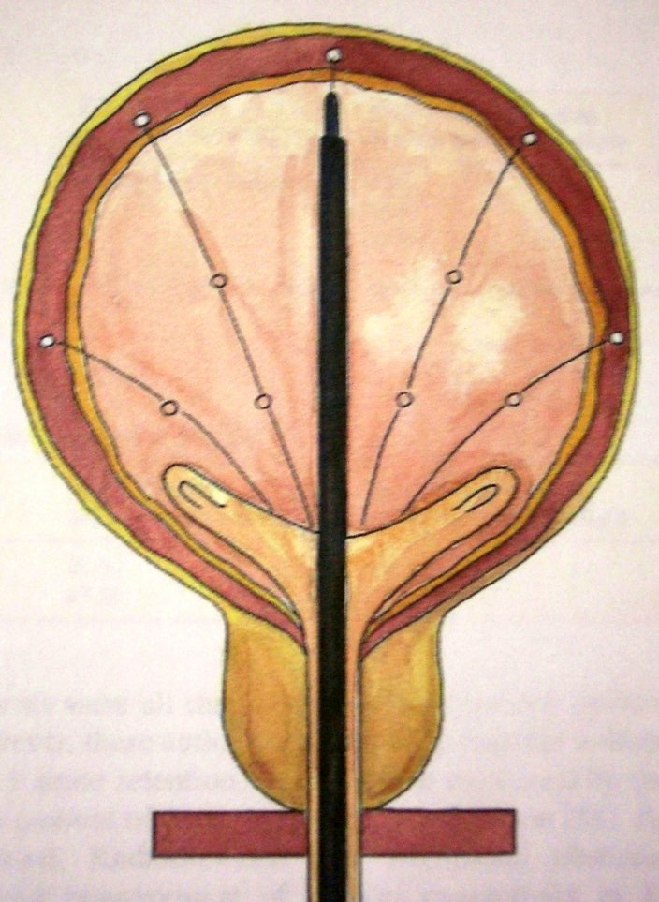
Transurethral Botulinum Toxin Injection
Mechanism of action
  Inhibits release of Ach from neuromuscular jxn nerve terminal
Dosage for Neurogenic:
  200 units detrusor +/- trigone
Most effective DO treatment is to change physiology to retention and then CIC

Slide 40
Botulinum Toxin for PD OAB
Dosing 100units if voiding, 200 if in retention
Efficacy lasts 3-12 months
Vurture 2018
  100 units
  19/24 pts had improvement of urgency (7 complete resolution)
  PVR increased from 17 to 126 avg
  3/24 had to start intermittent catheterization at 4 weeks

Slide 41
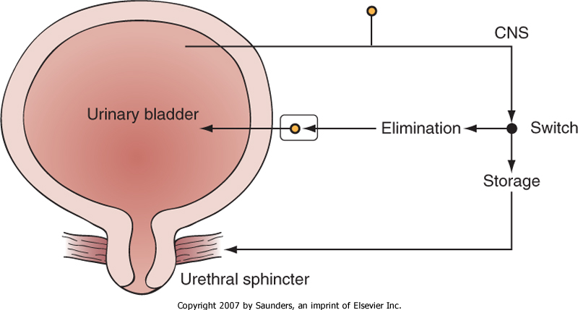

Slide 42
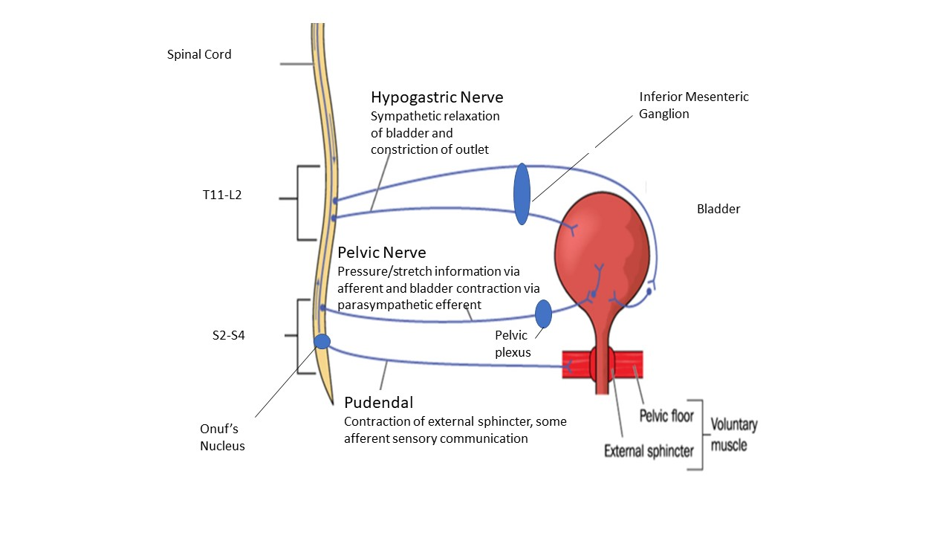
Targeting the - Peripheral Nervous System
Bladder Relaxation
Bladder Contraction
Modified from Stoffel JT, Female Genitourinary and Pelvic Floor Reconstruction, Springer 2021

Slide 43
Why Does Neuromodulation Work
Sacral Neuromodulation stimulates afferent peripheral nerves
  Down regulates C Fiber signaling
  Upregulates A fiber
Boosts Afferent bladder signaling to Brain
Inhibit reflex afferent- efferent arc
S3 electrode
From Stoffel JT. Ch 2 Neurophysiology and Anatomy, Female Urology Springer 2022

Slide 44
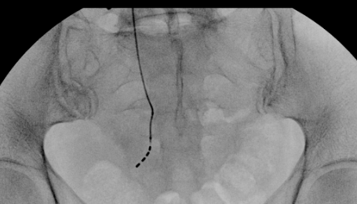
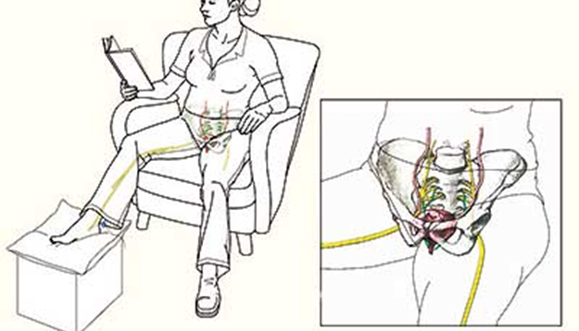
LUTS- Parkinson’s
Neuromodulation
  Kessler et al 2010 – systematic review and meta-analysis
  6 patients with Parkinson’s Disease
  Unclear benefits, risk likely low
PTNS
  7 Trials including RCT
  Kabay et al 2016
    47 patients
    Frequency decreased 6 voids/day
    Incontinence decreased 3 episodes/day

Slide 45
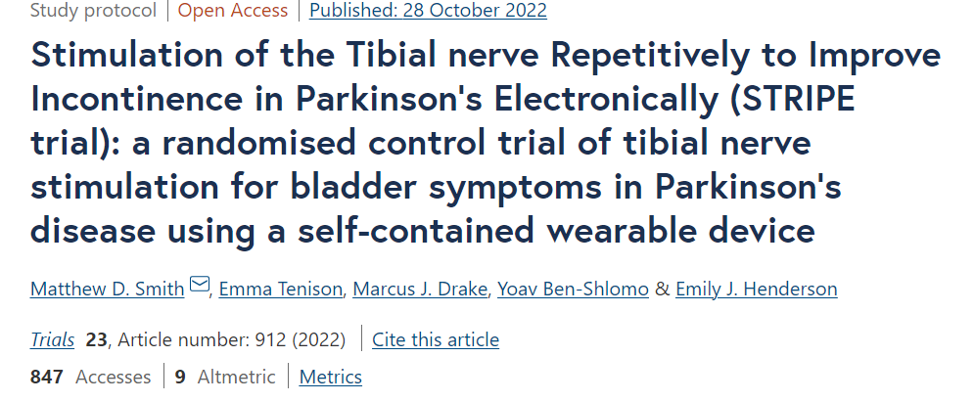
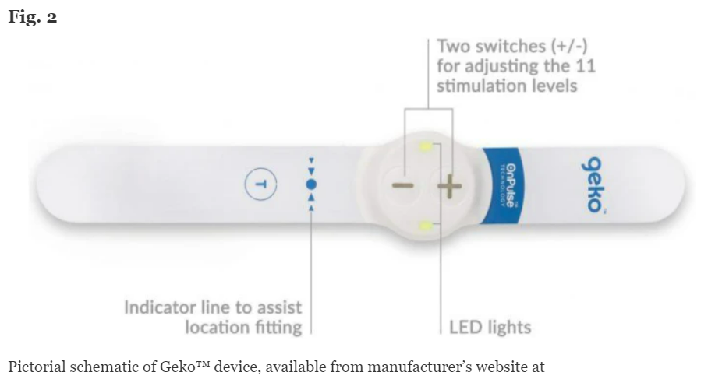

Slide 46


Slide 47
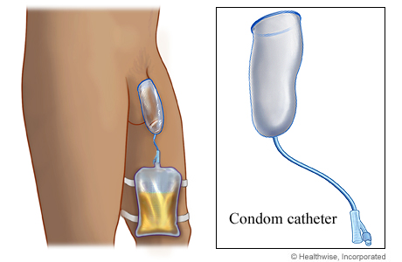
Condom catheters - Male
Slide from Anne Cameron

Slide 48
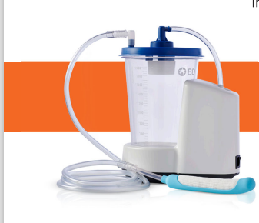
Pure-Wick External Female Catheter
Single Use
Placed between labia and gluteal folds
Used for 8 hours during sleep or immobility

Slide 49
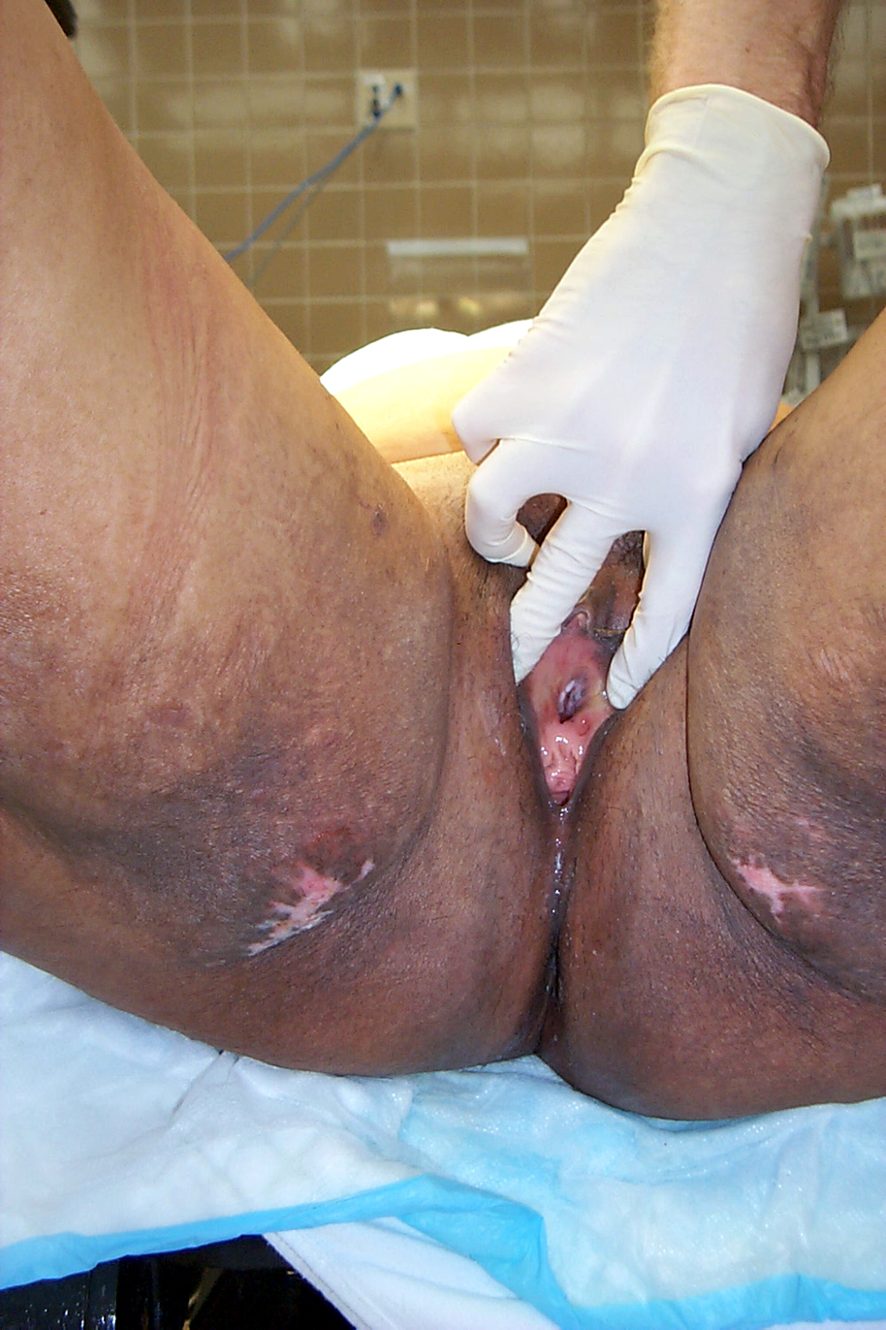
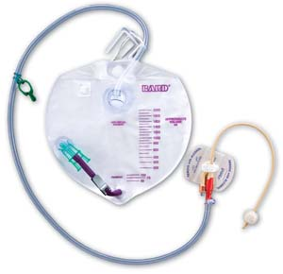
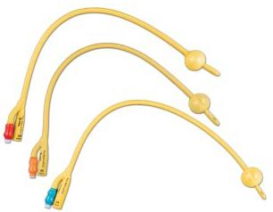
Urethral Catheter
Developed by Frederick Foley 1930’s
Creates gravity drainage system for bladder
Several Indications
  I/O’s
  Temporary immobility
  Impaired bladder contractility
  Compromised bladder outlet
lifemedical

Slide 50
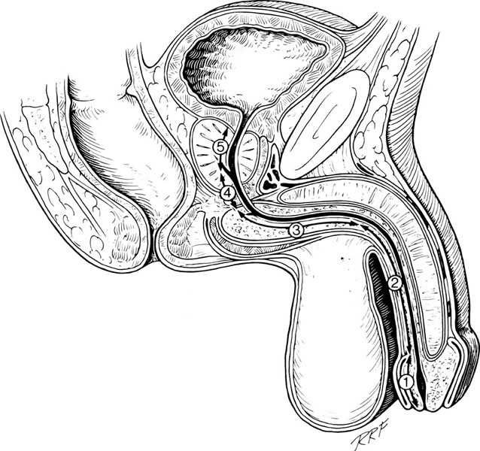
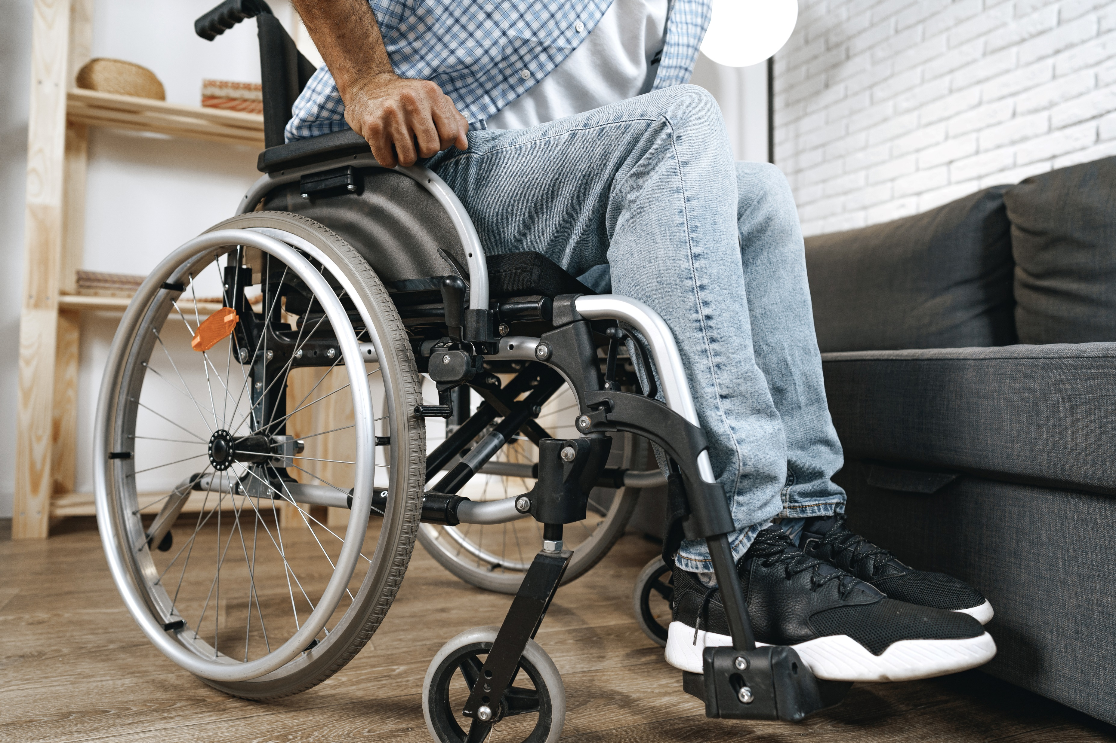
Indwelling catheters: Soft Tissue Assessment

Slide 51
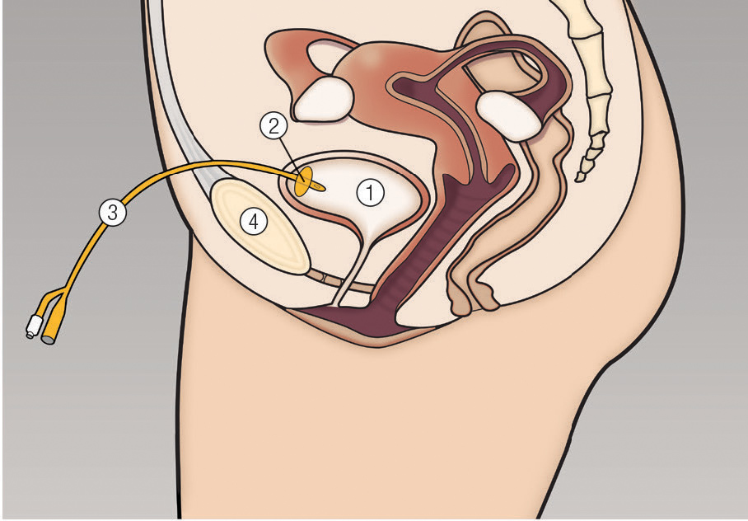
Suprapubic Tube
Catheter needs to be changed every 4 weeks
Increased risk of UTI and stones
Drainage bag should be below level of bladder

Slide 52
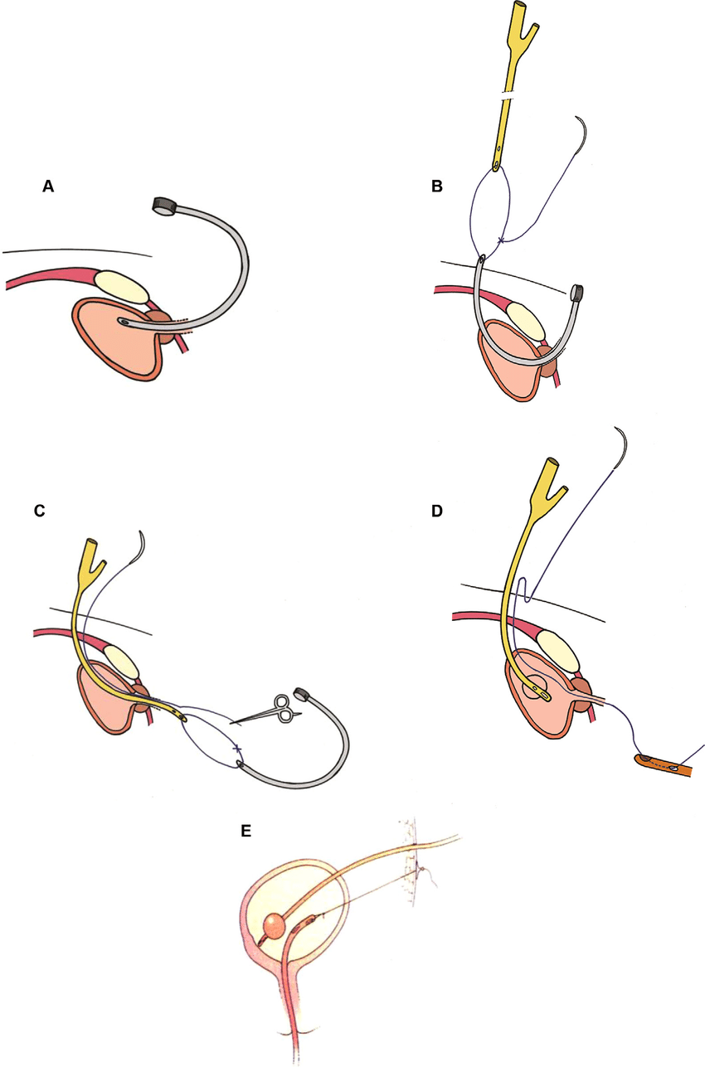
Retrograde Placement
Modified From Kuo et al 2015

Slide 53
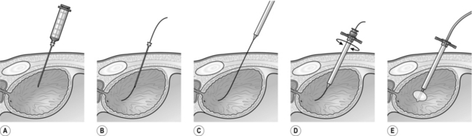
Antegrade placement
Meta-analysis 2019 (Hall et al)
Risk of Bowel injury = 0.25%

Slide 54
Summary of management of OAB in PD/MSA patients
Safety
Quality of Life
Health and Happiness
Protect against falls
Reduce skin breakdown
Reduce ER visits
Satisfaction with Bladder Management
Time
Resources

