Slide 1
Financial Barriers and Access to Care concerns for Patients with Esophageal Cancer
Rishindra M. Reddy, MD MBA, Professor, University of Michigan, Section of Thoracic Surgery
Endowed Jose Jose Alvarez Professor of Thoracic Oncology Research
Rishindra M. Reddy MD, MBA, University of Michigan, Section of Thoracic Surgery

Slide 2
Disclosures
Intuitive Surgical
Medtronic
Atricure
Genentech
On Target Laboratories
None Relevant to this talk
Rishindra M. Reddy MD, MBA, University of Michigan, Section of Thoracic Surgery

Slide 3
Objectives
Understand financial barriers for some patients with esophageal cancer
Discuss Race and its relationship to socioeconomic status
Review complexity of care pathways for esophageal cancer (at all stages)
Rishindra M. Reddy MD, MBA, University of Michigan, Section of Thoracic Surgery

Slide 4
Audience polling
Have you ever known any of your esophageal cancer patients to undergo medical bankruptcy?
  Yes
  No
Rishindra M. Reddy MD, MBA, University of Michigan, Section of Thoracic Surgery

Slide 5
Audience polling
Within your esophageal cancer population, have you ever consulted social work (or any sort of patient assistance) program for financial and/or transportation help?
  Yes
  No
Rishindra M. Reddy MD, MBA, University of Michigan, Section of Thoracic Surgery

Slide 6
Audience polling
Have you noted any disparities in esophageal cancer care based on race or gender?
  Yes
  No
Rishindra M. Reddy MD, MBA, University of Michigan, Section of Thoracic Surgery

Slide 7
Background
Born and raised in Michigan
14% AA population in the state, 85% AA population in Metro Detroit
Legacy of Dr. Orringer and Transhiatal Esophagectomy
Former Clerkship Director of Surgery
Rishindra M. Reddy MD, MBA, University of Michigan, Section of Thoracic Surgery

Slide 8
Background
Two Thousand Transhiatal Esophagectomies
Changing Trends, Lessons Learned
  Mark B. Orringer, MD,* Becky Marshall,* Andrew C. Chang, MD,* Julia Lee, MS,† Allan Pickens, MD,* and Christine L. Lau, MD*
Rishindra M. Reddy MD, MBA, University of Michigan, Section of Thoracic Surgery

Slide 9
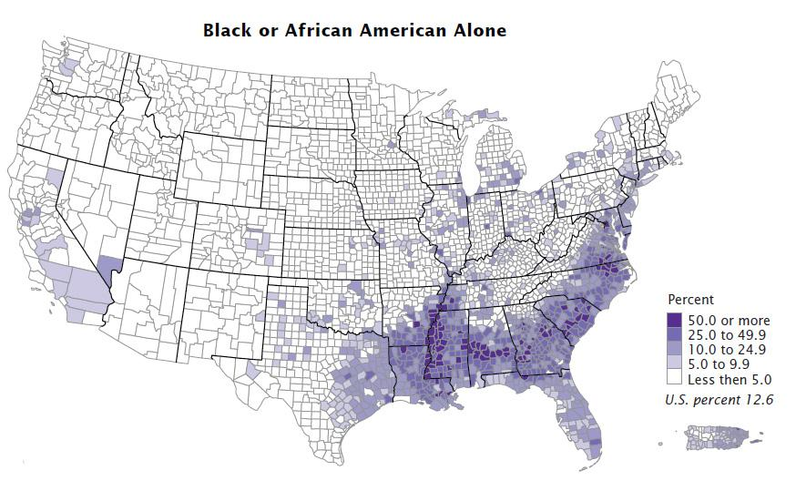
Two Thousand Transhiatal Esophagectomies
Changing Trends, Lessons Learned
  Mark B. Orringer, MD,* Becky Marshall,* Andrew C. Chang, MD,* Julia Lee, MS,† Allan Pickens, MD,* and Christine L. Lau, MD*
usafacts.org
Rishindra M. Reddy MD, MBA, University of Michigan, Section of Thoracic Surgery

Slide 10
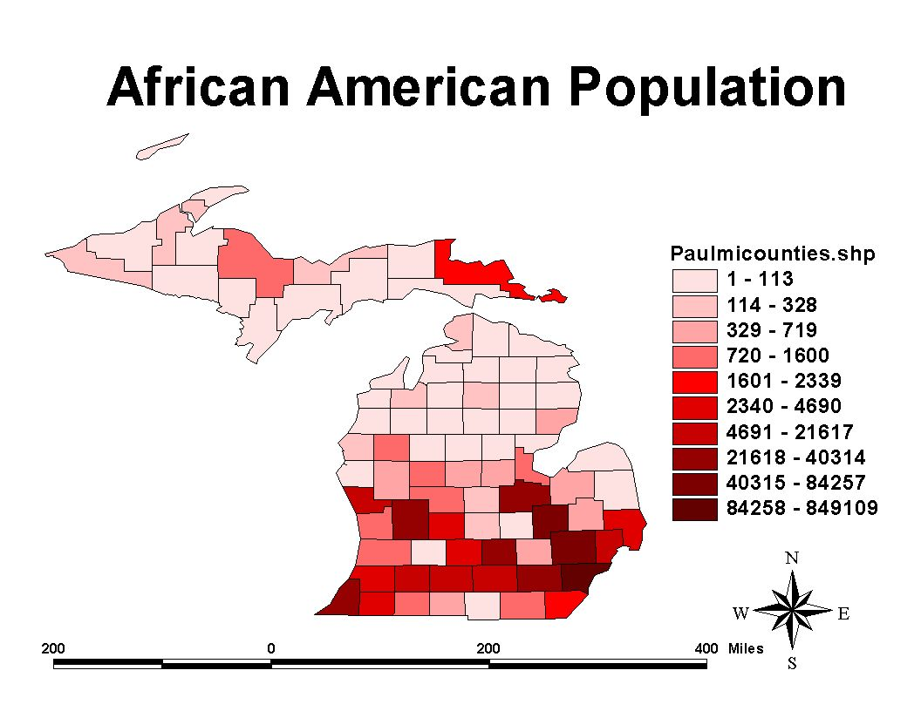
Map Page (umich.edu)
Rishindra M. Reddy MD, MBA, University of Michigan, Section of Thoracic Surgery

Slide 11
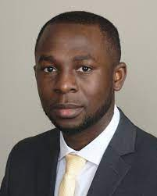
Racial disparities in Eso Cancer Surgery
Cliff Akateh
  Transplant Surgery Fellow-Stanford
  General Surgery-The Ohio State University
AA vs Caucasian patient outcomes after Esophagectomy
  Almost 3000 esophagectomies at Umich
  Well kept Database on Outcomes
Rishindra M. Reddy MD, MBA, University of Michigan, Section of Thoracic Surgery

Slide 12
Racial disparities in Eso Cancer Surgery
2.7% of Esophagectomy patients were AA
1% Asian
Hispanic not well recorded
14.5% of Michigan is AA
85% of Detroit is AA
Distrust of the overall health system
Distrust of University of Michigan
Challenges getting care in Ann Arbor
2015, <5% of UM Cancer Center referrals were AA patients
Rishindra M. Reddy MD, MBA, University of Michigan, Section of Thoracic Surgery

Slide 13
What have we found?-Akateh, et al
Retrospective Review of 2000+ esophageal cancer patients in a single center database.
Reviewed outcomes after esophagectomy, including long term survival
Majority of patients were treated with transhiatal esophagectomy
(Never published, but presented at the Clinical Congress in 2013)
Rishindra M. Reddy MD, MBA, University of Michigan, Section of Thoracic Surgery

Slide 14
What have we found?-Akateh, et al
No difference in survival or other short-term outcomes
Increased Length of Stay, but unclear why
Squamous cell cancer and mid-esophageal location did not increase risks associated with surgery
Rishindra M. Reddy MD, MBA, University of Michigan, Section of Thoracic Surgery

Slide 15
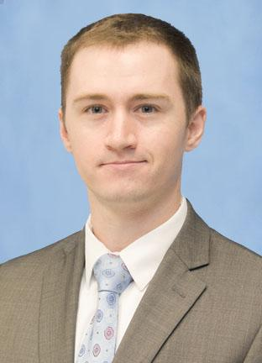
We have few AA patients, but why?
Kemp/Sarwar
Interviews with 20 different esophageal cancer care physicians in SE Michigan
Open ended interviews with GI docs, Med Onc, Surgery, Rad Onc to understand where AA patients go for care, and why
Presented at Academic Surgical Congress in 2014

Slide 16
GI
PCP
ER
GI
Med Onc
Endoscopy
Thoracic Surgery
Rad Onc

Slide 17
Socioeconomic Status > Race (95%)
1. Transportation Issues (90%)
2. Fear of Surgery/Anesthesia (45%)
3. Lack of understanding, follow-up, or access to primary care (85%)
Overcome Issues with Social Services (75%)

Slide 18
Conclusions (Kemp/Sarwar)
Some Senior physicians felt this wasn’t of value
Transportation was a key factor
  Bus services provided by other systems in Detroit, and in Michigan
Socioeconomic status was also a key factor

Slide 19
Where do we go next?
Lineback/Mervak-focused on low SES patients with Esophageal Cancer
Interviewed 80 patients/families with esophageal cancer
NOT through UM’s system (through FB, Church postings, Newspaper ads)
40 patients with low SES, but also 40 with high SES

Slide 21
Lineback CM, Mervak CM, Revels SL, Kemp MT, Reddy RM. Barriers to Accessing Optimal Esophageal Cancer Care for Socioeconomically Disadvantaged Patients. Ann Thorac Surg. 2017 Feb;103(2):416-421.

Slide 23
Lineback CM, Mervak CM, Revels SL, Kemp MT, Reddy RM. Barriers to Accessing Optimal Esophageal Cancer Care for Socioeconomically Disadvantaged Patients. Ann Thorac Surg. 2017 Feb;103(2):416-421.

Slide 25
Conclusions/Take-Away
Esophageal cancer care is complex
30% of patients with limited socioeconomic means may lose their job during their treatment
African American patients can have similar outcomes (from surgery), but may need more social support /transportation/flexibility, and this may be due to limited socioeconomic means

Slide 26
My Personal Conclusions/Take-Away
I have more empathy in helping patients get care
Failure to comply with treatment (missed appointments, etc.) may be due to financial limitations, rather than apathy to care.
We need a better system to help address financial (and social) inequality in patient care

