Slide 1

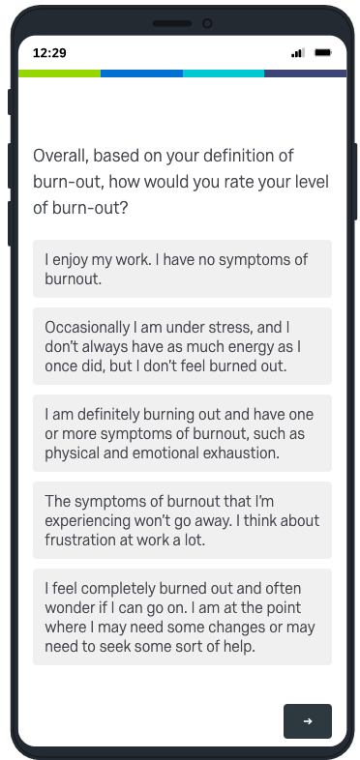
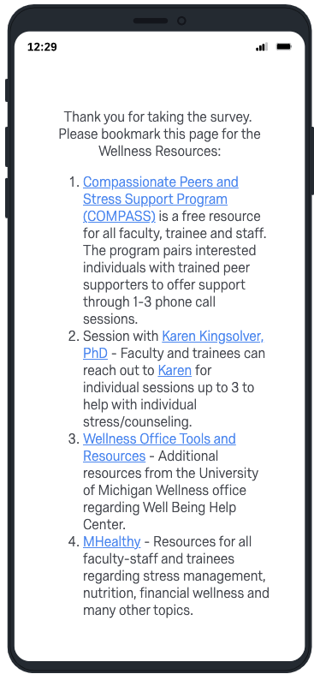
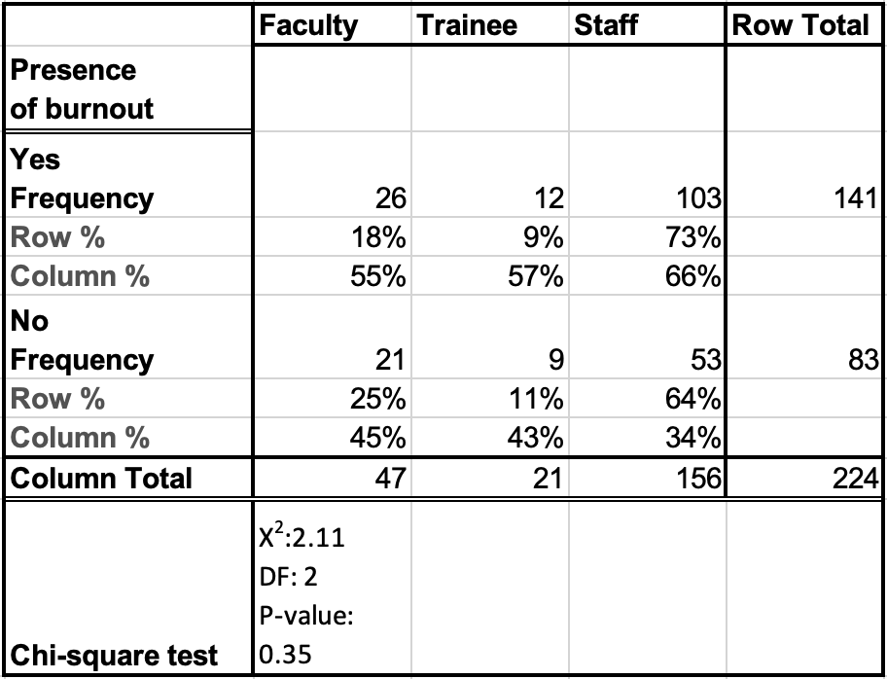
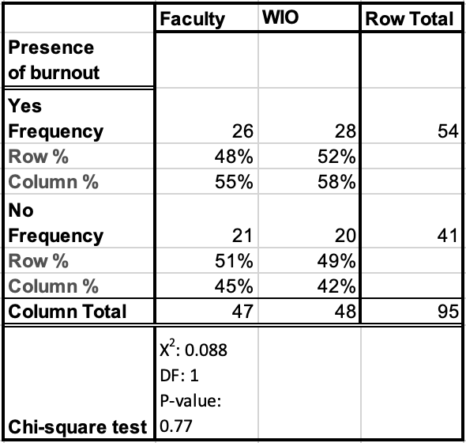
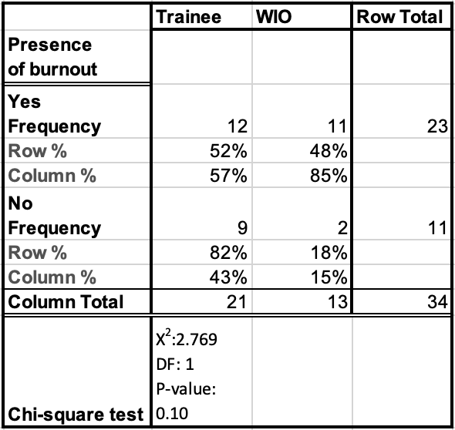
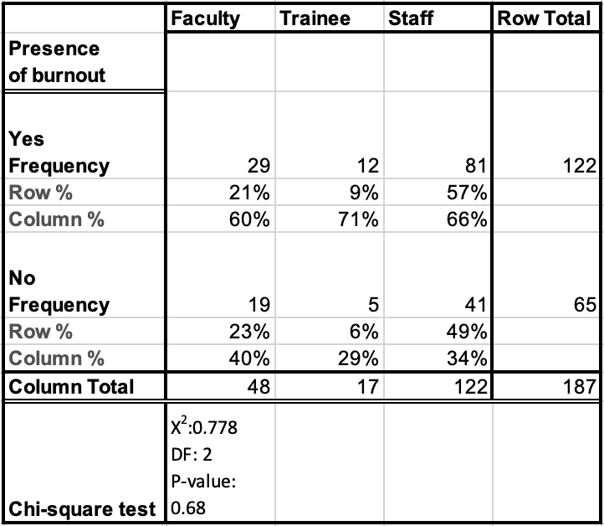
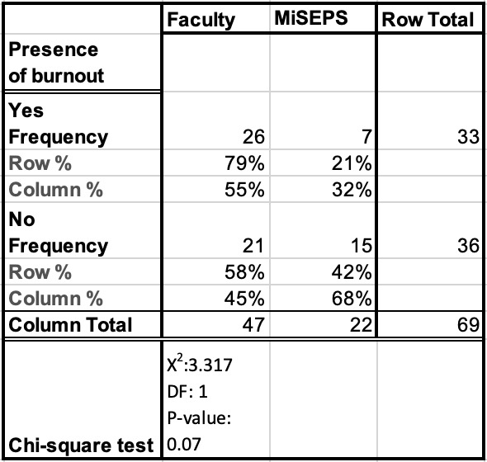
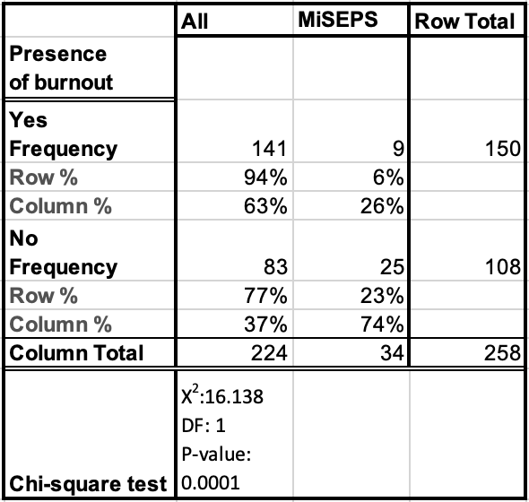
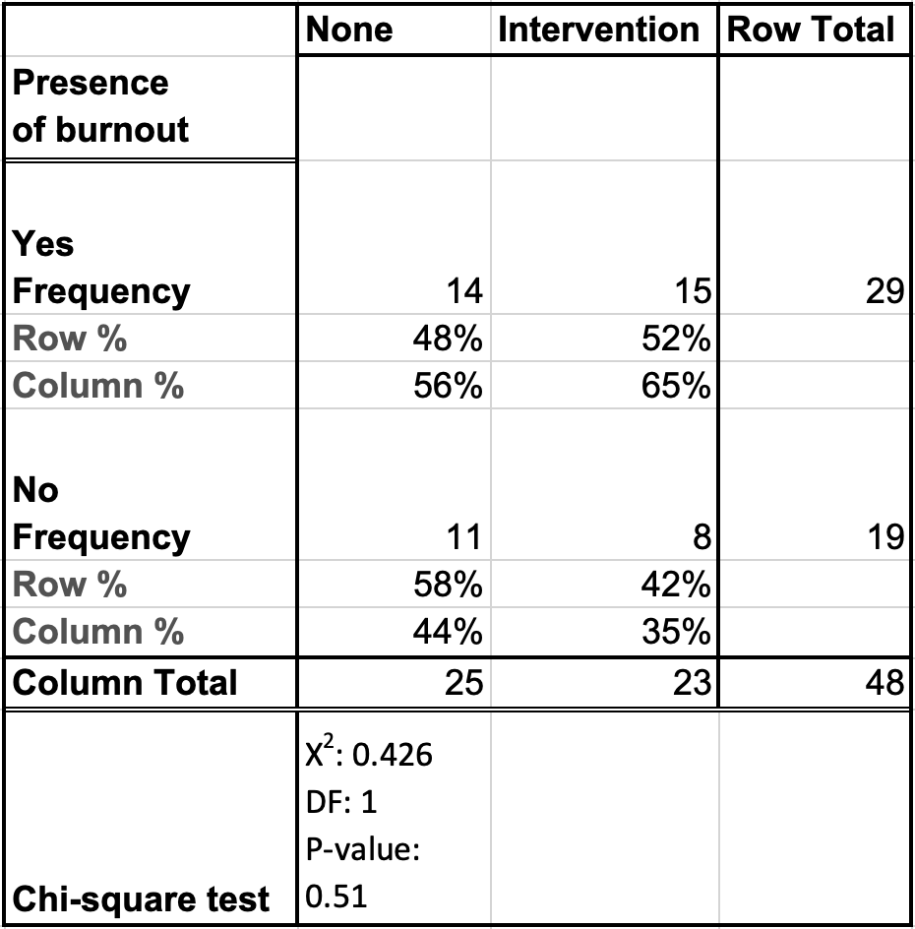
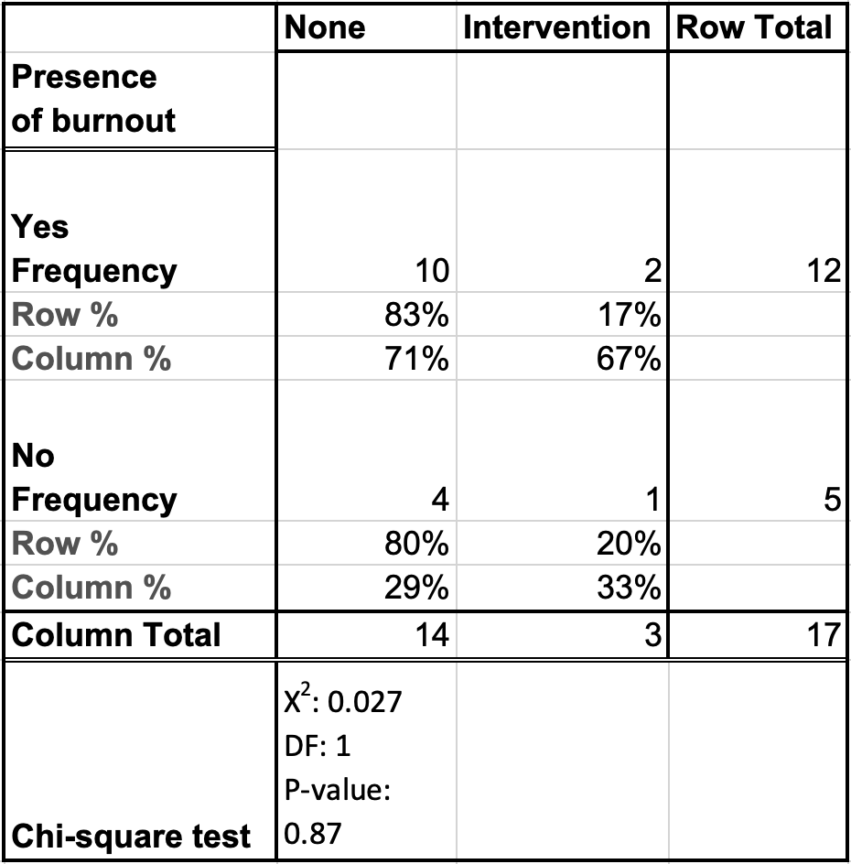
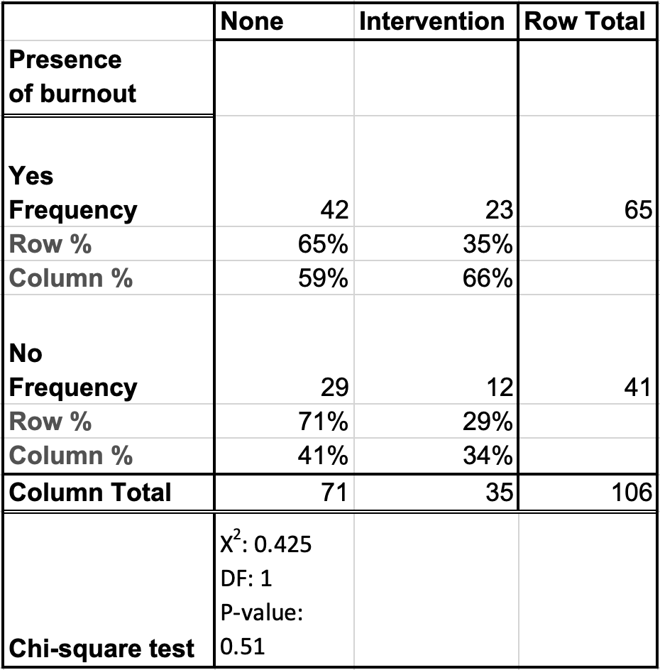
Burnout at a Tertiary Eye Care Center Found to be Significantly Higher After the Start of COVID-19
Warren Pan, MD, PhD; Jennifer Weizer, MD; Denise John, MD; Amy Zhang, MD
W.K. Kellogg Eye Center, Department of Ophthalmology and Visual Sciences, University of Michigan, Ann Arbor, MI
BACKGROUND
RESULTS
CONCLUSIONS
COVID-19 had an overwhelming impact on healthcare and ophthalmology
Ophthalmology was one of the least adaptable specialties with cancellation of elective surgeries, need for in-person examinations, and under-utilization of telemedicine
Previous survey found that 62.8% of physicians experienced burnout after COVID-19 compared to 38.2% before COVID-19
A recent study found that 37.8% of ophthalmologists experienced burnout with only a 5% response rate
A 2018 survey of ophthalmology residency program directors found that 26% noted an issue with resident burnout
A single-item survey question has been found to be a reliable and validated measure of burnout
The rationale for this work is to determine burnout in ophthalmology with a one-question survey after the start of COVID-19
A
B
A
B
Rate of participation with the single-item survey was significantly higher (~40%) compared to a previous study
This is the first study examining burnout among ophthalmology staff members
Rates of burn-out among ophthalmology faculty, trainees, and staff members are higher (55-66%) than those reported previously (37.8%)
These burn-out rates were comparable to those experienced in the WIO and MiSEPS survey for faculty and trainees
The majority of faculty and trainees pursued at least one intervention after the initial survey while the majority of staff members did not
The rates of burnout in the subsequent study were comparable between those who underwent at least one intervention and those who did not pursue any intervention among all groups
C
 | Trainees | Faculty | Staff
Response Rate | 43% (n=21) | 43% (n=47) | 41% (n=156)
Figure 1: Responses to the single-item survey by faculty, trainees, and staff members. (A) The single-item burnout measurement question with the five associated question. (B) Items 1-5 indicate the response that individuals answered in their single-item survey. The percent of individuals responding with each response per group was then plotted. (C) Response rates of ophthalmology trainees (residents, fellows), faculty and staff members.
Figure 2: Responses to the single-item survey by faculty, trainees, and staff members after intervention. (A) The list of resources offered to the responders at the end of the initial survey. (B) Chart detailing the number of interventions that faculty (black), trainees (white), and staff (gray) pursued in the three months between the initial and subsequent surveys.
Table 2: Rate of self-reported burnout in initial survey with no significant difference between groups
Table 2: Rate of self-reported burnout comparable among faculty and trainees with those part of Women In Ophthalmology
FUTURE DIRECTIONS
Another survey one year after the initial survey to determine if long-term intervention would affect burnout rates
Corroboration with a Press Ganey resilience evaluation to determine early warning signs of burnout
Further qualitative examination into components of ophthalmology that have contributed to burnout rates after the start of COVID-19
METHODS
Table 2: Rate of self-reported burnout in the subsequent survey
Table 2: Rate of self-reported burnout comparable among faculty and trainees with those part of Michigan Society of Eye Physicians and Surgeons
The study was judged and given an exemption by the University of Michigan IRB committee.
We employed a well-validated single-item burnout measure consisting of a five ordinal scale response anonymized on Qualtrics and sent it to the following groups: 1. Faculty members, 2. Trainees (residents and fellows), 3. Staff members.
The survey was also sent to the Women in Ophthalmology (WIO) and the Michigan Society of Eye Physicians and Surgeons (MiSEPS) listservs.
A list of resources available to the respondent were then listed at the end of the survey.
Results were further dichotomized as no symptoms of burnout (< 3) and at least one symptoms of burnout (> 2).
The survey was sent again three months later and asked if any resource was used
Statistical analysis was performed on Graphpad Prism and Stata.
REFERENCES
Table 2: Rates of burnout among physicians who undertook no or at least one intervention
Table 2: Rates of burnout among trainees who undertook no or at least one intervention
Table 2: Rates of burnout among staff who undertook no or at least one intervention
Dolan, E. D., Mohr, D., Lempa, M., Joos, S., Fihn, S. D., Nelson, K. M., & Helfrich, C. D. (2015). Using a Single Item to Measure Burnout in Primary Care Staff: A Psychometric Evaluation. Journal of General Internal Medicine, 30(5), 582–587. https://doi.org/10.1007/s11606-014-3112-6
McMurray, J. E., Linzer, M., Konrad, T. R., Douglas, J., Shugerman, R., & Nelson, K. (2000). The work lives of women physicians: Results from the physician work life study. Journal of General Internal Medicine, 15(6), 372–380. https://doi.org/10.1046/j.1525-1497.2000.9908009.x
Patel, S. Y., Mehrotra, A., Huskamp, H. A., Uscher-Pines, L., Ganguli, I., & Barnett, M. L. (2021). Variation In Telemedicine Use And Outpatient Care During The COVID-19 Pandemic In The United States. Health Affairs (Project Hope), 40(2), 349–358. https://doi.org/10.1377/hlthaff.2020.01786
Sedhom, J. A., Patnaik, J. L., McCourt, E. A., Liao, S., Subramanian, P. S., Davidson, R. S., Palestine, A. G., Kahook, M. Y., & Seibold, L. K. (2022). Physician burnout in ophthalmology: U.S. survey. Journal of Cataract and Refractive Surgery, 48(6), 723–729. https://doi.org/10.1097/j.jcrs.0000000000000837
Tran, E. M., Scott, I. U., Clark, M. A., & Greenberg, P. B. (2018). Assessing and Promoting the Wellness of United States Ophthalmology Residents: A Survey of Program Directors. Journal of Surgical Education, 75(1), 95–103. https://doi.org/10.1016/j.jsurg.2017.06.012
Williams, E. S., & Konrad, T. R. (2007). suboptimal patient care : Results from the MEMO study. Health Care Management Review, 32(September), 203–212.
Notes:
Total retinal thickness

