Slide 1
Role and Implementation of ICare HOME Tonometry in Glaucoma Care
Amy D. Zhang MD
Clinical Assistant Professor
Amydz@med.umich.edu

Slide 2
Financial Disclosure
None

Slide 3
Telemedicine
Advent of pandemic
Growth of telemedicine
Within ophthalmology –remote monitoring

Slide 4
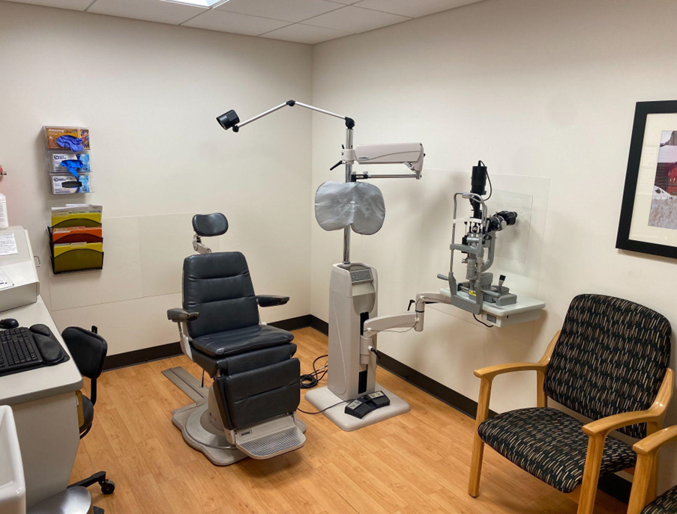
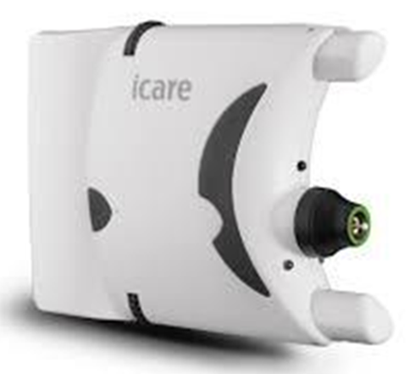

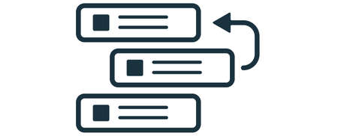
Icare Loaning Program

Slide 5
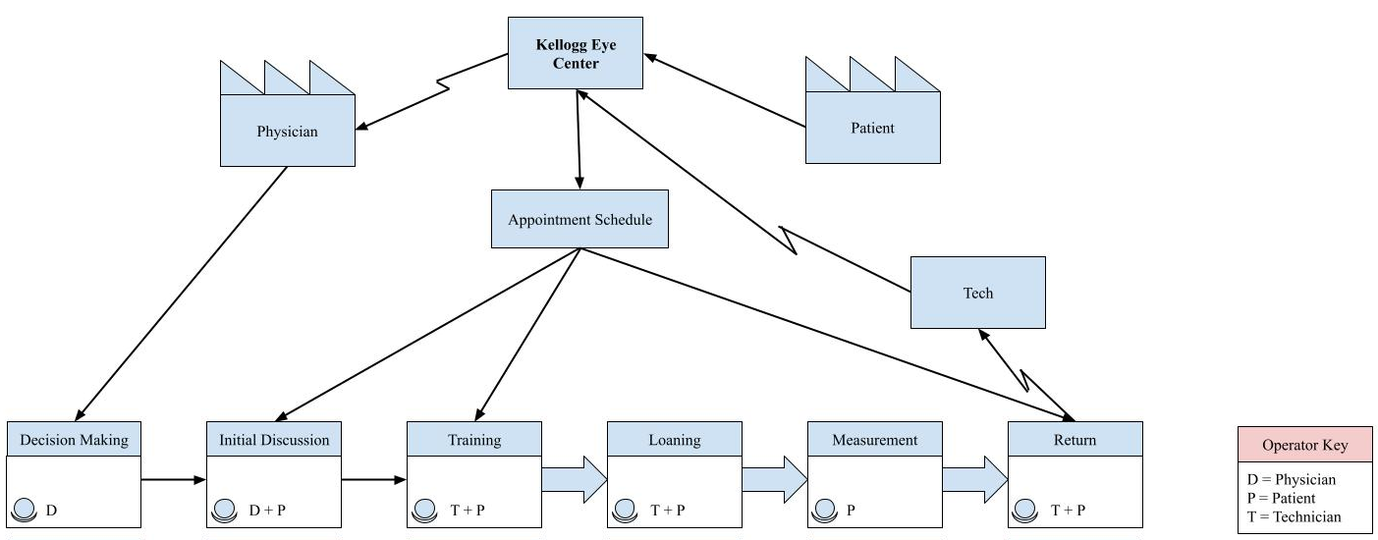


Value Stream Map- Quality Month Poster
Notes:
Value Stream Map

Slide 6





Analysis and Interventions to improve

Slide 7
Estimating Cost of Current Utilization
 | EXAMPLE
 | Date | Patient Count | Patient Waitlist | Recommended Devices | Device Cost | Probe Count | Probe Tracker | Probe Box Purchase | Probe Cost | Technician Time | Technician Cost | Total Cost
 | March-20 | 4 | 16 | 4 | $0.00 | 8 | 8 | 0 | $7.84 | 2 | $42.94 | $42.94
 | April-20 | 4 | 15 | 4 | $0.00 | 8 | 16 | 0 | $7.84 | 2 | $42.94 | $50.78
 | May-20 | 7 | 14 | 4 | $0.00 | 14 | 30 | 0 | $13.72 | 3.5 | $75.15 | $88.87
 | June-20 | 8 | 13 | 5 | $1,995.00 | 16 | 46 | 0 | $15.68 | 4 | $85.88 | $2,096.56
 | FORMULAS | Drag and drop down previous cell formula
 | INPUTS | Insert most recent patient and waitlist data
PARAMETERS
Item | Cost
HOME 1 device | $1,995.00
HOME 3 pack | $5,600.00
HOME 10 pack | $14,950.00
HOME device (10+ purchases) | $1,495.00
CLINIC software/device/year | $69.00
Probe box (50 probes/box) | $49.00
Technician Salary | $45,000.00
Technician Hourly Rate | $21.47

Slide 8
Future Modeling and Scalability
 | INSTRUCTIONS
 | This modeling tool forecasts future financial costs for the iCare Home program
 | Future cost analyses may be performed with the collected data
 | Additional information is provided within the example section
Date | Patient Count | Patient Waitlist | Recommended Devices | Device Cost | Probe Count | Probe Tracker | Probe Box Purchase | Probe Cost | Technician Time | Technician Cost | Total Cost
March-22 | 4 | 16 | 4 | $0.00 | 8 | 8 | 0 | $7.84 | 2 | $42.94 | $42.94
April-22
May-22

Slide 9
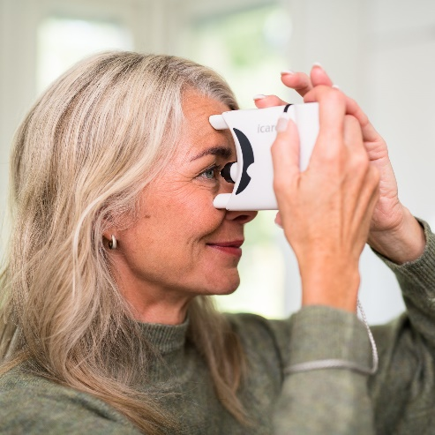
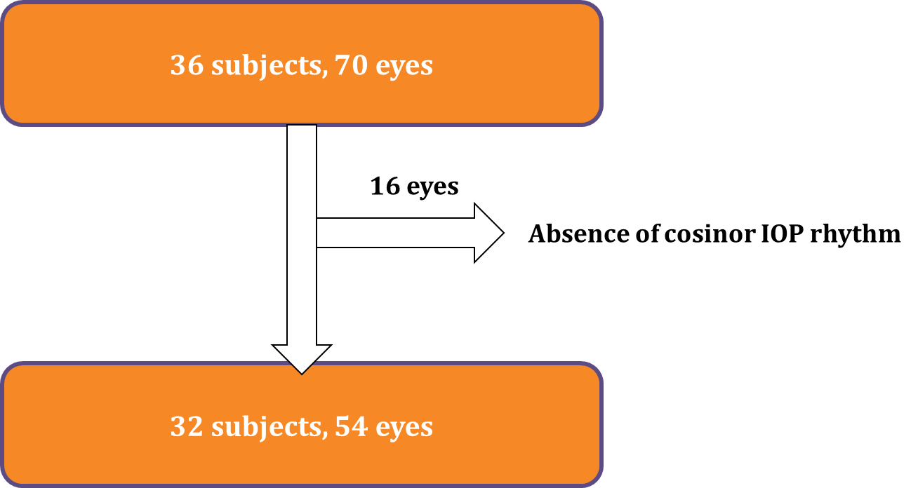
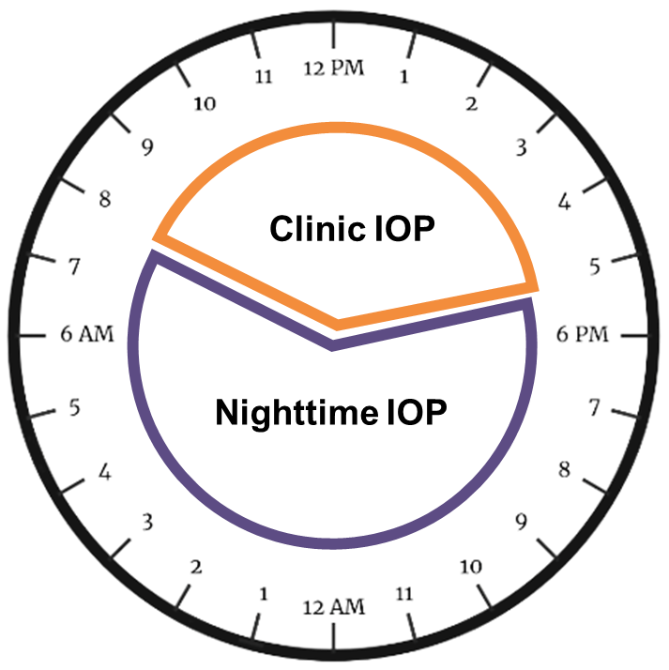
Icare HOME Retrospective Cohort Study-2 Academic Sites

Slide 10
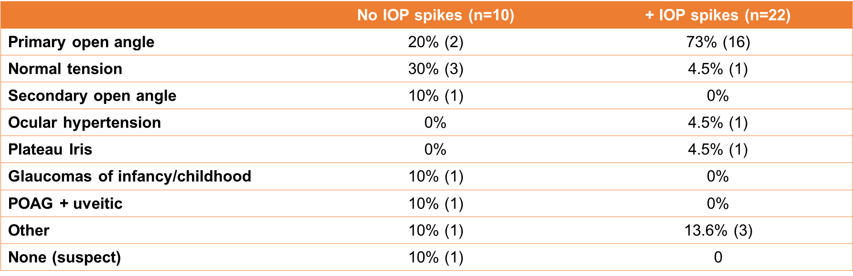

Slide 11
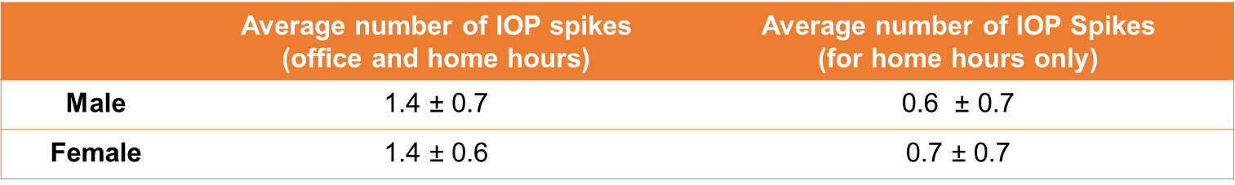
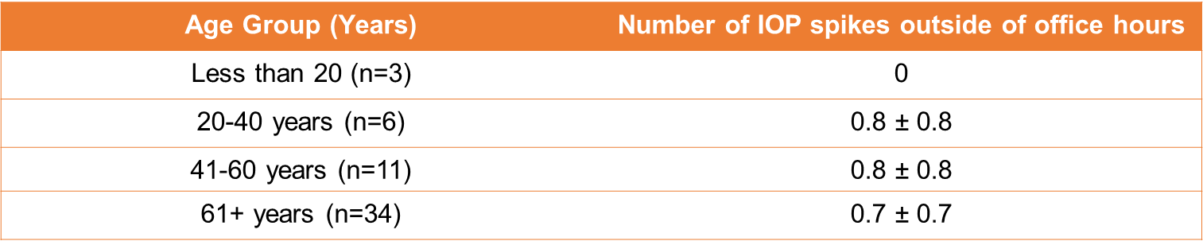

Slide 12
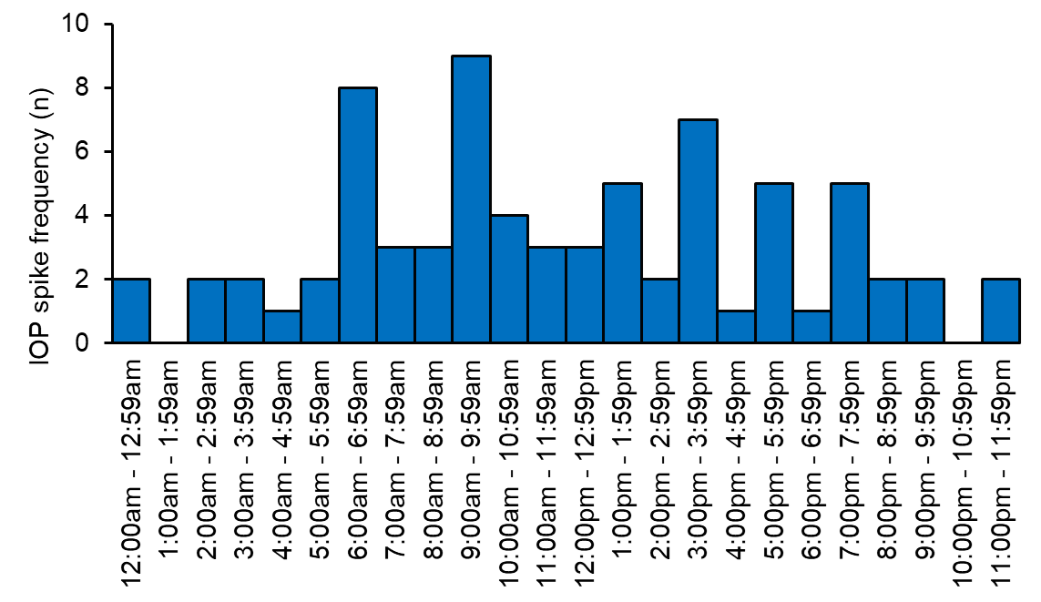



Home hours

Slide 13
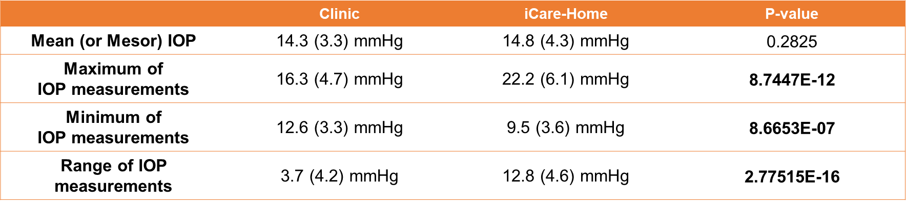
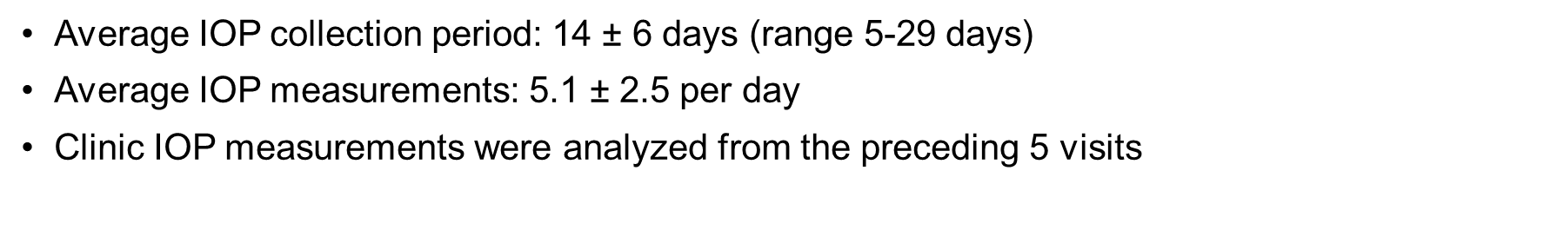
Notes:
Clinic IOP measurements were analyzed from the preceding 5 visits at maximum and included
3.3 ± 1.7 measurements per patient.

Slide 14
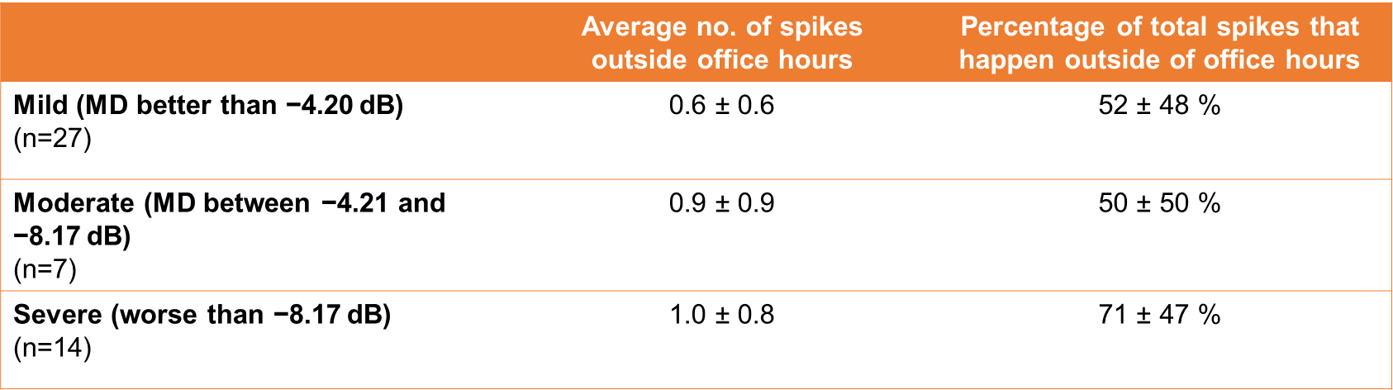
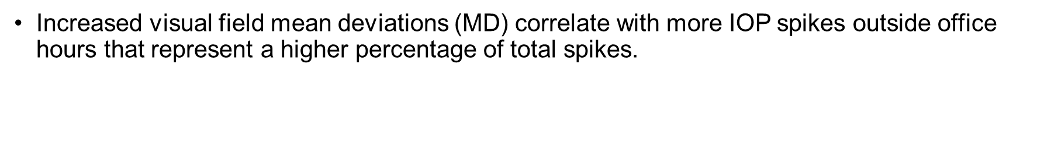
Notes:
n = number of eyes (not patients)
MD categorization based on https://www.ncbi.nlm.nih.gov/pmc/articles/PMC3171256/

Slide 15
Icare Home in Glaucoma Care
Guidelines for how patients should be measuring IOPs at home
  Frequency – at least every 2-4 hours, 5 days per week
  Timing – emphasis on early morning and nighttime measurements
Utility in telemedicine
Future studies should aim to evaluate:
  Patient subpopulations most likely to benefit from home tonometry?
  Ease of use of home tonometer for patients?
  Extended home IOP measurement collection period?
Notes:
Home tonometry shows promise in glaucoma management that may guide clinical practice, especially in patients with more severe disease. This was slightly different than the data presented by Liu et al.

