Slide 1
PO121 Home Tonometry Identifies Fluctuations in IOP Outside of Clinic Hours That May Guide Management of Glaucoma
Pariyamon Thaprawat, BS¹, Aysenur Musaogullari, BS², David M Reed PhD³, Amy D Zhang, MD¹, Andrea K Sawchyn, MD³, Sayoko E Moroi MD PhD³
¹ Department of Ophthalmology and Visual Sciences, University of Michigan, Kellogg Eye Center, Ann Arbor, MI USA
² The University of Chicago Pritzker School of Medicine, Chicago, IL USA
³ Department of Ophthalmology and Visual Sciences, The Ohio State University Wexner Medical Center, Columbus, OH USA

Slide 2
Financial Disclosure
Presenter: Pariyamon Thaprawat
I have no financial disclosures.

Slide 3
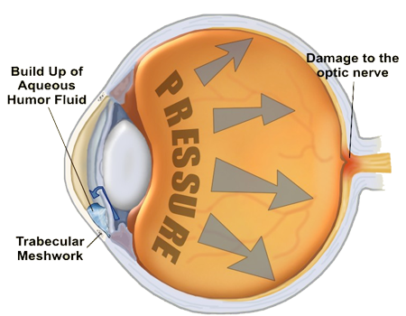
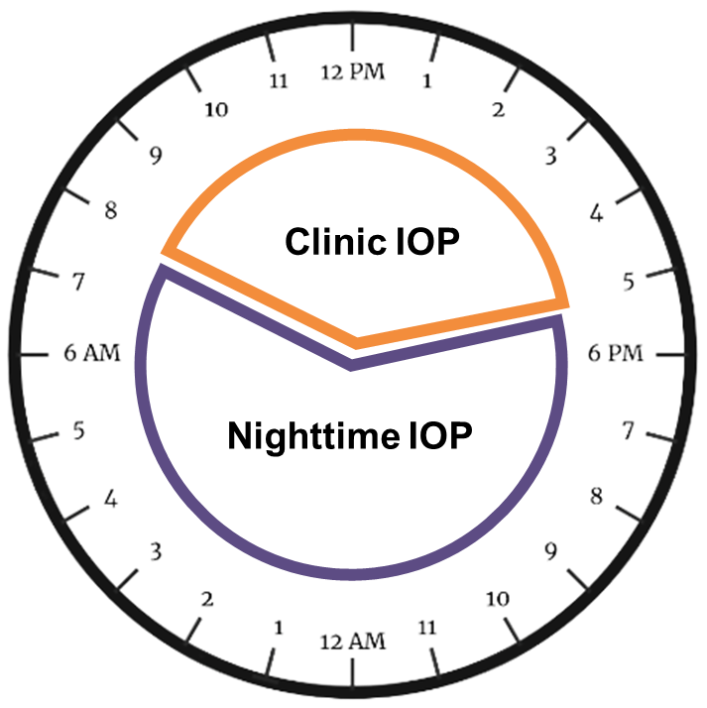
Background
Glaucoma is a group of eye diseases that results in damage to the optic nerve resulting in progressive vision loss.
Elevated intraocular pressure (IOP) is monitored for disease detection and progression, but IOP fluctuates throughout the course of a day in a circadian pattern¹.
Home tonometry allows for more IOP measurements to be accurately captured throughout the day²⁻⁵.
https://www.subpng.com/png-3v9cvl/
Our goal was to compare IOP measured using home tonometry to in-clinic tonometry to evaluate its utility in disease management for glaucoma patients.
Notes:
Glaucoma is a group of eye diseases that results in damage to the optic nerve resulting in progressive vision loss.
Elevated intraocular pressure (IOP) is a major risk factor and disease detection or management is clinically evaluated through IOP measurements.
However, IOP fluctuates throughout the course of a day in a circadian pattern¹ that cannot be captured by a single clinic IOP measurement.
This means that IOPs are usually highest in the early morning and lowest in late evenings
Home tonometry allows for more IOP measurements to be accurately captured throughout the day²⁻⁵.
Our goal was to compare IOP measured using home tonometry to in-clinic tonometry to evaluate its utility in disease management for glaucoma patients.

Slide 4
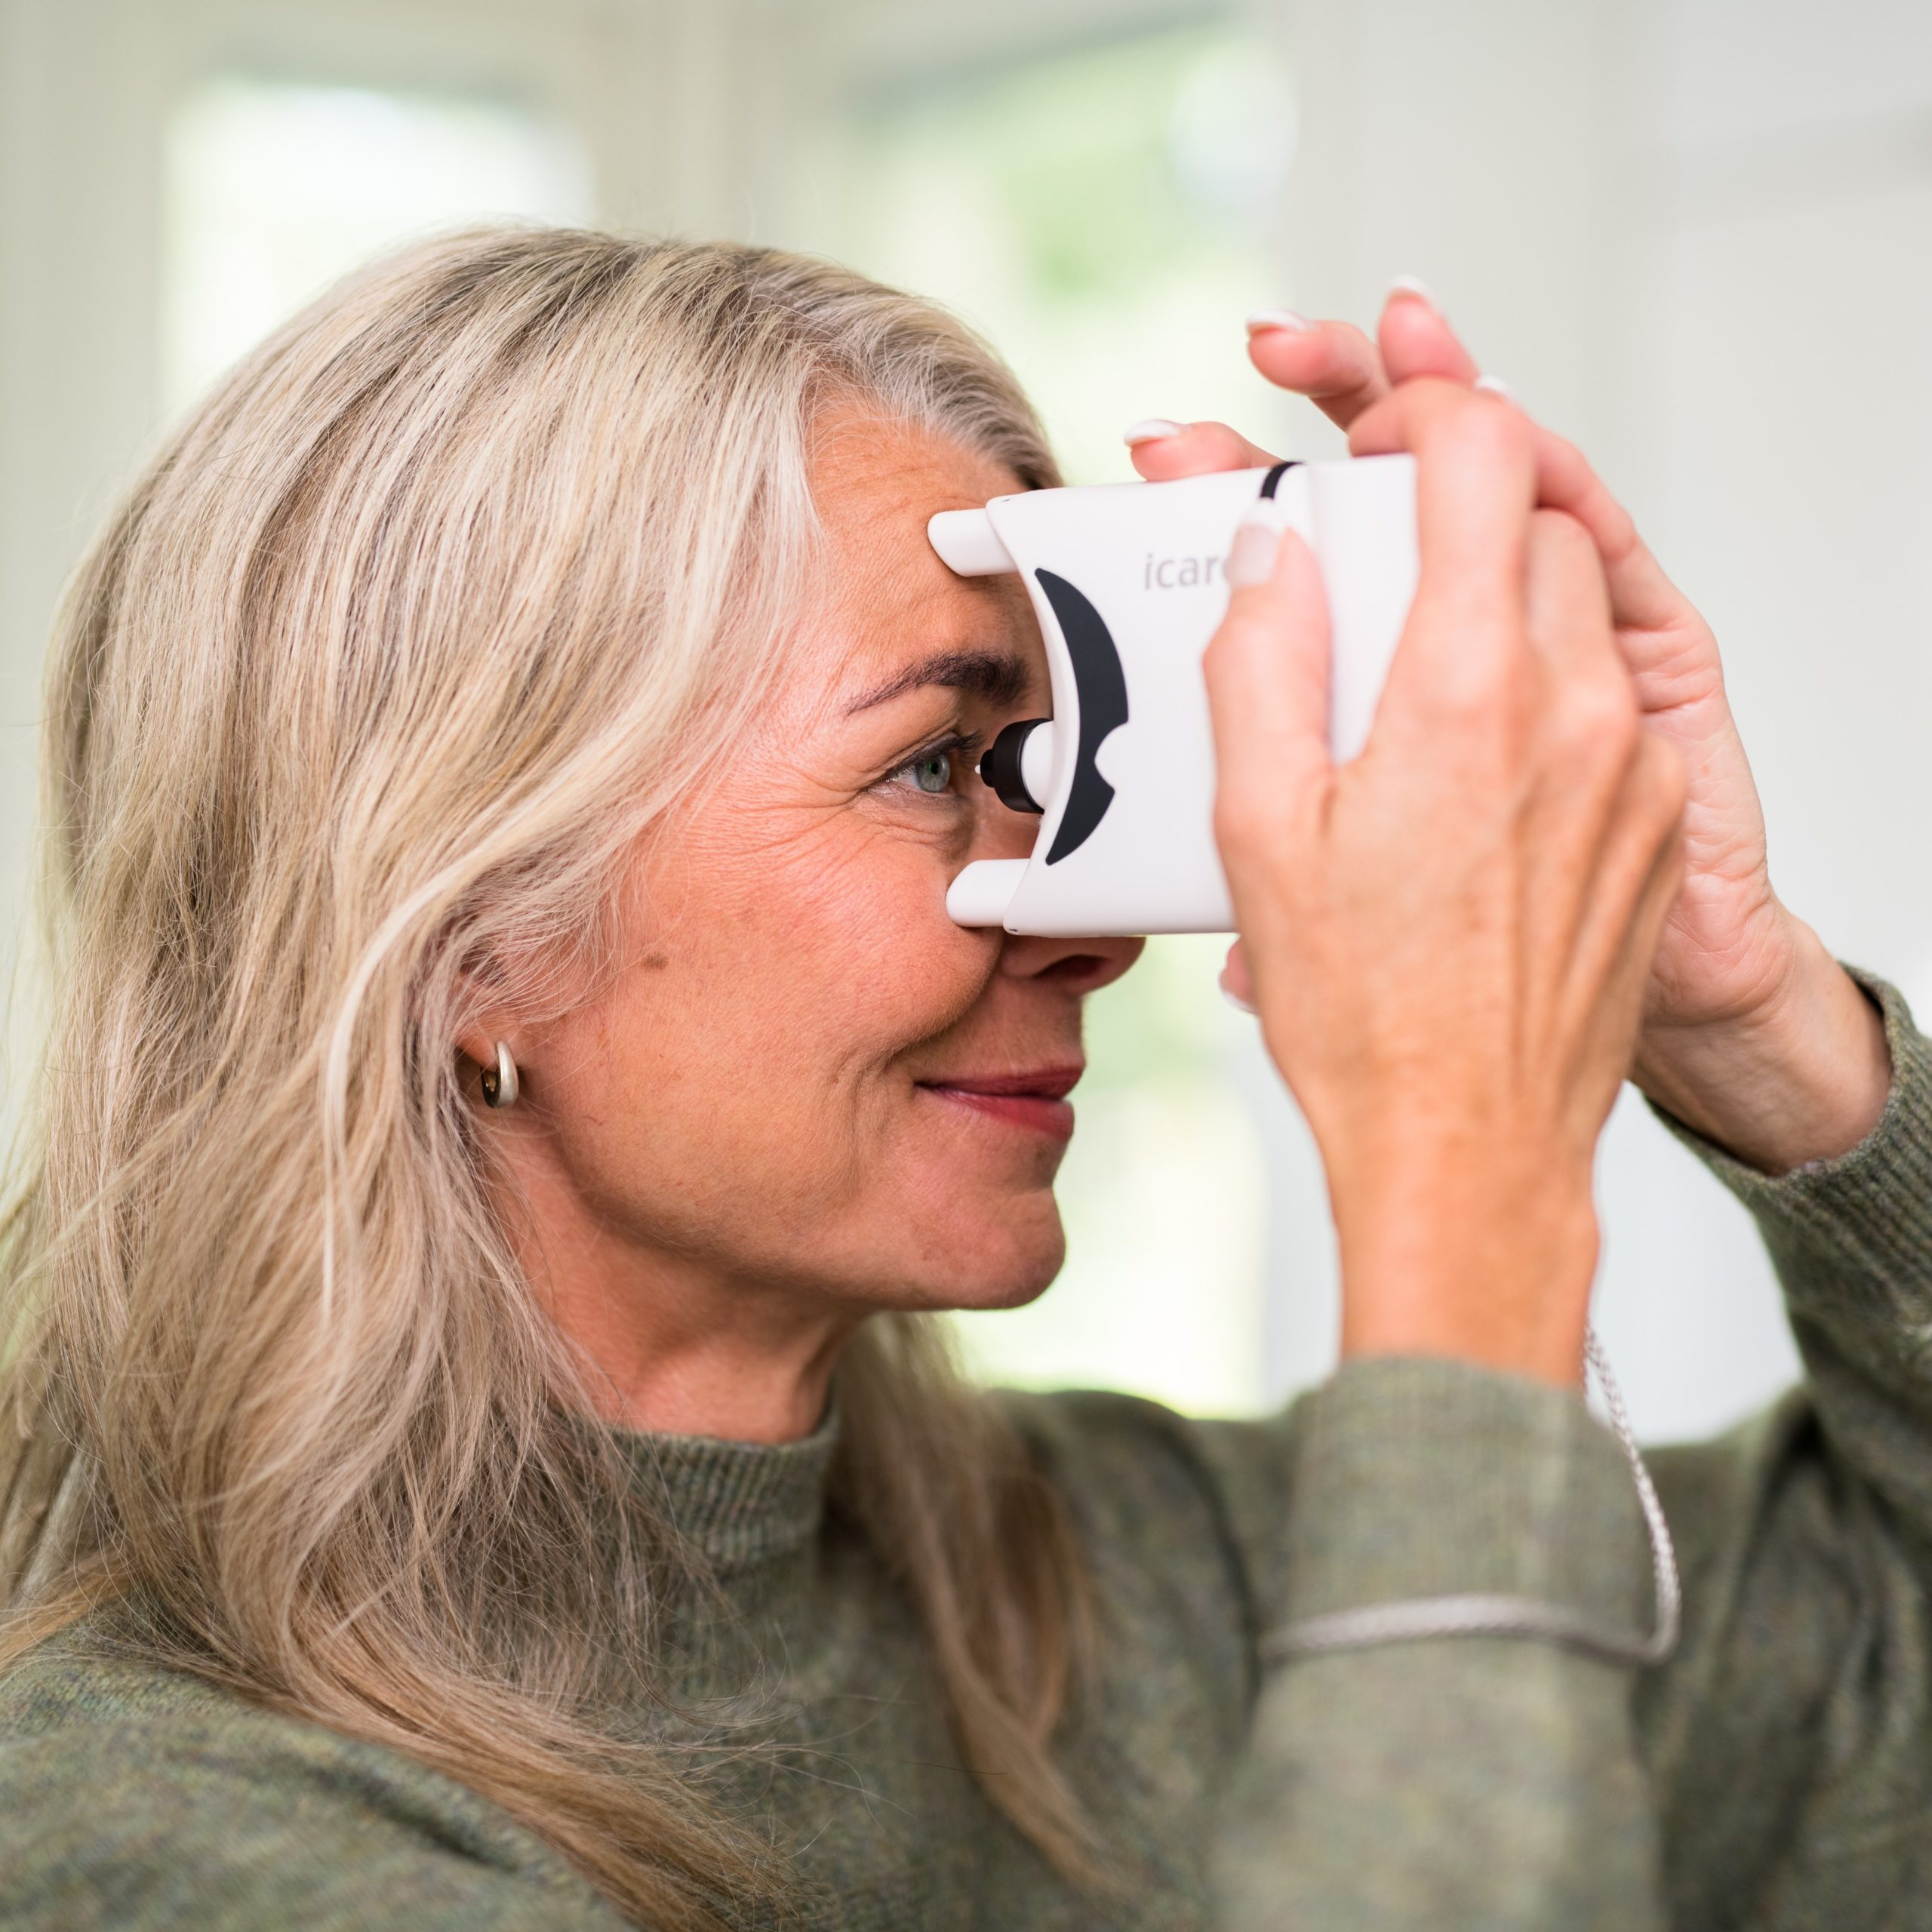
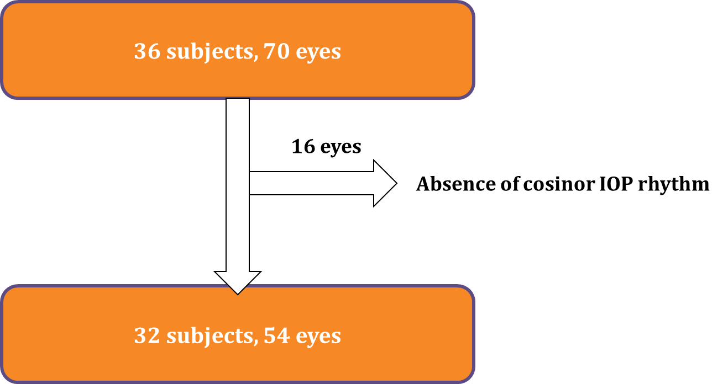
Methods and Materials
Retrospective cohort study of glaucoma patients using I-Care Home tonometry compared to in-clinic Goldman tonometry. Cosinor rhythmic analysis⁶ was used to determine circadian pattern of IOP*.
https://www.icare-world.com/product/icare-home-tonometer/
Koukkari WL et al, 2006
*PO153 for details on our cosinor analysis
Notes:
Potential questions: Why cosinor analysis vs. other methods?
Cosinor rhythmometry is a commonly used method to study periodic functions associated with circadian biological rhythms.
Why were 16 eyes eliminated? – data points did not fit into a cosine curve for analysis (cosine curve daily, then averaged for best fit curve)

Slide 5
Glaucoma types and IOP spikes
 | No IOP spikes (n=10) | + IOP spikes (n=22)
Primary open angle | 20% (2) | 73% (16)
Normal tension | 30% (3) | 4.5% (1)
Secondary open angle | 10% (1) | 0%
Ocular hypertension | 0% | 4.5% (1)
Plateau Iris | 0% | 4.5% (1)
Glaucomas of infancy/childhood | 10% (1) | 0%
POAG + uveitic | 10% (1) | 0%
Other | 10% (1) | 13.6% (3)
None (suspect) | 10% (1) | 0
No IOP spikes on either eye outside office hours
1 or more IOP spikes outside office hours on at least one eye
Notes:
Our study participants represented a variety of glaucoma types shown in this table and we evaluated the number of IOP spikes that occurred outside office hours in each type.
- You can see that the occurrence of spikes outside of clinic is not a unique characteristic of any single glaucoma type, but rather our data highlights that IOP spikes at home can occur across the spectrum of glaucoma patients.

Slide 6
Relationship between IOP spikes and patient:
 | Average number of IOP spikes (office and home hours) | Average number of IOP Spikes (for home hours only)
Male | 1.4 ± 0.7 | 0.6 ± 0.7
Female | 1.4 ± 0.6 | 0.7 ± 0.7
Gender:
Age Group (Years) | Number of IOP spikes outside of office hours
Less than 20 (n=3) | 0
20-40 years (n=6) | 0.8 ± 0.8
41-60 years (n=11) | 0.8 ± 0.8
61+ years (n=34) | 0.7 ± 0.7
Age:
Notes:
n = number of eyes (not patients)
We also looked at the relationship between home IOP spikes and patient gender or age.
- We found no statistical differences between either gender or age, again highlighting that home IOP spikes may be happening in both males & females, and across patient age groups.

Slide 7
Home tonometry identified higher maximum and minimum IOPs
 | Clinic | iCare-Home | P-value
Mean (or Mesor) IOP | 14.3 (3.3) mmHg | 14.8 (4.3) mmHg | 0.2825
Maximum of IOP measurements | 16.3 (4.7) mmHg | 22.2 (6.1) mmHg | 8.7447E-12
Minimum of IOP measurements | 12.6 (3.3) mmHg | 9.5 (3.6) mmHg | 8.6653E-07
Range of IOP measurements | 3.7 (4.2) mmHg | 12.8 (4.6) mmHg | 2.77515E-16
Average IOP collection period: 14 ± 6 days (range 5-29 days)
Average IOP measurements: 5.1 ± 2.5 per day
Clinic IOP measurements were analyzed from the preceding 5 visits
Notes:
Clinic IOP measurements were analyzed from the preceding 5 visits at maximum and included
3.3 ± 1.7 measurements per patient.

Slide 8
When did IOP spikes occur?
Home hours
Clinic hours
Home hours
69% (22 patients) had at least one IOP max. outside office hours (8AM -5PM)
62.5% (20 patients) had IOPs that only spiked outside office hours on at least one of their eyes
Notes:
Star = highlighting that early morning hours/spikes missed without home tonometry outside clinic hours
Consider different times for in-clinic visits (AM vs. PM appointments)

Slide 9
Home IOP spikes and glaucoma disease severity
 | Average no. of spikes outside office hours | Percentage of total spikes that happen outside of office hours
Mild (MD better than −4.20 dB) (n=27) | 0.6 ± 0.6 | 52 ± 48 %
Moderate (MD between −4.21 and −8.17 dB) (n=7) | 0.9 ± 0.9 | 50 ± 50 %
Severe (worse than −8.17 dB) (n=14) | 1.0 ± 0.8 | 71 ± 47 %
Increased visual field mean deviations (MD) correlate with more IOP spikes outside office hours that represent a higher percentage of total spikes.
Notes:
n = number of eyes (not patients)
MD categorization based on https://www.ncbi.nlm.nih.gov/pmc/articles/PMC3171256/

Slide 10
Discussion
Home tonometry shows promise in glaucoma management that may guide clinical practice, especially in patients with more severe disease.
Guidelines for how patients should be measuring IOPs at home
  Frequency – at least every 2-4 hours, 5 days per week
  Timing – emphasis on early morning and nighttime measurements
Utility in telemedicine
Future studies should aim to evaluate:
  Patient subpopulations most likely to benefit from home tonometry?
  Ease of use of home tonometer for patients?
  Extended home IOP measurement collection period?
Notes:
Which times/how many measurements are required (once q2-4 hours ~6-12 per day, at least 5 days a week, ~60-80 measurements per week)

Slide 11
References
Ciulla L, Moorthy M, Mathew S, et al. Circadian Rhythm and Glaucoma: What do We Know?. J Glaucoma. 2020;29(2):127-132. doi:10.1097/IJG.0000000000001402
Mudie LI, LaBarre S, Varadaraj V, et al. The Icare HOME (TA022) Study: Performance of an Intraocular Pressure Measuring Device for Self-Tonometry by Glaucoma Patients. Ophthalmology. 2016;123(8):1675-1684. doi:10.1016/j.ophtha.2016.04.044
Ogle JJ, Soo Hoo WC, Chua CH, Yip LWL. Accuracy and Reliability of Self-measured Intraocular Pressure in Glaucoma Patients Using the iCare HOME Tonometer. J Glaucoma. 2021;30(12):1027-1032. doi:10.1097/IJG.0000000000001945
Sood V, Ramanathan US. Self-Monitoring of Intraocular Pressure Outside of Normal Office Hours Using Rebound Tonometry: Initial Clinical Experience in Patients With Normal Tension Glaucoma. J Glaucoma. 2016;25(10):807-811. doi:10.1097/IJG.0000000000000424
McGlumphy EJ, Mihailovic A, Ramulu PY, Johnson TV. Home Self-tonometry Trials Compared with Clinic Tonometry in Patients with Glaucoma. Ophthalmol Glaucoma. 2021;4(6):569-580. doi:10.1016/j.ogla.2021.03.017
Cornelissen G. Cosinor-based rhythmometry. Theor Biol Med Model. 2014;11:16. Published 2014 Apr 11. doi:10.1186/1742-4682-11-16

