Slide 1
Characterizing Spatial Relationships of the Interannual Variability of CMIP6 Carbon Flux Data
December 9th, 2021
Engineering Honors Capstone
Willa Tobin
Notes:
Hello, my name is Willa Tobin and I am a senior in the engineering honors program studying climate and space engineering with a concentration in meteorology and today I will be presenting my capstone project titled “Characterizing Spatial Relationships of the Interannual Variability of CMIP6 Carbon Flux Data”.

Slide 2

The Carbon Cycle
Branches/Leaves
GPP
AR
NBP
AR
Stems
HR
AR
Roots
Microbes
Notes:
The primary mechanisms for carbon exchange between the land and atmosphere are photosynthesis and respiration. Photosynthesis is the uptake of carbon by plants, and at the ecosystem scale is called gross primary production or GPP. Once atmospheric CO2 is biologically fixed, it can be respired by plants, which is known as autotrophic or AR, or dead organic matter can be decomposed by bacteria and fungi in the soil which is known as heterotrophic or HR. The net carbon flow into the land is defined as net biospheric productivity or NBP. NBP is denoted by a double headed arrow because it is highly spatially variable. We define NBP as positive when the net carbon flow is into the land and negative when the net carbon flow is into the atmosphere.

Slide 3
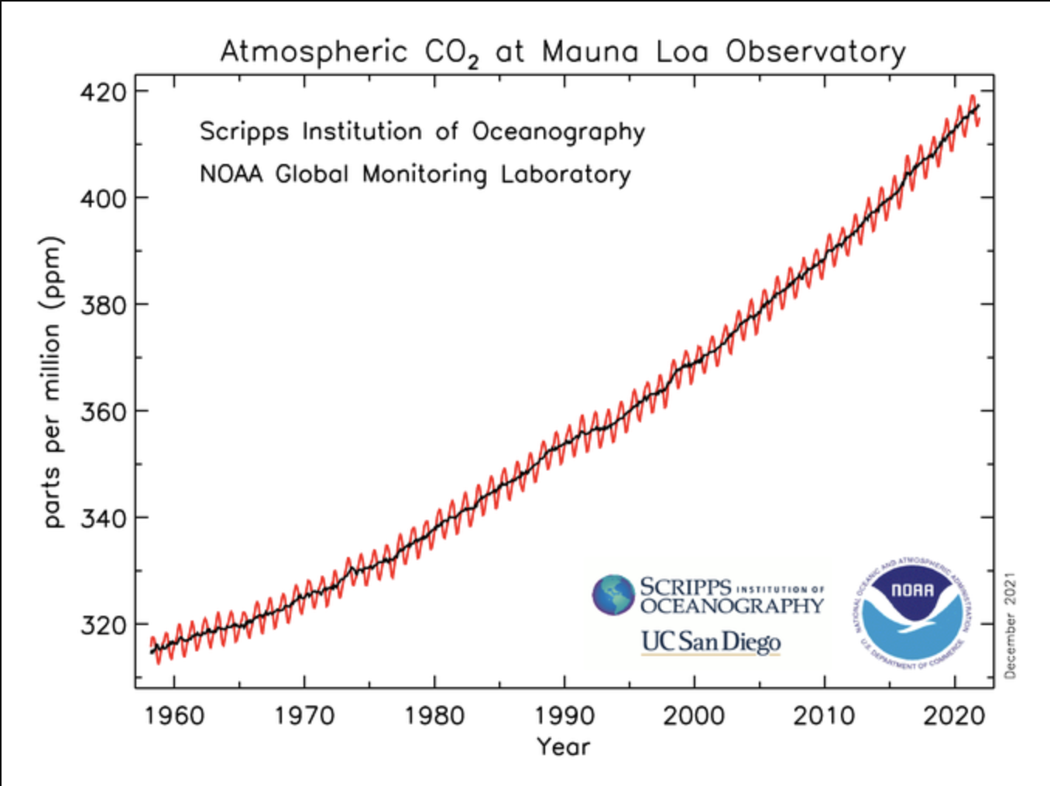
Notes:
In 2020, 31.6 Pg of CO2 was released into the atmosphere due to anthropogenic sources. About 50% of this is taken up by natural carbon sinks and as a result atmospheric CO2 levels increase by 2.6 ppm from 2019 to 2020. This figure is showing atmospheric CO2 observations measured in Hawaii dating back to 1960, and as you can see concentrations of CO2 in the atmosphere has been steadily increasing every year. NOAA reported 2020 as the second warmest year on record, with a temperature anomaly of 1 oC above the 20th century average. We know that greenhouse gases lead to warming surface temperatures, but recent studies have also shown that temperature anomalies are impacting the net carbon flux.
Understanding the mechanism controlling the net carbon land sink is becoming increasingly important as our environment is forced to adapt to growing levels of carbon dioxide in the atmosphere.
Sources: https://ourworldindata.org/co2-emissions
https://sos.noaa.gov/catalog/datasets/ocean-atmosphere-co2-exchange/#:~:text=to%20Notable%20Features-,When%20carbon%20dioxide%20CO2%20is%20released%20into%20the%20atmosphere,certain%20areas%20of%20the%20ocean.
https://www.climate.gov/news-features/understanding-climate/climate-change-atmospheric-carbon-dioxide
https://www.climate.gov/news-features/understanding-climate/climate-change-global-temperature

Slide 4
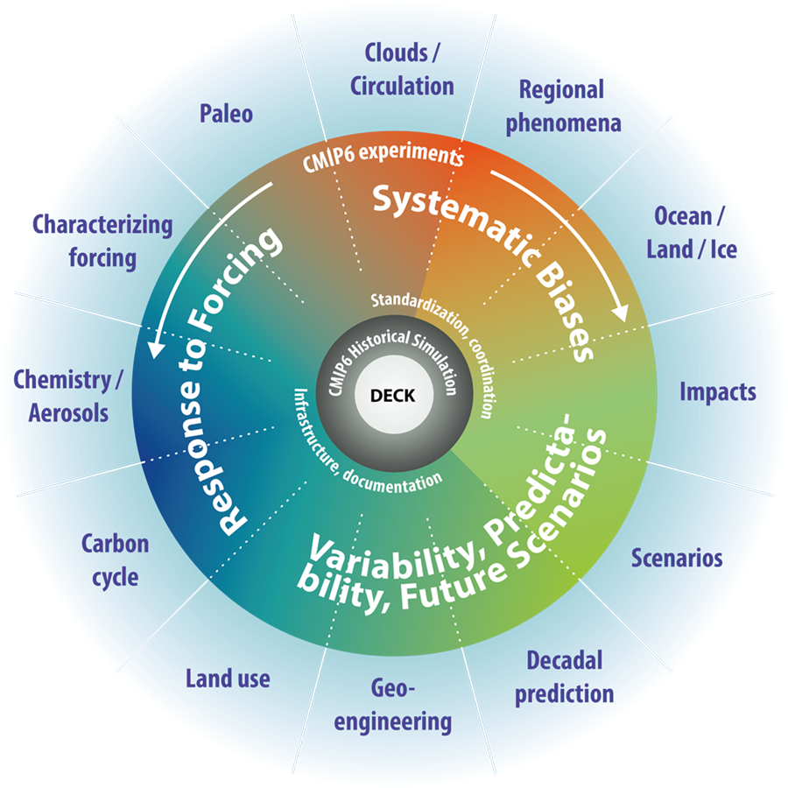
Earth System Models
Image source
Notes:
The data used in our study comes from five ESMs from the Coupled Model Intercomparison Project version 6 (CMIP6). The primary model used for our analysis is CESM2. Each CMIP6 model has slightly different parameterizations of earth system processes, so we are using a set of 5 models to account for any uncertainty in model simulations. For each model, we analyzed the last twenty years of the historical simulation (1995 to 2015) to focus on characterizing recent trends.

Slide 5
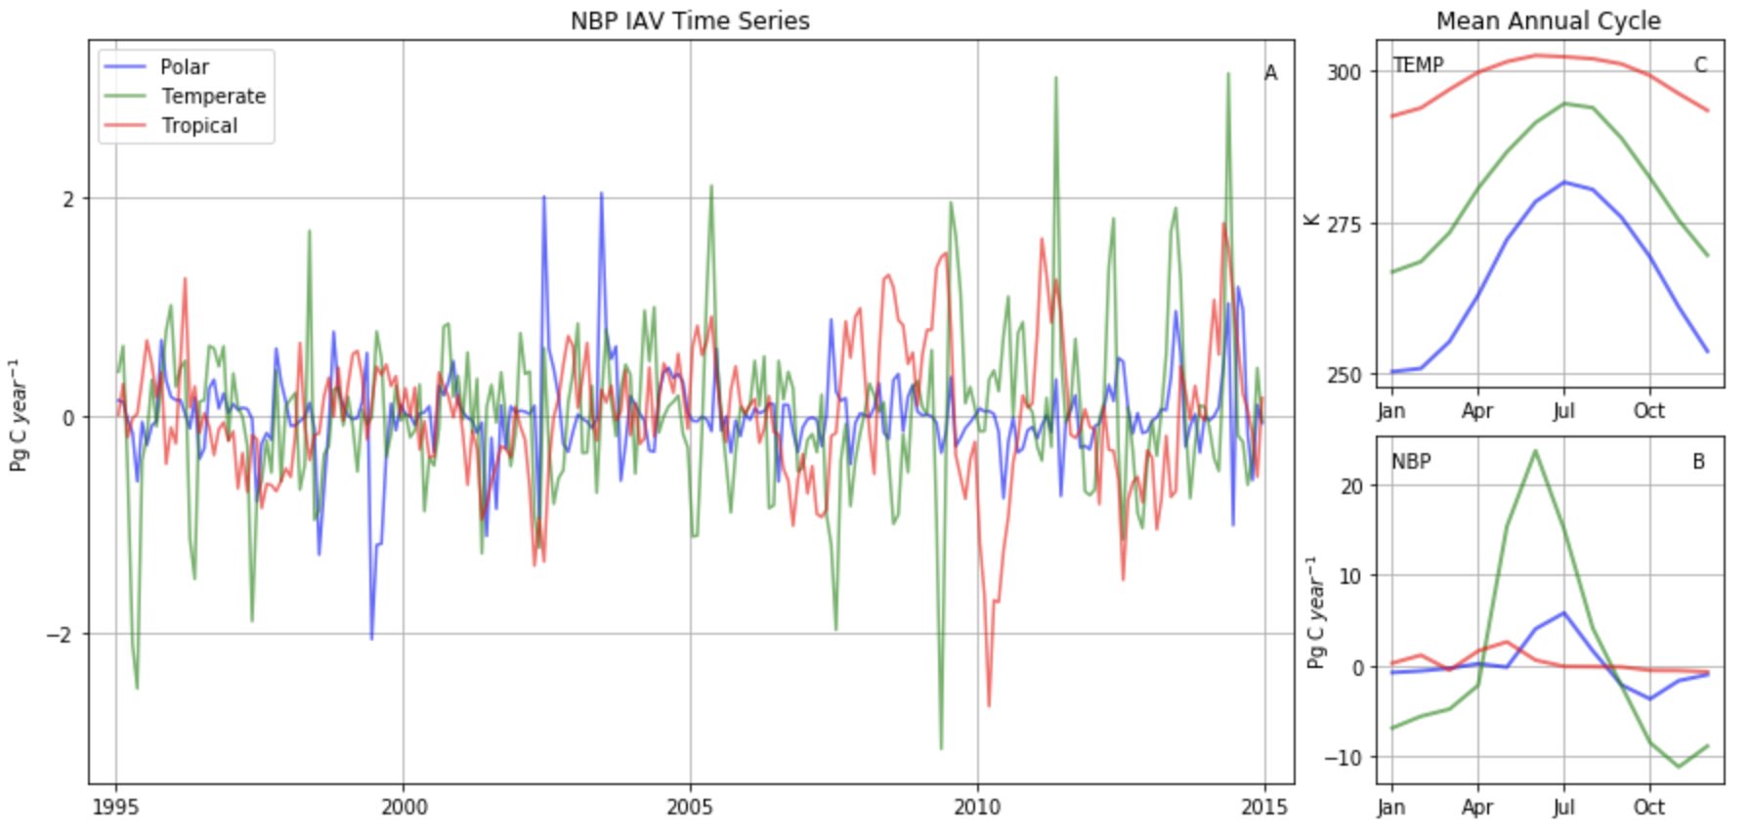
Notes:
Terrestrial carbon cycle fluxes show large variations on seasonal timescales and regional spatial scales. Panel A shows NBP data from CESM2 for a polar, temperate and tropical region with the long term and seasonal trends removed to highlight the interannual variability (IAV) of NBP for each region.
Panel B shows the seasonality of temperature for each region. In this panel we can see the summer peaks for the polar and temperate region, whereas the tropical region does not exhibit as strong of a seasonal cycle. These seasonal patterns are mirrored in the average monthly NBP for each zonal region in panel C. There have been multiple studies illustrating the dependence of the tropical carbon cycle on the interannual variability of temperature due to the response of carbon fluxes to temperature anomalies (Want et al., 2012). Here, we will expand this analysis to polar and temperate regions to characterize how temperature and the previously mentioned carbon fluxes are coupled.

Slide 6
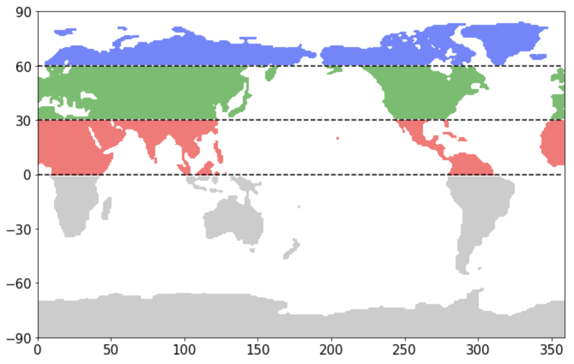
Region Boundaries
Notes:
The data output from the historical simulations is globally gridded monthly data. For simplicity, we are only using data from the northern hemisphere. We created three zonal regions to characterize polar, temperate, and tropical ecosystems and aggregated the data for each region at each time step to get one monthly value for each region. The latitude bounds for our three regions are 0 to 30 degrees for the tropical region in red, 30 to 60 degrees for the temperate region in green, and 60 to 90 degrees for the polar region in blue.

Slide 7
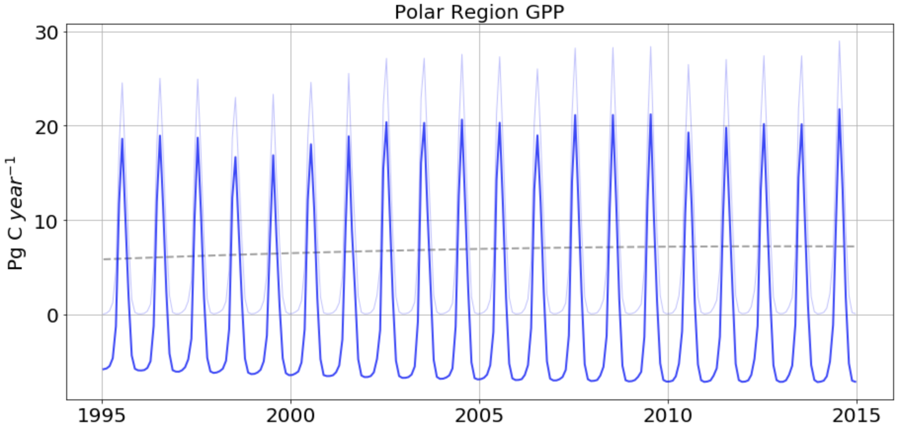
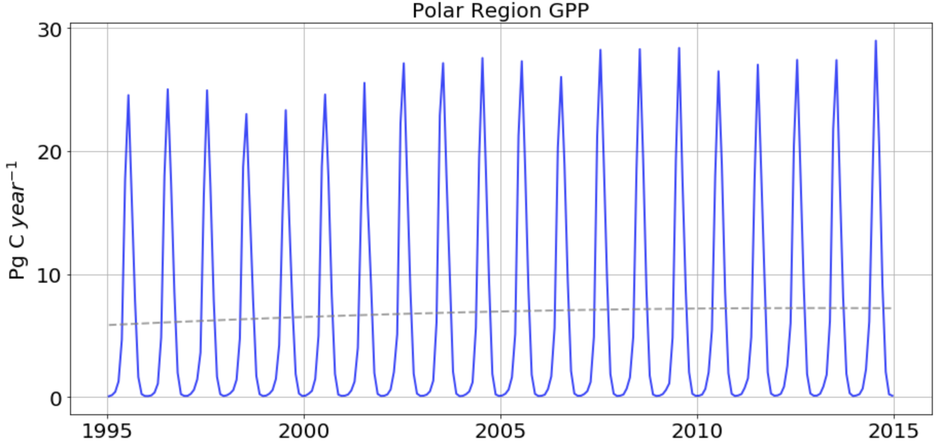
Long Term Trend
Notes:
The next step in our data processing was to remove the long term and seasonal trends to get to the interannual variability of each data set. To illustrate this process, I am using the GPP data from the polar region. The long term trend was removed by fitting a second order polynomial to the data and subtracting it from the original data set. As shown in the above figure with the grey dashed line representing the second order fitting. **CLICK** When we subtract the long term trend, we are centering the data around zero. GPP physically can’t be negative, but for the purposes of our analysis negative values are OK.

Slide 8
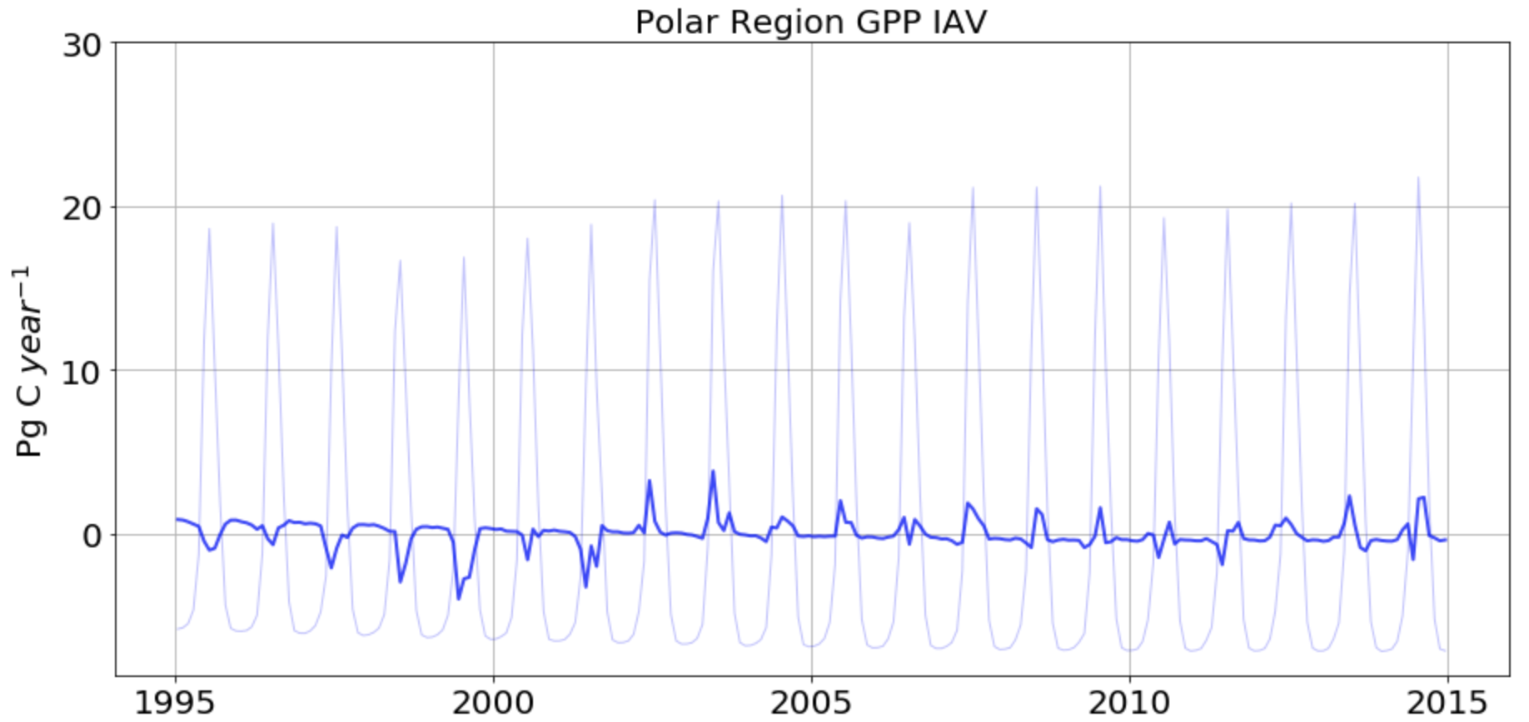
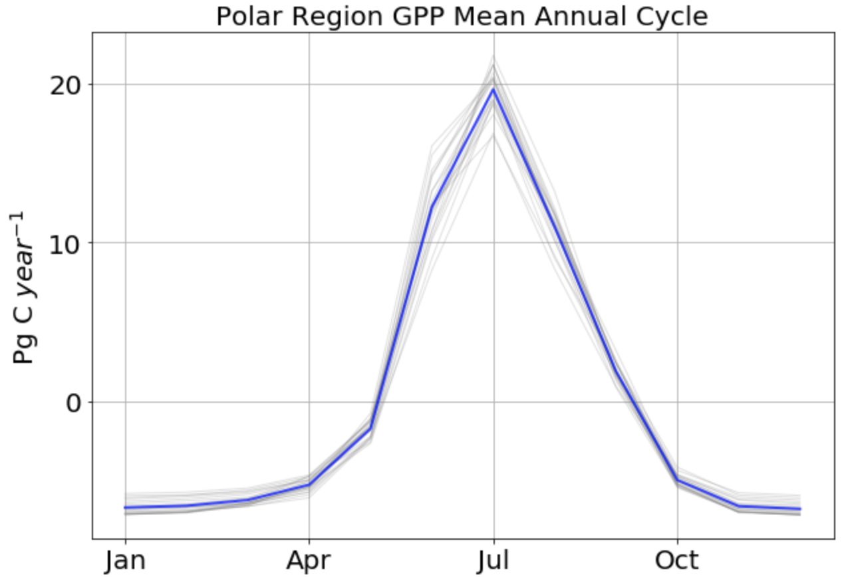
Seasonal Cycle
Notes:
The next component signal to deal with is the seasonal cycle. We removed the seasonal cycle from the detrended data sets by finding the monthly averages from 1995 to 2015. This figure shows each years GPP cycle plotted in grey and the 20 year average plotted in blue. This blue cycle was then subtracted from each each year. **CLICK** The light blue line shows the detrended time series from the previous slide, and the dark blue line shows the new time series with the seasonal cycle removed. An issue we ran into that is quite evident in this figure, is that after after removing the long term and seasonal trend, most of the data for the winter months was clustered around zero.

Slide 9
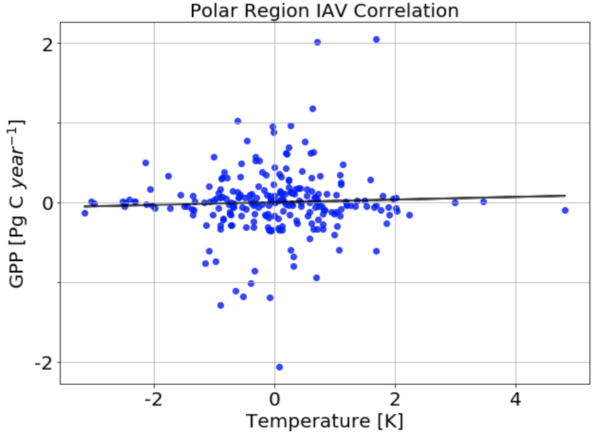
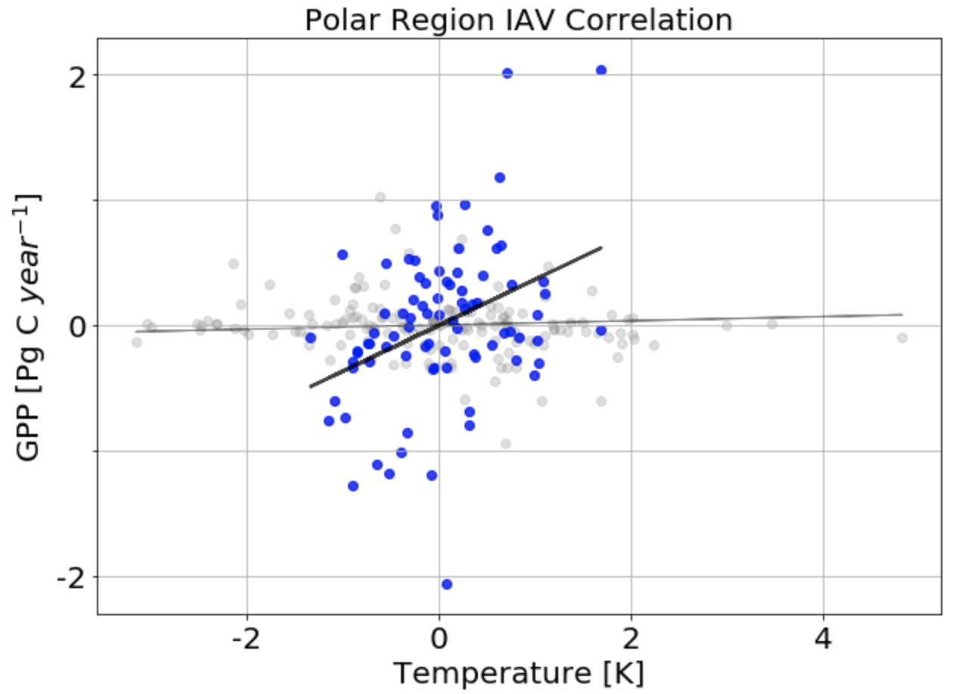
Growing Season
Notes:
The majority of the data being around zero for GPP as shown here underpredicted the relationship between GPP and temperature. The root of this problem comes from the models parameterizing vegetation to be dormant in the winter and therefore GPP and AR to be zero. We only want to consider months when the carbon cycle is active, so we defined a growing season as months with a zonal mean temperature above zero degrees celsius, and only considered data for those months. **CLICK** Removing the winter months from the data significantly increased the slope of the linear regression and highlights a stronger linear relationship between temperature and GPP for the polar region.

Slide 10
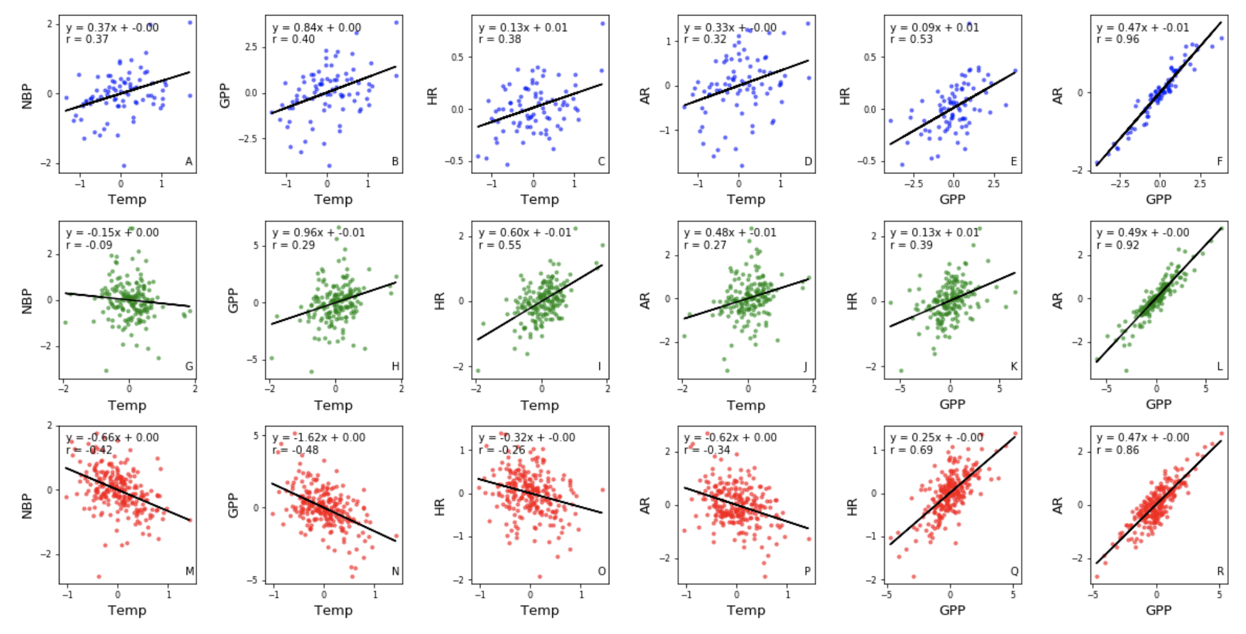
Notes:
We expanded this analysis to each variable paring and region. For this presentation, I will be focusing on the temperature and NBP relationship for each region.

Slide 11
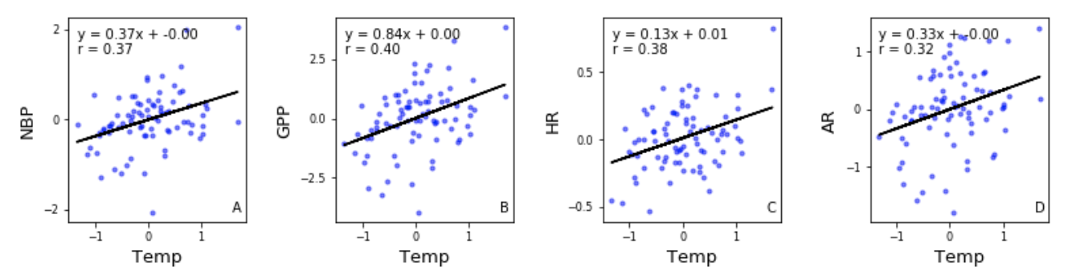
Polar Temperature Correlations
Notes:
The polar region is temperature limited, as ecosystems are dormant in the winter so carbon exchange is restricted to the summer months. For every 1 ºC increase in temperature, NBP increases by 0.37 Pg C year⁻¹ as seen in panel A. The positive couplings of each flux with temperature shows that even when only considering the growing season months with long term and seasonal trends removed, temperature still exhibits controls over carbon exchange. For the polar region, GPP increases approximately twice as much for each 1 ºC increase compared to total respiration (HR + AR) which is why we see a positive correlation between temperature and NBP.

Slide 12
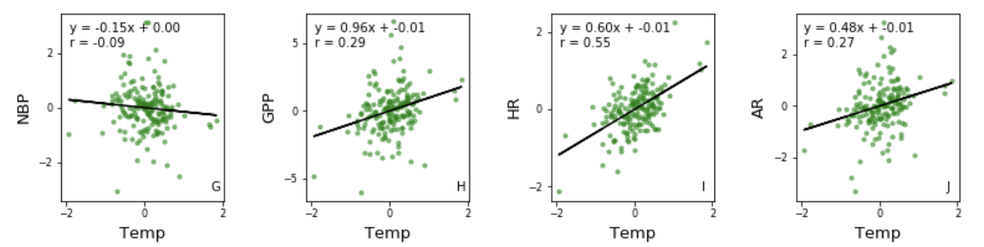
Temperate Temperature Correlations
Notes:
The net carbon flux of the temperate region is less dependent on temperature than the polar region. For every 1 ºC increase in temperature, NBP decreases by 0.15 Pg C year⁻¹ as seen in panel G. The sign of the correlation between temperature and the component carbon fluxes (GPP/HR/AR) is the same as in the polar region, but the NBP temperature correlation becomes negative. This is due to the impact of temperature on HR increasing more than on GPP when compared to the polar region.

Slide 13
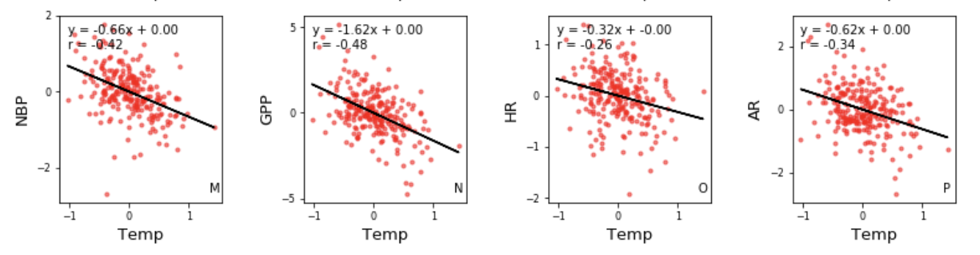
Tropical Temperature Correlations
Notes:
There is a dramatic change in the impact of temperature on each carbon flux for the tropical region compared to the polar and temperate regions. For every 1 ºC increase in temperature, NBP decreases by 0.66 Pg C year⁻¹. Increasing temperature now decreases the magnitude of each carbon flux. We speculate that this is because the mean temperature of the tropical region is close to the optimum temperature for photosynthesis, so increasing temperature will decrease plant productivity. Similar to the polar region, GPP decreases approximately double that of total respiration (HR + AR) for every 1 ºC increase.

Slide 14
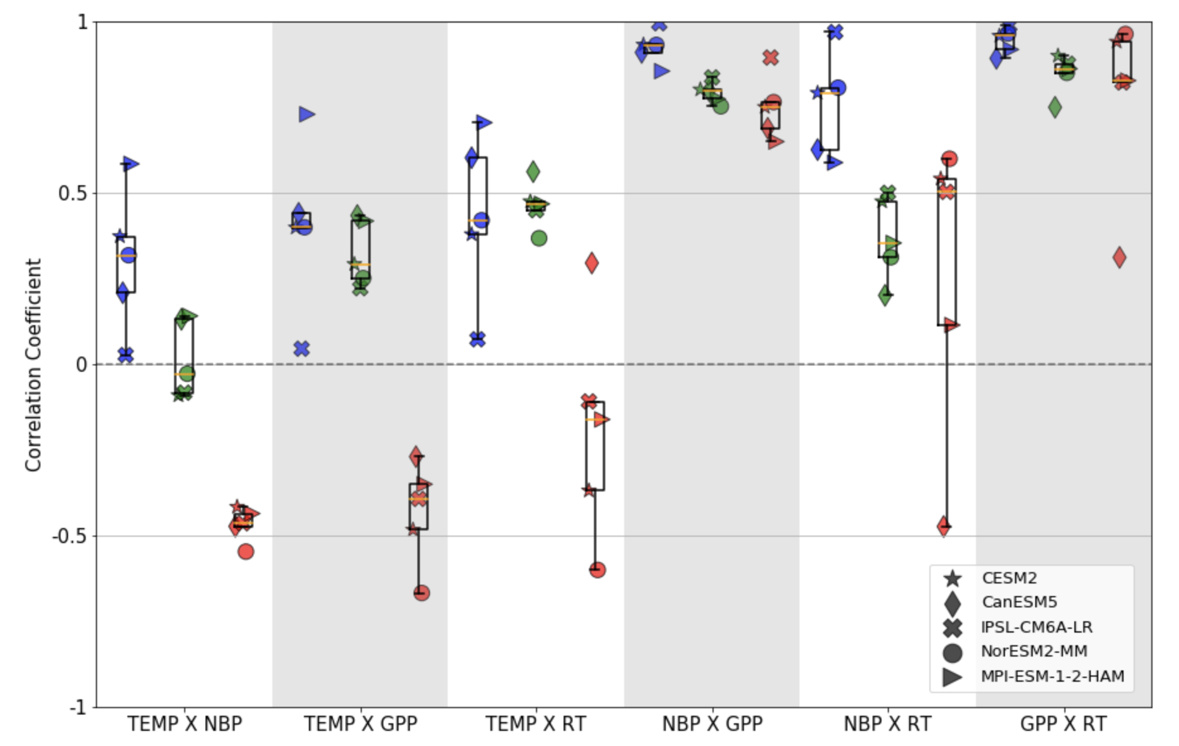
Notes:
When we bring in the other models, we get a better sense of the validity of our results. Five models is by no means an exhaustive list, but still gives us a range of values to provide some comparison. This figure condenses HR and AR into total respiration or RT. The variable pairing is listed on the x axis and correlation value on the y axis.
The models show the most agreement in correlation strength in the temperate region (max spread of 0.30), and the least agreement in the tropical region (max spread of 1.07).

Slide 15
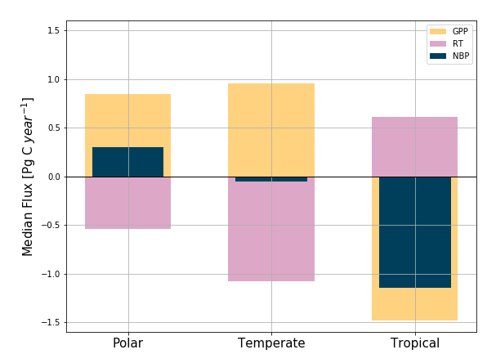
Notes:
Focusing on the first three columns, the models show modest positive correlations for temperature and GPP and temperature and RT for the polar and temperate regions. The slope of the linear fit of the median model for each temperature correlation is used in the figure on the right. For the temperate region, the temperature and GPP and temperature and RT fits have similar magnitude slopes shown in yellow and purple respectively in the right figure, which results in a net zero correlation for NBP shown in black in the right figure. The models show a larger spread in the polar and tropical regions correlation magnitudes for temperature and GPP and temperature and RT which results in a similar spread in magnitude for temperature and NBP. For the polar and tropical regions, the temperature and NBP correlations do not spread around zero. The polar region temperature correlations for each model have similar magnitudes, indicating that for each model, the slope of the linear temperature and GPP fit is approximately double the slope of the linear temperature and RT fit. This is illustrated in the figure on the right with the GPP median flux for the polar region of just under 1 Pg C/year and the RT median flux of 0.5 Pg C/year. The same can be said for the tropical region, with the exception of CanESM5 due to the outlier temperature and RT correlation.

Slide 16
Conclusions
Future Warming of 2 ºC
Increasing Polar Land Sink
Increasing Tropical Land Source
Notes:
Based on the relationships we have quantified, we can expect that a future warming scenario of 2 ºC would cause NBP to increase by 0.74 Pg C year⁻¹ in the polar region, decrease by 0.30 Pg C year⁻¹ in the temperate region, and decrease by 1.32 Pg C year⁻¹ for the tropical region. **CLICK**
Overall, the biosphere of the high latitudes becomes more of a carbon sink. **CLICK** The opposite is true for the lower latitudes. Warming temperatures increase respiration faster than production, enhancing the carbon source of the tropical biosphere. Since the polar regions are warming faster than the tropics, we can expect to see more of a change in the net land sink of the poles compared to the increase in the net source of the tropics.

Slide 17
Future Directions
Model Data Bias
Observational Data
Notes:
Using model data presents some bias in our results as each model has its own bias that influences our correlation values. We chose to use a model that showed results in the middle of the range to prevent over correlation of our variables. Our results also do not differentiate between correlations of the actual carbon fluxes and correlation between the mechanisms controlling the fluxes. **CLICK**
Being able to quantify the relationship between these variables will allow us to improve our modelling of the carbon cycle. Observational data sets play a key role in this as they provide a metric to compare model outputs to and provide accurate boundary/initial conditions from which to force the model. Carbon cycle fluxes can not be directly measured at large spatial scales which requires the use of models or upscaling methodologies. Our understanding of the dynamics at play for the IAV of the carbon cycle is limited, so quantifying how NBP, GPP, and RT are affected by each other and temperature will improve how we parameterize the carbon cycle in ESMs and strengthen the quality of our future climate projections.

Slide 18

Questions
Thank you for listening and a special thanks to my advisor, Professor Gretchen Keppel-Aleks, for supporting me and this project for the past two years!
Notes:
How did you get involved in this project?
I joined Professor Keppel-Aleks carbon cycle research team in the winter semester of my sophomore year. I was generally interested in the carbon cycle and wanted to learn more about how we model the carbon cycle. I was taking a course taught by Professor Keppel-Aleks and reached out after class to talk more about her research and if she had any projects I could work on. And now here we are!
What other paths could you have explored, or could other students/teams explore in the future on this project?
An aspect of this project that could be explored further is how future warming will influence heterotrophic respiration of the high latitudes. A large reservoir of carbon is held in the frozen soil of the high latitudes, which is known as permafrost. As temperatures rise and the permafrost layer diminishes, we expect to see heterotrophic respiration increase as the active soil layer thickens.
How do you hope to use what you learned from this project in your future career?
Three of the main things I learned from this project are a deeper knowledge of the carbon cycle, data analysis and visualization techniques in python, and technical communication. I will be working as a climate data scientist after graduation so all three of these skills will be valuable to me in my future career.

