Slide 1

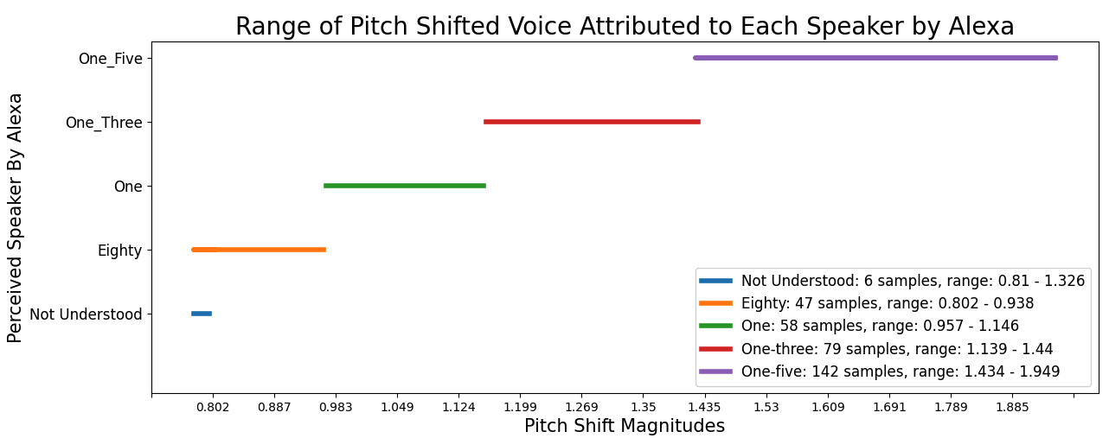
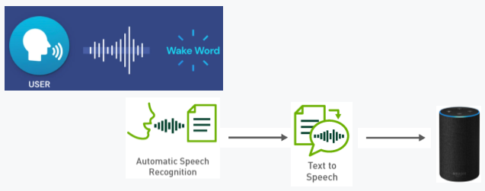
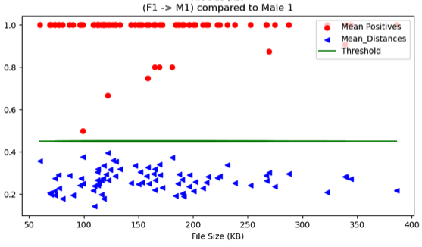
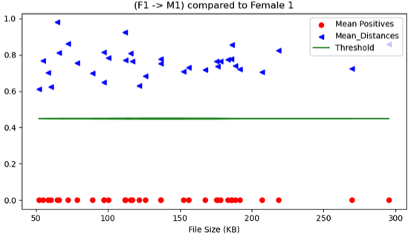
Mediators Allowing Users to Control
Amount of Information Given When Using Technology
Herbert Li (Honors Capstone)
Abstract
Technology can help tackle many issues, but technological innovation has outpaced our privacy protection. 94.9 million smart speakers, such as Amazon Alexa Echo and Google Home Assistant, are listening to us in our homes. People’s preferences, voices, and daily activities become accessible to other companies and sometimes are open to unwanted exploitation. To combat such an issue, I propose designing mediators with privacy preservation interventions to protect more of customers’ data when they interact with smart speakers.
Methods
1. Pitch shift: Register pitch shifted voices as different users, and randomly pitch shift users’ voice command in a reasonable range to have obfuscation.
2. External wake word & speech recognition & text to speech: activate mediator using external wakeword, and output transcribed user’s command in a different voice to Alexa.
3. External wake word & voice conversion: activate mediator using external wakeword and output converted user’s command using ML voice conversion methods.
Figure 1. Range of pitch shifts Alexa associates with each registered user
Figure 2. Apply external wakeword to activate mediator, conduct speech recognition and text to speech of users’ command in a different seletect voice. Combine stored “Alexa” wake word and command in the selected voice and output audio to Alexa device.
Objectives
1. Allow people to control when devices collect their information.
2. Hide users’ information but still allow users to interact with smart speakers’ virtual assistants.
3. Mimic functionalities such as personalization in a safer way.
Smart speakers send users’ spoken commands to the cloud without informing users explicitly, and sometimes can collect users’ data even when users’ did not say the wakeword. The goal is to find the balance between privacy preservation, computational power, and usability.
Implications
The mediator can help the National Institute of Standards and Technology determine reasonable criteria for privacy labels. Products with mechanisms implemented to preserve privacy following the discovered benchmark should receive privacy labels. Subsequently, customers can better discern products that protect their privacy, which helps motivate companies to implement privacy preservation mechanisms. If we gradually extend privacy labels to more spaces, privacy will no longer be just a bonus but a requirement and a human right.
Figure 3. Evaluation of converted voices from original voices and target voices.
Notes:
*Process flow needs what is moving for each arrow
Opportunity/Problem
•Goals/Objectives
•Experimental Design
•Process Design
•Research Findings
•Recommendations
/Proposed Solution(s)

