Slide 1
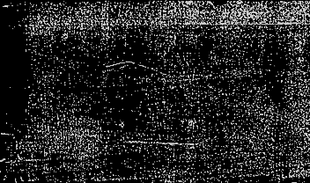

Opponent indifference in rating systems: a Theoretical Case for Sonas
Greg Bodwin and Forest Zhang

Slide 2


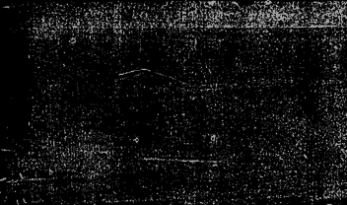
Motivation
What is a rating system?
Why be “opponent indifferent”?

Slide 3

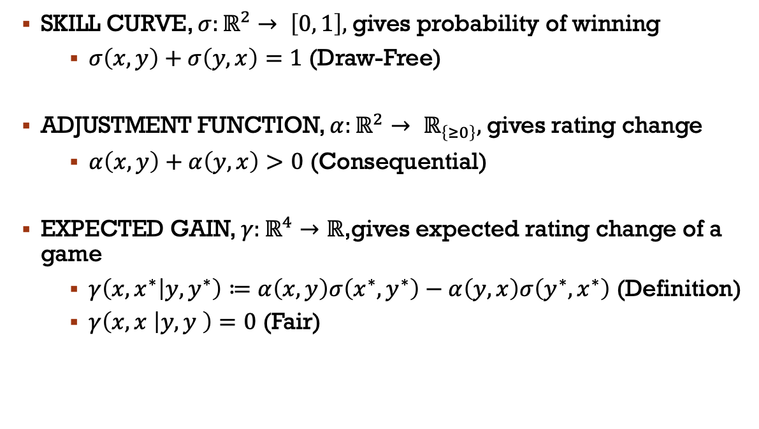
Definition of a Rating System
SKILL CURVE, $σ:ℝ^{2}→ \left[0, 1\right],$gives probability of winning
  $σ\left(x,y\right)+σ\left(y,x\right)=1$ (Draw-Free)
ADJUSTMENT FUNCTION, $α:ℝ^{2}→ ℝ_{\left\{≥0\right\}},$gives rating change
  $α\left(x,y\right)+α\left(y,x\right)>0$ (Consequential)
EXPECTED GAIN, $γ:ℝ^{4}→ℝ$,gives expected rating change of a game
  $γ\left(x,x^{∗} | y,y^{∗}\right)≔α\left(x,y\right)σ\left(x^{∗},y^{∗}\right)−α\left(y,x\right)σ\left(y^{∗},x^{∗}\right)$ (Definition)
  $γ\left(x,x | y,y \right)=0$ (Fair)

Slide 4

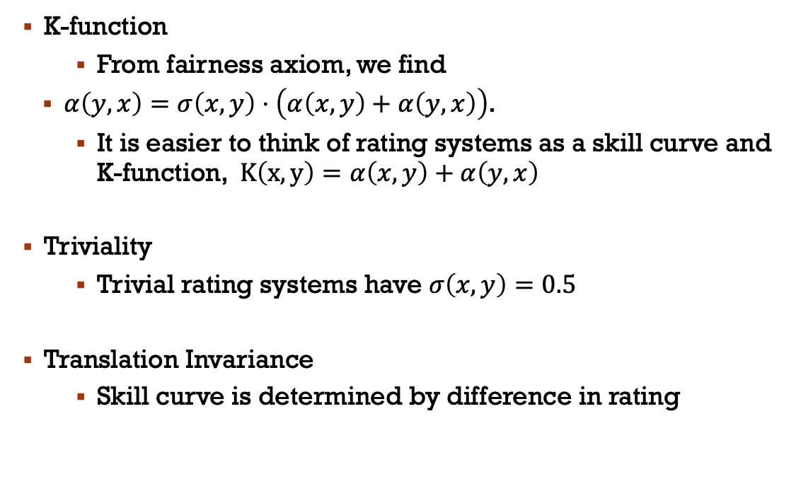
Definition of a rating System cont.
K-function
  From fairness axiom, we find
  $α\left(y,x\right)=σ\left(x,y\right)⋅\left(α\left(x,y\right)+α\left(y,x\right)\right)$.
  It is easier to think of rating systems as a skill curve and K-function, $K\left(x,y\right)=α\left(x,y\right)+α\left(y,x\right)$
Triviality
  Trivial rating systems have $σ\left(x,y\right)=0.5$
Translation Invariance
  Skill curve is determined by difference in rating

Slide 5

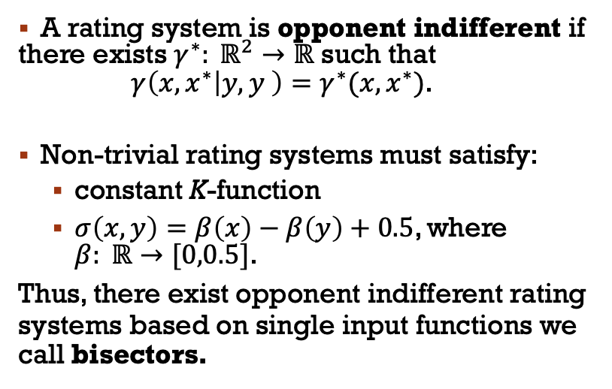
AttEMPT #1: Opponent Indifference
0 rated opponent
2000 rated opponent
A rating system is opponent indifferent if there exists $γ^{∗}: ℝ^{2}→ℝ$ such that $γ\left(x,x^{∗} | y,y \right)=γ^{∗}(x,x^{∗})$.
Non-trivial rating systems must satisfy:
  constant K-function
  $σ\left(x,y\right)=β\left(x\right)−β\left(y\right)+0.5$, where $β: ℝ→[0,0.5]$.
Thus, there exist opponent indifferent rating systems based on single input functions we call bisectors.

Slide 6
opponent indifference is not useful
Skill Chain
A rating system has full scale if it can accommodate an infinitely long skill chain.
Opponent indifferent rating systems cannot satisfy full scale.
Beginner
>95%
Hobbyist
>95%
Tournament player
>95%
Grandmaster

Slide 7

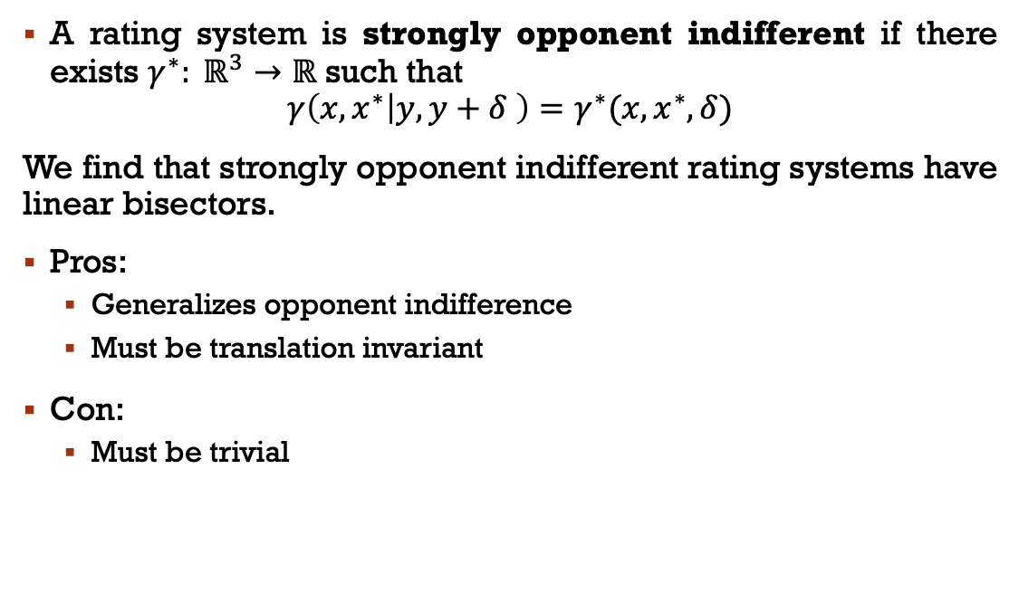
Attempt #1 but worse ☹: strong opponent indifference
A rating system is strongly opponent indifferent if there exists $γ^{∗}: ℝ^{3}→ℝ$ such that
$$γ\left(x,x^{∗} | y,y+δ \right)=γ^{∗}(x,x^{∗},δ)$$
We find that strongly opponent indifferent rating systems have linear bisectors.
Pros:
  Generalizes opponent indifference
  Must be translation invariant
Con:
  Must be trivial

Slide 8

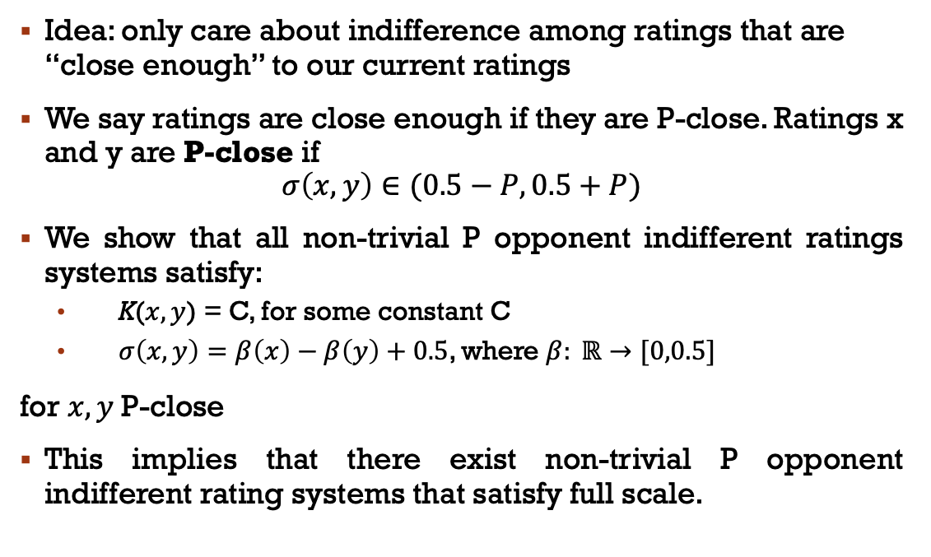
Attempt #2: P opponent indifference
Idea: only care about indifference among ratings that are “close enough” to our current ratings
We say ratings are close enough if they are P-close. Ratings x and y are P-close if
$$σ\left(x,y\right)∈(0.5−P,0.5+P)$$
We show that all non-trivial P opponent indifferent ratings systems satisfy:
  K($x,y$) = C, for some constant C
  $σ\left(x,y\right)=β\left(x\right)−β\left(y\right)+0.5$, where $β: ℝ→[0,0.5]$
for $x,y$P-close
This implies that there exist non-trivial P opponent indifferent rating systems that satisfy full scale.

Slide 9
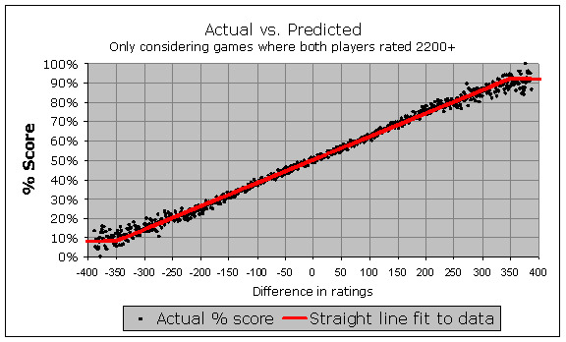
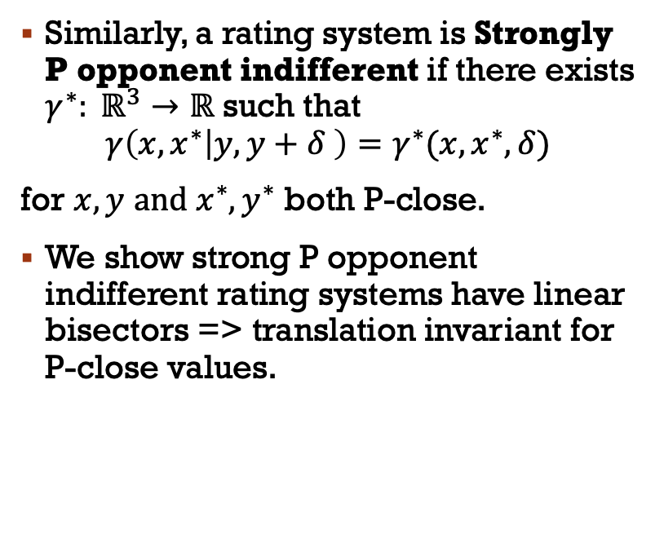
Attempt #2 but better: strong P opponent indifference ☺
Similarly, a rating system is Strongly P opponent indifferent if there exists $γ^{∗}: ℝ^{3}→ℝ$ such that
$$γ\left(x,x^{∗} | y,y+δ \right)=γ^{∗}(x,x^{∗},δ)$$
for $x,y$ $and x^{∗},y^{∗}$ both P-close.
We show strong P opponent indifferent rating systems have linear bisectors => translation invariant for P-close values.
The Sonas rating system is strongly opponent indifferent, and it has been argued to be superior to the popular rating system Elo in predicting the outcome of high-level chess games.
Figure 3: the translation invariant Sonas skill curve overlaying FIDE match data with ratings 2200+. Figure by Jeff Sonas from
Jeff Sonas. The elo rating system – correcting the expectancy tables. 2011. URL: https: //en.chessbase.com/post/the-elo-rating-system-correcting-the-expectancy-tables.

Slide 10
COnclusion
Strong P opponent indifference reasonably protects against opponent selection attacks

Slide 11

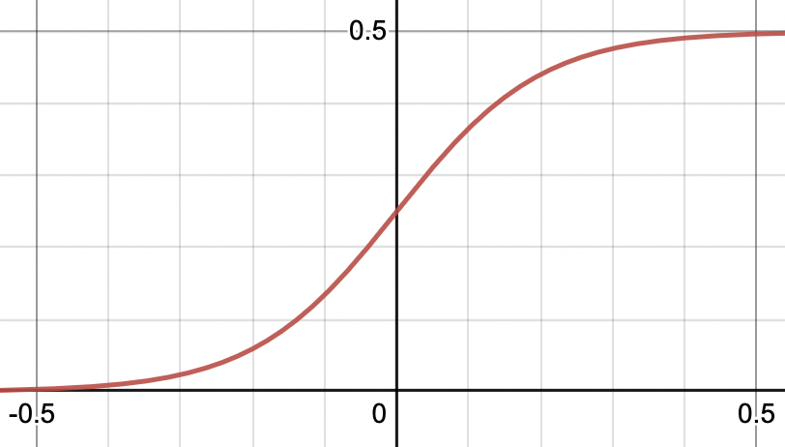
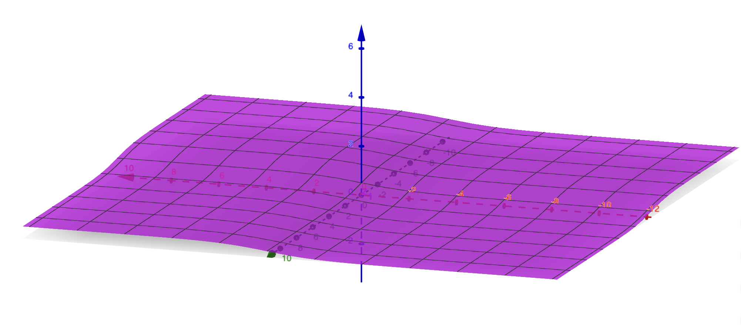
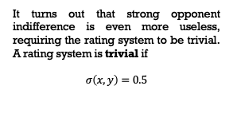
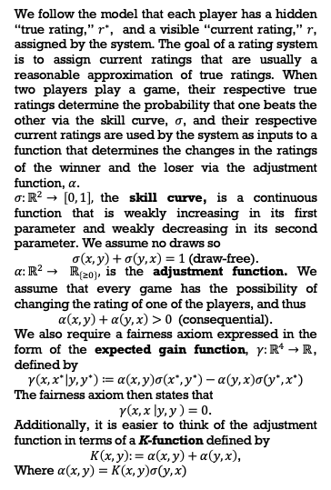
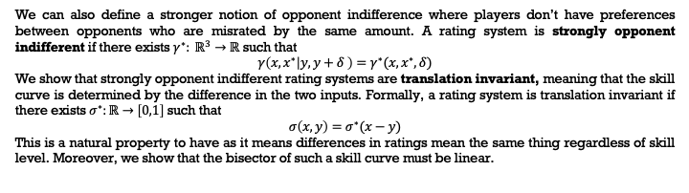
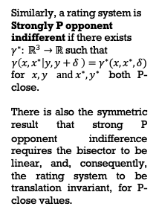
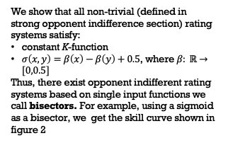
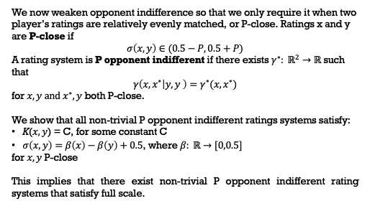
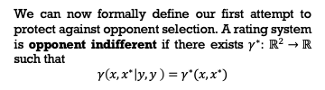
Opponent Indifference in Rating Systems: A Theoretical Case for Sonas
Forest Zhang (Honors Capstone) and Greg Bodwin
Department of Computer Science and Engineering, University of Michigan, Ann Arbor, MI
INTRODUCTION
RESULTS
Rating systems are a set of functions that are primarily used to predict the outcome of matches and rank players in competitive games. Many matchmaking systems give players some control over their opponent’s rating; for example, a player might be able to selectively initiate games against opponents whose ratings are publicly visible, or a player may abort a game without penalty after seeing their opponent’s rating. Selectively choosing opponents does not make a player better at a game, so allowing it to affect rankings is undesirable. Thus, our work is focused on protecting against this behavior through “opponent indifferent” rating systems. An opponent indifferent rating system creates no incentives for rating-maximizing players to selectively choose their opponents, even when the choosing player is incorrectly rated.
Opponent Indifference vs Full Scale
Unfortunately, opponent indifference is too strict to model most player pools in real life. In most games, you would expect there to be a player chain such that player 1 beats player 2 >50% of the time, player 2 beats player 3 >50% of the time, etc. Ideally, a rating system would be able to accommodate an infinite player chain. We call this property full scale, and opponent indifferent rating systems cannot have full scale. In fact, with a win percentage of 75%, a chain of length 4 is already untenable, making opponent indifferent rating systems not effective against opponent selection attacks
We show that all non-trivial (defined in strong opponent indifference section) rating systems satisfy:
constant K-function
$σ\left(x,y\right)=β\left(x\right)−β\left(y\right)+0.5$, where $β: ℝ→[0,0.5]$
Thus, there exist opponent indifferent rating systems based on single input functions we call bisectors. For example, using a sigmoid as a bisector, we get the skill curve shown in figure 2
Figure 1: sigmoid function [1]
Figure 2: skill curve with a sigmoid bisector [2]
RATING SYSTEM DEFINITION
Strong Opponent Indifference
We can also define a stronger notion of opponent indifference where players don’t have preferences between opponents who are misrated by the same amount. A rating system is strongly opponent indifferent if there exists $γ^{∗}: ℝ^{3}→ℝ$ such that
$$γ\left(x,x^{∗} | y,y+δ \right)=γ^{∗}(x,x^{∗},δ)$$
We show that strongly opponent indifferent rating systems are translation invariant, meaning that the skill curve is determined by the difference in the two inputs. Formally, a rating system is translation invariant if there exists $σ^{∗}:ℝ→\left[0,1\right]$ such that
$$σ\left(x,y\right)=σ^{∗}(x−y)$$
This is a natural property to have as it means differences in ratings mean the same thing regardless of skill level. Moreover, we show that the bisector of such a skill curve must be linear.
We follow the model that each player has a hidden “true rating,” $r^{∗}$, and a visible “current rating,” $r$, assigned by the system. The goal of a rating system is to assign current ratings that are usually a reasonable approximation of true ratings. When two players play a game, their respective true ratings determine the probability that one beats the other via the skill curve, $σ$, and their respective current ratings are used by the system as inputs to a function that determines the changes in the ratings of the winner and the loser via the adjustment function, $α$.
$σ:ℝ^{2}→ \left[0, 1\right],$the skill curve, is a continuous function that is weakly increasing in its first parameter and weakly decreasing in its second parameter. We assume no draws so
$σ\left(x,y\right)+σ\left(y,x\right)=1$(draw-free).
$α:ℝ^{2}→$ $ℝ_{\left\{≥0\right\}},$is the adjustment function. We assume that every game has the possibility of changing the rating of one of the players, and thus
$α\left(x,y\right)+α\left(y,x\right)>0$ (consequential).
We also require a fairness axiom expressed in the form of the expected gain function, $γ:ℝ^{4}→ℝ$, defined by
$$γ\left(x,x^{∗} | y,y^{∗}\right)≔α\left(x,y\right)σ\left(x^{∗},y^{∗}\right)−α\left(y,x\right)σ(y^{∗},x^{∗})$$
The fairness axiom then states that
$γ\left(x,x | y,y \right)=0$.
Additionally, it is easier to think of the adjustment function in terms of a K-function defined by
$K\left(x,y\right):=α\left(x,y\right)+α\left(y,x\right)$,
Where $α\left(x,y\right)=K\left(x,y\right)σ(y,x)$
It turns out that strong opponent indifference is even more useless, requiring the rating system to be trivial. A rating system is trivial if
$$σ\left(x,y\right)=0.5$$
P Opponent Indifference
Strong P Opponent Indifference
Strongly P opponent indifferent rating systems have seen some practical utility. The Sonas rating system is strongly opponent indifferent, and it has been argued to be superior to the popular rating system Elo in predicting the outcome of high-level chess games.
We now weaken opponent indifference so that we only require it when two player’s ratings are relatively evenly matched, or P-close. Ratings x and y are P-close if
$$σ\left(x,y\right)∈(0.5−P,0.5+P)$$
A rating system is P opponent indifferent if there exists $γ^{∗}: ℝ^{2}→ℝ$ such that
$$γ\left(x,x^{∗} | y,y \right)=γ^{∗}(x,x^{∗})$$
for $x,y$ $and x^{∗},y$ both P-close.
We show that all non-trivial P opponent indifferent ratings systems satisfy:
K($x,y$) = C, for some constant C
$σ\left(x,y\right)=β\left(x\right)−β\left(y\right)+0.5$, where $β: ℝ→[0,0.5]$
for $x,y$P-close
This implies that there exist non-trivial P opponent indifferent rating systems that satisfy full scale.
Similarly, a rating system is Strongly P opponent indifferent if there exists $γ^{∗}: ℝ^{3}→ℝ$ such that
$$γ\left(x,x^{∗} | y,y+δ \right)=γ^{∗}(x,x^{∗},δ)$$
for $x,y$ $and x^{∗},y^{∗}$ both P-close.
There is also the symmetric result that strong P opponent indifference requires the bisector to be linear, and, consequently, the rating system to be translation invariant, for P-close values.
Figure 3: the translation invariant Sonas skill curve overlaying FIDE match data with ratings 2200+. Figure by Jeff Sonas from [3]
OPPONENT INDIFFERENCE
DEFINITION
FUTURE WORK
REFERENCES
We can now formally define our first attempt to protect against opponent selection. A rating system is opponent indifferent if there exists $γ^{∗}: ℝ^{2}→ℝ$ such that
$$γ\left(x,x^{∗} | y,y \right)=γ^{∗}(x,x^{∗})$$
Here are some open problems arising from our work.
1. What systems can satisfy opponent indifference properties if we relax our model to allow rating systems that do not follow our model?
2. Can opponent selection attacks be avoided by systems that separately track a display rating, which is visible to players and which players may try to maximize, from a matchmaking rating, used internally by the system to adjust ratings?
3. Can opponent indifference properties be achieved simultaneously with other desirable properties of rating systems? Other natural properties to consider include fast convergence of current ratings to true ratings, or other notions of strategyproofness, like the one considered by Ebtekar and Liu.
1. Desmos Graphing Calculator. 2022. Desmos Graphing Calculator. [online] Available at: <https://www.desmos.com/calculator?create_account> [Accessed 28 November 2022].
2. GeoGebra. n.d. GeoGebra. [online] Available at: <https://www.geogebra.org/apps/> [Accessed 28 November 2022].
3. Jeff Sonas. The elo rating system – correcting the expectancy tables. 2011. URL: https: //en.chessbase.com/post/the-elo-rating-system-correcting-the-expectancy-tables.

