Slide 1


Slide 2






3D Printed Ultrasound Cuff for Detection of Knee Implant Loosening
Designed by Liz Hughes and Josh Norton
Advised by: Joseph Schwab, M.D., Hamid Ghaednia, PhD, and Sina Yazdkhasti, PhD
Notes:
This is going to be a complicated introduction. My name is Liz Hughes and I am a senior studying biomedical engineering at Umich.
My name is Josh Norton and I am studying aerospace engineering at Purdue. We worked on this project this summer at the SORG group: a collaboration between Harvard med school and mass general hospital. We worked on a 3D printed ultrasound cuff that used predictive machine learning algorithms to detect knee implant loosening under the guidance of our advisors- joe, hamid, sina.

Slide 3
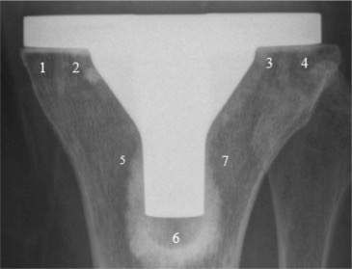
Motivation for Research
2.3 million joint replacements a year[1]
  10% end in failure= $8 billion/year [2]
With increasingly younger patients receiving knee replacements, more patients are requiring revision operations [3]
One of the main causes of implant failure is implant loosening, caused by extended wear and tear
https://www.sciencedirect.com/science/article/pii/S0883540317301201
[1] “2013 extremity update,” Orthop Newt News, vol. 24, no. 1, pp. 1–16, 2013.
[2] Mohit Bhandari, Jon Smith, Larry E Miller, and Jon E Block. Clinical and economic burden of revision knee arthroplasty. Clinical Medicine Insights: Arthritis and Musculoskeletal Disorders, 5:CMAMD–S10859, 2012.
[3] P. O. Associates, “The results of the 2020 american joint replacement registry.” [Online].
Notes:
Brief discussion of the problem at hand– big market for joint replacement revision market due to younger patients receiving implants.
Younger Recipients= more wear and tear on the device, causing implant loosening.
This image shows a scan of a knee implant. Aseptic loosening occurs mostly at points 5 and 7 on this image. The main side effect of aseptic loosening is pain for the patient.
Current methods such as CT scans and MRI imaging can only detect loosening once it has become severe and revision is required.

Slide 4
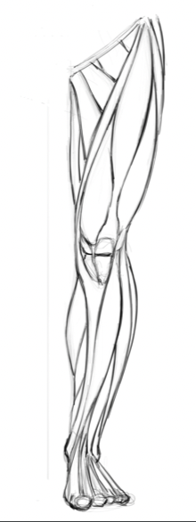
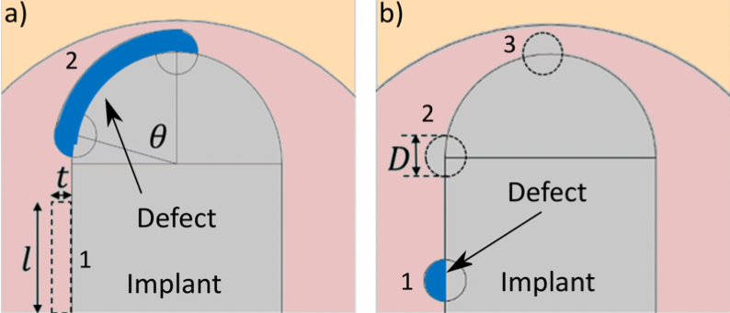
Project Goals and Methods
Our goal: To build a wearable ultrasound cuff that, with machine learning methods, can identify and describe joint replacement defects earlier and more accurately than current diagnostic methods.
A diagram of gross implant loosening, determined by location, arc angle/length, and thickness
A diagram of “bubble” implant loosening, determined by diameter and location
Notes:
Read goal statement
Left Figure shows where the two measurements for the cuff would be taken on a patient with implant
Right figure shows how we have modelled different types of loosening– we label bubble and loose differently, but both have variables that we changed: size and location. Grey is implant, red is bone, yellow is muscle

Slide 5
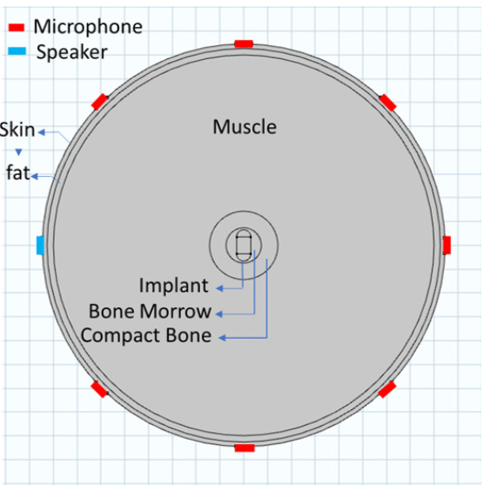
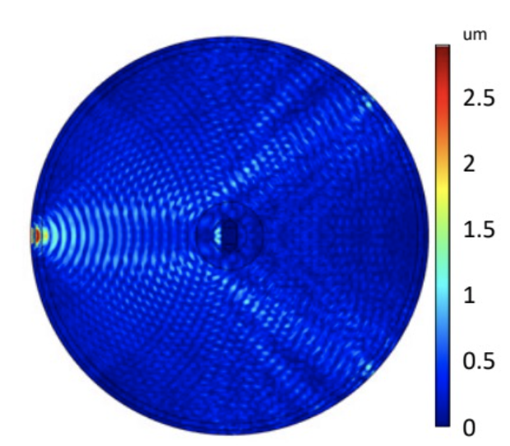
Comsol Input Module
Displacement Field
Notes:
To prove that this low frequency ultrasound idea would work, we had to run simulations and create the predictive algorithms with simulation data. On the left we show the construct that was used to record data in COMSOL. The blue is the piezoelectric sensor that was actuated and the red were the sensors that were recording the waves. Each of the eight sensors was actuated at 1-300 kHz for each trial of the COMSOL simulation. Therefore, each trial had a matrix of 64x300 in size. Inside of the concentric circles are the compact bone, bone marrow, and implant itself. This simulation was modified to include various bubbles and loosenings of different sizes and locations. Once we collected the data, we superposed it, resulting in matrices of even bigger size for each COMSOL setup.
On the right is the displacement field of the material at 300 kHz. The sensor on the left was actuated and the displacements are recorded. This shows how the signal interacts with the bone and implant, and how signal can bounce off of these materials and deflect in other directions for the sensors to pick up.

Slide 6
Machine Learning
Sensor Amplitude Matrix
Bubble
Healthy
Loosening
Step One: Determine Presence of Defects
Notes:
Our machine learning algorithms read in the amplitude data that was recorded during every trial for every sensor actuated. It is split into two steps. The first round of algorithms are determining the presence of the defects. These algorithms read in the sensor amplitude matrix of the eight trials per condition and determined if the condition was healthy, a bubble, or loosening.

Slide 7
Step One: Determining Presence of Defect
Model | Small Data Accuracy | Big Data Accuracy
Linear Discriminant | 89.51% | 93.7%
Quad SVM | 87.48% | 92.0%
Fine KNN | 48.30% | 84.8%
Bagged Trees | 67.77% | 74.4%
Bilayered NN | 94.90% | 98.0%
Notes:
Here are some of our results of testing these algorithms. When we read in new data, the algorithms processed them and here are the results of the accuracies of the algorithms. We ran 15 different classification algorithms. We also extrapolated the data, labelled as “big data” as well as decreased the amount of data fed to the algorithms “small data.” Because in several cases the accuracies were similar between the larger and smaller data sets, we determined that we could cut down on our computation costs by using smaller data sets for the rest of our analysis. As you can see, the bilayered neural network had an accuracy of almost 95% in our trials.
We also tested algorithms by inducing noise into the system, running principal component analysis, and trying smaller frequency ranges.

Slide 8
Machine Learning
Sensor Amplitude Matrix
Bubble
Healthy
Loosening
Step Two: Characterize Defects
Length
Diameter
Thickness
Location
Location
Notes:
Now we are moving on to our second step of the machine learning algorithms. After the classification was determined, data was separated into bubble and loose categories. Between these two categories, four algorithms were made. We were able to determine the size and location of new bubble data and the size and location of new loosening data. On the next slide, we will show visually our results.

Slide 9
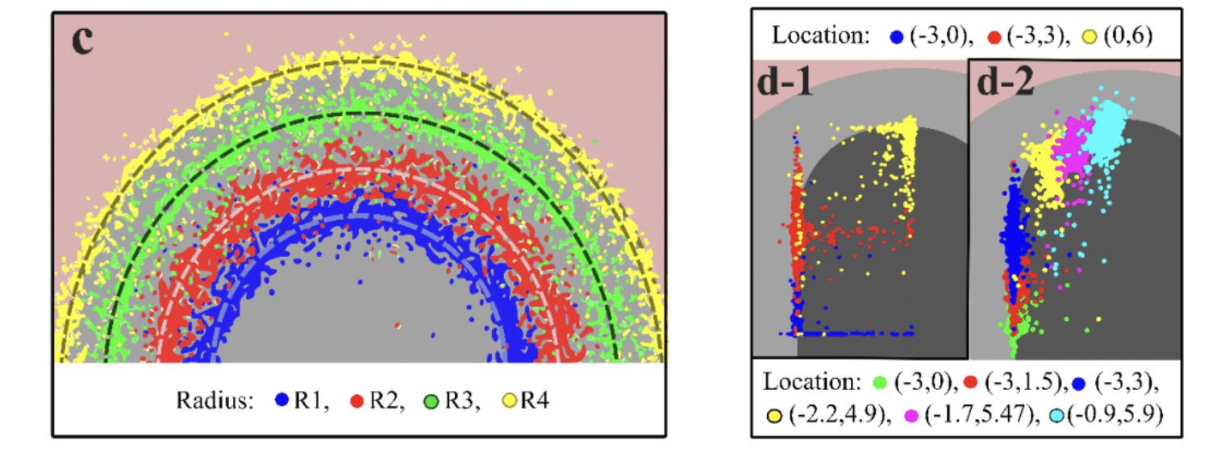
Step Two: Characterizing Defects
Notes:
Here we are showing image representations of the results of our regression algorithms. The figure c, on the left, shows the results for the bubble size regression. This is a zoomed in image of the bubble along the implant-bone interface. Each color represents the data for a certain size of bubble. For example, the blue dots represent the predicted results of trials that had an actual size of .6 mm. The black line going through the blue dots is the actual size of .6 mm. Given the small scale of these defects, we consider our algorithm to detect bubble size to be a success.
The other images show our location results. d-1 represents the bubble location results and d-2 represents the loosening location results. For the loosening, the location also varied with changes in length, which is why there are six colors represented on that figure. As you can see, each color is clumped by its location along the implant-bone interface.

Slide 10
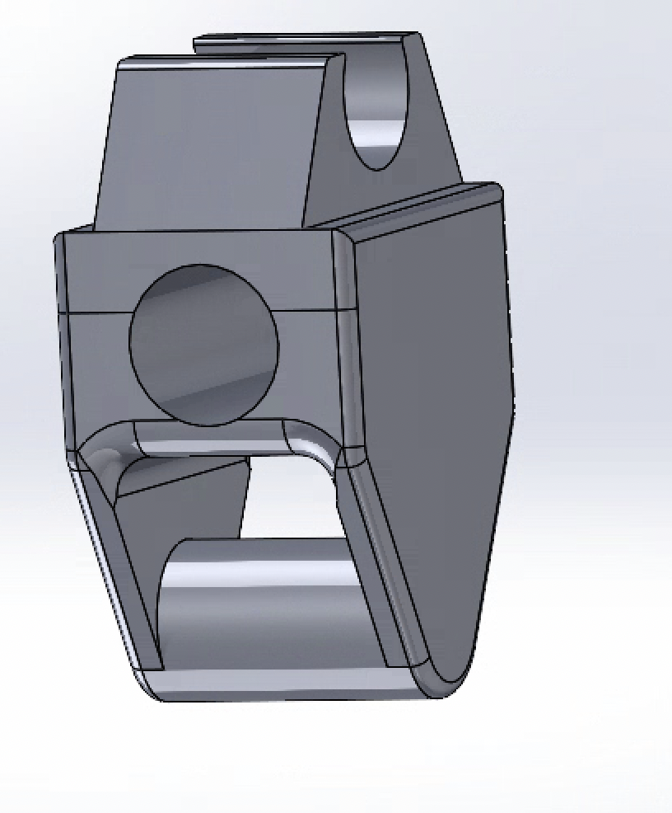
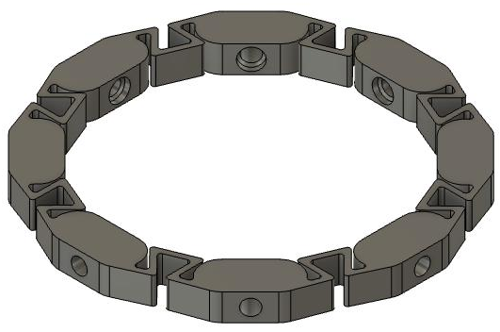
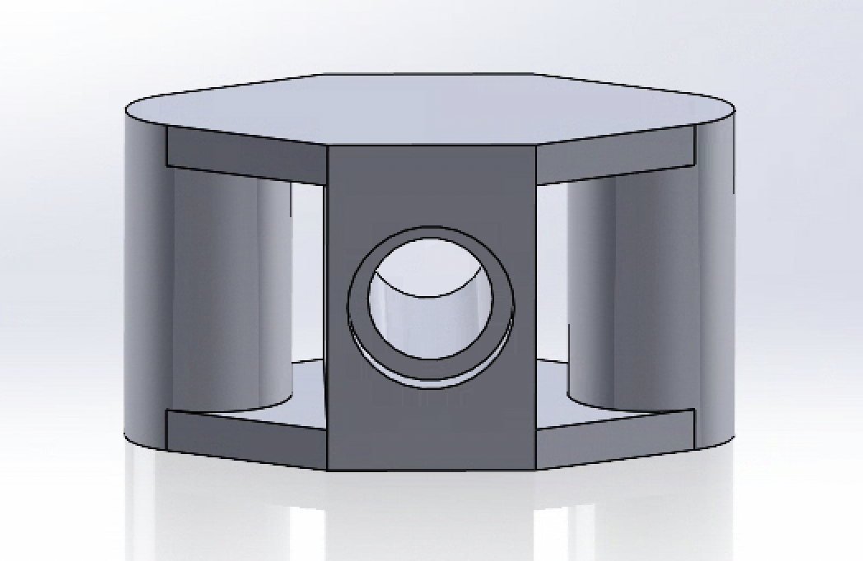
Early Stage Prototypes
Modular Design:
Flexible Joint Design:
Notes:
Engineering goals:
8 piezoelectric sensors, evenly spaced around leg, even contact on the skin. Must have snug fit, but allow for vibration
Cuff must (be adaptable) to fit above and below knee
Wiring capabilities
Must have different size ranges
Here are initial designs for the cuff
modular design for a snap-together assembly
downsides: although can make different sizes, because of the limit in size ranges and placement of sensor slots, sensors cannot be 100% even spread around circumference
Our initial full cuff design
gave us the stretch and symmetry needed
downsides: due to the zig-zag pattern that we implemented, the cuff was breaking along the straight edge (show with laser pointer)

Slide 11
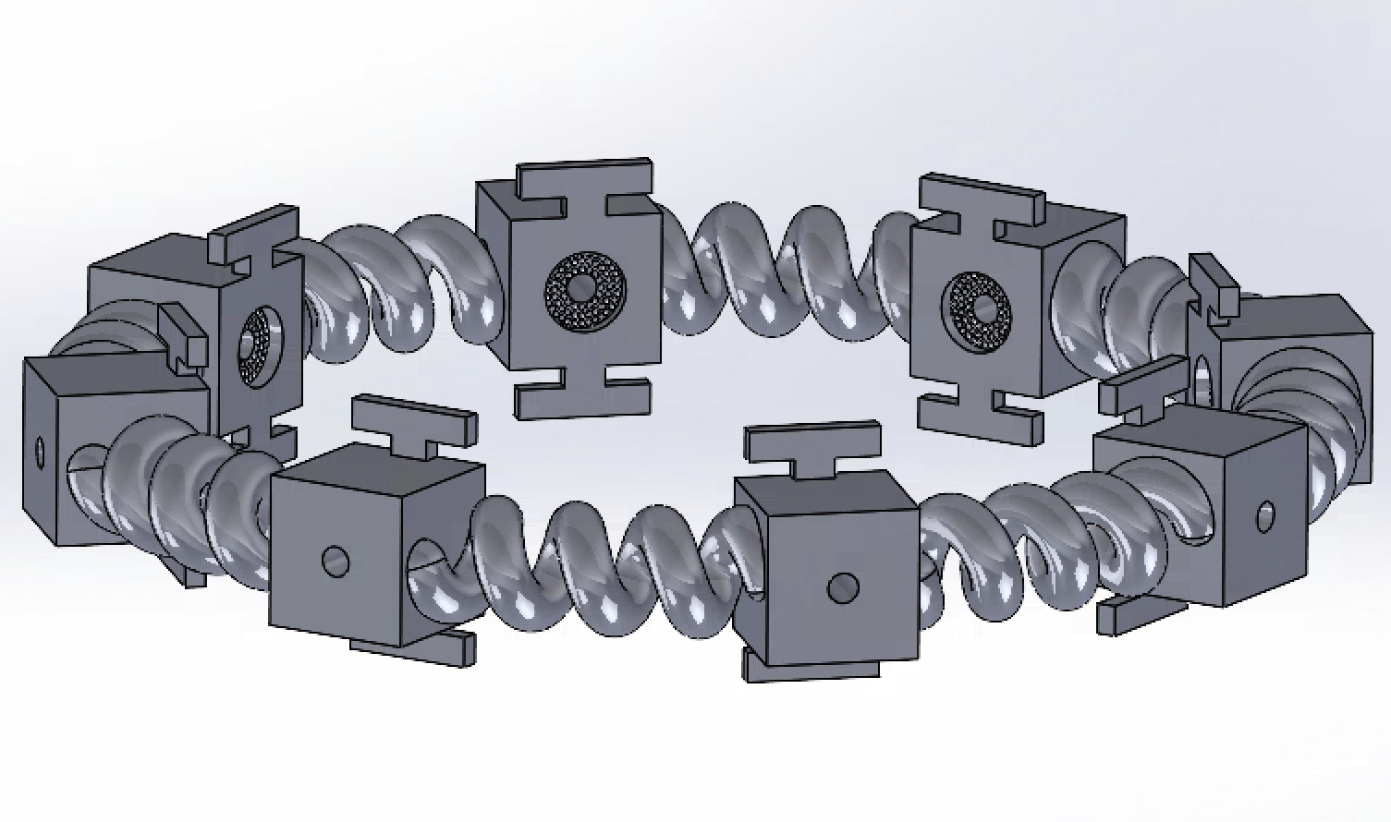
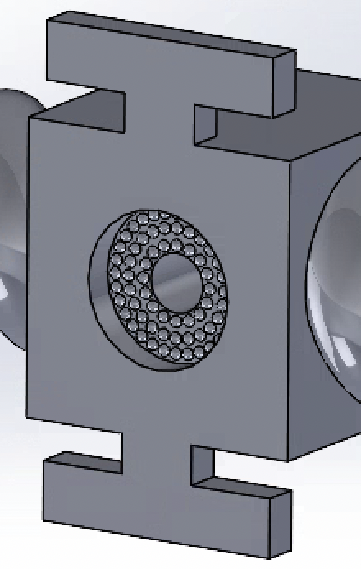
Current Prototype
Notes:
Here is our finalized design, after many iterations.
We changed our design to have coils that allowed for stretch without having any sharp angles that would cause force buildup and breakage
We wanted direct,stable contact with the skin, hence the “I” bar addition
We added hemispherical projections out of the internal of the sensor cuff in order to have air pockets to prevent vacuum within slot and allowed vibration

Slide 12
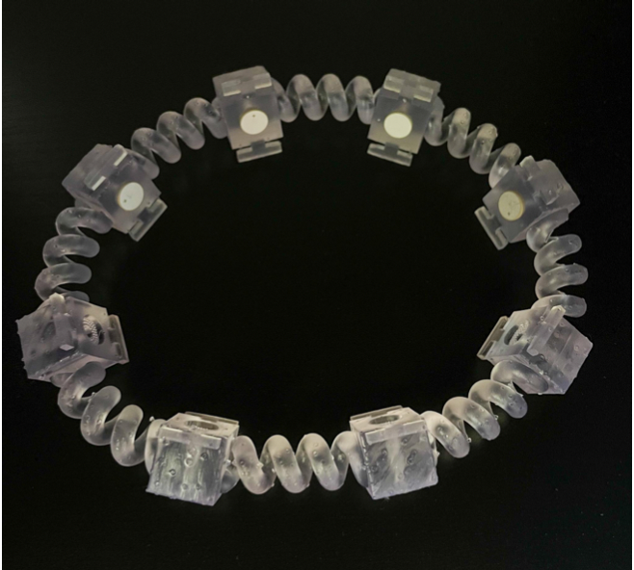
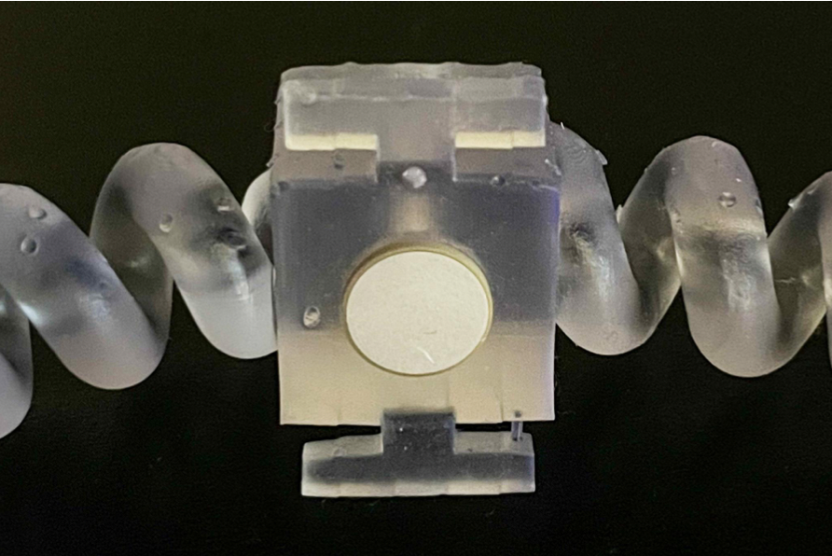
Current Prototype
Notes:
Here are photos of our printed cuff with the sensors inserted. We printed on FormLabs with Flexible 80A resin. The cuff is built to fit the average calf and stretch to fit the quad above the knee as well.

Slide 13
Summary:
Ran COMSOL simulations of 8 piezoelectric sensors of frequency 1-300 kHz on the knee cross section
Created classification and regression algorithms that predicted presence and details of defect
Prototyped a wearable cuff to be used for data acquisition
Next Steps:
Streamline code to run seamlessly from data acquisition to displaying defect information
Implement algorithm to the cuff via Arduino
Conduct experiments and record data from cuff on cadaver knee joints
Notes:
Give a brief summary of each part of the project (physical cuff design w piezoelectric sensors, COMSOL simulation, machine learning predictive models)
Explain what’s next for the project (condense code into one software, connect cuff to algorithms, record data from the cuff on cadaver knee joints)

Slide 14
Questions

Slide 15
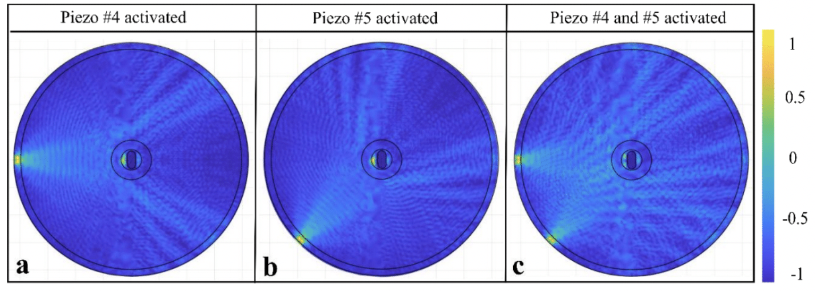
Supplementary Material: Superposition

Slide 16
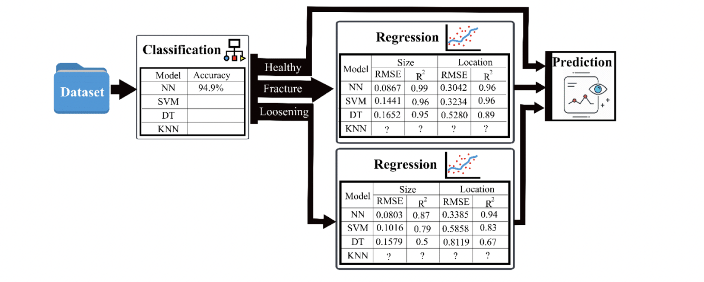
Supplementary Material: Algorithm Results
87.5%
LD
89.5%
48.3%

Slide 17
Supplementary Material:
Classification Algorithms
Accuracy Results
Model | Small Data | Big Data
Linear Discriminant | 89.51 | 93.7
Quad SVM | 87.48 | 92
Cubic SVM | 86.45 | 93
Fine KNN | 48.3 | 84.8
Medium KNN | 44.71 | 68
Weighted KNN | 46.99 | 62
Boosted Trees | 55.61 | 74.4
Bagged Trees | 67.77 | 74.4
Subspace Discriminant | 87.13 | 90.7
Narrow Neural Network | 94.1 | 98.5
Medium Neural Network | 93.7 | 99
Wide Neural Network | 87 | 99
Bilayered Neural Network 10,10 | 94.9 | 98
Bilayered Neural Network 10,5 | 94.4 | 98.4
Trilayered Neural Network | 92.7 | 98.7

Slide 18
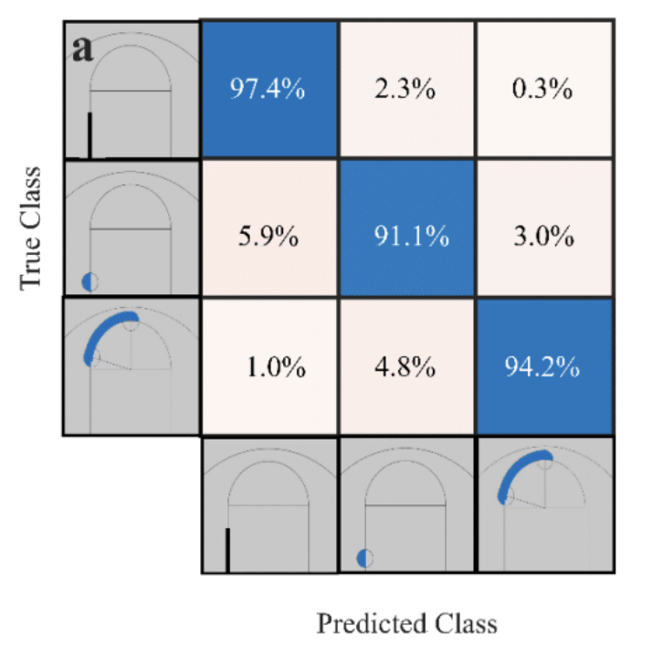
Supplementary Material: Classification Confusion Matrix

Slide 19
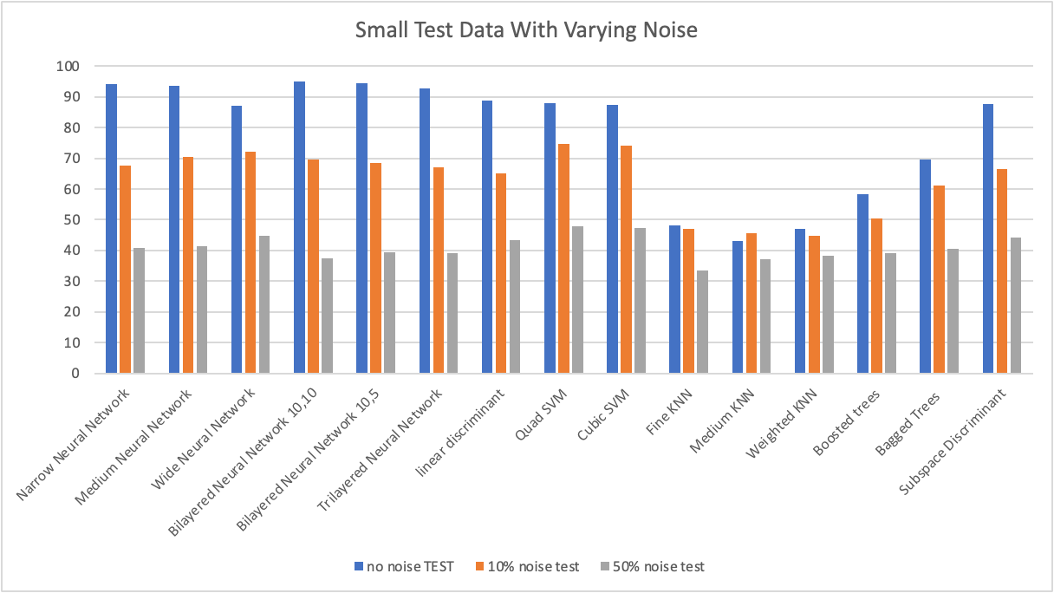
Supplementary Material: Noise Analysis

Slide 20
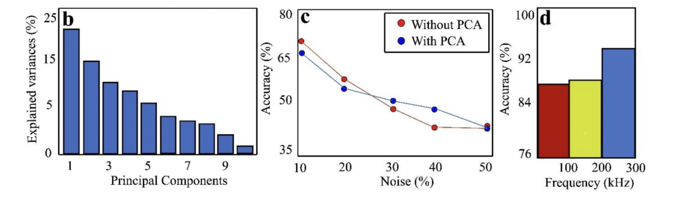
Supplementary Material: PCA, Noise, and Frequency Range Analysis

